Slide 1

Heat-Treatment Online Monitoring System

Slide 2
Heat treatment - PROJECT Calendar
2015
2018
Projected started at
Ended At

Slide 3
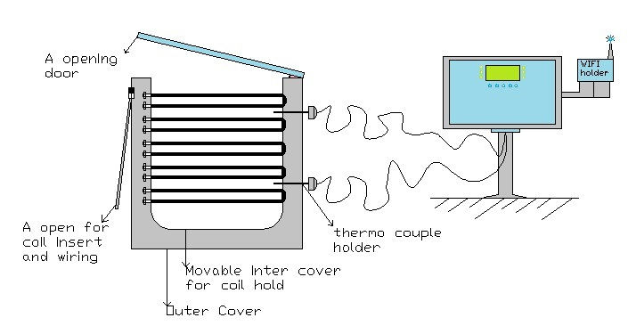
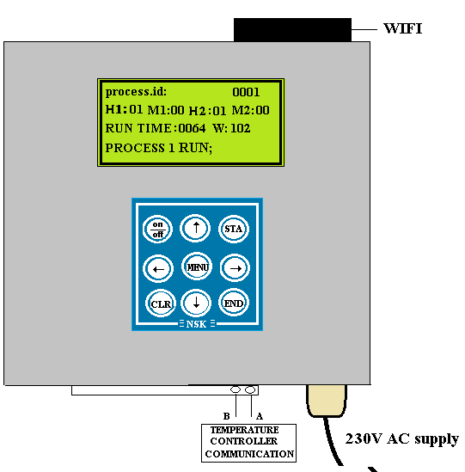

Hardware stability
DIRECT MEASURE
FURNACE CONTROLLER
COMM USING WIFI

Slide 4
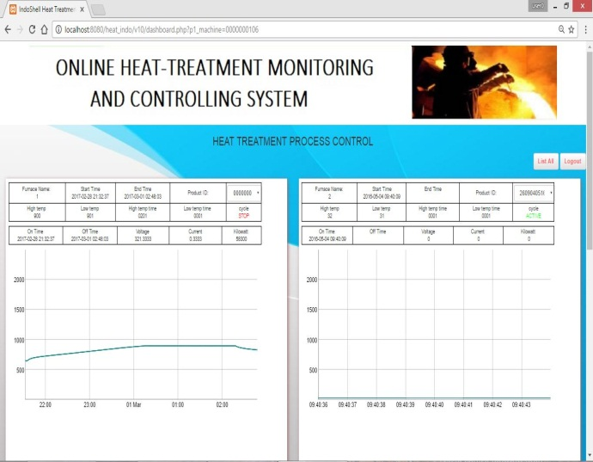
Software scope
Online
Report
&
Graph Recorder
01
02
Set points Control
(Temp & Time)
Enter Your
Screenshot Here
03
Scheduler and data backup
Secured Access for Set points
04

Slide 5
Automation Benefits
Manual Recorder
Online Recorder
Paper Recorder Cost High
Online recorder Cost low.
6 to 8 month Service
required.
Service Not required.
Manually need to start
timer & temp control
Manual Not required. so
Operator work reduction
Manual record data, power,
Data backup
Live Monitoring, Power,
Data backup.
Report not available
Online Report available .

Slide 6
REGULAR WORK FLOW
Instruction From Lab
Manager
Lab In charge
Batch Loading Work
operator
Kavitha
Set Temp & Time
Hourly Monitor
Hand record Graph Plot
Batch Unloading work
Workers
Hardness 2 page report

Slide 7
Proposed work flow
Instruction From Lab
Batch Loading Work
Mr. Devaraj
Mr. Anand
Kavitha
Operator
Set Temp & Time
Hourly Monitor
Hand Graph Plot
Batch Unloading work
Harness 2nd page
Mail Report
Graph Status (MAIL)

Slide 8
Software
Graph. - 3 month - version 1.0
Temperature set point - 3 month - version 2.0
Time control. - 3 month - version 3.0
Power meter reading. - 3 month - version 4.0
Report font page - 3 month - version 5.0
Hardness and result - 3 month - version 6.0
Full record. - 6 month - version 7.0
http://appville.in/ind/dashboard.php (website)- version 8.0
Android App - 5 month - version 9.0
scheduler - 1 month - version 10

Slide 9
Thank you Sir

