Slide 1



Foreign Direct Investment Report
01
SELVAMANI R K
https://github.com/Selvamani6903/Foreign-Direct-Investment-FDI-

Slide 2

Introduction
The FDI dataset contains annual Foreign Direct Investment data for 63 sectors in India from 2000-01 to 2016-17. It includes 18 columns, one for sector names and 17 for yearly FDI amounts. This dataset is valuable for analyzing investment trends and sectoral growth over the years
01

Slide 3
Main KPIs
Sum 2000-2001 =>Total Number of Foreign Inversement.
Graph 2000,2001,2002 show the total number of inversement in Each sector which help in indentifying the trend of the inverstment.
02
02

Slide 4
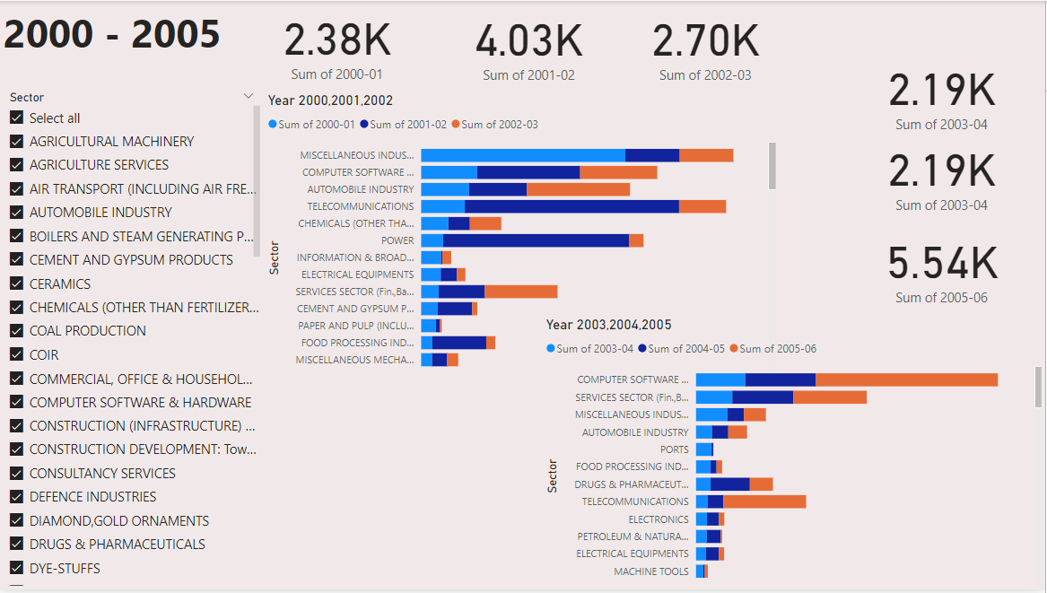
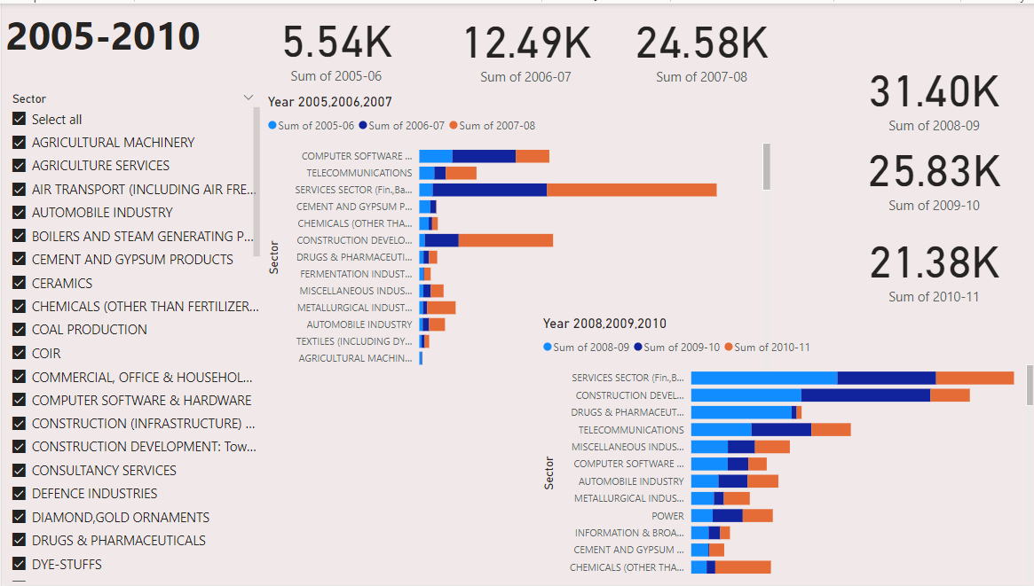
My Design
02

Slide 5

THANKS YOU
https://github.com/Selvamani6903/Foreign-Direct-Investment-FDI-

