Slide 1
PLANNING
MES
SAP
Guideline module for SOP activity's
DCS
SAFETY
QUALITY
OTHERS

Slide 2
Planning activity’s
Plan conversion from planning mail
PM request slip preparation
PLANNING
Effective machine plan like cross transfer
Priority mixer plan
Equipment release for preventive maintenance.

Slide 3
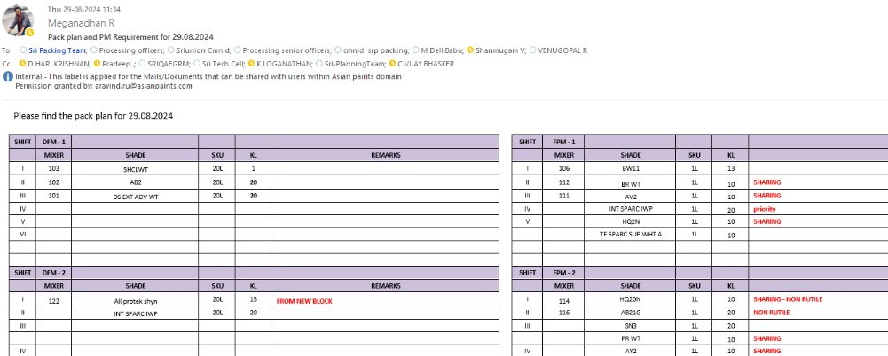
Plan conversion from planning mail

Slide 4
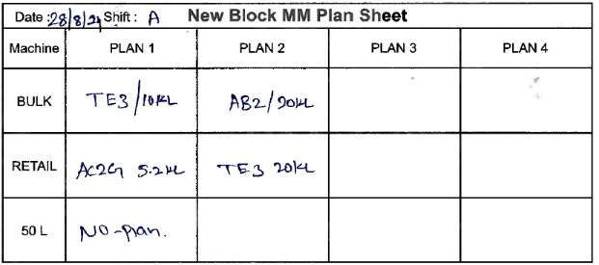
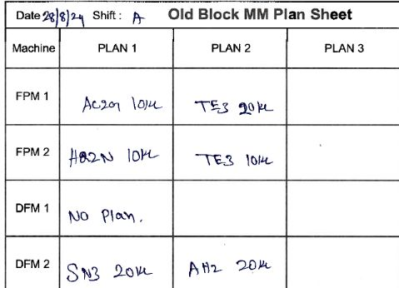
PM request slip preparation
MES இல் Plan செய்ததுக்கு எற்றவாறு அணைத்து Machine க்கும் மேலை காட்டியவாறு பேக்கிங் மேட்டரில்request SlipFill செய்து Material movement operator இடம் கொடுக்கவேண்டும்.

Slide 5
MES activity’s
PACK PLAN – Upload in MES
PO –Creation in MES
MES
Ensure the start packing
Ensure the on time FG approval
Ensure the on time resume packing operation.
Ensure the on time end production in MES.

Slide 6
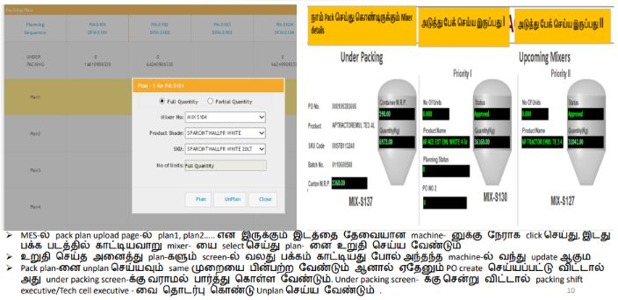
PACK PLAN UPLOAD IN MES

Slide 7
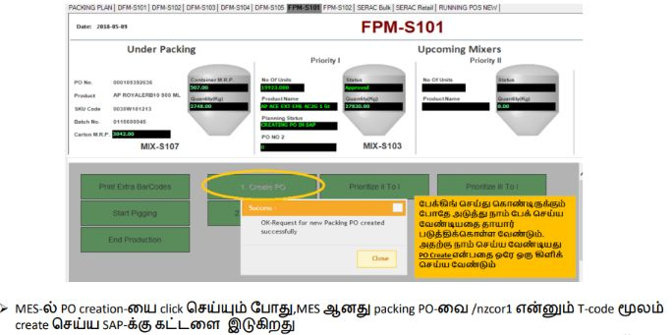
PO –Creation in MES

Slide 8
SAP activity’s
PO CREATION – SAP material list in /nzcor2
PO CREATION – control recipe creation
PO CREATION – Packing material checking
SAP
PO CREATION – QA Check
PO CREATION – Reservation check
Price label – MES to SAP command.
Price label – SAP to printer command .
Price label – Manual Print.

Slide 9
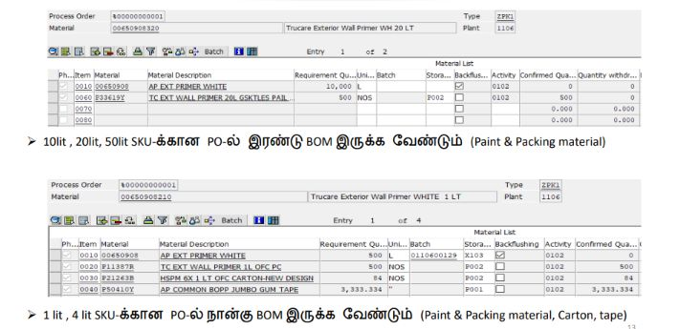
PO CREATION – SAP material list in /nzcor2

Slide 10
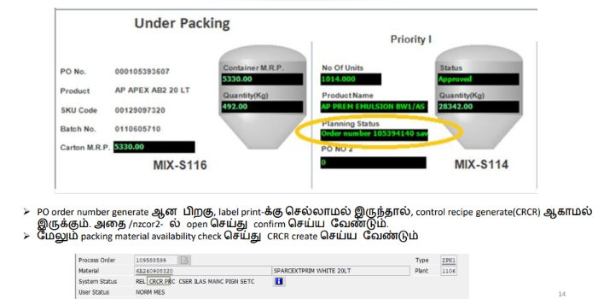
PO CREATION – control recipe creation

Slide 11
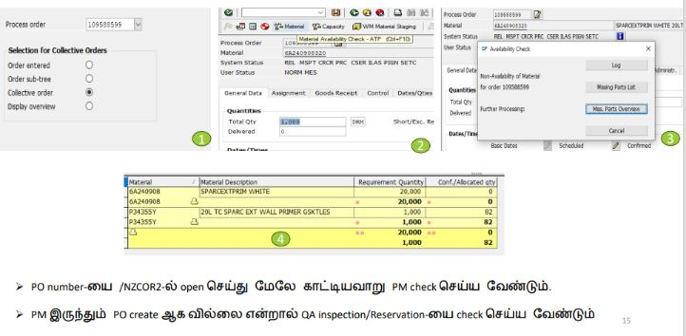
PO CREATION – Packing material checking

Slide 12
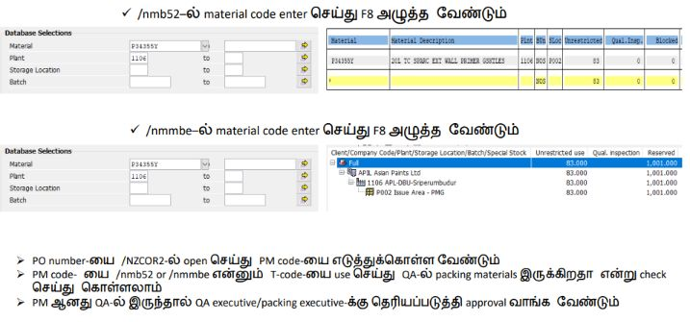
PO CREATION – QA Check

Slide 13
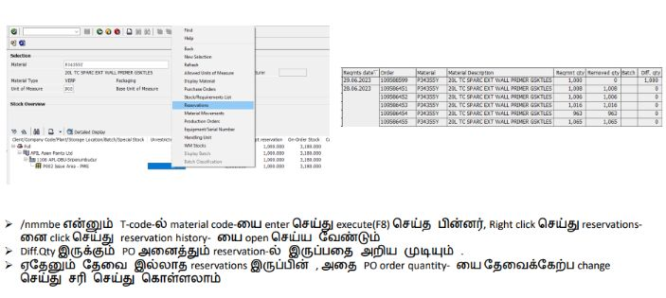
PO CREATION – Reservation check

