Slide 1


Task Management App

Slide 2

User Story
User friendly Task Management system using Mern Stack.
User can create their own profile and Login and logout securely.
User profile can be edited
Task can be added , modified and removed when completed
Tasks are presented as list.

Slide 3
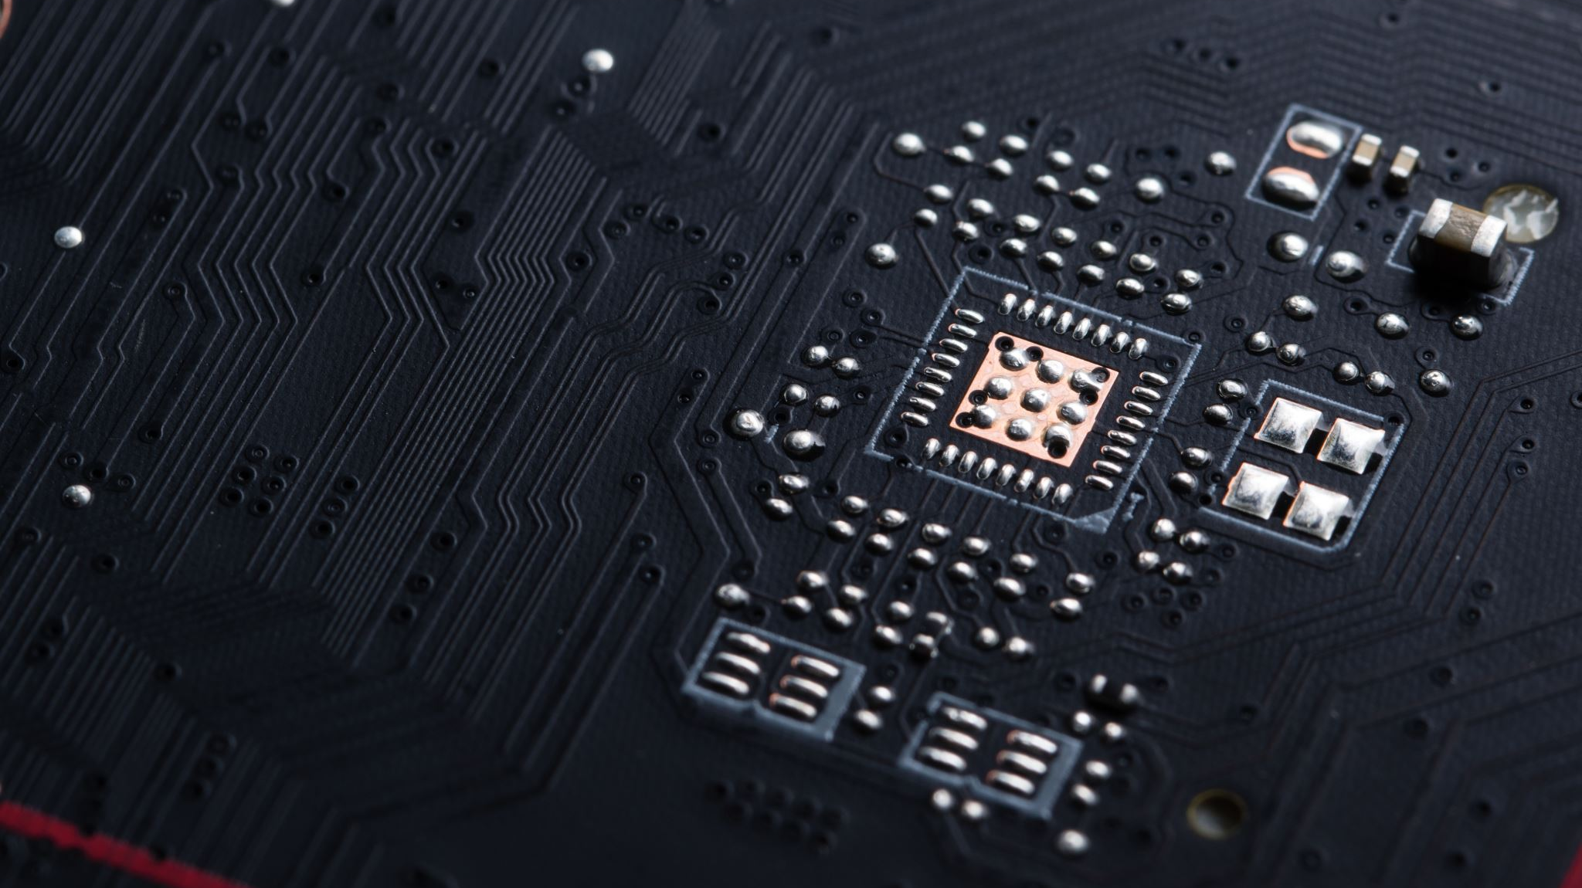
Technologies Used
BACKEND
MongoDb
Mongoose
Express
NodeJs
jSON Web Token
bcrypt
FRONEND
React
react-router-dom
react-hot-toast
axios
vite.js
z

Slide 4
DEMO

Slide 5
FUTRURE IMPROVEMENTS
ADDING MORE FUNCTIONALITY FOR THE USERS LIKE SENDING EMAIL NOTIFICATION , ADDING REMINDER
CONVERTING TO WORK ORDER FLOW APP
IMPROVED USAGE ON THE PAGE AREA

Slide 6
LINKS
DEPLOYED SITE :
GITHUB REPO :
GITHUB PROFILE :

