Slide 1
Employee Data Analysis using Excel
STUDENT NAME: SELVAPON.C REGISTER NO: 312204624,0E7292027E755648A4F458A8F8ED9BB7
DEPARTMENT: COMMERCE
COLLEGE:K.C.S KASI NADAR COLLEGE OF ARTS & SCIENCE

Slide 2
PROJECT TITLE
Employee analysis according to Department

Slide 3

AGENDA
1.Problem Statement 2.Project Overview 3.End Users
4.Our Solution and Proposition 5.Dataset Description 6.Modelling Approach 7.Results and Discussion 8.Conclusion
3/21/2024 Annual Review

Slide 4
PROBLEM STATEMENT
1. To evaluate and compare employee performance and engagement across different departments within the organization.
The goal is to identify trends, strengths, and areas for
improvement to enhance overall employee satisfaction.
Total of per day rate of employee
Average total of hourly rate
productivity and

Slide 5
PROJECT OVERVIEW
This structured approach helps in effectively evaluating employee performance and contributions within the context of a department project.
Tables
Conditional formatting
Pivot chart-line chart, pie chart
Sum formulas
Slicers

Slide 6

WHO ARE THE END USERS?
Sales Department
Research and Development Department
Human resources Department

Slide 7
OUR SOLUTION AND ITS VALUE PROPOSITION
Scenario Analysis :
Used to analyse different situation
Visual representation
Chars and graphs
Advanced Analytics tools
*Formulas and functions
Pivot tables
Comprehensive Data management
Data organization
*Data integration
User-Friendly Interface
*Accessibility
*Ease of use

Slide 8
Dataset Description
Data overview :
To analyze employee data by department, first aggregate key metrics like headcount, performance, and turnover rates for each department.
Then, compare these metrics across departments to identify trends
and disparities
Data field:
Employee lD
Age
Department
Education field
Gender
Hourly rate
Marital status
Per day rate

Slide 9
MODELLING
Data cleaning.
Creating table.
Creating pivot chart.
Creating dashboard.
Inserting pivot chart in dashboard.
Inserting formulas in dash board to make interaction.
Creating interactive dashboard by putting all together elements
9

Slide 10

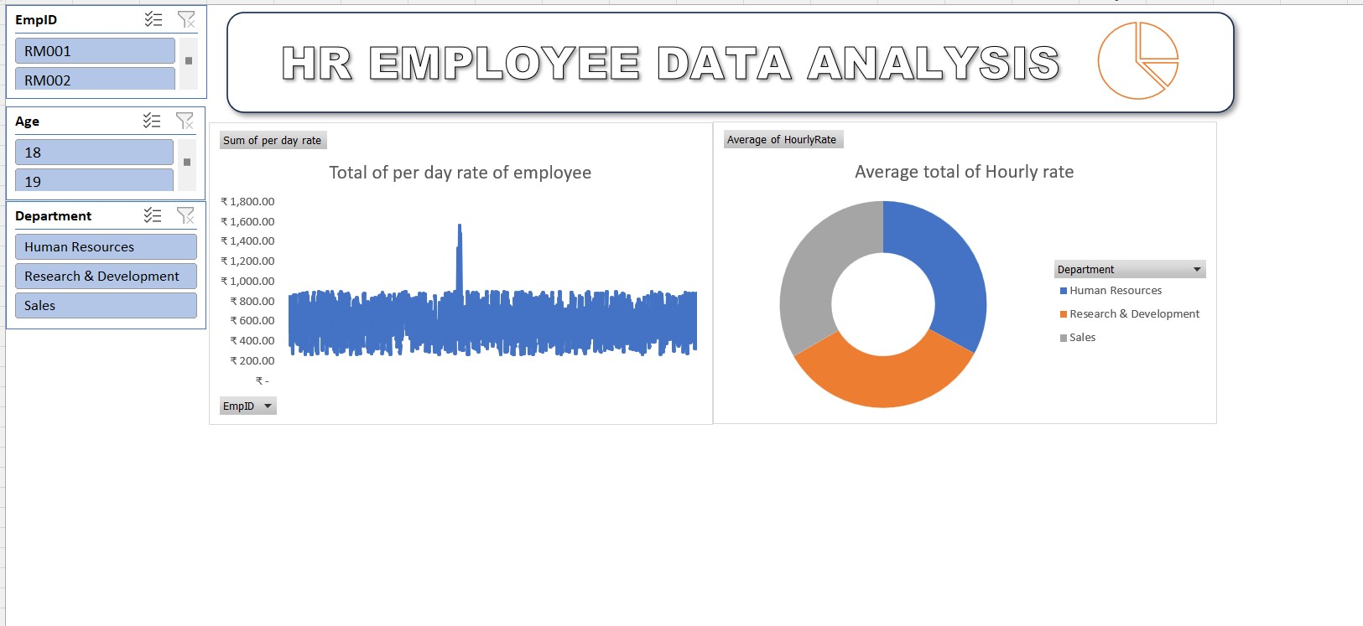
RESULTS
10

Slide 11
conclusion
In conclusion, analyzing employees by department reveals variations in performance, turnover, and workforce composition.
These insights can guide targeted interventions to address specific departmental needs, optimize resource allocation,
and improve overall organizational effectiveness. Tailored
strategies can enhance employee satisfaction and operational efficiency.

