Slide 1
SELVAPRIYA K
Final Project
3/21/2024 Annual Review

Slide 2
PROJECT TITLE
PNEUMONIA DETECTION FROM CHEST X-RAYS
3/21/2024 Annual Review

Slide 3


AGENDA
Problem Statement
Project Overview
Who are the end users?
Solutions and value of propositions
WOW factor in the solution
Modelling
Results
3/21/2024 Annual Review

Slide 4

PROBLEM STATEMENT
Pneumonia is a respiratory infection that inflames the air sacs in one or both lungs, leading to symptoms such as cough, fever, and difficulty breathing. Timely diagnosis and treatment are crucial for improving patient outcomes and preventing complications. Chest X-rays are commonly used to diagnose pneumonia, but accurately interpreting these images can be challenging, especially for healthcare professionals with varying levels of experience.
3/21/2024 Annual Review

Slide 5

PROJECT OVERVIEW
The aim of this project is to develop a computer-aided diagnostic (CAD) system capable of accurately detecting pneumonia from chest X-ray images. The system should be able to differentiate between normal chest X-rays and those indicating pneumonia, providing clinicians with valuable assistance in their diagnostic process.
Dataset Acquisition
Data Preprocessing
Model Development
Model Training
Model Evaluation
Integration and Deployment
Performance Comparison
3/21/2024 Annual Review

Slide 6

WHO ARE THE END USERS?
The end users of a Pneumonia Detection system from chest X-rays would primarily consist of healthcare professionals involved in diagnosing and managing respiratory infections, such as radiologists, clinicians, primary care physicians, and emergency department staff. These professionals would utilize the system as a valuable tool to aid in the interpretation of chest X-ray images, assisting them in accurately identifying cases of pneumonia and making informed treatment decisions for their patients. Additionally, telemedicine providers operating in remote or underserved areas may leverage the system to facilitate timely diagnoses and management recommendations for patients accessing healthcare services remotely. Furthermore, healthcare researchers and developers involved in advancing medical imaging technology and artificial intelligence applications in healthcare may also utilize the system for research purposes, contributing to further advancements in the field.
3/21/2024 Annual Review

Slide 7

YOUR SOLUTION AND ITS VALUE PROPOSITION
My Pneumonia Detection solution utilizes advanced deep learning algorithms to provide accurate and efficient diagnosis from chest X-ray images. It enhances diagnostic accuracy and workflow efficiency, seamlessly integrating into clinical practice. Accessible to facilities of all sizes, it aids healthcare professionals in decision-making, especially in telemedicine settings. By continually evolving with medical imaging and AI advancements, it ensures reliable, timely diagnoses, improving patient outcomes while expanding access to quality care.
3/21/2024 Annual Review

Slide 8

THE WOW IN YOUR SOLUTION
The WOW factor in our Pneumonia Detection solution lies in its ability to revolutionize the diagnostic process, offering a seamless blend of cutting-edge technology and practical utility. By harnessing the power of deep learning algorithms, our solution achieves unparalleled accuracy and efficiency in detecting pneumonia from chest X-ray images. Its user-friendly interface and seamless integration into clinical workflows ensure ease of adoption and use for healthcare professionals. Moreover, its capacity to facilitate remote diagnostics and telemedicine consultations expands access to quality healthcare, marking a significant leap forward in healthcare accessibility and patient care.
3/21/2024 Annual Review

Slide 9
MODELLING
In leveraging Convolutional Neural Networks (CNNs) for Pneumonia Detection from Chest X-rays, we embark on a transformative journey in medical imaging. Through meticulous data preprocessing, we curate a diverse dataset and fine-tune it for uniformity and quality. Choosing an apt CNN architecture, we construct a model tailored to the intricacies of chest X-ray images, integrating convolutional, pooling, and fully connected layers. With diligent training on a split dataset, we optimize model parameters, guarding against overfitting through continuous validation. Evaluation metrics validate our model's prowess, ensuring robust performance in distinguishing between normal and pneumonia-positive cases. Seamless deployment in clinical workflows marks the culmination, promising enhanced diagnostic accuracy and efficiency in the quest to combat pneumonia's impact on global health.
3/21/2024 Annual Review

Slide 10
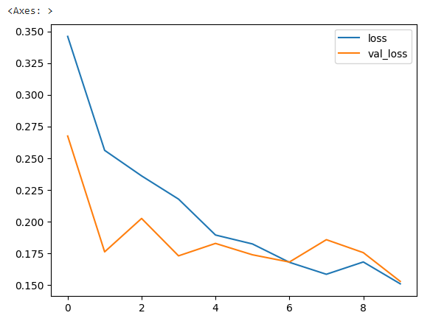
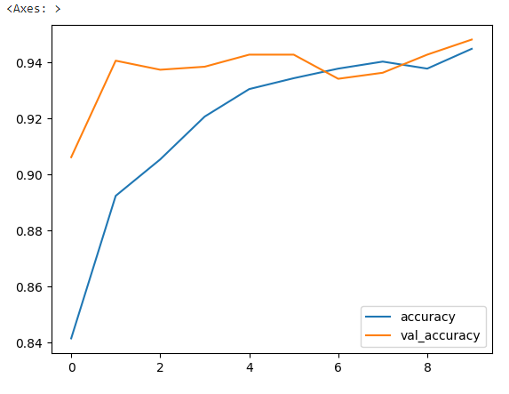
RESULTS
3/21/2024 Annual Review

