Slide 1
Which of 44 conversations needs a manager today?
SPENDNEST | REVENUE INTELLIGENCE INBOX
30 calls and 14 meetings from 21 August 2026, sorted into six traceable routes.
1
2
3
Switch says 36.7% connected, yet 2 of those 11 were silent
Prepaid cards clash with buyers who hold a credit line
UI caching bugs risk wrong payment amounts
B11 and B14 had zero speech. C04 was a real voicemail tagged not connected.
M03 turn 6, M04 turns 11 and 22: INR 1.3 crore credit line, churn risk.
M07 turn 23: Mark as Paid kept INR 18,200. M09 turn 21: fresh token expired.
Notes:
The manager problem: with 44 calls and meetings in one day, which ones need action and which numbers can be trusted. Three findings: the telephony connect rate is not ground truth, the prepaid model collides with credit-line buyers, and form-caching bugs put payment accuracy at risk.

Slide 2
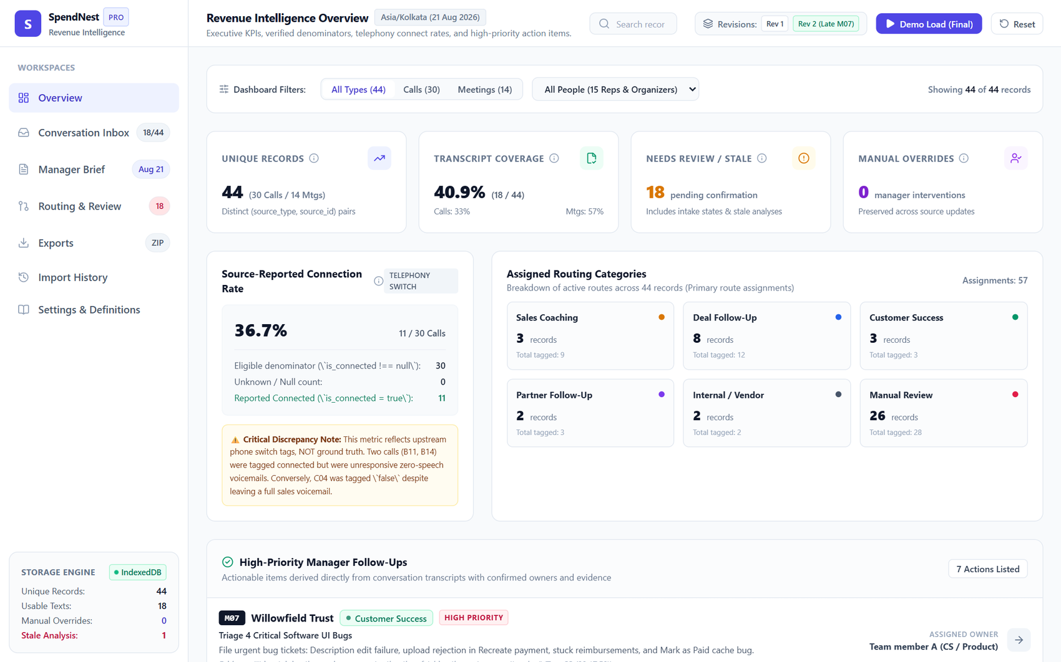
Interface built for triage
Chosen
Overview leads with verified KPIs and shows every denominator
Seven workspaces: inbox, routing review, brief, exports, import history
Manager decisions sit beside machine suggestions
Left out on purpose
Pipeline INR forecast and rep leaderboard: no CRM data to back them
Live LLM calls: offline and deterministic instead
Overview: 44 records, 40.9% transcript coverage, 36.7% source-reported connect rate
Notes:
The Overview puts verified operational numbers first and explains each denominator. A pipeline forecast and rep leaderboard were deliberately left out because the data has no CRM table or staff directory to support them.

Slide 3
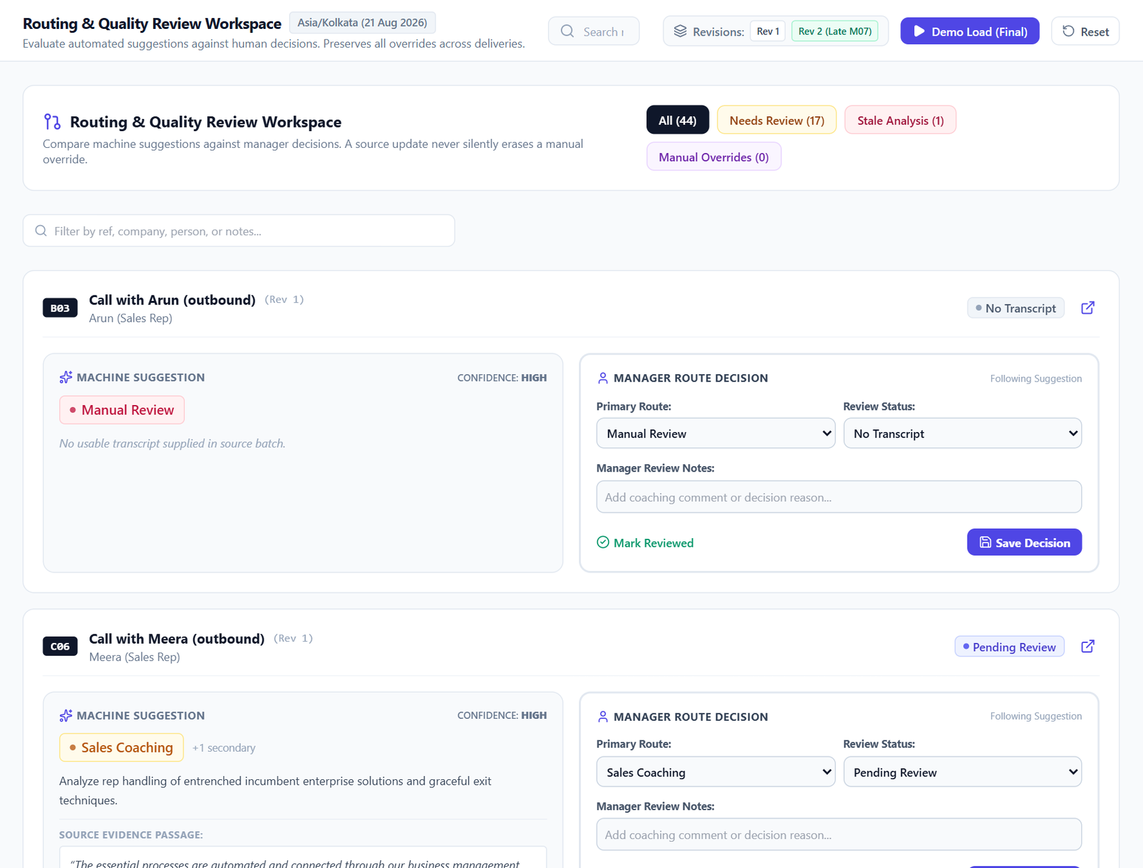
Routing and folder design
Six routes, one export folder each
Sales coaching
sales_coaching/
Deal follow-up
deal_follow_up/
Customer success
customer_success/
Partner follow-up
partner_follow_up/
Internal / vendor
internal_vendor/
Manual review
manual_review/
Multi-route records are written to every matching folder.
Hard case, M04 Cedarwave
Booked as a card migration, but the customer called prepaid the main issue and cited an INR 1.3 crore credit line. Routed to Customer Success, then Deal Follow-up.
Machine suggestion beside the manager decision; overrides save per record
Notes:
Six functional routes, each with its own export folder. M04 was booked as a routine migration, but the transcript shows churn risk tied to prepaid funding, so the primary route is Customer Success with Deal Follow-up as secondary.

Slide 4
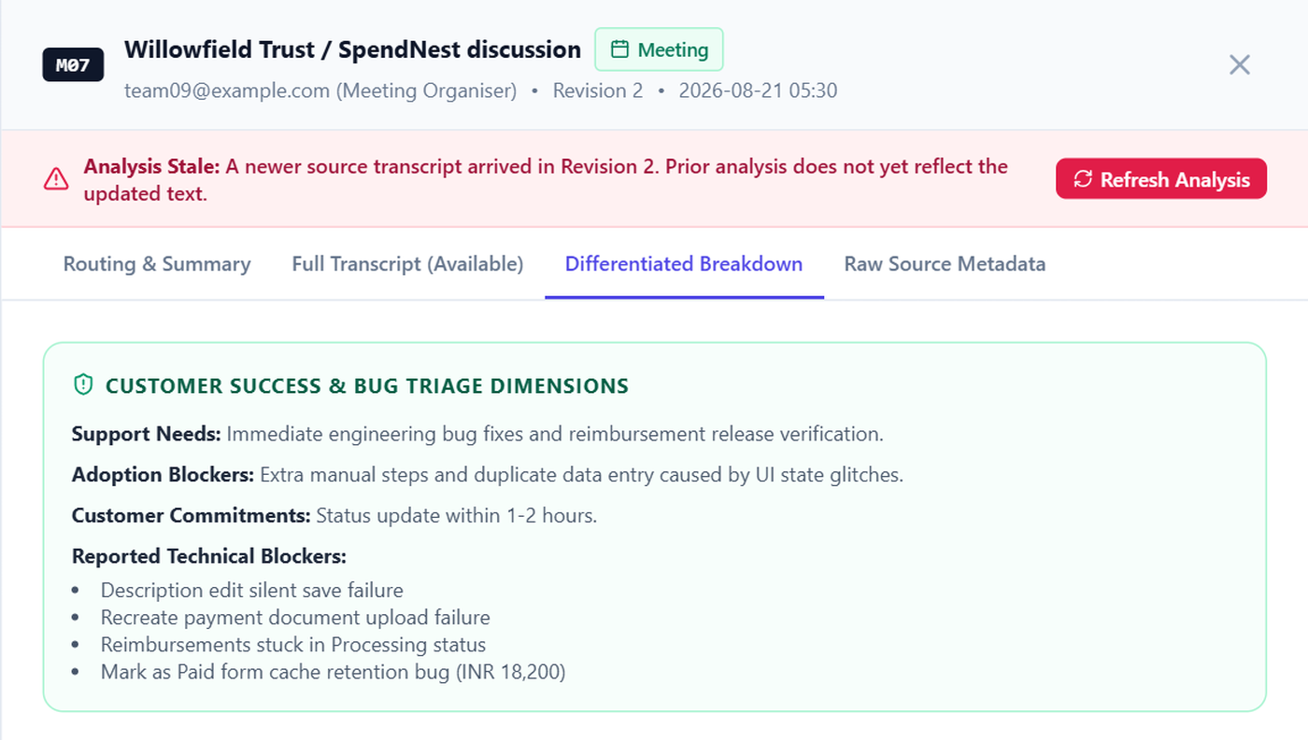
Checking a number and a conclusion
11 / 30
Conclusion: M07 is a bug-triage case
calls tagged connected by the phone switch (36.7%)
Denominator: 30 calls with a flag, 0 unknown
B11, B14: transcripts show zero speech
C04: 95-second voicemail, tagged not connected
Overview labels it source-reported only
Evidence: M07 turn 23 (00:17:50), Mark as Paid keeps the previous amount. Routed to Customer Success; analysis flagged stale after Rev 2.
Notes:
Number check: 11 of 30 calls carry is_connected true, but two of those had no speech and one voicemail was tagged false, so the dashboard labels the metric as source-reported. Conclusion check: M07 turn 23 shows the Mark as Paid form retaining a previous amount, which is an engineering defect rather than a training gap.

Slide 5
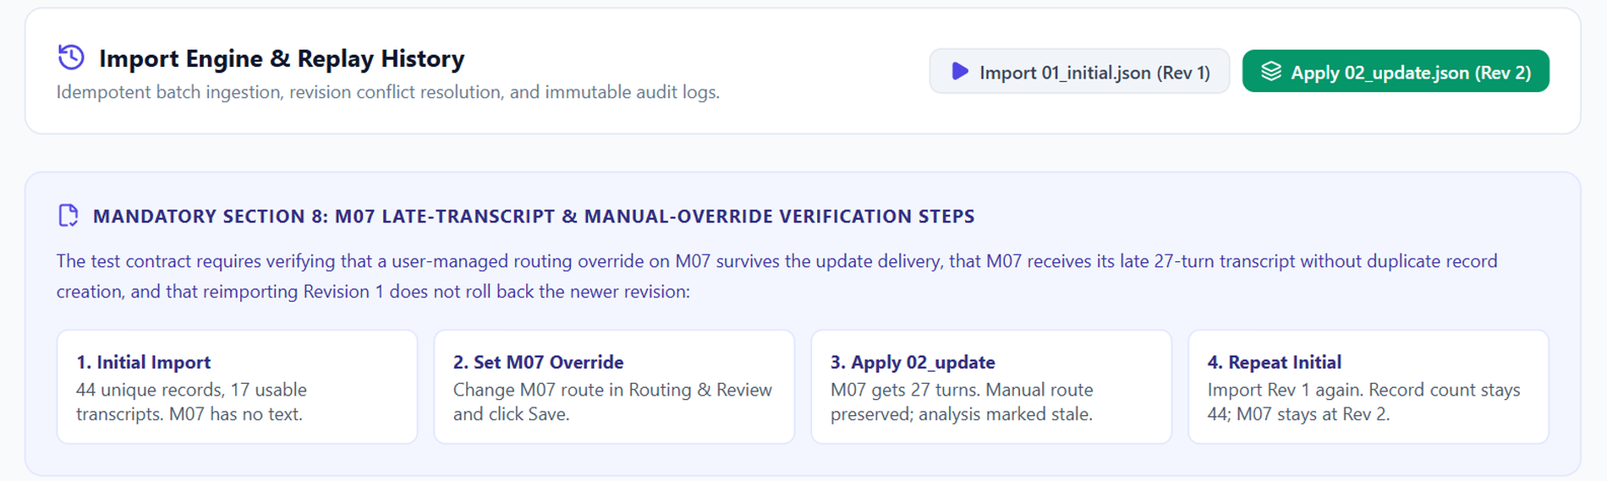
Replay test: counts stay true
44 to 44
17 to 18
Kept
No rollback
Re-importing Rev 1 ignores all records
Rev 2 adds M07's 27-turn transcript
M07 manual route survives the update
Rev 1 again leaves M07 at Rev 2
Notes:
The four required replay steps. These results are asserted by the project's Vitest suite (15 tests) and match the README replay table: 44 records stay 44, usable transcripts go from 17 to 18, the M07 manual route survives Rev 2, and re-importing Rev 1 does not roll back.

Slide 6
Trade-offs, limits and next steps
Trade-offs
AI usage
Pre-generated analysis for 18 transcripts plus a keyword fallback: offline and testable, not live AI. Rejected a pipeline forecast and rep leaderboard to avoid invented totals.
AI assistants helped with UI scaffolding, TypeScript types and test boilerplate. Every quote and count was checked against source records. About 7.5 hours spent.
Known limits
Next
Single-day extract (21 August 2026). Audio links are placeholders, so no playback. No CRM integration.
Live call webhook with speech-to-text, two-way CRM sync, and role-based access for coaching versus executive views.
Notes:
Closing slide: the main trade-off is determinism and offline portability over live AI, and credibility over a flashy forecast. Known limits are the single-day dataset, placeholder audio URLs and no CRM integration.

