Slide 1
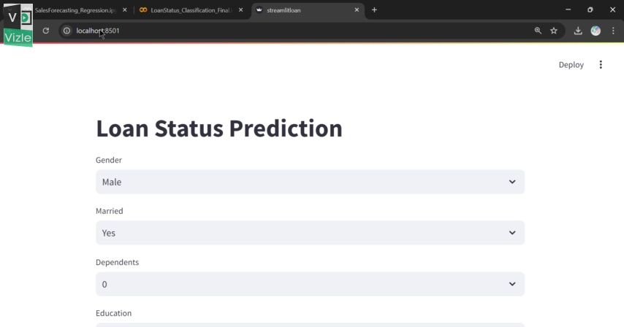
Notes:
[2.0 - 9.0]

Slide 2
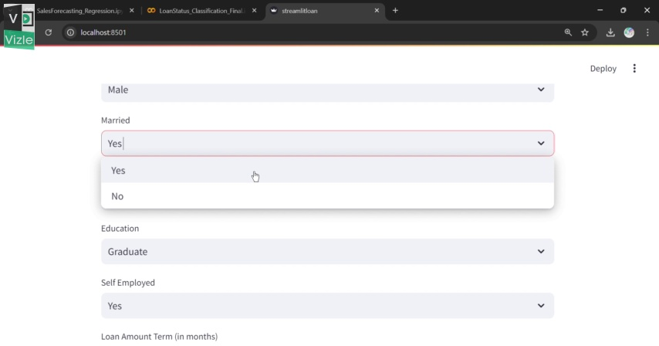
Notes:
[9.0 - 18.0]

Slide 3
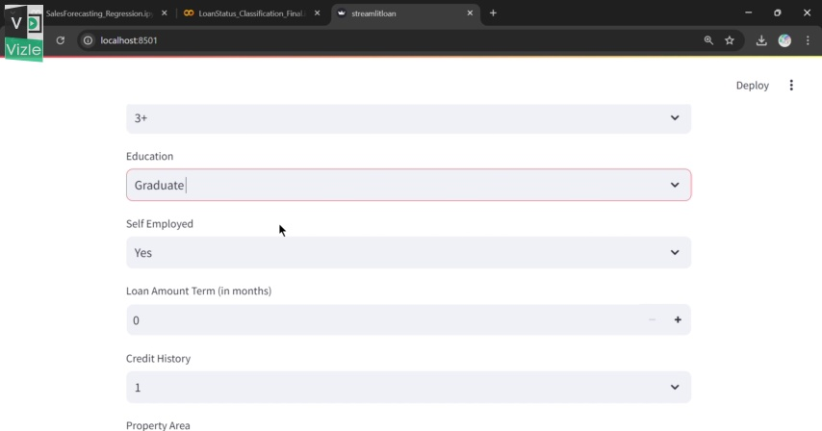
Notes:
[18.0 - 27.0]

Slide 4
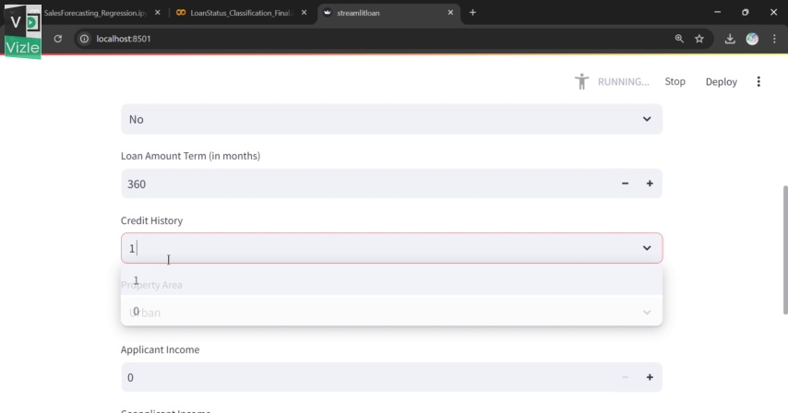
Notes:
[27.0 - 36.0]

Slide 5
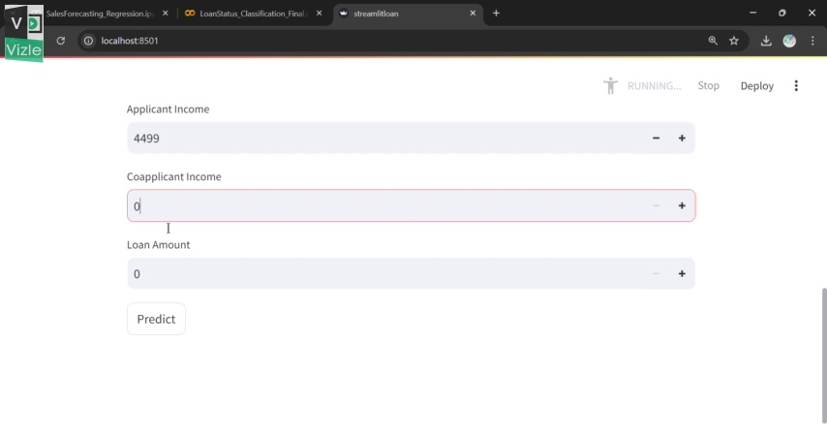
Notes:
[36.0 - 45.0]

Slide 6
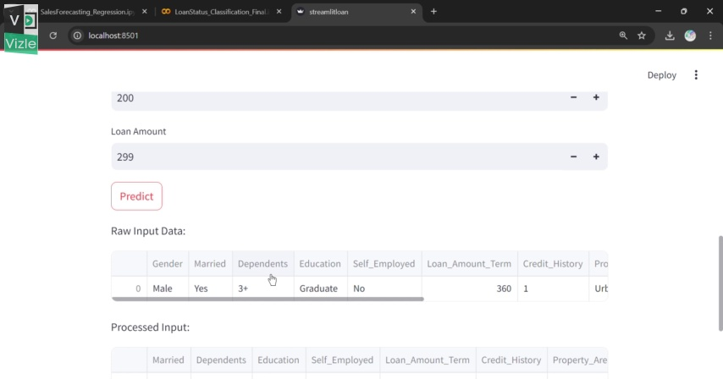
Notes:
[45.0 - 63.0]

Slide 7
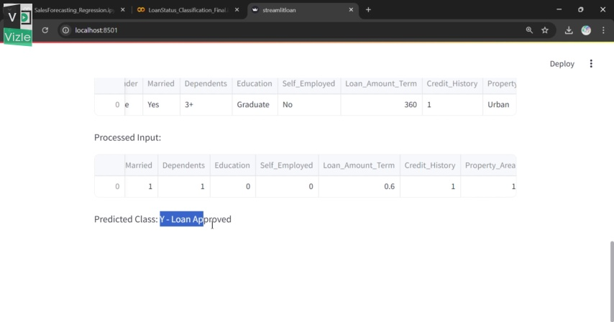
Notes:
[63.0 - 72.0]

Slide 8
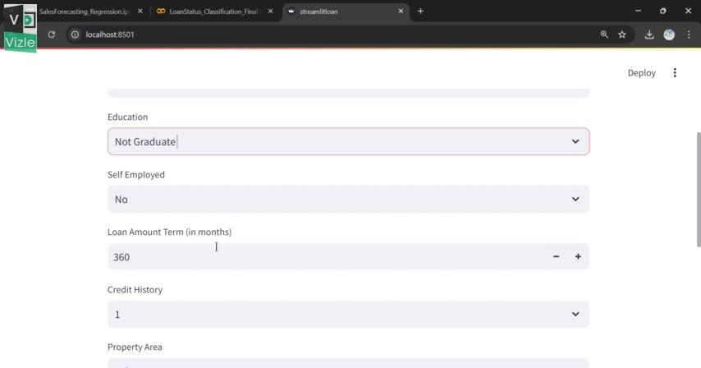
Notes:
[72.0 - 81.0]

Slide 9
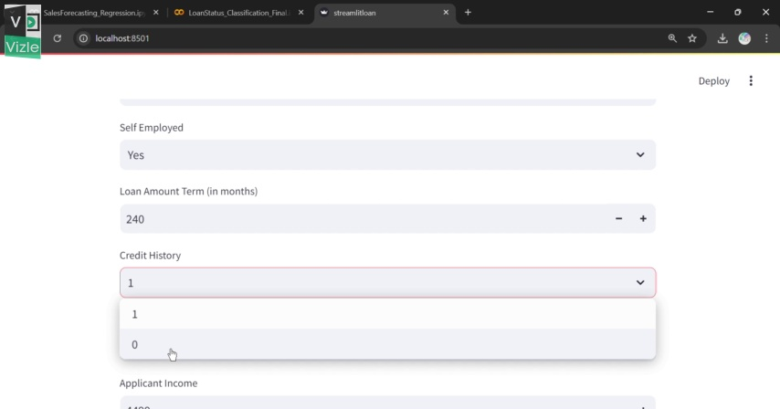
Notes:
[81.0 - 90.0]

Slide 10
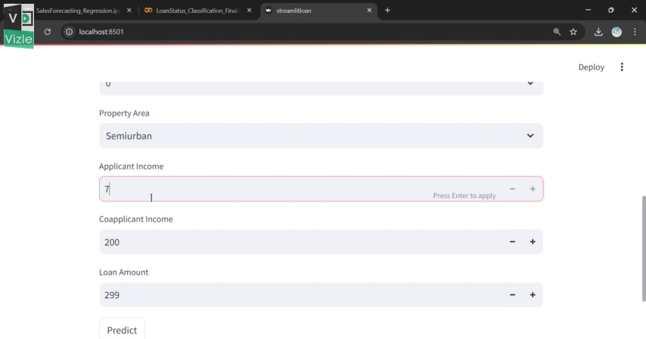
Notes:
[90.0 - 99.0]

Slide 11
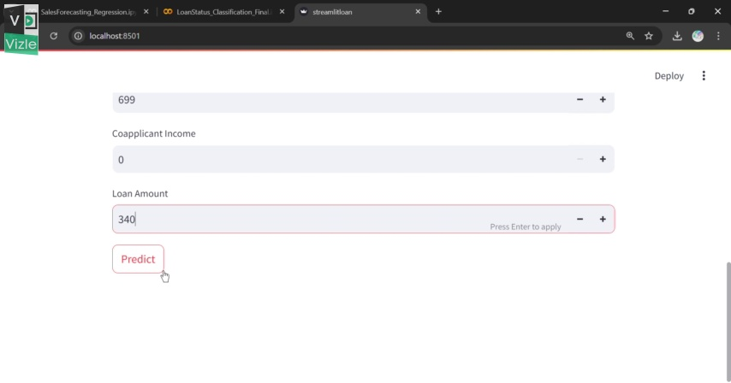
Notes:
[99.0 - 108.0]

Slide 12
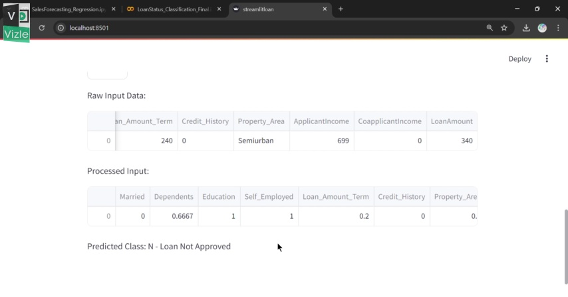
Notes:
[108.0 - 113.2]

