Slide 1


Agamotto
Agamotto
INTELLIGENT PROCTORING SYSTEM:
AI-POWERED REAL-TIME EXAM MONITORING AND MALPRACTICE DETECTION

Slide 2

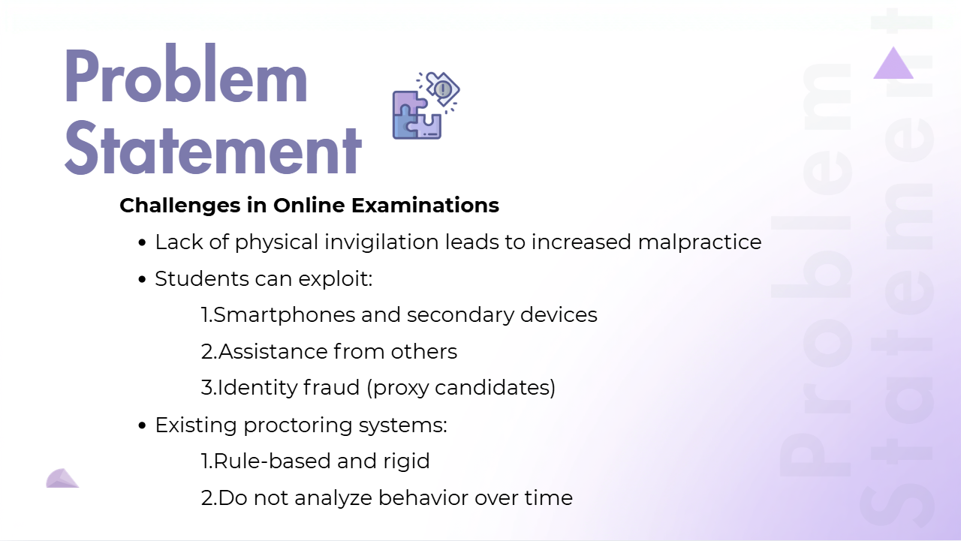



Problem Statement
Challenges in Online Examinations
  Lack of physical invigilation leads to increased malpractice
  Students can exploit:
1.Smartphones and secondary devices
2.Assistance from others
3.Identity fraud (proxy candidates)
  Existing proctoring systems:
1.Rule-based and rigid
2.Do not analyze behavior over time
Problem Statement

Slide 3

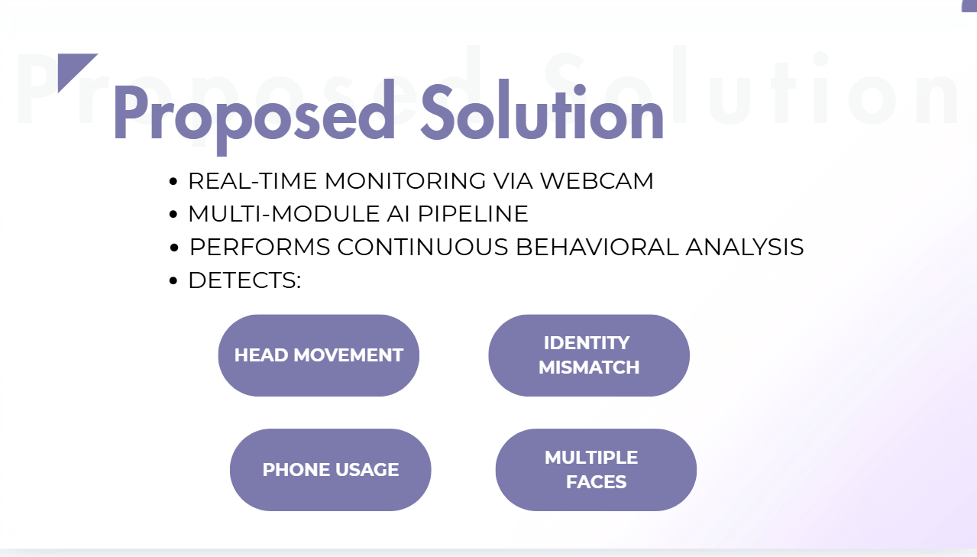
Proposed Solution
Proposed Solution
  REAL-TIME MONITORING VIA WEBCAM
  MULTI-MODULE AI PIPELINE
  PERFORMS CONTINUOUS BEHAVIORAL ANALYSIS
  DETECTS:
HEAD MOVEMENT
IDENTITY
MISMATCH
PHONE USAGE
MULTIPLE
FACES

Slide 4

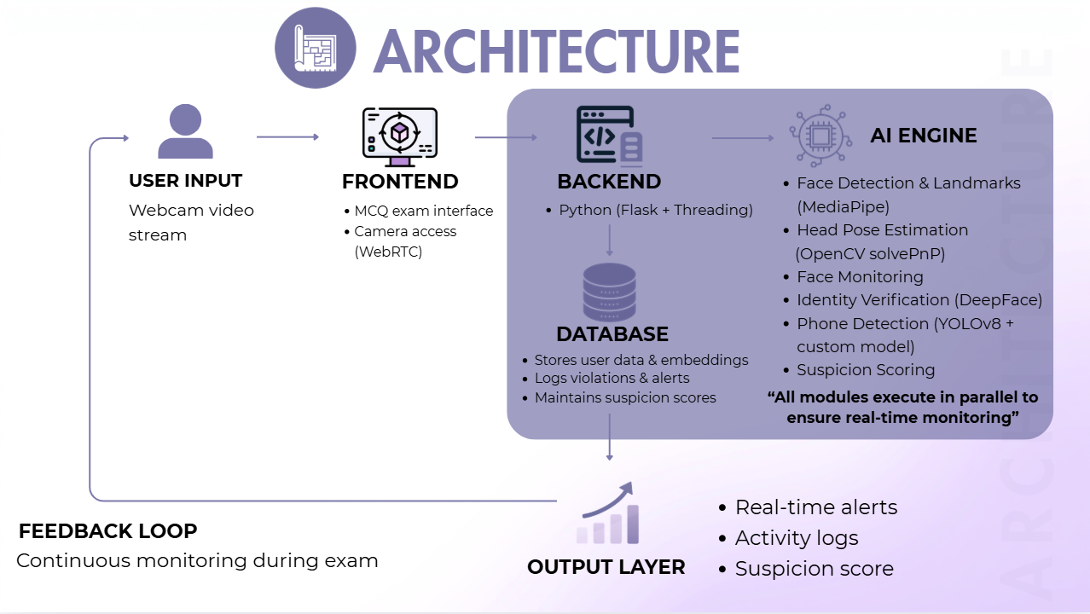






ARCHITECTURE
AI ENGINE
USER INPUT
FRONTEND
BACKEND
  Face Detection & Landmarks (MediaPipe)
  Head Pose Estimation
(OpenCV solvePnP)
  Face Monitoring
  Identity Verification (DeepFace)
  Phone Detection (YOLOv8 + custom model)
  Suspicion Scoring
Webcam video stream
  MCQ exam interface
  Camera access (WebRTC)
  Python (Flask + Threading)
ARCHITECTURE
DATABASE
  Stores user data & embeddings
  Logs violations & alerts
  Maintains suspicion scores
“All modules execute in parallel to ensure real-time monitoring”
  Real-time alerts
  Activity logs
  Suspicion score
FEEDBACK LOOP
Continuous monitoring during exam
OUTPUT LAYER

Slide 5

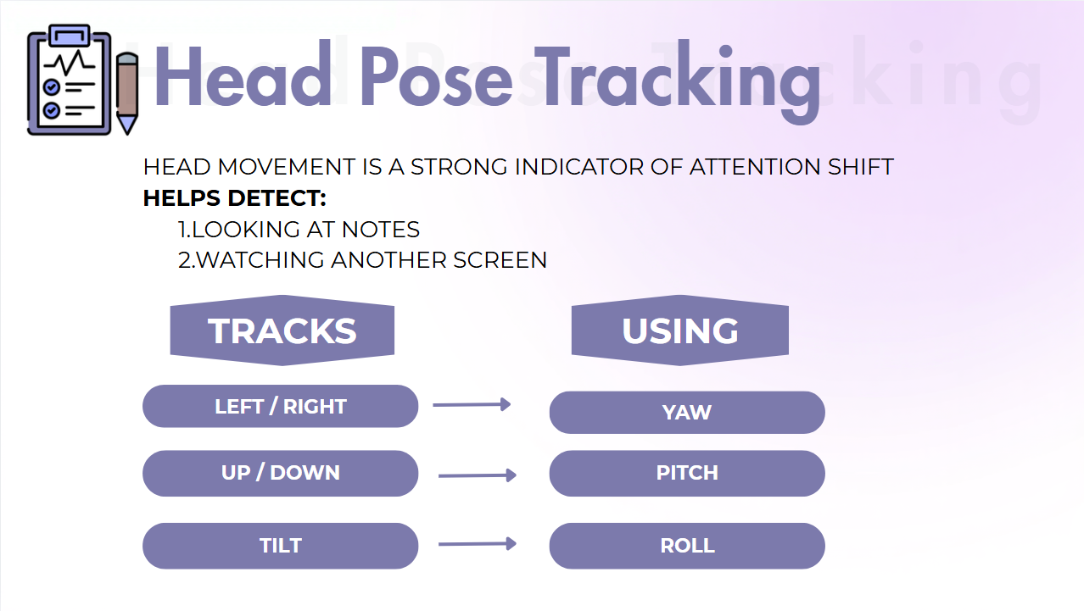

Head Pose Tracking
Head Pose Tracking
HEAD MOVEMENT IS A STRONG INDICATOR OF ATTENTION SHIFT
HELPS DETECT:
1.LOOKING AT NOTES
2.WATCHING ANOTHER SCREEN
TRACKS
USING
LEFT / RIGHT
YAW
UP / DOWN
PITCH
TILT
ROLL

Slide 6
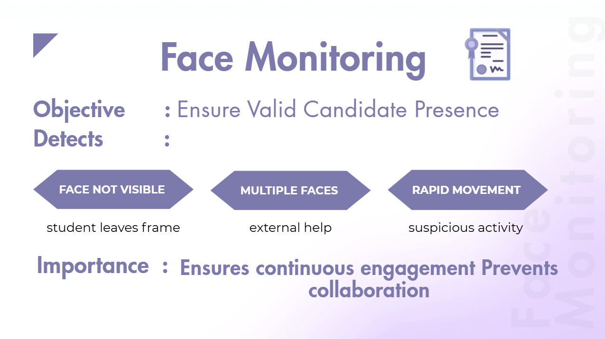

Face Monitoring
Objective : Ensure Valid Candidate Presence
Face Monitoring
Detects :
FACE NOT VISIBLE
MulTIPLE FACES
RAPID MOVEMENT
student leaves frame
external help
suspicious activity
Importance :
Ensures continuous engagement Prevents collaboration

Slide 7
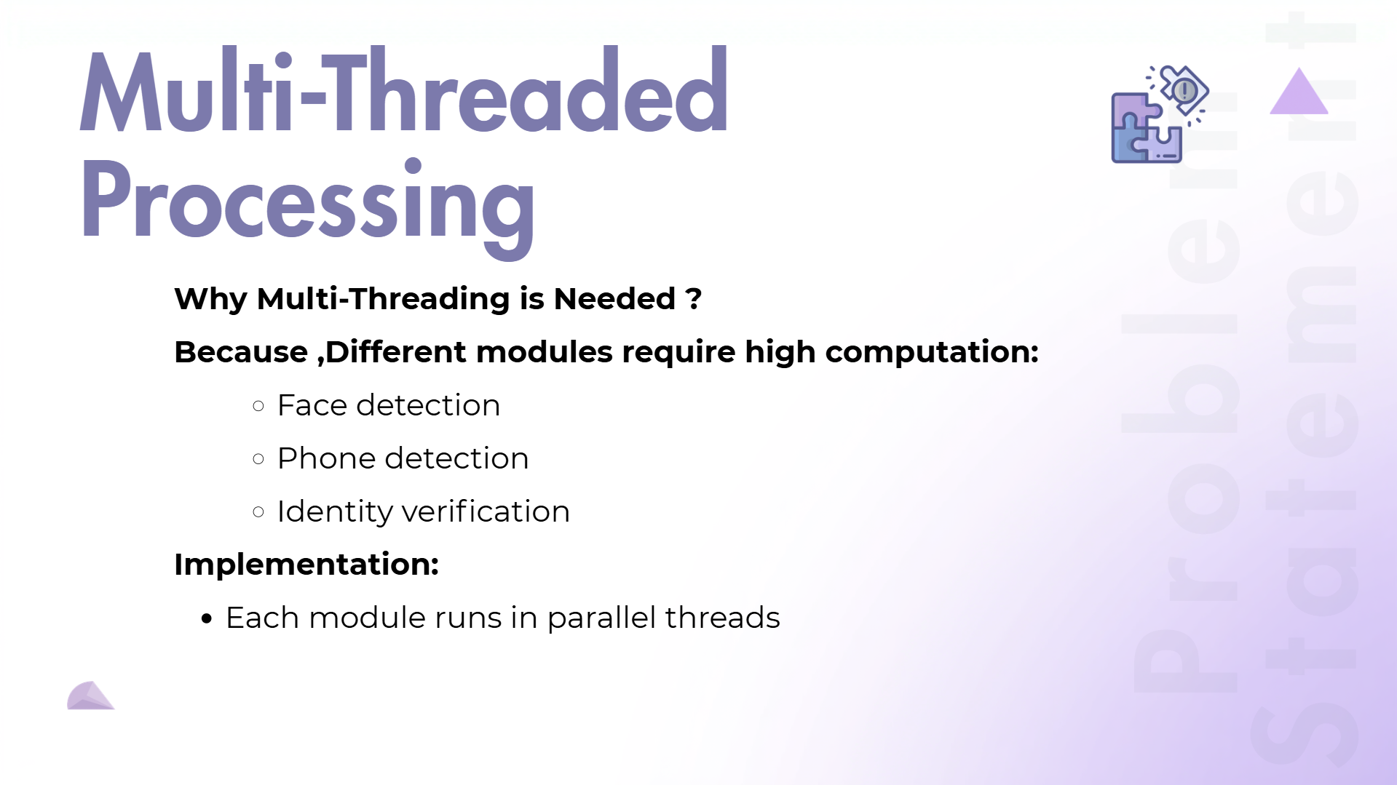
Multi-Threaded Processing
Why Multi-Threading is Needed ?
Because ,Different modules require high computation:
    Face detection
    Phone detection
    Identity verification
Implementation:
  Each module runs in parallel threads
Problem Statement

Slide 8
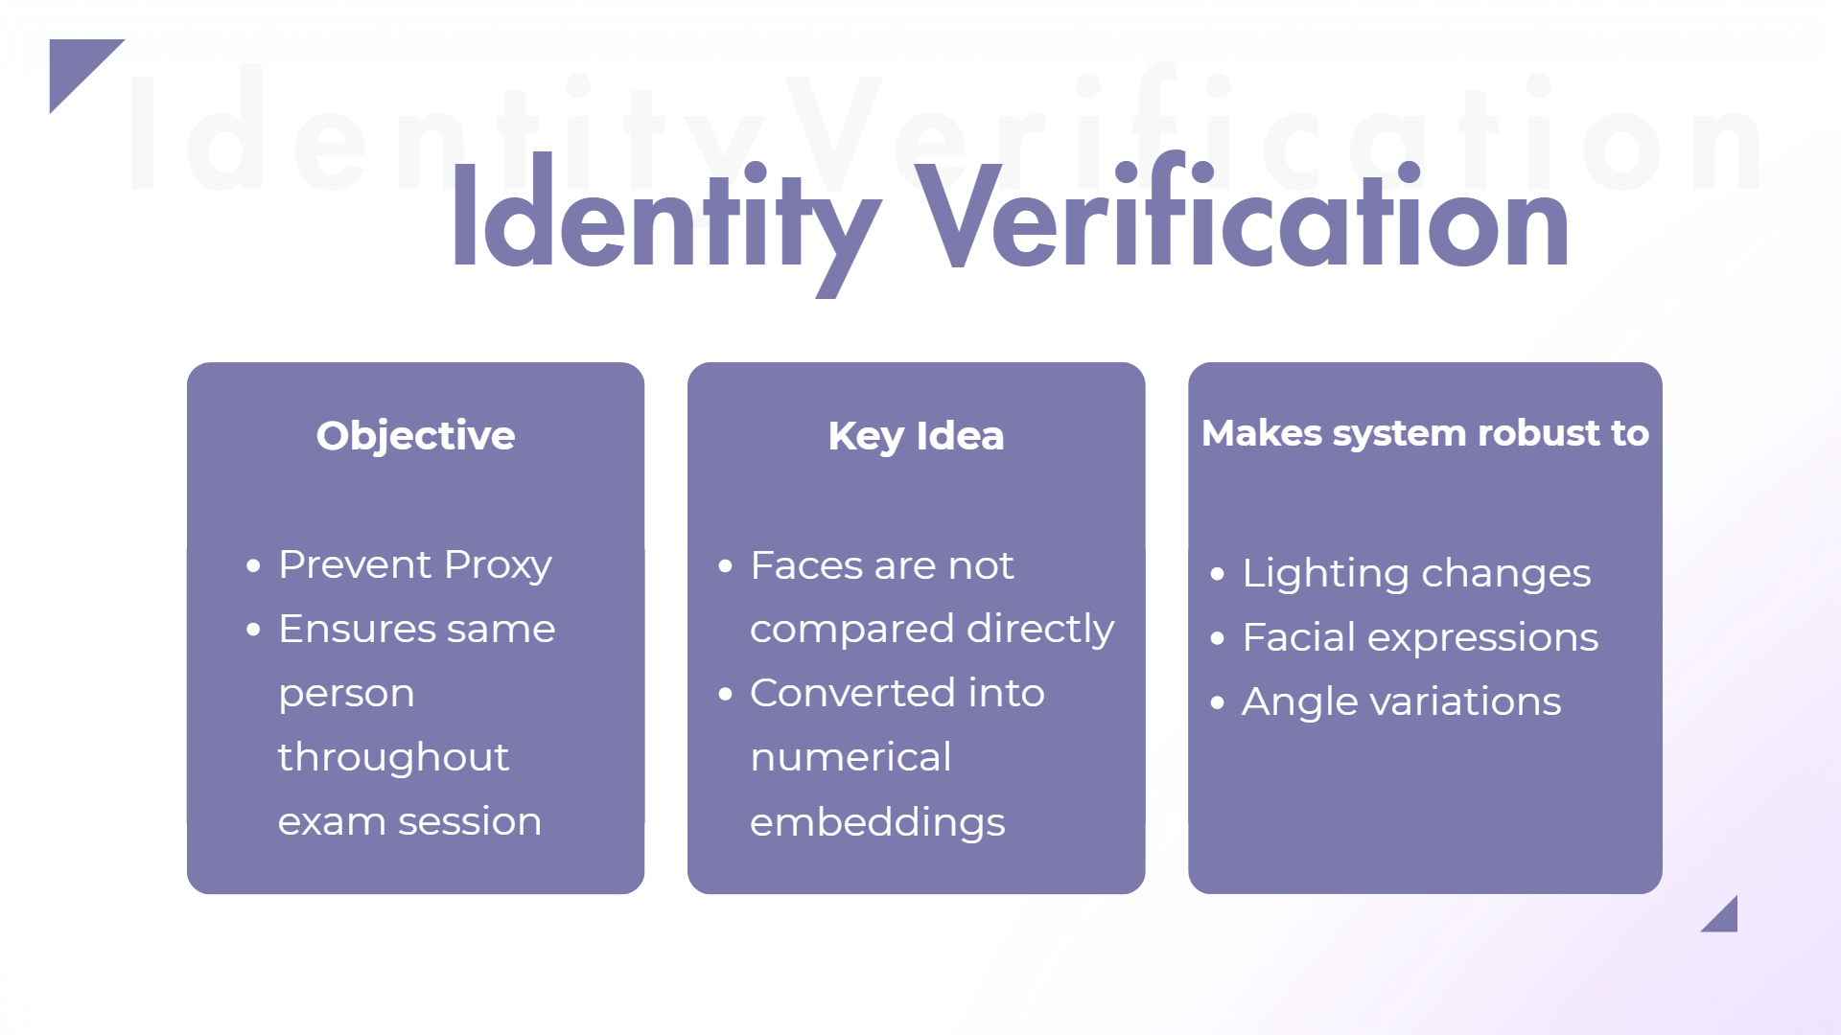
IdentityVerification
Identity Verification
Objective
  Prevent Proxy
  Ensures same person throughout exam session
Key Idea
  Faces are not compared directly
  Converted into numerical embeddings
Makes system robust to
  Lighting changes
  Facial expressions
  Angle variations

Slide 9
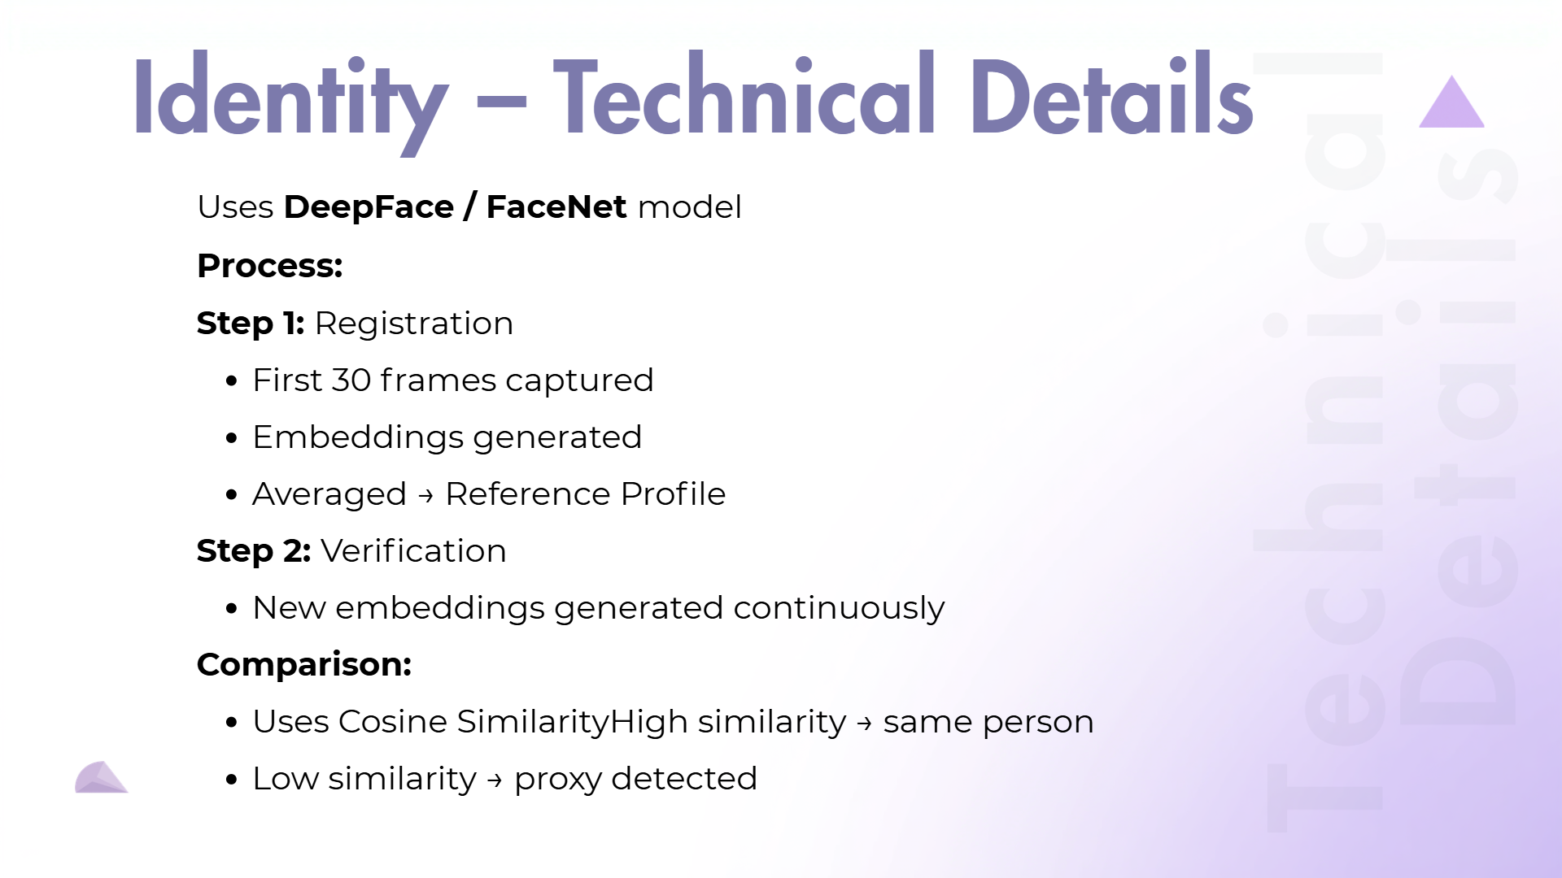
Identity – Technical Details
Uses DeepFace / FaceNet model
Process:
Step 1: Registration
  First 30 frames captured
  Embeddings generated
  Averaged → Reference Profile
Step 2: Verification
  New embeddings generated continuously
Comparison:
  Uses Cosine SimilarityHigh similarity → same person
  Low similarity → proxy detected
Technical Details

Slide 10
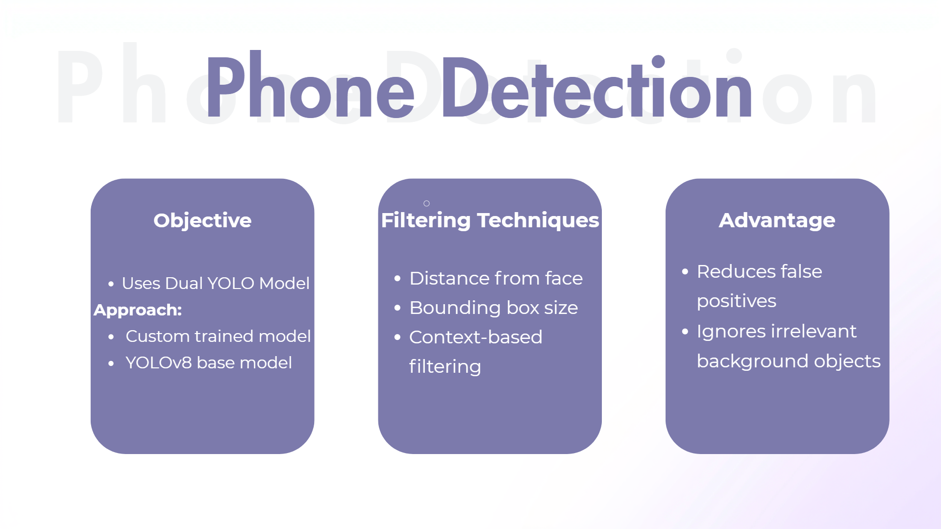
Phone Detection
PhoneDetection
Objective
Filtering Techniques
Advantage
  Distance from face
  Bounding box size
  Context-based filtering
  Reduces false positives
  Ignores irrelevant background objects
  Uses Dual YOLO Model
Approach:
  Custom trained model
  YOLOv8 base model

Slide 11

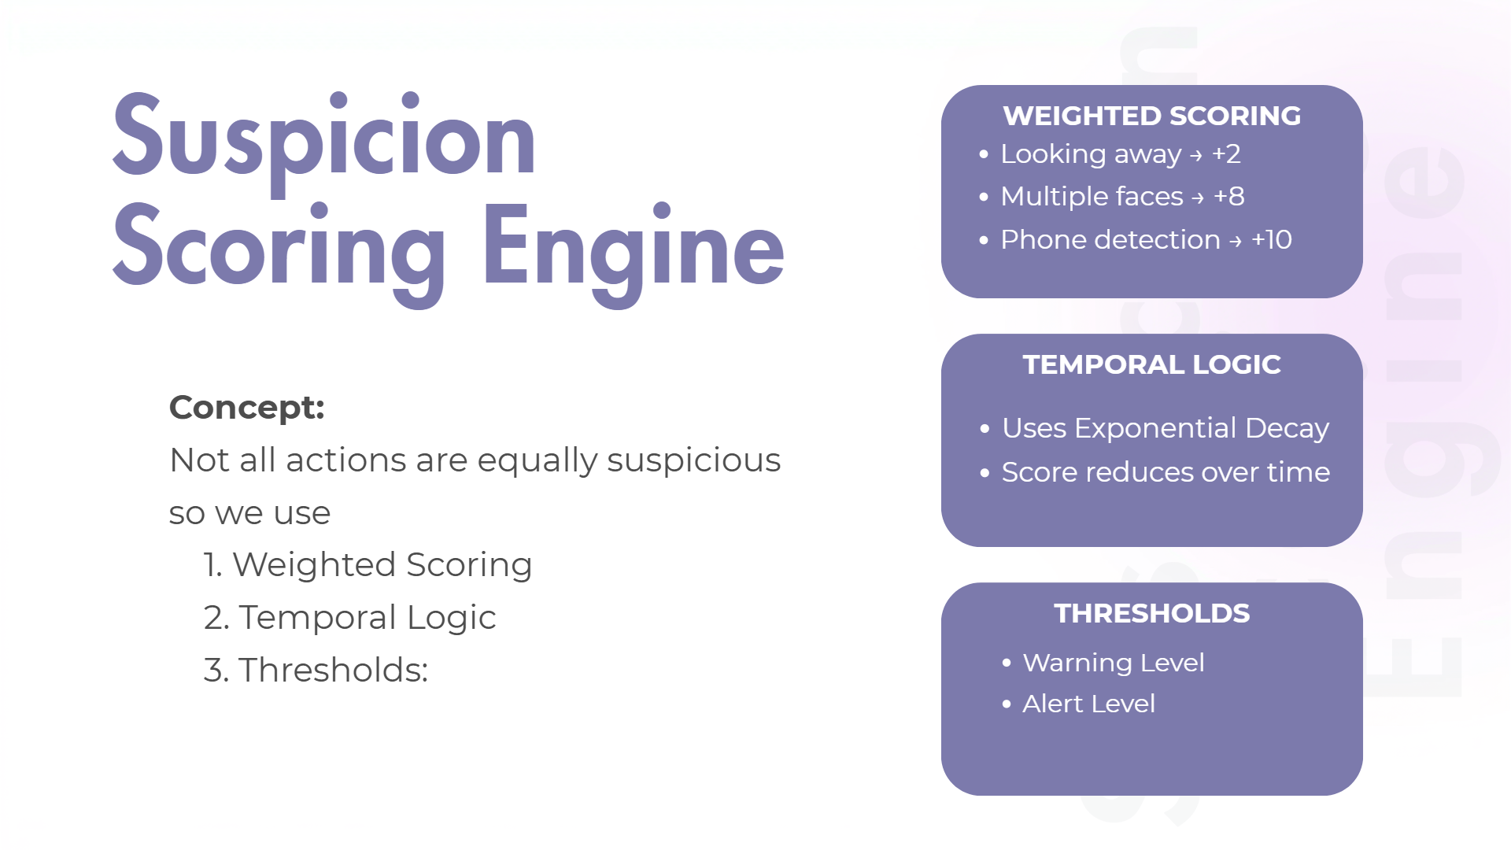
Suspicion Scoring Engine
WEIGHTED SCORING
  Looking away → +2
  Multiple faces → +8
  Phone detection → +10
Suspicion Scoring Engine
TEMPORAL LOGIC
Concept:
Not all actions are equally suspicious
so we use
1. Weighted Scoring
2. Temporal Logic
3. Thresholds:
  Uses Exponential Decay
  Score reduces over time
THRESHOLDS
  Warning Level
  Alert Level

Slide 12
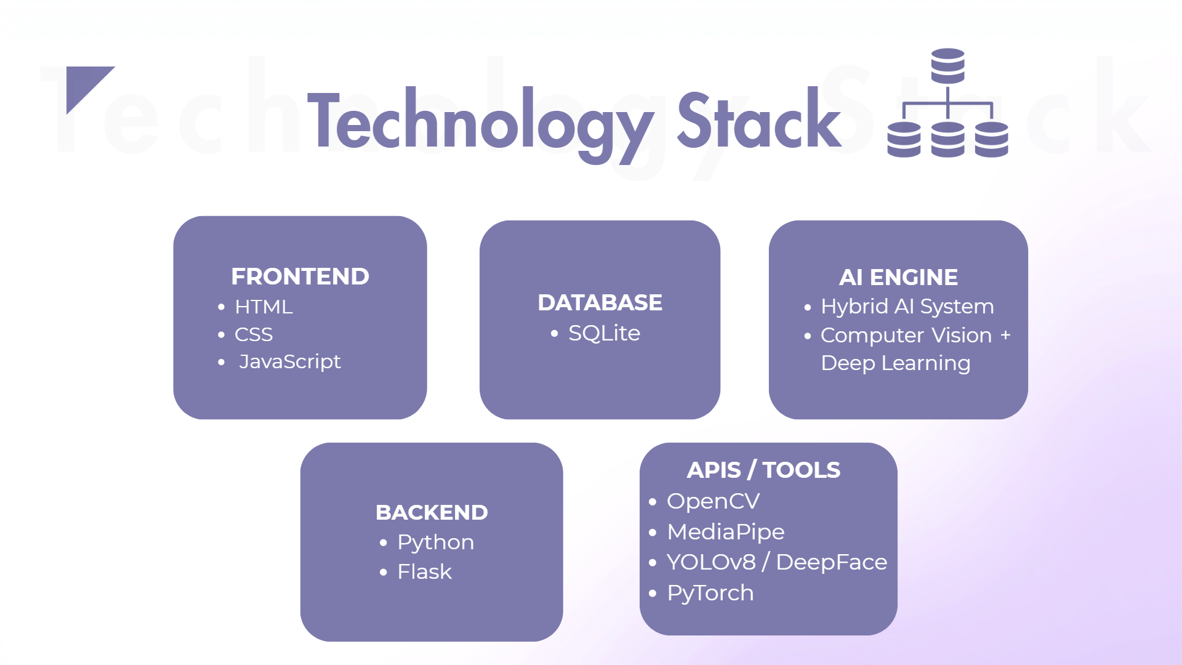
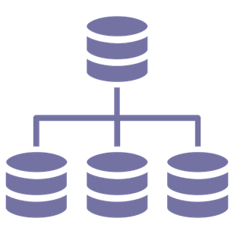
Technology Stack
Technology Stack
FRONTEND
  HTML
  CSS
  JavaScript
AI ENGINE
  HYBRID AI SYSTEM
  Computer Vision + Deep Learning
DATABASE
  SQLite
APIS / TOOLS
  OPenCV
  MediaPipe
  YOLOv8 / DeepFace
  PyTorch
BACKEND
  Python
  Flask

Slide 13
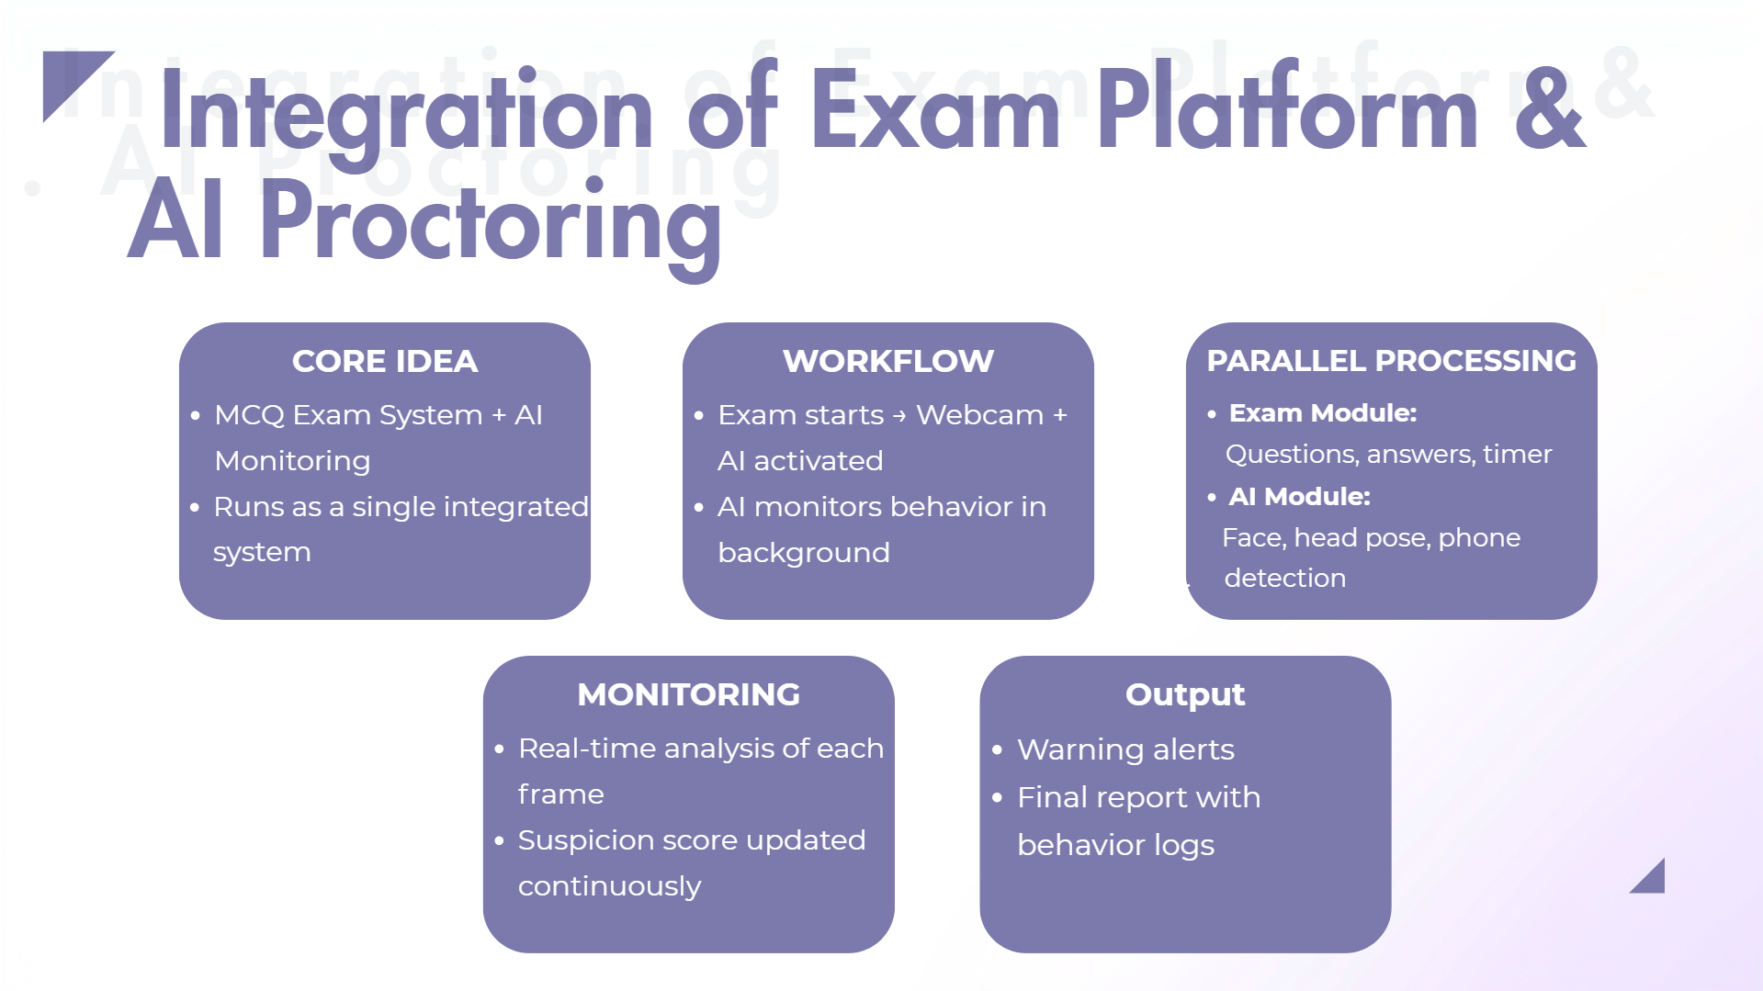
Integration of Exam Platform& . AI Proctoring
Integration of Exam Platform & AI Proctoring
CORE IDEA
WORKFLOW
PARALLEL PROCESSING
  MCQ Exam System + AI Monitoring
  Runs as a single integrated system
  Exam starts → Webcam + AI activated
  AI monitors behavior in background
  Exam Module:
Questions, answers, timer
  AI Module:
Face, head pose, phone . detection
MONITORING
OUTPUT
  Real-time analysis of each frame
  Suspicion score updated continuously
  Warning alerts
  Final report with behavior logs

Slide 14


THANK YOU
THANK YOU

