Slide 1
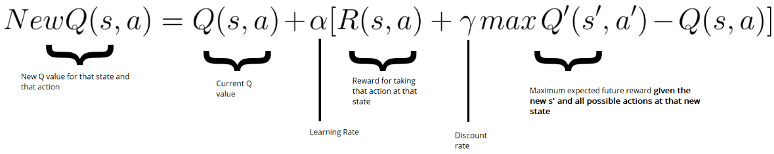
Q-Learning
In Q-learning, the goal is to learn a single deterministic action from a discrete set of actions by finding the maximum value.
Finding the optimal path that maximizes the reward
Terms: Environment-agent, state, action, reward

Slide 2
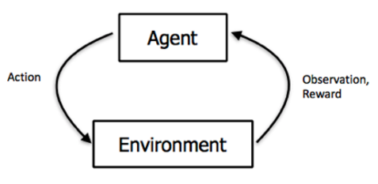
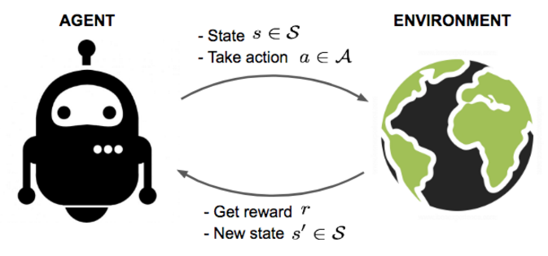

Slide 3
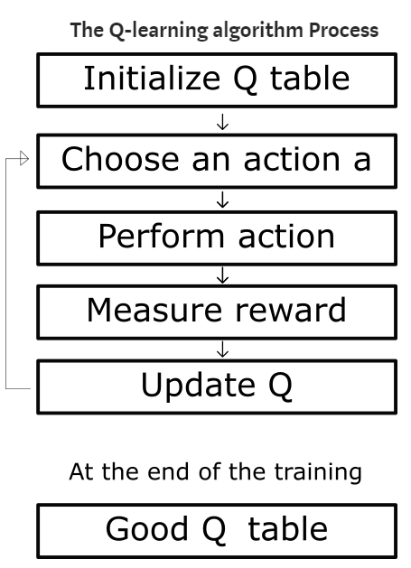
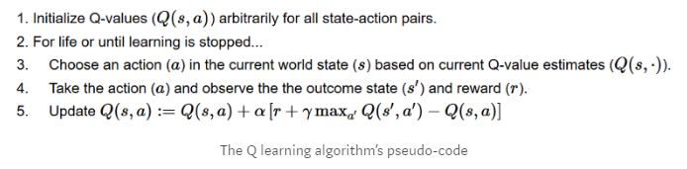

Slide 4
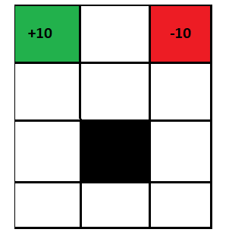
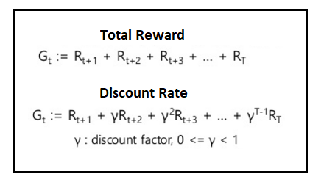
Reward

Slide 5
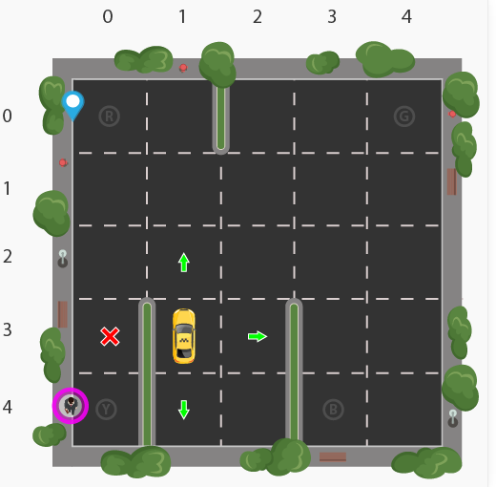
Gym Taxi: State
5x5 grid = 25 Cell
4 locations that we can pick up and drop off a passenger: R, G, Y, B
The agent encounters one of the 500 states and it takes an action. 5*5*5*4 = 500

Slide 6
Gym Taxi: Action
Action in our case can be to move in a direction or decide to pickup/dropoff a passenger.
Action Space: South, north, east, west, pickup, dropoff

Slide 7
Gym Taxi: Reward
Positive reward for a successful dropoff (+20)
Negative reward for a wrong dropoff (-10)
Slight negative reward every time-step (-1)
Each successfull dropoff is the end of an episode

Slide 8

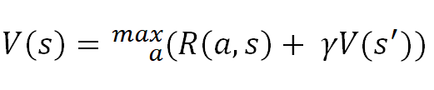
Bellman Equation

Slide 9
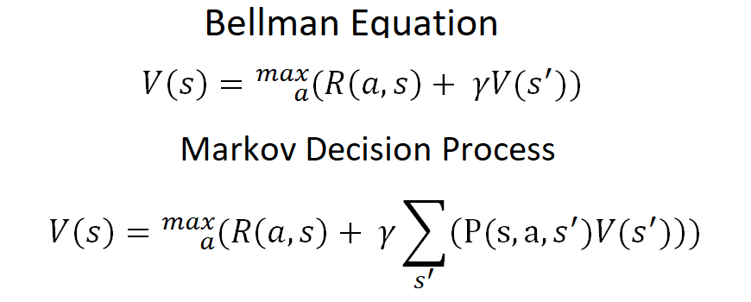
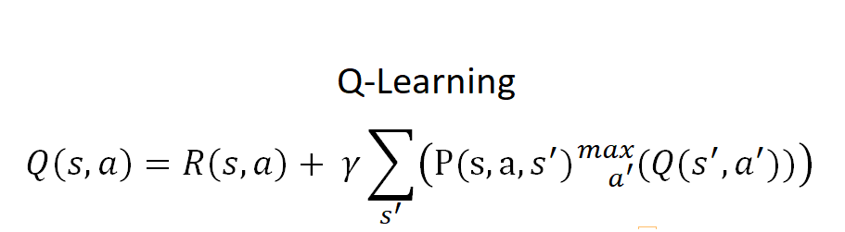

Slide 10
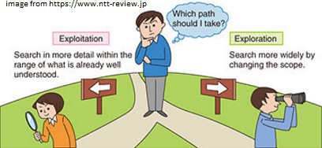



Exploitation vs Exploration

Slide 11
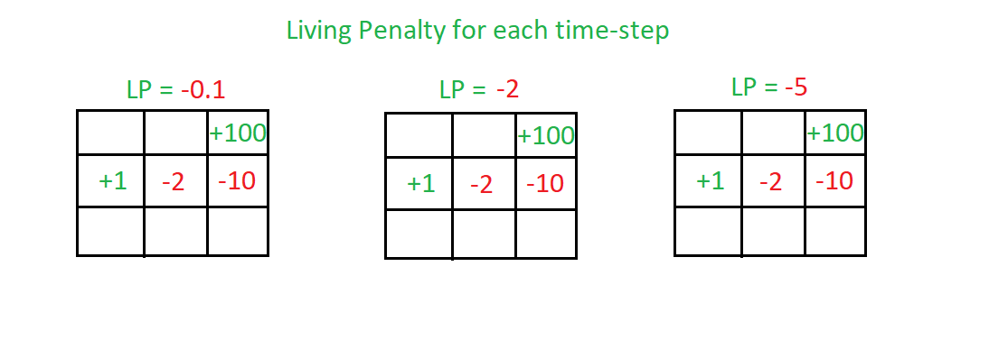
Living Penalty

Slide 12
Gym Taxi Q-Learning
The agent encounters one of the 500 states and it takes an action (6).

Slide 13
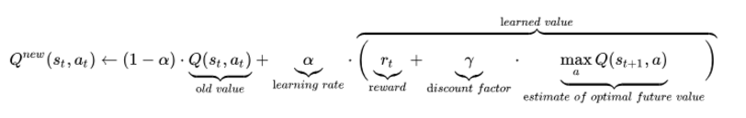
Same Q-functions

Slide 15
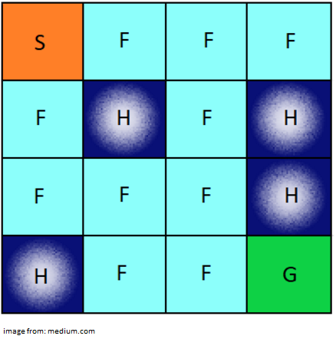
FrozenLake-v0
https://gym.openai.com/envs/FrozenLake-v0/
https://github.com/openai/gym/blob/master/gym/envs/toy_text/frozen_lake.py

Slide 16
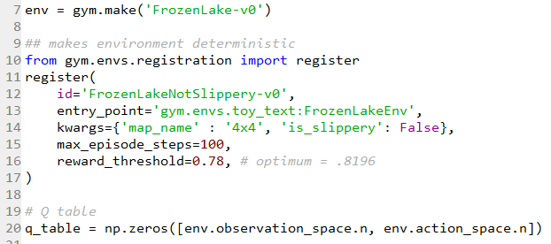

Slide 17
Sonuç
State, action, reward, deterministic/stochastic,
Bellman Equation
Markov Decision Process
Q Learning
Temporal Difference
Exploitation vs Exploration
Living Penalty
Taxi/Frozen Lake
Ek Kaynak: https://www.youtube.com/playlist?list=PLZbbT5o_s2xoWNVdDudn51XM8lOuZ_Njv

Slide 18
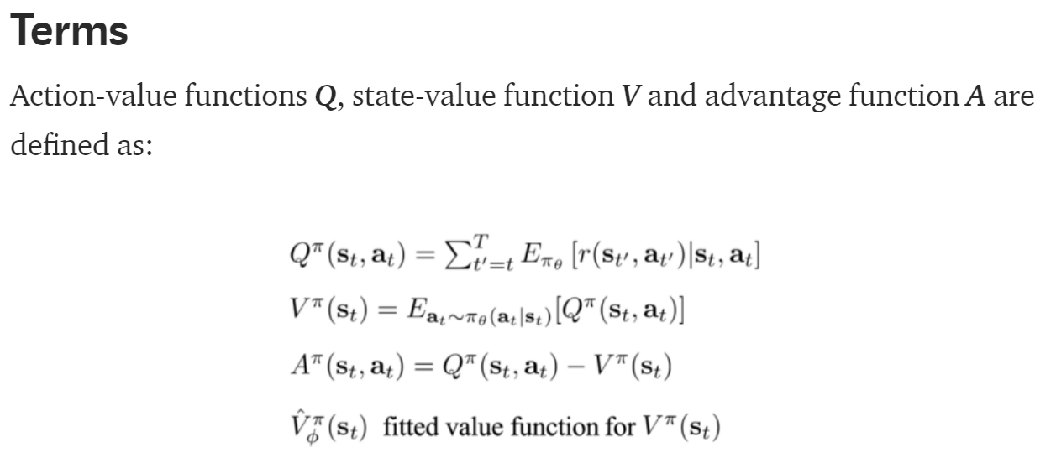
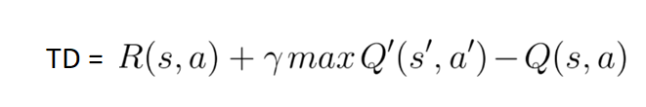

Slide 19
