Slide 1
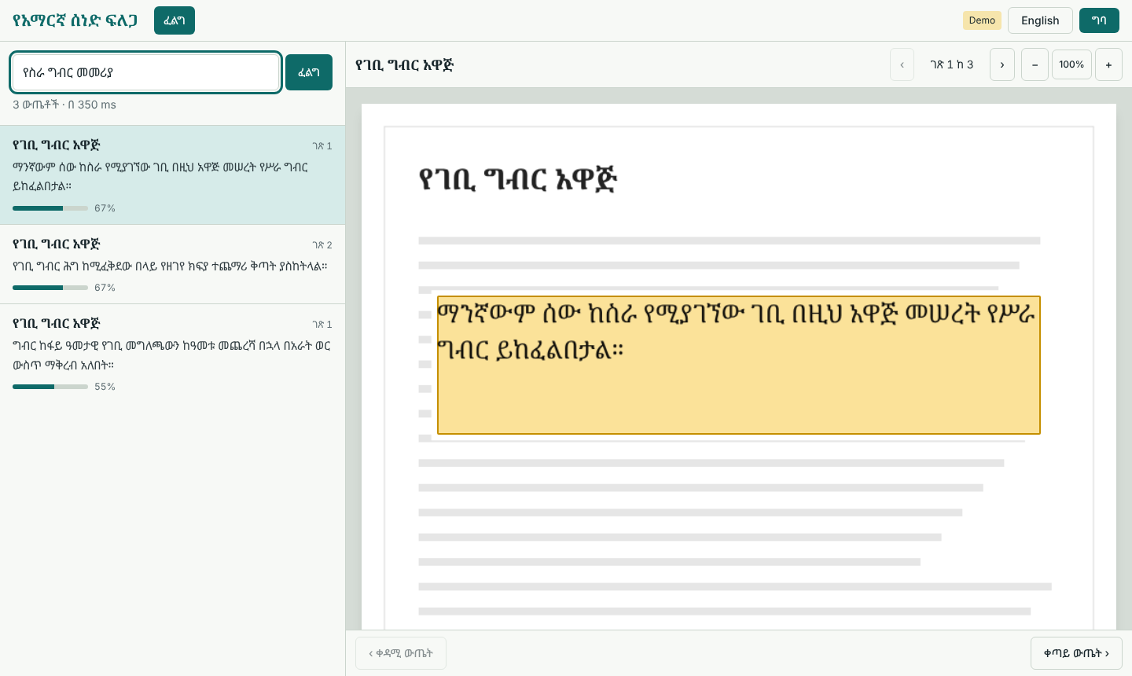
AI-Powered Amharic Document Digitization and Semantic Retrieval System
Senior Project Final Defense
Kibreab Dawit Ferid Hamza
Semir Sultan Yassin Bedru
Search results open on the page image with the passage highlighted
HiLCoE School of Computer Science
Notes:
Introduce the team and the project in one sentence: a web system that digitizes scanned Amharic documents and lets people search them by meaning, then shows the exact passage on the page image. The picture is the finished interface running in demo mode.

Slide 2


Scanned Amharic archives cannot be searched
Raw OCR is noisy
Keyword search misses meaning
Ethiopic has 300+ characters and look-alike homophones. Skew, noise and blur raise the character error rate.
Amharic words inflect and are spelled in several ways, so exact matching returns false negatives.
Same meaning, no shared words
Query: የስራ ግብር መመሪያ
Filed under: የገቢ ግብር ሕግ
Notes:
Two barriers from the proposal. First, off-the-shelf OCR struggles with Ethiopic script. Second, lexical search cannot connect a query about workplace tax guidance with a document filed as income tax law. This is the example used in the proposal's background section.

Slide 3
From paper scan to highlighted passage
Upload
Preprocess
OCR
Normalize
Index and search
Viewer
Admin adds PDF or image
Deskew, binarize, denoise
Text and word boxes
Unify homophones, chunk
bge-m3 + BM25, ChromaDB
Results with highlight
Yassin, Semir
Kibreab
Ferid, Semir
Ferid
Kibreab, Semir
Yassin
Built entirely with open-source tools: React, FastAPI, OpenCV, Tesseract, bge-m3 and ChromaDB. Cost: $0.
Highlighted stages are the frontend and integration module presented in detail next.
Notes:
Walk left to right. Each stage has a named owner from the task division. Our module (Yassin) is both ends: the upload on the admin side and the viewer on the search side. Everything in between is covered by teammates in their own sections.

Slide 4
Who built what
Member | Owns | Tasks
Kibreab Dawit | Preprocessing, embedding and hybrid search | 1 corpus curation, 4 OpenCV preprocessing, 8 embedding and hybrid search
Ferid Hamza | OCR (co-owner), normalization | 5 OCR integration (with Semir), 6 Amharic text normalizer
Semir Sultan | Backend, OCR (co-owner) | 7 database and ChromaDB setup, 5 OCR integration, 9 API design and auth
Yassin Bedru | Frontend, integration, UAT | 3 wireframes, 10 React app, viewer and bounding-box overlay, 9 API integration (with Semir), 11 UAT
Shared: Task 2 requirements and UML (everyone), Task 11 testing (each tests their module), Task 12 documentation (each writes a chapter).
Notes:
Task division as agreed by the team. Yassin's row is highlighted because the next section covers it: wireframes, the React application, the API integration and the user acceptance test.

Slide 5


Search in Amharic, see the passage on the page
Ranked results
Natural-language query, match score and snippet for each passage
Page viewer
Preprocessed page image with highlight boxes, zoom, page and result navigation
Two languages
Amharic and English interface, switched in one click
Notes:
This is the main screen. The user types a question, the left list shows ranked passages with a match percentage, and the right side opens the preprocessed page image with the passage highlighted. Built with React 18, Vite and Tailwind CSS.

Slide 6
The highlight stays exact at any zoom level
1
OCR returns a pixel box
left, top, width, height on the page image
// pixels to normalized (backend)
x = left / pageWidth
y = top / pageHeight
// normalized to CSS (frontend)
left: x * 100 + '%'
top: y * 100 + '%'
// verified in test TC-05
{x:.10, y:.18, w:.80, h:.13}
-> left:10%; top:18%;
width:80%; height:13%
2
Backend normalizes it
Divides by page width and height to get values from 0 to 1
3
Frontend draws percentages
One box per line; the overlay scales with the image
Notes:
Why normalized coordinates: if the backend sent pixels, the highlight would drift when the user zooms or resizes the window. With values between 0 and 1 the same numbers work at every size. The conversion function is in src/lib/bbox.js and is covered by unit tests.

Slide 7
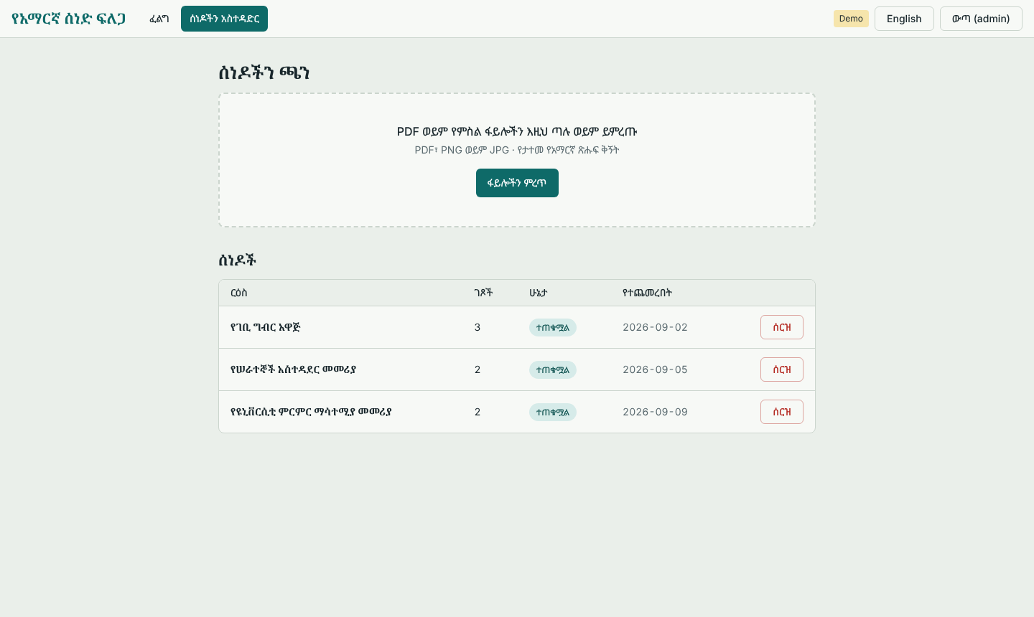
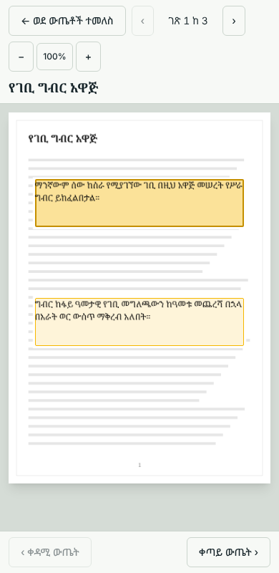


Admin tools and a full mobile view
Upload and delete are admin-only
Searching needs no account
Sign-in with JWT. Upload with progress, status updates every 2.5 s, delete after confirmation.
Phones open the viewer full screen. No horizontal scrolling at 390 px.
Notes:
Role-based access as in the proposal: public searchers can search without an account, administrators sign in to upload and delete. The admin table polls the backend while any document is queued or processing. On phones the viewer takes the whole screen with a Back button.

Slide 8
A written contract with the backend
Method | Path | Purpose
POST | /auth/login | Sign in, returns token and role
GET | /search?q=&k= | Ranked passages with page and boxes
GET | /documents | List documents and status
POST | /documents | Upload a file (admin)
DELETE | /documents/{id} | Remove a document (admin)
GET | /documents/{id}/pages/{n}/image | Preprocessed page image
One file, src/lib/api.js, holds every API call. Leave VITE_API_URL empty to use the built-in mock; set it to use FastAPI. Errors are read from the detail field; a 401 or 403 returns the user to sign-in.
Notes:
Task 9 integration, frontend side. Semir implements these endpoints; the frontend only talks to them through one module, so any mismatch shows up in one place. The mock backend let the interface be built and tested before the real API existed. Integration against the real service is the step still to run with Semir.

Slide 9
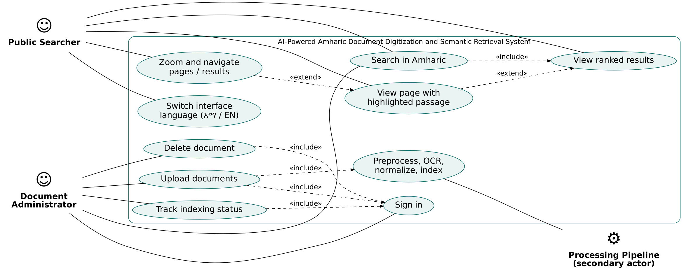
Designed before it was built
Use-case diagram. Sequence, class and ER diagrams: Annexes B and C. Wireframes: Annex D.
Notes:
Show that the interface came from analysis: use cases for the two roles, sequence diagrams for ingestion and search, an ER diagram for the data, and wireframes. All are in the annexes of the report.

Slide 10
Automated tests: 18 unit, 31 of 31 end-to-end
18
unit tests passing
31/31
browser scenarios passing
0
console errors
Notes:
The 18 unit tests cover the bounding-box maths, the choice of which boxes to draw, the reading of backend error messages and the search contract. The 31 end-to-end scenarios drive a real Chromium browser through search, the viewer with one or several highlight boxes, language switch, login, session expiry, upload, delete, their error cases and the phone layout, and also check that no JavaScript error appears. Both suites were re-run on the final build and passed. They run against the mock backend; re-running them against FastAPI is the integration check.

Slide 11
Evaluation targets from the proposal
Measure | Target | Measured by | Result
Frontend scenarios | All pass | Yassin | 31 of 31 passed
OCR character error rate | Lowest achievable | Ferid, Semir | Enter from OCR benchmark
OCR time per page | Under 3 s on GPU | Ferid, Semir | Enter from benchmark
Retrieval MRR@10, Recall@K | 30 test queries | Kibreab | Enter from benchmark
Search latency | Under 1.5 s | Kibreab, Semir | Enter from integrated test
Usability (SUS) | 68 or higher | Yassin | Enter after UAT sessions
Highlighted cells are filled with each module owner's measured figures before the defense.
Notes:
Targets come straight from section 7.3 and 7.6 of the proposal. Only the frontend result is filled in because it is the only one measured so far. The amber cells must be completed with real numbers from the OCR benchmark, the retrieval benchmark and the UAT before presenting. Do not present estimates.

Slide 12

User acceptance test: protocol
T1
Search and name the top result
How it is measured
T2
Find the highlighted passage
5 to 8 participants, individual 25-minute sessions
Task success, time and errors per task
10-item System Usability Scale, scored 0 to 100
Targets: success 80% or more, SUS 68 or more
T3
Search with a synonym
T4
Next page, zoom, back to results
T5
Switch interface language
T6
Sign in and upload a document
Sessions pending. Results are reported only from real participants.
T7
Delete the test document
Notes:
The kit contains consent forms in English and Amharic, a facilitator script, an observer sheet, the SUS in both languages and a scoring workbook with formulas. The SUS formula was checked with a worked example (answers 4,2,5,1,4,2,5,2,4,2 give 82.5). No participant data exists yet, so no result is shown.

Slide 13
Limitations and future work
Limitations
Next steps
Printed text only; no handwriting or camera capture
One highlight box per chunk, not per line
UAT sample of 5 to 8 users shows major problems, not statistics
Free-tier compute limits model size
Line-level highlight boxes
Show recognized text beside the page image
Filters by document and date, result pagination
Token refresh for long admin sessions
Notes:
Be upfront about limits; they come from the proposal's scope and from what the frontend does today. Each next step is a concrete extension of the existing design.

Slide 14
Type a question in Amharic. See the passage on the page image.
Thank you. Questions?
Kibreab Dawit Ferid Hamza Semir Sultan Yassin Bedru
Notes:
Close with the one-sentence value of the system, then take questions. Be ready to explain: why normalized boxes, how the mock backend works, what the e2e tests cover, and why UAT results are not shown yet.

