Slide 1
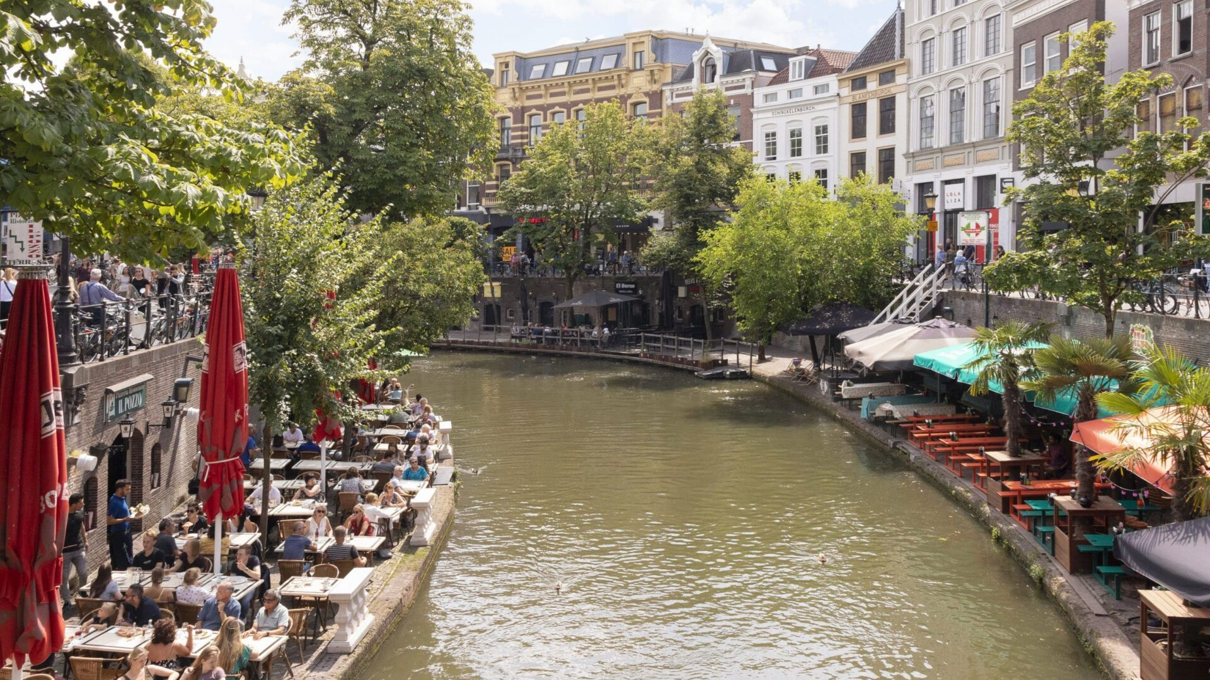
Binnenstad

Slide 2
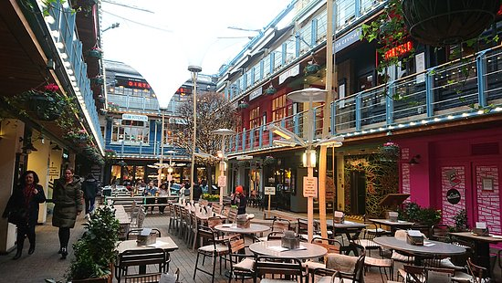
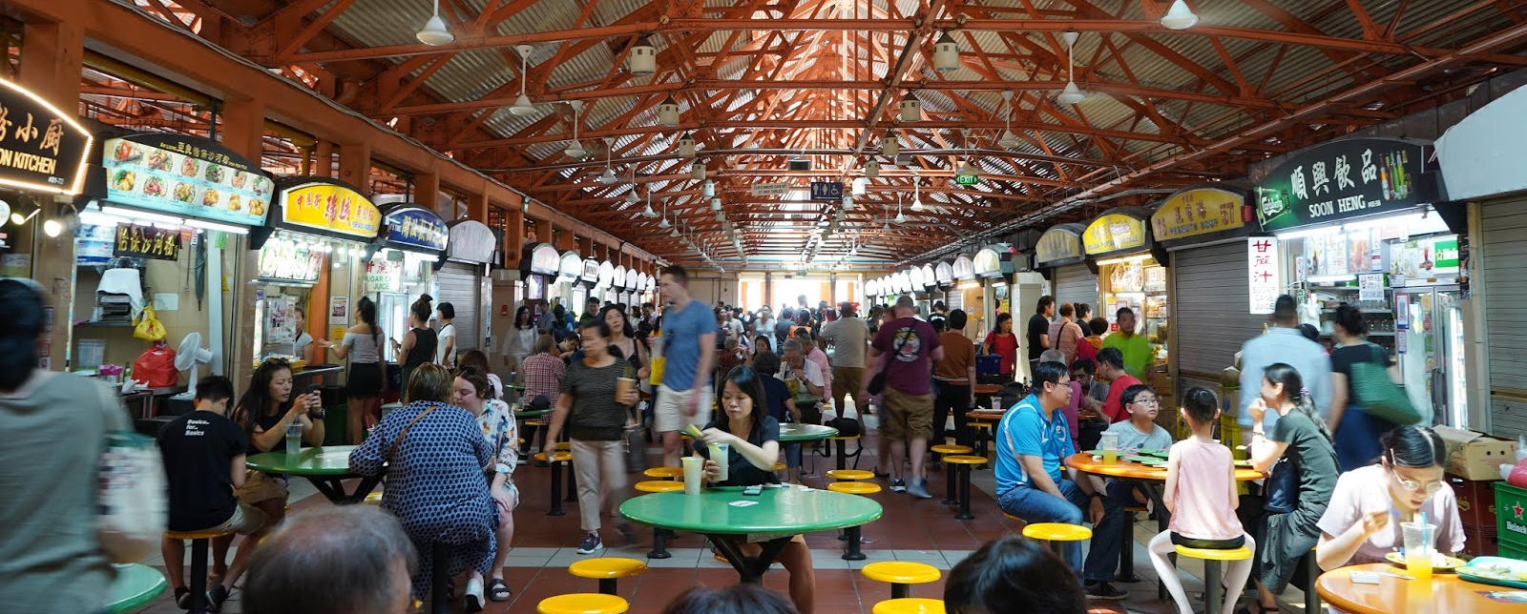
Foodcourts
Singapore & Londen
Uniek en alternatief
Foodtrucks, kleine stallen of volledige restaurant/café/bar
Uniek, belevenis, gezamenlijk gevoel
Digitalisering
Kingly Court Carnaby - Londen
These community hubs will give people pride in their town centres again.
This move towards being a loyal supporter of your high street is not going to go away.
Local authorities love the concept too.
Maxwell Food Centre - Singapore

