Slide 1
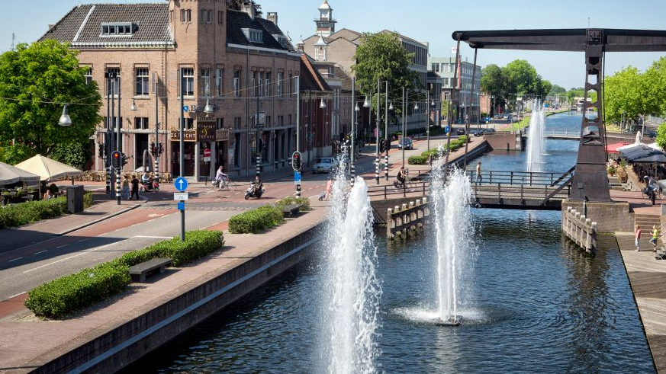
Helmond’s
Brainport Smart District

Slide 2
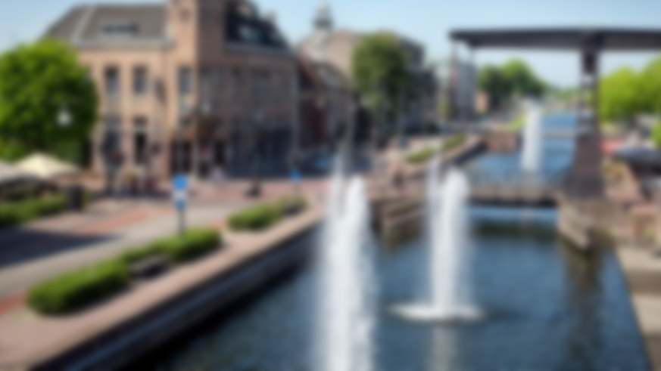
○
○
●
 |  | Wegbreedte (m) | Aantal bushaltes (m2) | Evenementen per maand | Groen (m2) | Kunst (m2) | Hoogte gebouwen (m) | Vuilnisbakken (m2) | Aantal zitplekken | Loopafstand (m) | App Budget
Rustig | 4 | + | + | * |  |  |  |  | * | +
Sfeervol | 2 | * |  | * | + | * | + |  | *
Veel ruimte | 3 | + |  |  |  |  | *
Bereikbaar | 5 | + | + |  |  |  |  |  |  | + | *
Schoon | 2 |  |  |  | + |  |  | +
Kleurrijk | 3 | * |  |  | + | + | *
Gezellig | 3 | * |  | * | * | * |  |  | *
Veel laadpunten | 5 | * | * |  |  |  | * |  |  |  | *
Veel wifi | 2 |  |  |  |  |  |  |  | *
Veel informatie | 2 |  | * |  |  |  |  |  | * |  | +
 |  | 185 | 125 | 45 | 85 | 55 | 85 | 20 | 65 | 90 | 70
Relationships:
▲ Highly positive
● Positive
○ Negative
▼ Highly negative
Relationships
✚ Strong relationship (10)
✽ Medium relationship (5)
_ Weak/no relationship (0)

