Slide 1
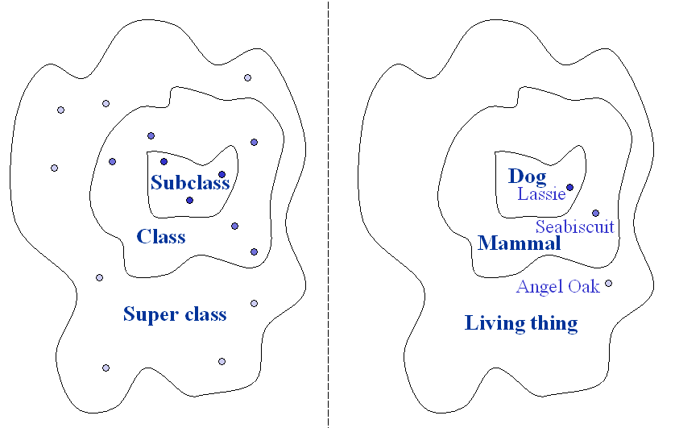
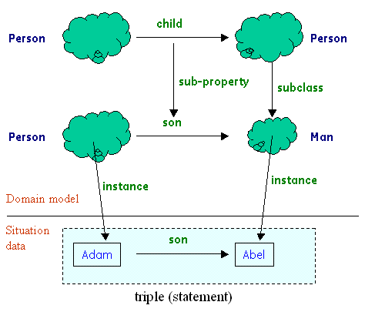
Semantic Modeling (Using SADL/OWL)
Models based on set theory:
  Formal, subset of first-order logic
  Computable (OWL DL)
Restrictions capture first-order logic:
gender of Person must be one of {Male , Female}.
a Person is a Man only if gender has value Male.
a Person is a Mother only if child has at least 1 value,
gender has value Female.
Rules capture domain logic, calculations:
Rule UncleDefined
given x is a Man
y is a Person
z is a Person
p is a Person
if x is child of p
y is child of p
x != y
z is child of y
then x is an Uncle
x is uncle of z .
Rule AreaOfRectangle
given x is any Rectangle
then area of x = height of x * width of x .
Models consist of:
  Instances (occurrences of things, ideas)
  Classes (categories of instances)
  Properties (attributes, relationships)
  Hierarchies of classes, properties
  Statements about specific instances
References:
OWL: http://www.w3.org/2004/owl
SADL: http://sadl.sourceforge.net

Slide 2
What’s a Semantic Model Good For?
Reusable Domain Model
  Equipment structure, configuration
  Business strategy
Reasoning
  Compute logical implications, numerical values, etc.
Consistency Checking
  Is input (situation data) valid?
Model-Driven User-Interface
  Configure user-interface based on equipment type, user, etc.
Example Domains Modeled To-Date
  Equipment maintenance
  Equipment configuration
  Data provenance in multi-level security environment
  Security policy
  Smart Grid network model tracing and validation

