Slide 1
Adam
Eve
Man
Woman
Cain
Abel
Person
A
A
A
A
A

Slide 2
property p
Domain
Range

Slide 3
Domain
property p
Range
Domain
Mediating Concept
Range
property p1
property p2
Other Information about property p

Slide 4
Domain
property p
Range
subclass
subclass
Role
Role
Domain
Mediating Concept
Range
property p1
property p2
Other Information about mediating concept

Slide 5
Man
wife
Woman
subclass
subclass
Husband
Wife
Man
Marriage
Woman
husband
wife
Other Information about mediating concept

Slide 6
Man
wife
Woman
Man
husband-in
Marriage
wife-in
Woman
where
when
Place
Date/Time

Slide 7
property p
Domain
Range
t-box
a-box
property p
Subject
Object
triple (statement)

Slide 8
child
Person
Person
sub-property
subclass
son
Person
Man
instance
instance
t-box
a-box
son
Adam
Abel
triple (statement)

Slide 9
child
Person
Person
sub-property
subclass
son
Person
Man
t-box
instance
instance
a-box
son
Adam
Abel
triple (statement)

Slide 10
Subclass
Dog
Lassie
Class
Seabiscuit
Mammal
Angel Oak
Super class
Living thing

Slide 11
Class
Class
Subclass 1
Subclass 2
Separation created
by differentiae

Slide 12
Subclass
Dog
Lassie
Class
Seabiscuit
Mammal
Angel Oak
Super class
Living thing

Slide 13
shapes-top.sadl
import
shapes-specific.sadl
import
shape-rules.sadl
import
shapes-test.sadl

Slide 14
child
Person
Person
sub-property
subclass
son
Person
Man
instance
instance
Domain model
Situation
data
son
Adam
Abel
triple (statement)

Slide 15
Person
(Parent)
child
Person
(Child)
sub-property
subclass
Person
(Parent)
son
Man
(Son)
instance
instance
Domain model
Situation
data
son
Adam
Abel
triple (statement)

Slide 16
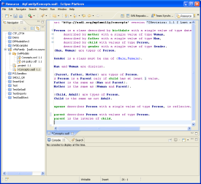
Develop
Deploy Application
SADL Models
OWL Models
Rules
Repository,
e.g, CVS
Clients
Diffs
SADL-IDE
Data, Query
SADL Models
OWL Models
Rules
OWL Models
Rules
Response
Server Disk
Local Disk
Reasoner/
Rule Engine:
Select one of
Multiple Available
Reasoner/
Rule Engine:
Select one of
Multiple Available

Slide 17
Dog
Mammal
Cow
Horse
Cat

Slide 18
Dog
Mammal
Cow
Horse
Cat

Slide 19
SportsEquipment
Bicycle
Vehicle

Slide 20
Birth
is a
location
latitude
38.186111
child
George

Slide 21
George
child
==
location
latitude
mother
==
latitude
==
weight
Philadelphia
is a
weight
mother
Birth
is a
is a
child
child
Samuel
Ruby

Slide 22
Hat
Man
is a
is a
is a
Boots
friend
owns
color
is a
owns
?
part
is a
color
Color
Buckle
is a
is a
Silver

Slide 23
Everything
⟙
class hierarchy
A B C D E … W X Y Z
⊥
Nothing

Slide 24
N1
new model
imports
M1
starting model
imports
imports
M2
M3
imports
imports
imports
M4
M5
M6
imports
M7
knowledge base

Slide 25
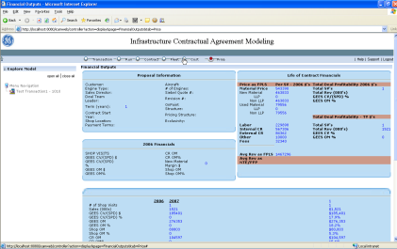

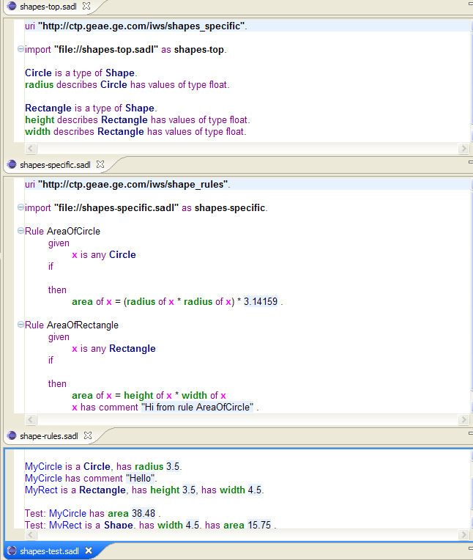
Model Delivery and Lifecycle Management
Web Clients
Application Clients
Conclusions
SADL-IDE: Editing and
Testing Environment
End-Users
Situation
SADL
Models
OWL
Models
+
SWRL or
Jena Rules
Web Service
Reasoner
and
Rules Engine
(Jena or Pellet)
SADL Server
Repository and
Version Control
Experts
IT

Slide 26

SADL Translator/Reasoner Plug-in Pairs
Model Developer View
Client
Client View
SADL IDE
ISadlServer (Java API, JAX-WS, Predix)
Query
Model
ID
Data*
Query
Result
SADL
Editor
Query
Translator
Concept
+
Rule
Translator
Query In
Reasoner
Specific
Format
Reasoner
Plug-in
SADL Server
Query
Translator
Query In
Reasoner
Specific
Format
Reasoner
Plug-in
Query
Results
ITranslator
Interface
IReasoner
Interface
ITranslator
Interface
IReasoner
Interface
Model
SADL Files
Files in Reasoner
Specific Format
Model
Local Disk
Local Disk
Or
HTTP Service
Source Code
Control System
Server View
*Data can be triples, RDF files (or streams), or CSV data with an identified mapping template.
Notes:
Accomplishment 3 cont: Revised V2 architecture providing for translator/reasoner pairs with optimized translation.

Slide 27



SADL Architecture
Client
Interface
Developer
Consumer
SADL Model
-----
OWL Model
Rules
SADL FILE
Reasoner
Translator/ Reasoner
OWL Model
Rules
T&R Config
Reasoner Config

Slide 28
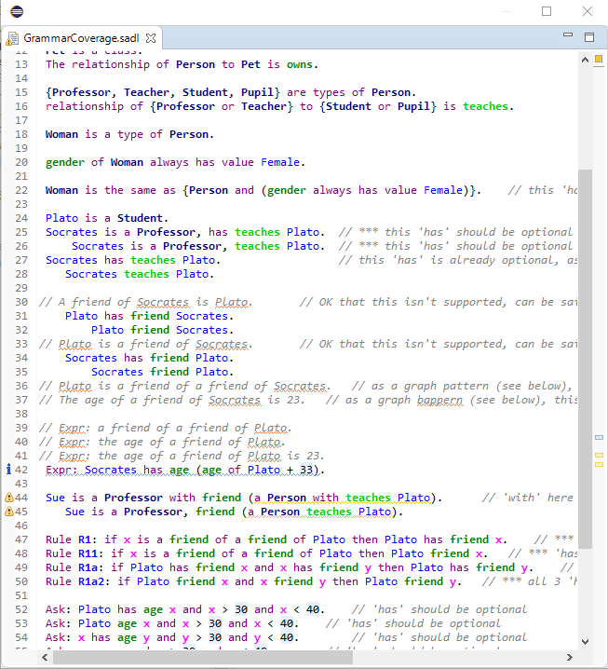
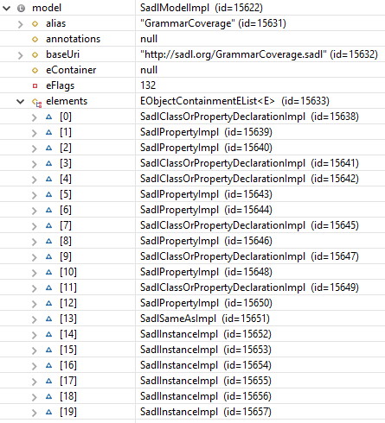
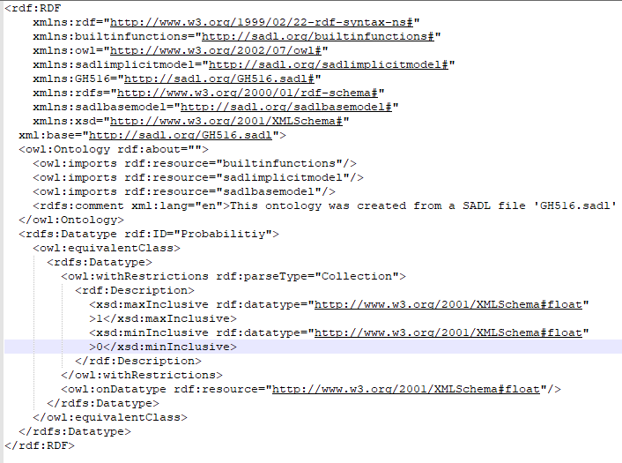

Xtext/ANTLR
Parser
Inferred Model,
Query and Test Results
Model in SADL grammar as defined
in Sadl.xtext
SadlModel AST in EMF
Markers:
Error,
Warning,
Info
Target
Reasoner
JenaBasedSadl-ModelProcessor
Model
Elements
Rules, Queries
OWL Model
JenaBasedSadl-ModelValidator
Target
Translator
In-memory Rules, Queries, Tests, etc. in Intermediate-Form
JenaBasedSadl-InferenceProcessor

