Slide 1
Innovation with the European Central Bank
Marcelle September 2017

Slide 2
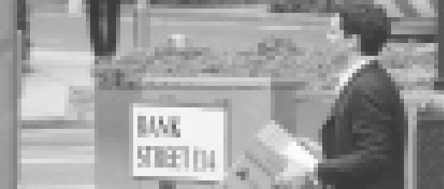
Sept 12 - 2008

Slide 3
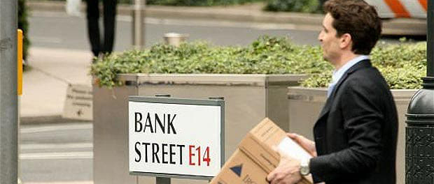
Sept 12 - 2008
The Friday before the fall of Lehman Brothers…

Slide 4
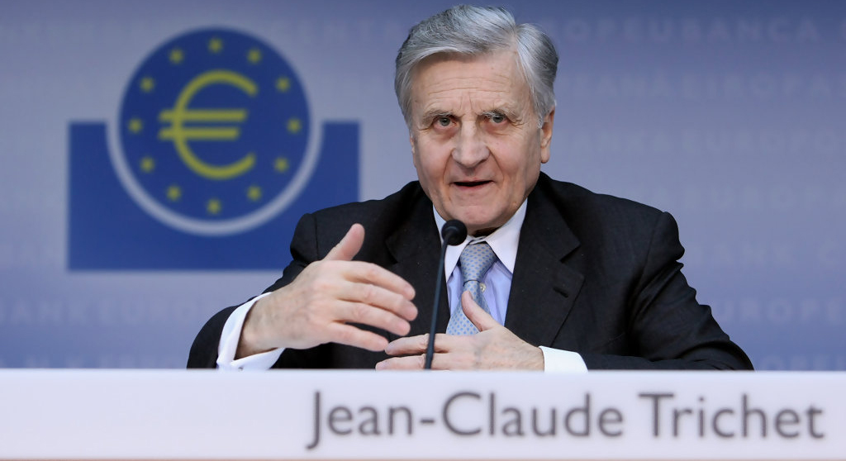

Slide 5
TRY-IT-OUT-OVATION

Slide 6

See Your
Results Soon….

Slide 7

Our Real Target….

Slide 8
Our Real Target….

Slide 9
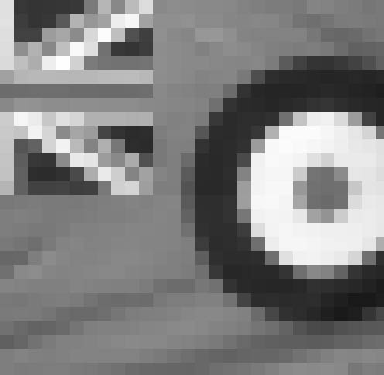
Early View with
Try-It-Out-Ovation

Slide 10

Final Result with
Try-It-Out-Ovation

Slide 11
Thank You

