Slide 1
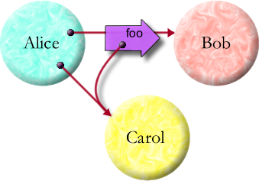
Robust Composition:
Towards a Unified Approach to
Access Control and Concurrency Control
by Mark S. Miller
Tuesday March 28, 2006

Slide 2
Talk Overview
Research question
  Programs as plans. Plan interference hazards
  Controlling access & concurrency
Approach
  Robust composition by controlling interaction
Example & Demo (time permitting)

Slide 3
Research Question
Programmers express plans for machines to run
    Plan must handle all relevant contingencies
    Danger: explosive case analysis
Plan Coordination =
    plan composition (realize cooperative opportunities)
    + plan separation (avoid destructive interference)
OO works “in the small” – local, sequential, benign
    Abstraction reduces relevant cases
Can we support plan coordination at Internet scale?
    asynchronous, distributed, possibly malicious
    Existing separate solutions don’t compose well

Slide 4
Progress vs. Consistency?
(concurrency control)
Progress
Communicating
event loops
?
Shared-state concurrency
Deadlock
Interference
by interleaving
Consistency
Notes:
Walk-in HP logo

Slide 5
Functionality vs. Security?
(access control)
Applications
User’s Authority
Cooperative
?
Dynamic Least Authority
Static Sandboxing
Applets
No Authority
Isolated
Dangerous
Safe
Notes:
Walk-in HP logo

Slide 6
Purposes and Hazard
(interaction control)
Minimal adequate
interaction
Compositional
purpose
?
Conventional tradeoffs
Isolation
Interference
hazards
Safe separation
Notes:
Walk-in HP logo

Slide 7
Simultaneous Problems
Excess authority invites abuse (viruses, spyware)
Interleaving causes inconsistency
Excluding interleavings cause deadlock
Inter-machine latency delays distributed plans
Partial failures (disconnects and crashes) demand diverse recovery strategies
Novelty: Integration and linguistic support,
Interaction control by reference states & transitions

Slide 8
Reference states & transitions
Causal transmission depends on state
RESOLVED
UNRESOLVED
near
EVENTUAL
local promise
resolve
REMOTE
remote promise
far
partition
broken

Slide 9
Robust Composition Challenges for Internet-scale distributed computing
Extend virtues of oo-languages …
  … among mutually suspicious objects
  … on mutually suspicious machines
  … without undue vulnerability.
Let objects interact asynchronously…
  … in partially predictable order
  … with distant machines
  … that may not be reachable.

Slide 10
Extend virtues of oo-languages …
Alice says: bob.foo(carol)
abstraction & composition, rapid prototyping
precise semantics, compact familiar notation

Slide 11
… among mutually suspicious objects …
Object-capabilities: Reference Graph == Access Graph
Absolute encapsulation—causality only by messages
Only references permit causality
Graph limits what’s possible

Slide 12
… on mutually suspicious machines …
Object
Reference
Message
Vat/Process
Machine
Pluribus: cryptographic capability protocol
Kernel-E: safe mobile code

Slide 13
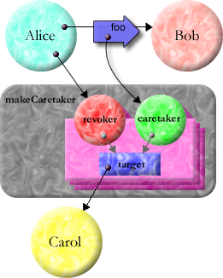
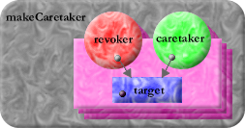
… without undue vulnerability.
Alice says: def [carol2, carol2revoker] := makeCaretaker(carol)
bob.foo(carol2)
def makeCaretaker(var target) :any {
def caretaker {
match [verb :String, args :any[]] {
E.call(target, verb, args)
} }
def revoker {
to revoke() :void {
target := null
} }
return [caretaker, revoker]
}
target

Slide 14



Let objects interact asynchronously …
Cell
statusChanged
3
3
statusChanged
myListeners
Isolated Turns
Mutually exclusive access to all that’s synchronously accessible
No explicit locking
balance
balance says:
cell <- statusChanged(3)
setStatus
acctMgr says:
balance.setStatus(3)
acctMgr

Slide 15
Let objects interact asynchronously …
delta
foxtrot
tango
bravo
zulu
charlie
Turns are isolated units of operation

Slide 16
… in partially predictable order …
A
x
B
z
Alice says:
y
Bob says:
z
carol <- w()
bob <- x(carol)
carol <- y()
carol <- z()
w
C
FIFO <= E-ORDER <= CAUSAL
enforced by protocol

Slide 17
… with distant machines …
def r3 := (x <- a()) <- c(y <- b())
Expands to...
def r1 := x <- a()
def r2 := y <- b()
def r3 := r1 <- c(r2)
Messages always move
towards arrowhead.
x
r1
c
r3
a
r2
X
y
b
Y

Slide 18
… that may not be reachable.
RESOLVED
UNRESOLVED
near
Near: “.” & “<-”
    local objects
Eventual: only “<-”
    promise or remote
    lock-free atomicity
Broken: complains
    Reify partition
    NaN-like contagion
EVENTUAL
local promise
resolve
REMOTE
remote promise
far
partition
broken
Unresolved Promises
    Results of “<-”
    pipeline messages
Off-line Caps (unshown)
    Reify right to reconnect

Slide 19



Example: Alice pays Bob
def payment := myPurse <- makePurse()
payment <- deposit(10, myPurse)
bob <- buy(..., payment)
when (payment) -> ... {
when (myPurse <- deposit(10, payment)) ... {
... # dispense value
}
}
buy
makePurse
deposit
deposit
mint
$0
$10
name
sealer
unsealer
$100
$200
$90
$210

Slide 20
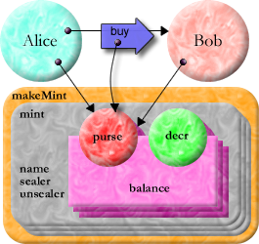
Distributed Secure Money in E
def makeMint(name :String) :any {
def [sealer, unsealer] := makeBrandPair(name)
def mint {
to makePurse(var balance :(int >= 0)) :any {
def decr(amount :(0..balance)) :void {
balance -= amount
}
def purse {
to getBalance() :int { return balance }
to makePurse() :any { return mint.makePurse(0) }
to getDecr() :any { return sealer.seal(decr) }
to deposit(amount :int, src) :void {
unsealer.unseal(src.getDecr())(amount)
balance += amount
} }
return purse
} }
return mint
}
No explicit crypto

Slide 21
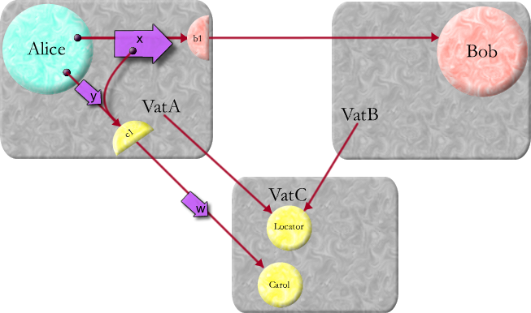
Enforcing E-Order
Alice says:
carol <- w()
bob <- x(carol)
carol <- y()

Slide 22
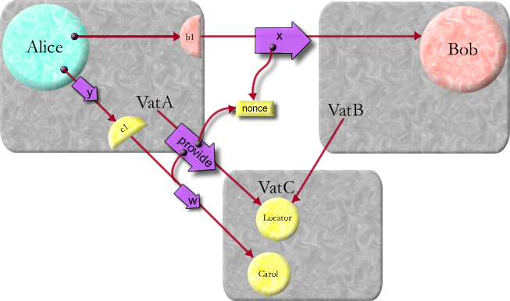
Enforcing E-Order
VatA says:
bob <- x([cVatID,nonce])
cLocator <- provide(carol,nonce)

Slide 23
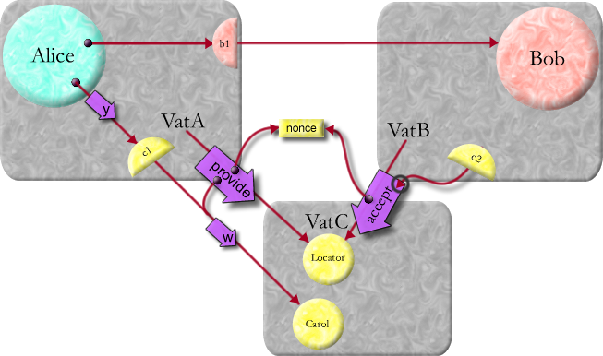
Enforcing E-Order
VatB says:
def c2 := cLocator <- accept(nonce)

Slide 24
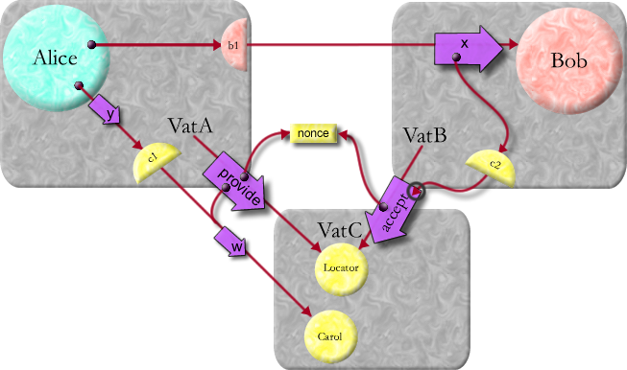
Enforcing E-Order
VatB says:
bob <- x(c2)

Slide 25
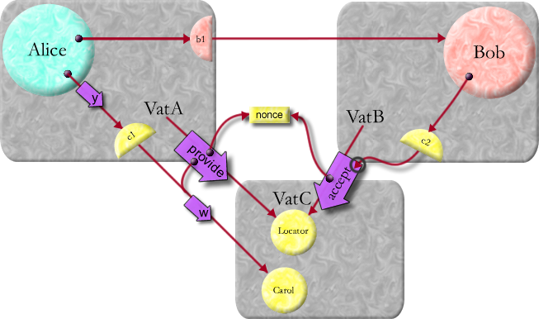
Enforcing E-Order

Slide 26
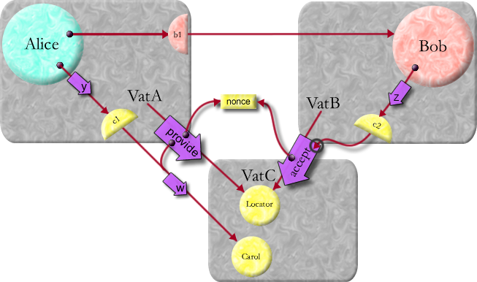
Enforcing E-Order
Bob says:
c2 <- z()

Slide 27

Enforcing E-Order

Slide 28
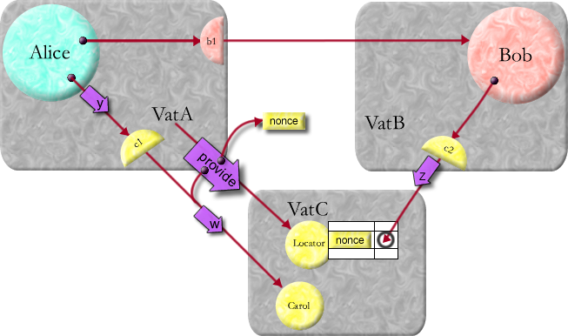
Enforcing E-Order
cLocator says:
map[nonce] := c2r

Slide 29

Enforcing E-Order

Slide 30
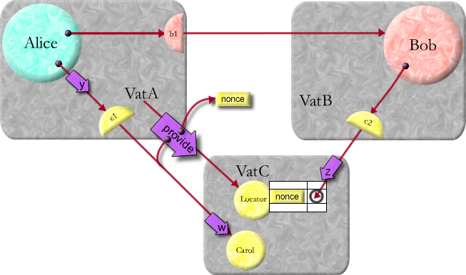
Enforcing E-Order

Slide 31

Enforcing E-Order

Slide 32
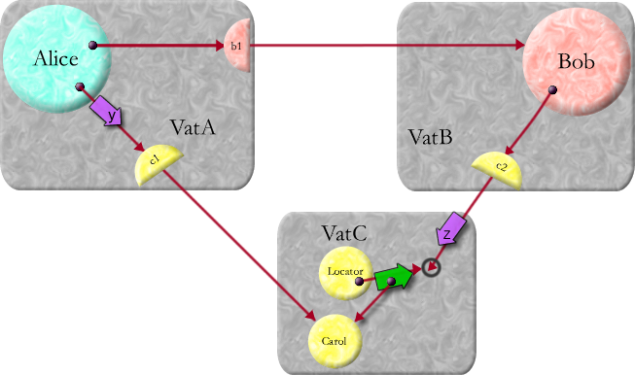
Enforcing E-Order
resolve
cLocator says:
c2r.resolve(carol)

Slide 33
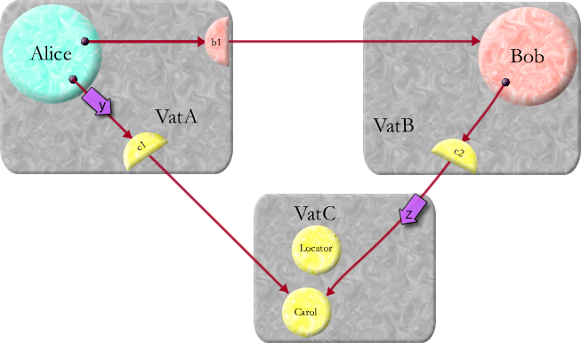
Enforcing E-Order

