Slide 1
Crowdsourcing Multiverse Analyses to Examine the Robustness of Research Findings
Tom Heyman, Leiden University
Erin M. Buchanan, Harrisburg University of Science and Technology

Slide 2
Multiverse Analyses
An analysis in which a researcher may:
“perform all analyses across the whole set of alternatively processed data sets corresponding to a large set of reasonable scenarios” (Steegen et al., 2016)
Allows for the study of the robustness of the effect of analytic choices on the research results

Slide 3
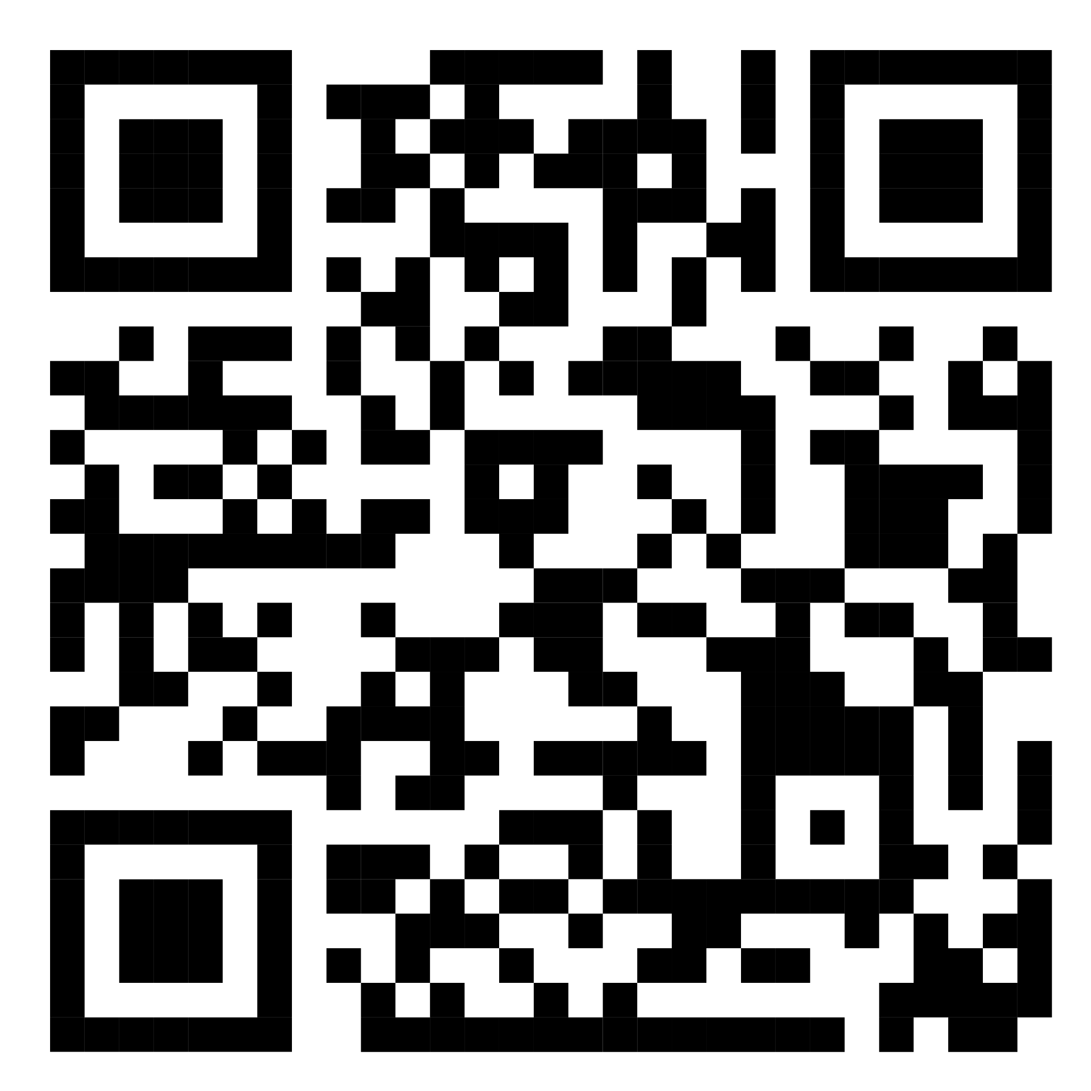
PSA007 Example: Semantic Priming
A large scale crowdsourced semantic priming study (ongoing)
Effect of interest: Unrelated word-pair trials versus Related word-pair trials
Tree - nurse (unrelated)
Doctor - nurse (related)

Slide 4
Step 1: Research Question
Clearly outline the substantive research question
Is there a semantic priming effect?
Are there differences in priming across languages?

Slide 5
Step 2: Expert selection
Identify experts in the field via:
Literature search
Personal network
Snowball procedure

Slide 6
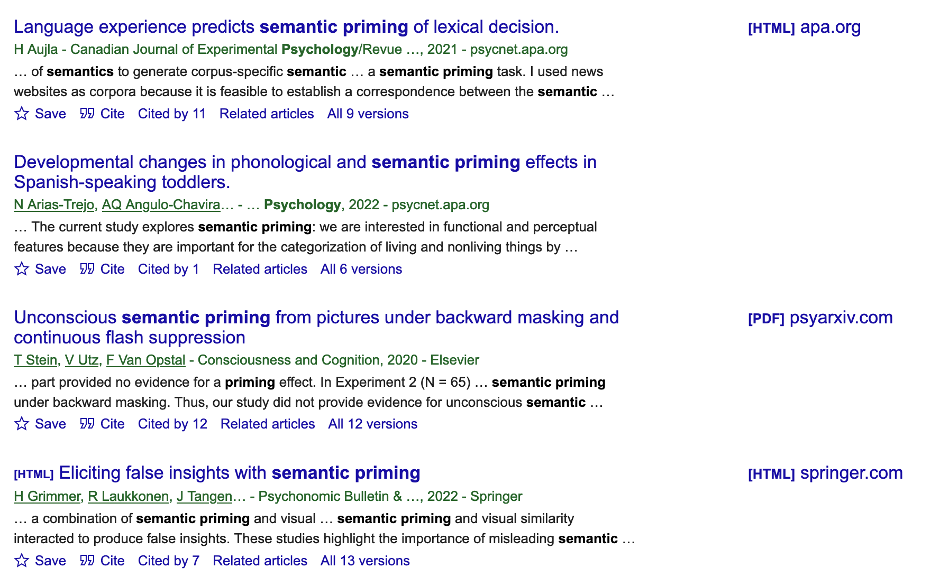
Step 2: Expert selection

Slide 7
Step 3: Elicit analysis pathways
Identify analysis degrees of freedom through:
Survey of experts from step 2
Use corresponding author meta-data to email experts
Inspection of the articles from the literature search in step 2
Meta-analytic coding of pathways considered

Slide 8
Step 3: Elicit analysis pathways
Data cleaning (elimination of individual trials, participants, outliers, etc.)
Dependent variable (z-scored, transformed, subtracted response latencies)
Statistical Analysis (t-test, multilevel model, meta-analysis)
Inference decision criteria

Slide 9
Step 4: Combining pathways
Process the outcomes from step 3
Evaluate which pathways can be sensibly combined
Outliers + all analyses
Subtracted scores only on item level analyses (not multilevel models)

Slide 10
Step 5: Pathway validation
Experts are (again) asked to rate importance and suitability of pathways
Pathways are given weights that can be used to rank / select
Inferior pathways can be removed or receive less weight
Depending on feasibility one could select only the top X most suitable pathways
Outcome is the final multiverse of pathways to be applied to (newly collected) data

Slide 11
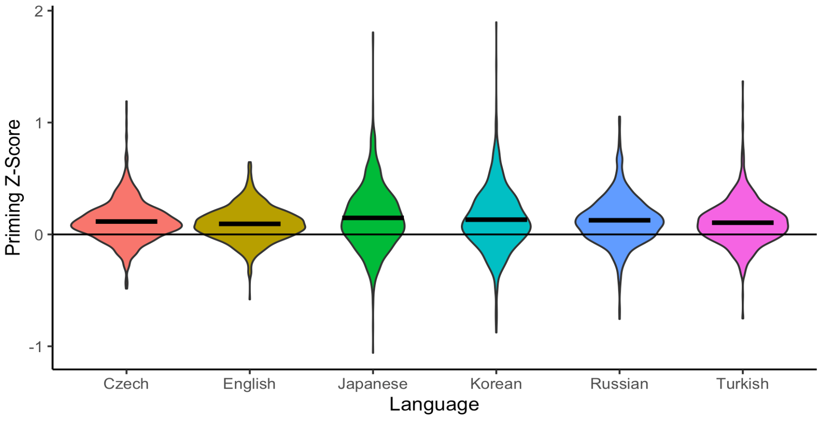
Example Results

Slide 12
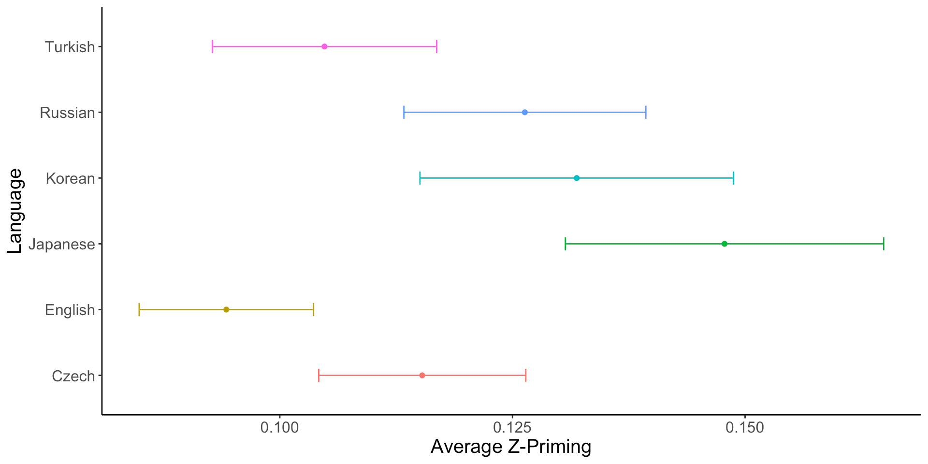
Example Results

Slide 13
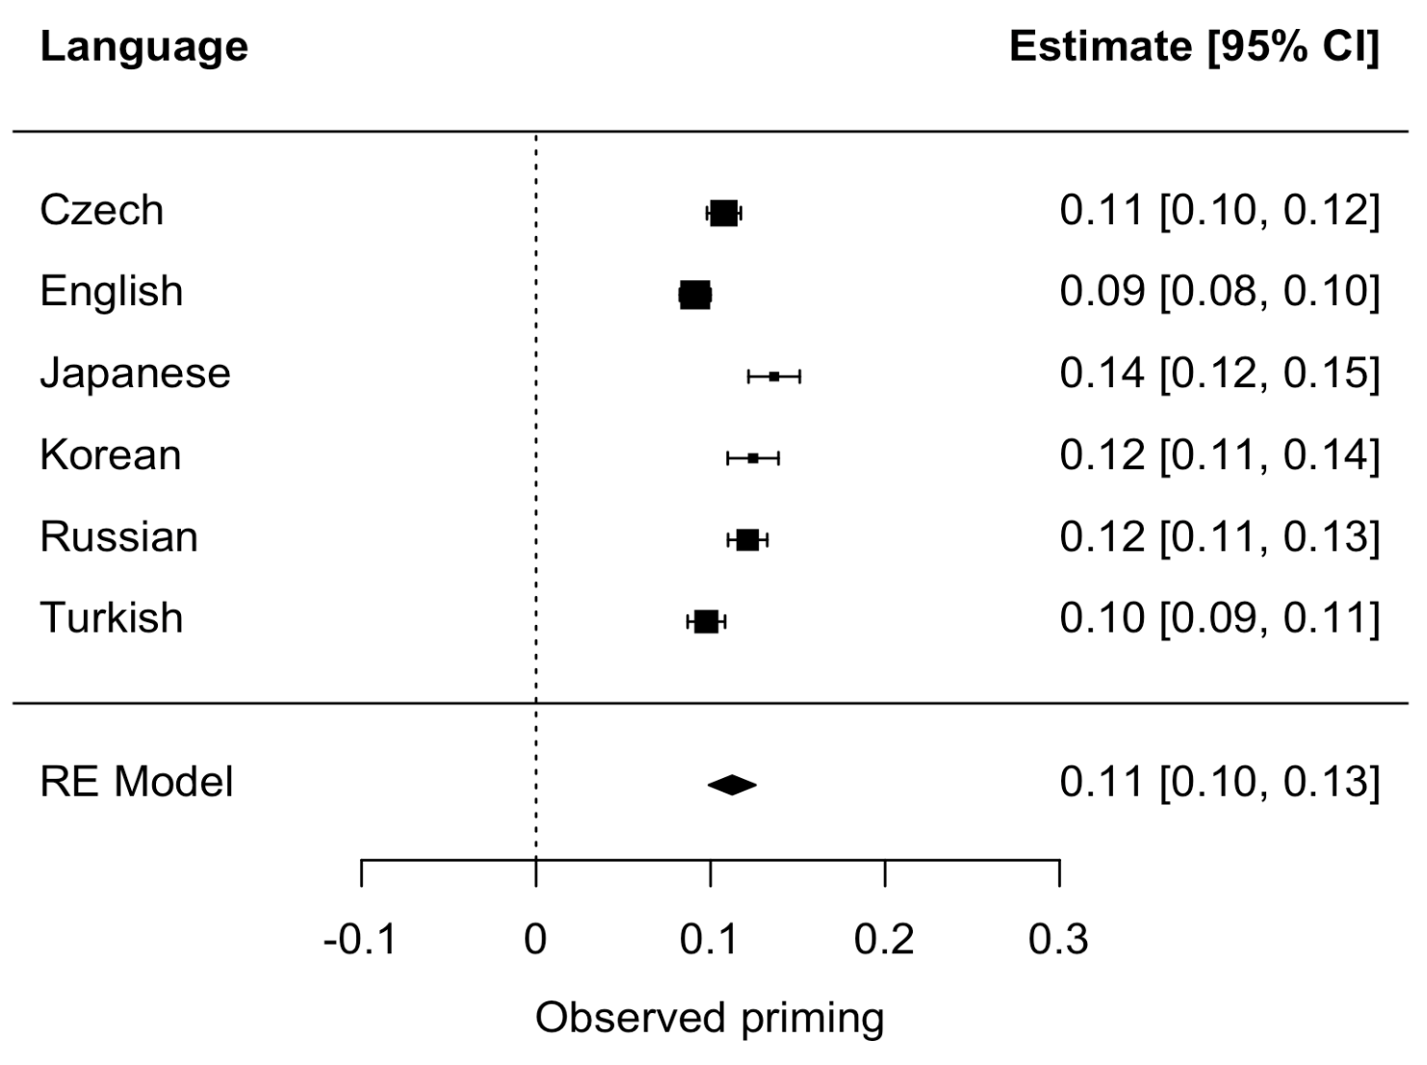
Example Results

Slide 14
Thanks and join us!
We are actively looking for collaborators to help coordinate this project.
If interested, email buchananlab@gmail.com.
Questions?

