Slide 1
BTS Comes for Linguistics
Semantic Priming Across Many - Languages

Slide 2
outline
What is Big Team Science?
What are some of the issues in BTS?
How has open/BTS impacted linguistics?
A BTS Linguistics Project: The SPAML

Slide 3






Big Team Science

Slide 4
Big Team Science
Collaboration = 2+ people working together
Big team science = BIG collaborations
10 plus authors at 10 plus institutions*
*we made this up

Slide 5
Big Team Science
Two types:
Individual projects: Open Science Collaboration, many others
Organizations: Psychological Science Accelerator, Many Xs, NutNet, DRAGNet

Slide 6
Big Team Science
Why BTS?
The internet!
Credibility revolution (“replication crisis” or “psychology’s renaissance”)
WEIRD Science

Slide 7
Big Team Science
Why BTS?
Change in incentives (easier to publish)
TOP Guidelines
Registered reports

Slide 8

Growing Pains – Project Management
No one was trained for this!
How do you manage so many people?
Tracking students after they graduate
IRBs across the globe
Translation

Slide 9
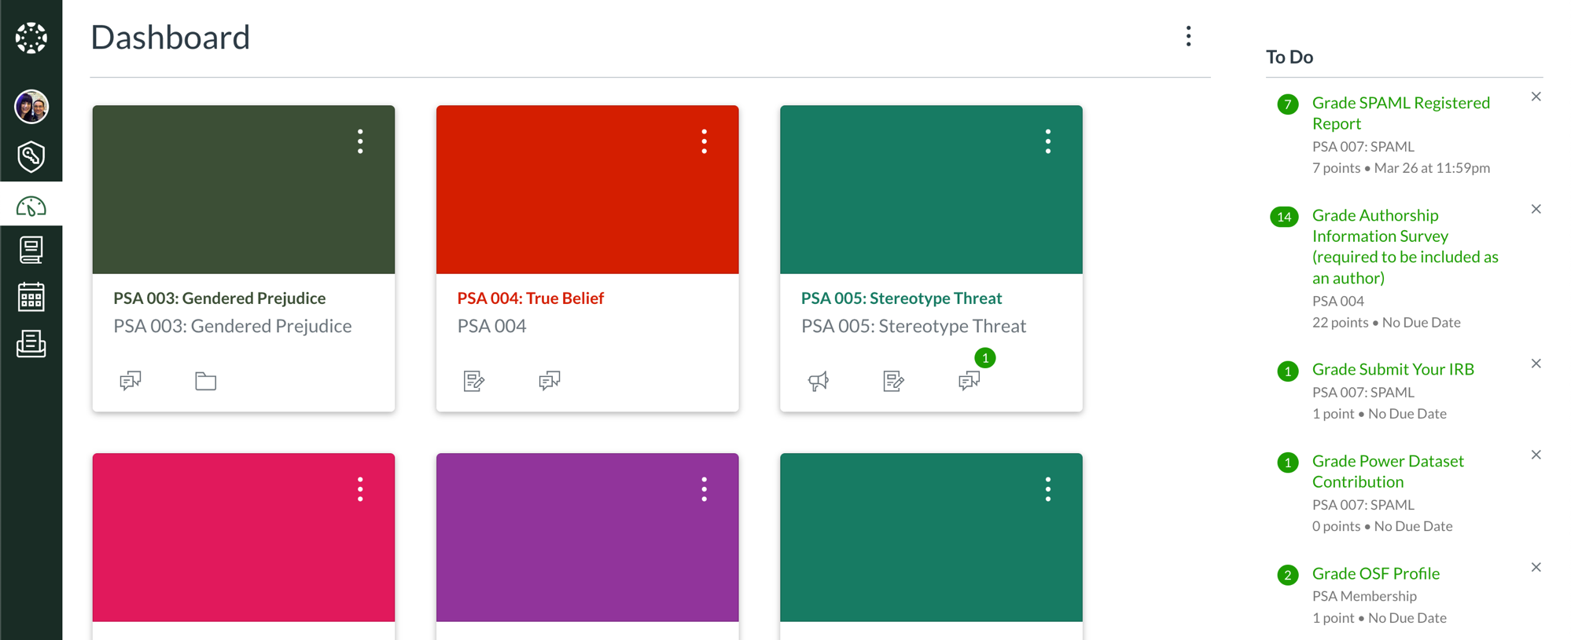

Slide 10

Growing Pains - CRediT
Contributor Roles Taxonomy
Not everyone can collect data
Incentivize other contributions (code review, management, programming)
Diversifying the people who do the things
Not all geopolitical regions work well together

Slide 11
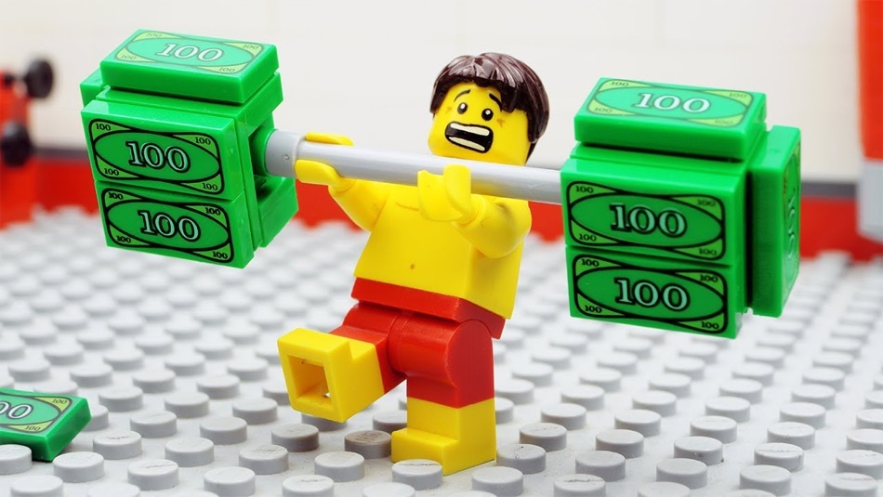
Growing Pains - Funding
Funding projects is terribly difficult
Funding infrastructure is even worse!
Comparison to the Open Science Framework

Slide 12

Growing Pains - Implementation
Consider some of the following:
Not everyone has access to paid software and tools (Qualtrics, Survey Monkey, SPSS)
Not all countries have open access to the internet (Google, Qualtrics)
Each lab may not have the skill set to run the study
Ensuring equality of methods between labs can be difficult
Combining datasets is a nightmare
Learning a new toolset for each study can be daunting

Slide 13

Growing Pains – Journals
Journals are not ready for Big Team Science
Page limits, authorship rules, and bad manuscript submission systems
Consortium authorships are not favored

Slide 14
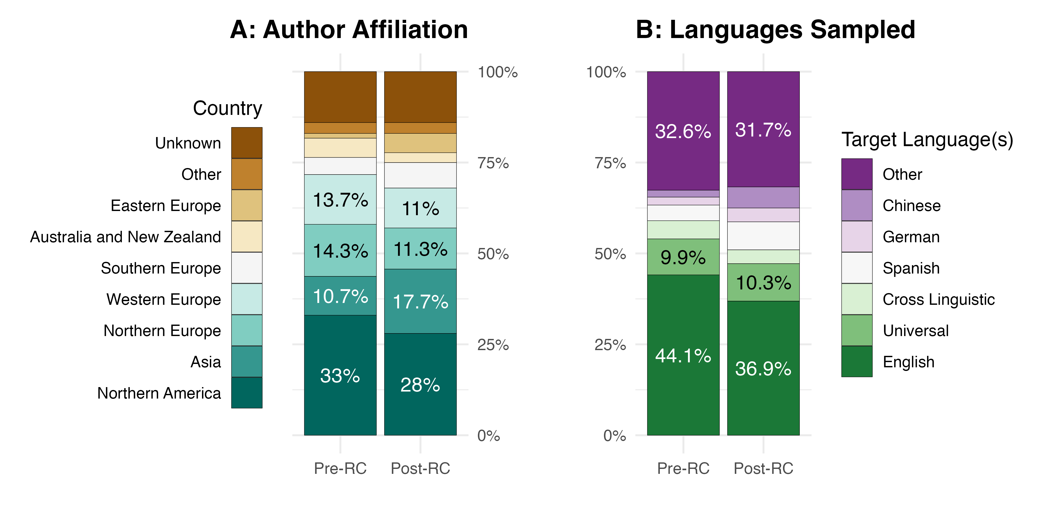
Open Science in Linguistics

Slide 15
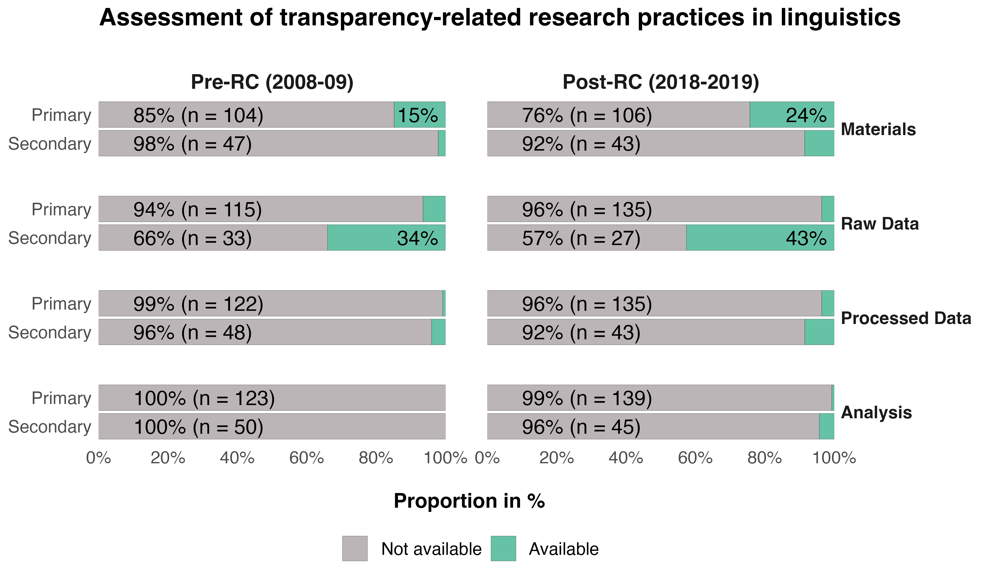
Open Science in Linguistics

Slide 16
Open Science in Linguistics
Not sure it’s all that bad!
Big corpora datasets
Influence of Natural Language Processing on the field

Slide 17
Bts In Linguistics
Semantic Priming Project*
Maybe more? Research TBD ... also biased!
PSA007: Semantic Priming Across Many Languages
*not sure it meets my made-up definition

Slide 18

Bts In Linguistics
The Psychological Science Accelerator
The PSA is a CERN for psychological science
Globally distributed network of researchers with more than 1000 members in 82 countries
Open science principles and practices

Slide 19
SPAML Overview
Cognitive
Psychology
Psycho-
linguistics
Computational
Linguistics

Slide 20
Semantic Priming
Semantic priming occurs when:
Target responses are facilitated (faster)
When a previously shown cue is related to the target

Slide 21
Semantic Priming
Priming measurement:
Lexical Decision Task
Naming Task

Slide 22
Semantic Priming
Words are linked in pairs:
Cue: doctor
Unrelated target: tree
Related target: nurse
Nonsense target: tren
https://psa007.psysciacc.org/

Slide 23
Semantic Priming
Semantic priming replicates pretty well
But not always …
Every lab has their words “that work”
How can we leverage the computational skills found in natural language processing with the open data publications to improve this research?

Slide 24
SPAML Goals
Assess semantic priming across (at least) 10 languages using matched stimuli
But not WEIRD stimuli
Provide a large-scale dataset for reuse in linguistics

Slide 25
How do You Even Stimuli?
Corpus Text Data: Open Subtitles Project
Freely available subtitles in ~60 languages for computational analysis
Approximately 43 languages contain enough data to be useable for these projects
The Subtitle Projects have had a serious impact on our field.

Slide 26
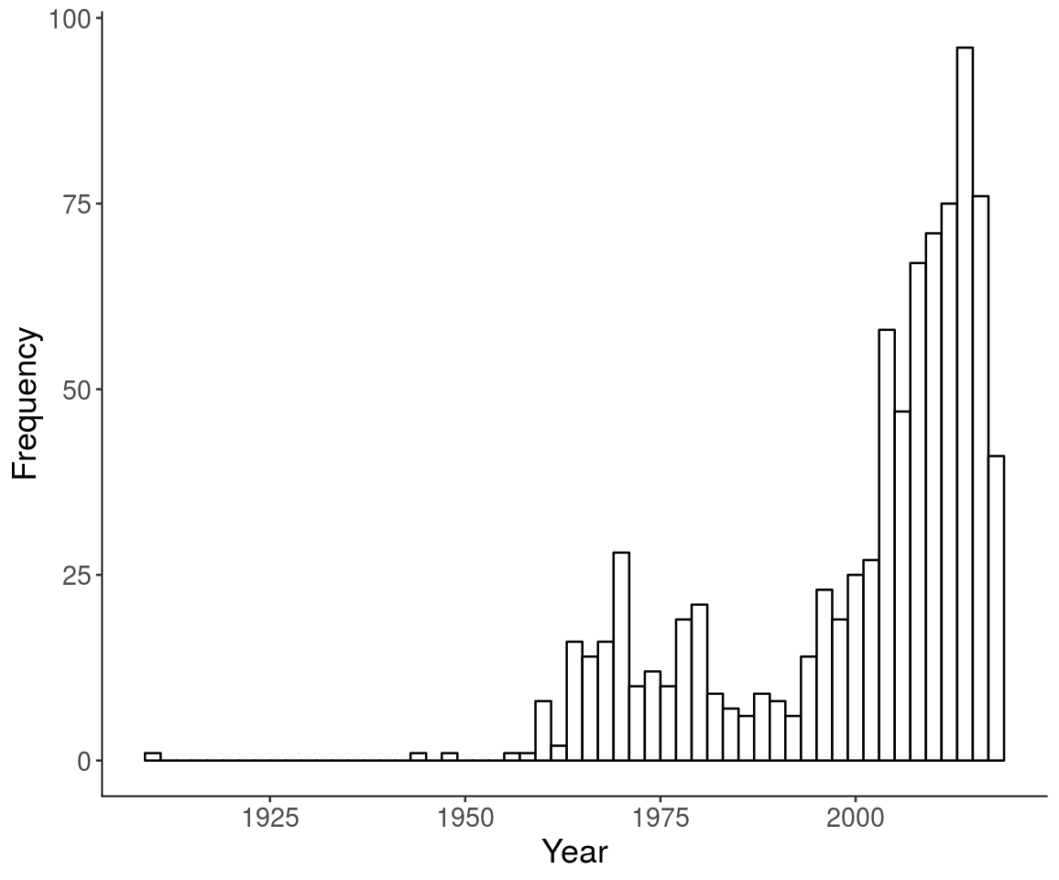

Slide 27
How do You Even Stimuli?
Selection Procedure:
Nouns, verbs, adjectives, and adverbs
Using udpipe, we can do this across many languages
Using word frequency, the top 10,000 words in each language were selected

Slide 28
How do You Even Stimuli?
Selection Procedure:
Similarity was calculated by using subs2vec project
Cosine is a distance measure of vector similarity, similar to correlation
Top five cosine values for each word were selected

Slide 29
How do You Even Stimuli?
Selection Procedure:
These data were merged together to create a dataset of possible stimuli across all languages (using translation)
1208416 number of pairs were found across the forty-four languages with an average overlap of 3.23% (2.70 to 70.27)
The pairs were sorted by language overlap to final selection

Slide 30
The Experiment
Semantic Priming Data
A single stream lexical decision task will be used
Trials are formatted as:
A fixation cross (+) for 500 ms
CUE or TARGET in uppercase Serif font
Lexical decision response (word, nonsense word)

Slide 31
The Experiment
Semantic Priming Data
This procedure creates data at many levels
Subject level: for every participant
Item level: for each individual item, rather than just cue or just concept
Priming level: for each related pair compared to the unrelated pair
Nonsense words have a purpose!

Slide 32
But Good Science Practices!
Power for non-hypothesis tests is tricky
AIPE: Accuracy in parameter estimation approach may be best (see anything by Ken Kelley)
Power to create a “sufficiently narrow” confidence interval
So, we simulated using the English Lexicon Project and Semantic Priming Project

Slide 33
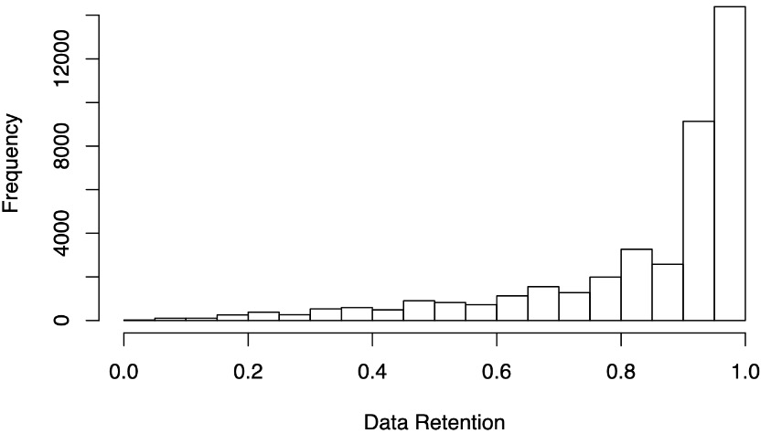
But Good Science Practices!
Expect about 84% data retention (people get things wrong, which you can’t use)

Slide 34
But Good Science Practices!
Calculated the standard error for response latencies
Randomally sampled from the data simulating n = 5, 10, … 200
At what point is the standard error of 80% of the samples < our target standard error?

Slide 35
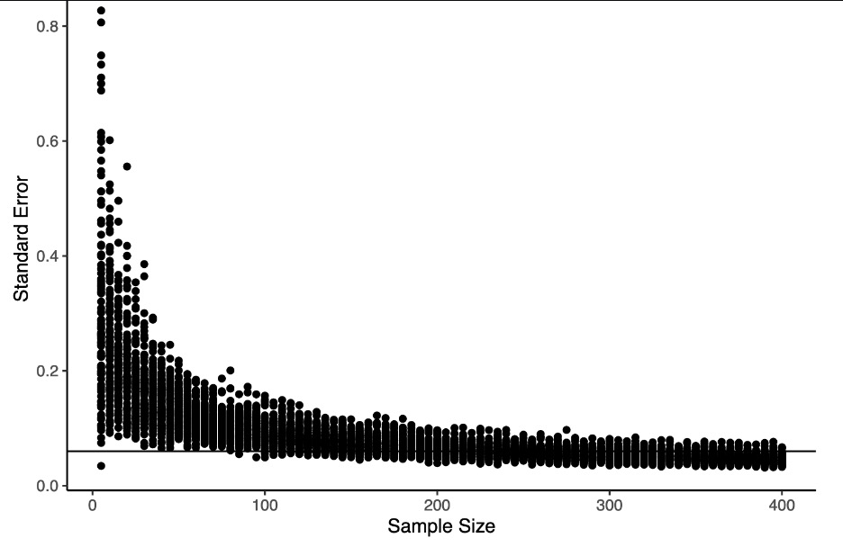
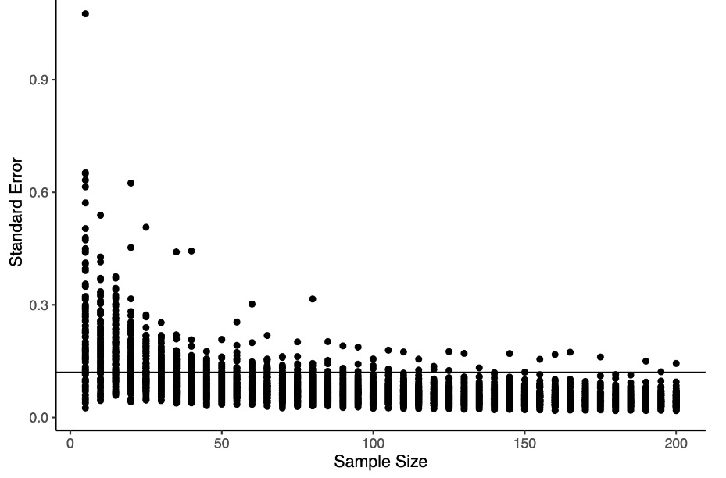
But Good Science Practices!

Slide 36
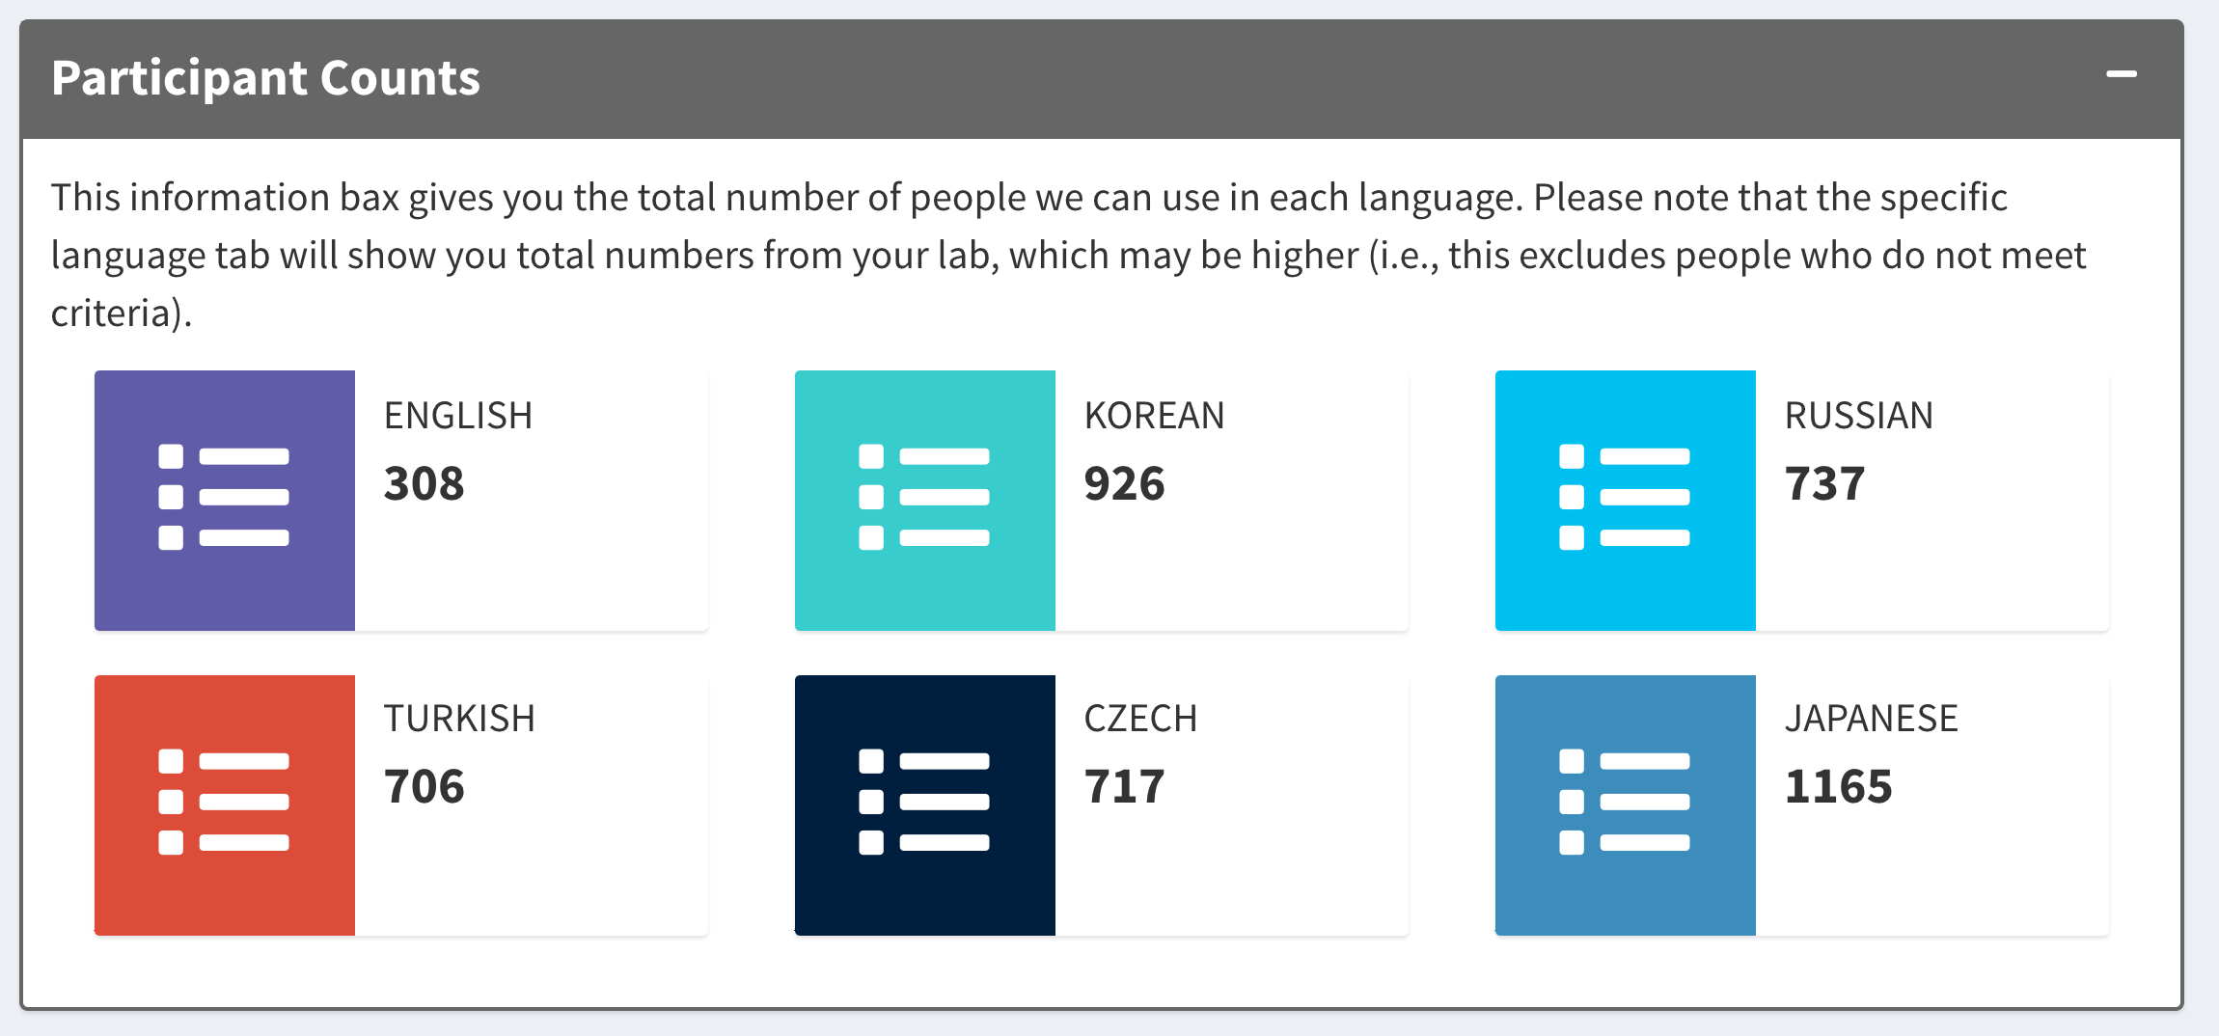
Ok, so…is there Priming?

Slide 37
Japanese
Accuracy:
Nonwords = 94%
Words = 96%
Related targets: 98%
Unrelated targets: 97%

Slide 38
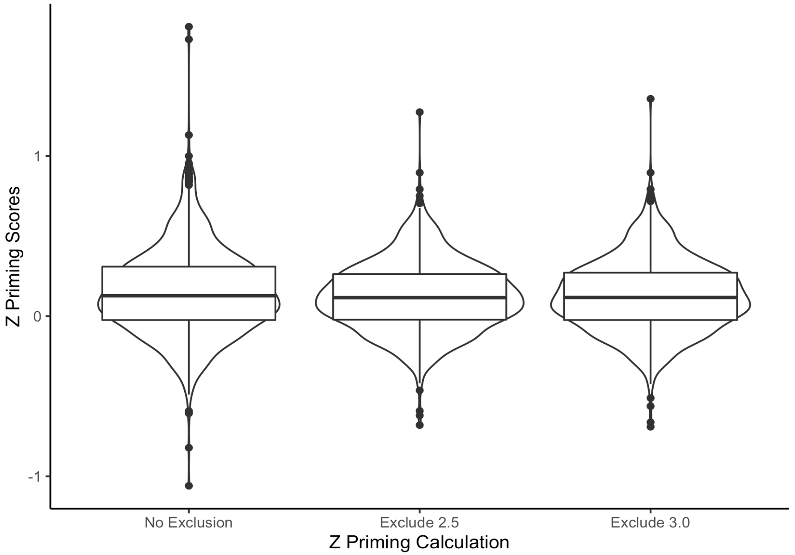
Japanese

Slide 39
Japanese
What worked?
Blind – deaf
Romeo – Juliet
Carnival – Festival
November – December

Slide 40
Japanese
What didn’t work?
Status - position
Fox – rabbit
Explanation – plausible
Report – inform

Slide 41
Summary
Big team science is hard
Linguistics is ripe for studies in this area to increase the breadth of language, researcher, and participants including
Japanese showed priming!! (!!)

Slide 42
Questions
All thoughts welcome!
https://github.com/SemanticPriming/SPAML/
Twitter: @aggieerin
Email: buchananlab@gmail.com
GitHub: doomlab

