Slide 1
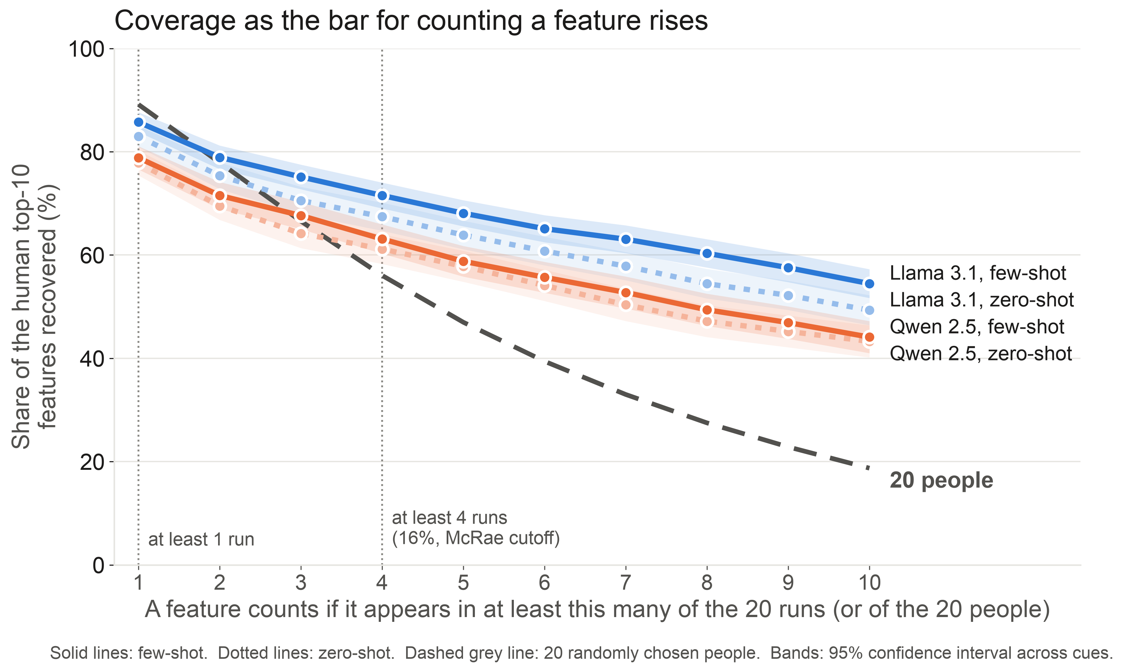
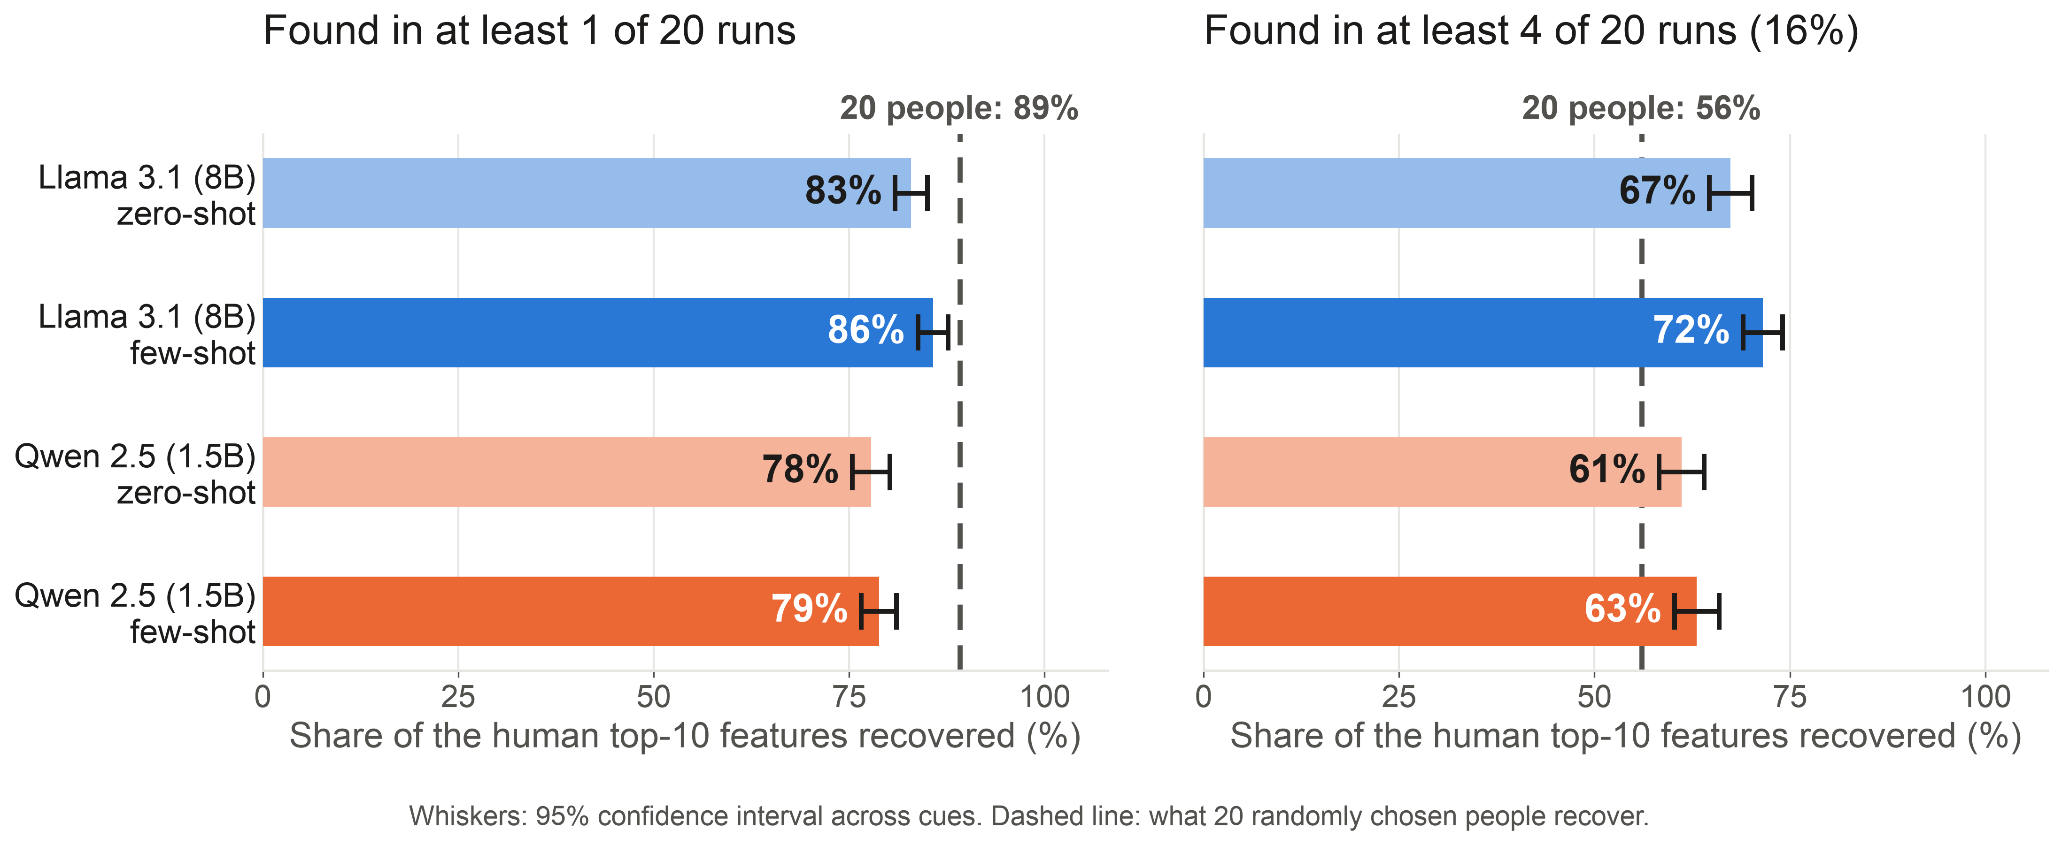
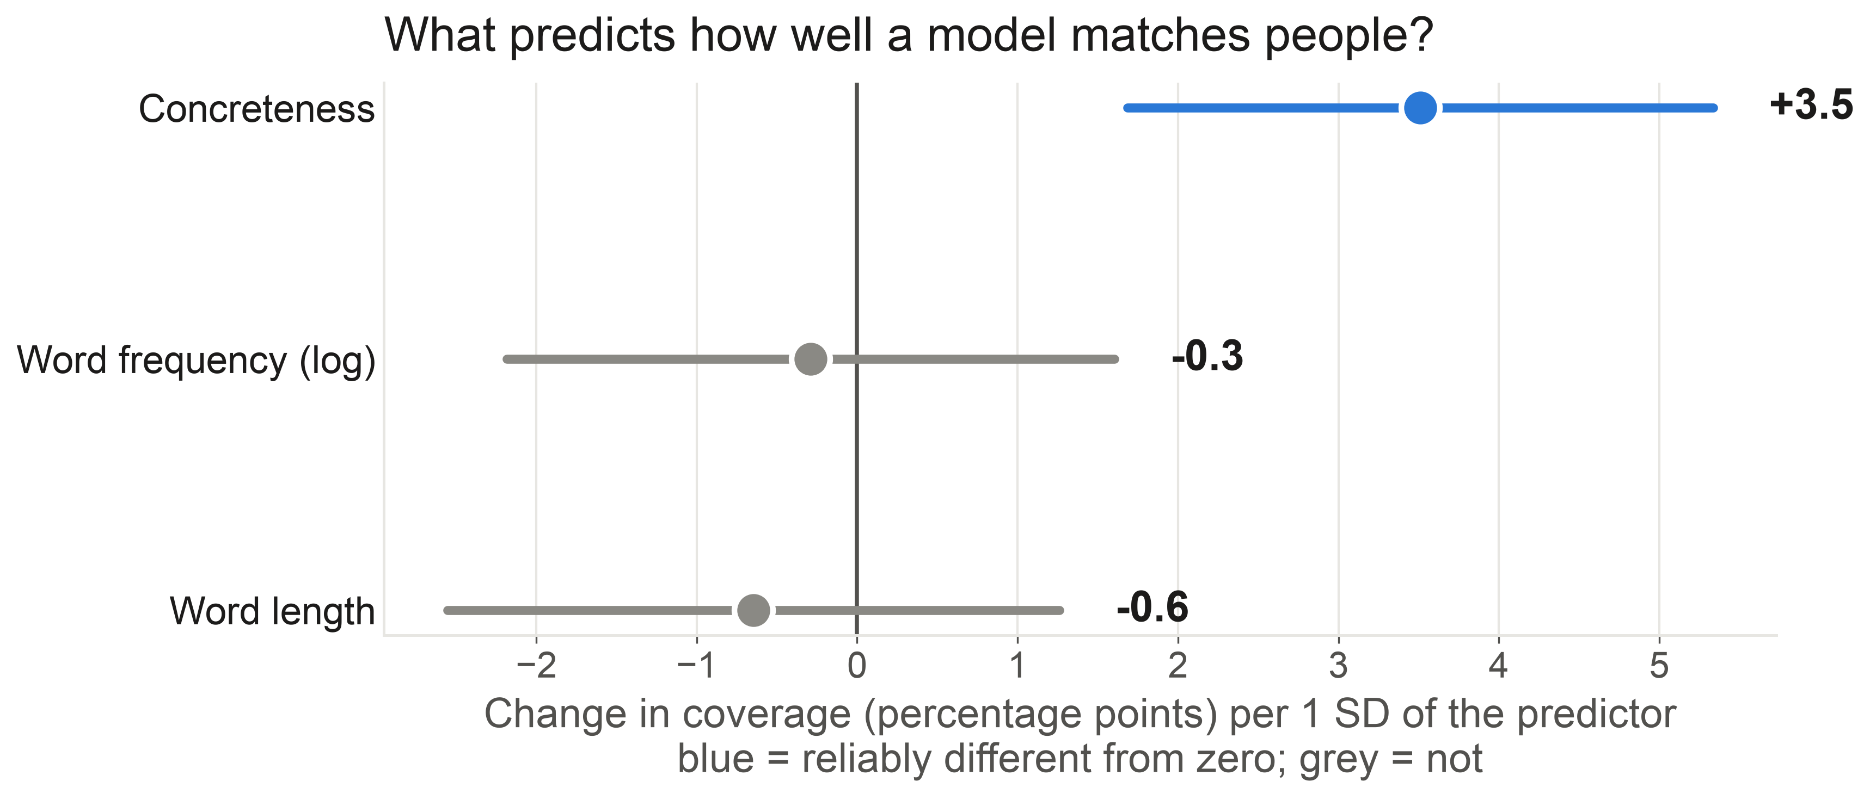
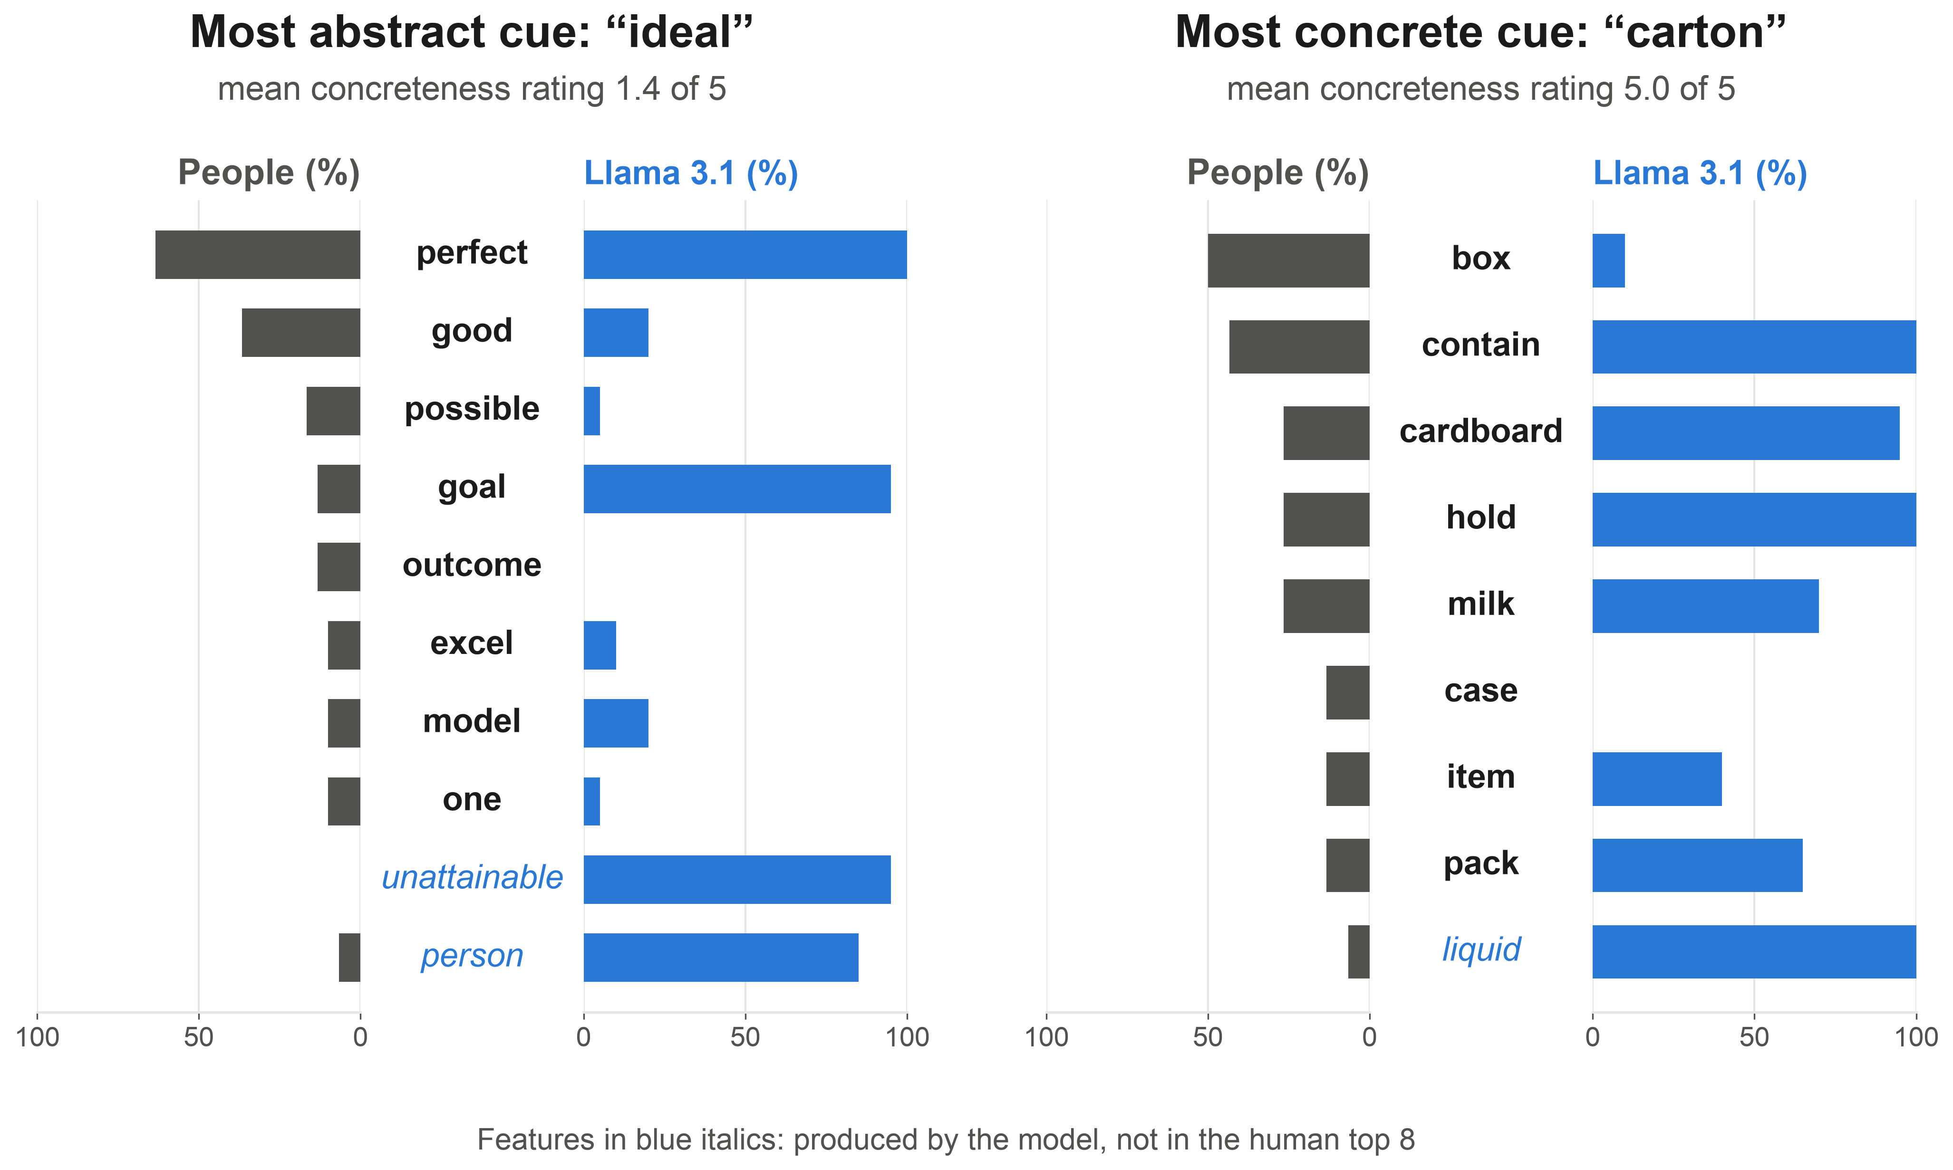
CAN LANGUAGE MODELS WRITE FEATURE NORMS LIKE PEOPLE DO?
Erin M. Buchanan [add co-authors]
Harrisburg University of Science and Technology
THE QUESTION
HOW IT WORKS
Models do the same task as people; both lists go through the same cleaning
Feature norms (people list what a word means) are slow and expensive to collect.
Can open language models write them? We gave two models the same instructions people had, and treated each model run as one virtual participant (20 per word).
We compared the lists with human norms for 200 words, each listed by 30 or more people.
1 The task
2 20 virtual people
3 Cleaned like people
4 Feature norms
5 Compared with people
Same instructions people had: list the properties of the word (alone, or with 8 real human lists)
Each model answers 20 times; every run is one participant
Spelling, numbers, stop words; related words merged (gambling = gamble)
Percent of runs that listed each feature, for each of 200 test words
Share of the human top-10 features the model also lists; ceiling = 20 real people
Example, one model run for “chair”: “has four legs, used for sitting, made of wood” → four · leg · sit · wood
THE HEADLINE
Llama 3.1 comes close to what 20 people produce; a repeat-only bar flips it
WHAT WE FOUND
Llama 3.1 (8B) recovers 86% of the features people list most. A sample of 20 people recovers 89%.
A much smaller model (Qwen 2.5, 1.5B) recovers 78-79%.
But count only each model's first 5 words (what a person writes) and Llama drops to 61%.
Showing the model real examples helps little (about +2 points).
Concrete words are a little easier (about +3.5 points per SD); word frequency and length do not matter.
Models beat 20 people at 4 of 20 runs because they repeat words; people spread over many different ones.
WHAT HELPS, AND WHAT IT LOOKS LIKE
LIMITS
Models write about 27 words per run, people about 5.
The models were not checked for having seen these norms.
Two models, 200 test words, one temperature (0.7).
QR code
Pipeline, data and results: github.com/SemanticPriming/subs2strudel (llm_feature_norms/)
Coverage rises a little with concreteness; word frequency and length do not matter.

