Slide 1

Testing the Assumption of Model Similarity Across Languages
Phillip A Grim II
Erin M. Buchanan
Harrisburg University of Science and Technology
Notes:
Hi everyone! Welcome to our talk on computational language modeling. My name is Erin Buchanan and my colleague Phil Grim will also be presenting with me today.

Slide 2
Using Subtitles = Win!
The Open Subtitles Corpus (http://opus.nlpl.eu/OpenSubtitles-v2018.php) provides linguistic data for 50+ languages
Subtitles have shown to be critically useful datasets for word frequency calculation (New et al., 2007; Brysbaert & New, 2009; Keuleers et al., 2010; Cuetos et al., 2012; Van Heuven et al., 2014; Mandera et al., 2015; and more)
The corpora are freely available to download for use in linguistic projects
Notes:
The open subtitle corpus is a very large, freely available, and recently updated set of language corpora. Each corpus consists of subtitles from movies to represent more naturalistic use of language. At present, the corpus website provides more than 50 language of various corpus sizes.
Several of these datasets have been transformed into frequency norms, which have been successful at predicting lexical decision times and more. Gary Lupyan’s lab has also published several papers exploring the open subtitle corpora and how they might provide insights into the structure of language.

Slide 3
The subs2vec Project
van Paridon and Thompson (2020):
Data: The Open Subtitles + Wikipedia Corpus
Model: FastText
Notes:
The subs2vec project is a recent publication by van paridon and Thompson – it is an exciting project that creates distributional models using subtitles and Wikipedia corpora for a large number of languages. Using FastText, they trained models using the parameters noted in the table here on the right.
We are particularly interested in examining the suitability of these language models focusing on three parameters: window size, dimensions, and model algorithm: continuous bag of words or cbow versus a skip gram approach.

Slide 4
Critical Limitations
Mandera et al. (2016):
English: CBOW model with 300 dimensions, window size 6
Dutch: CBOW model with 200 dimensions, window size 10
No evidence of examination of model parameters
Not all languages critically tested
Notes:
This training of these models is a potentially a critical limitation of the subs2vec project. Mandera et al have previously shown that English and Dutch fit different model parameters, although there are differences in the processing and programming of these models. However, it seems that these model choices may indeed make a difference but they are not fully explored in the original paper.
Additionally, the subs2vec paper focuses on the necessity of using open subtitles plus Wikipedia together to ascertain model fit, and not all languages were tested. Therefore, our project builds on the subs2vec work by manipulating these parameters and providing evidence of the best models for each language.

Slide 5

PSA 007: SPAM-L
Outcomes:
Create appropriate models for each language
Show the parameters for each model
Output by the words by dimension matrix for model similarity calculations
These outcomes will be used for a larger set of projects on semantic priming
Learn more: https://psysciacc.org/psacon2020-videos/
Join us! Email buchananlab@gmail.com
Notes:
I’ll let Phil tell you about our progress in examining model similarity across languages. Quickly, I wanted to note that this project is part of a larger megastudy that focuses on semantic priming partnered with the Psychological Science Accelerator. The PSA is a global network of research labs who partner together to engage in world wide research. The project's lofty goals include providing a large-multilinguistic normed dataset for computational analysis, code packages for accessing and interacting with the data, and more.
We are looking for collaborators on this project and several more. If you would like to join or learn more, please contact me.

Slide 6
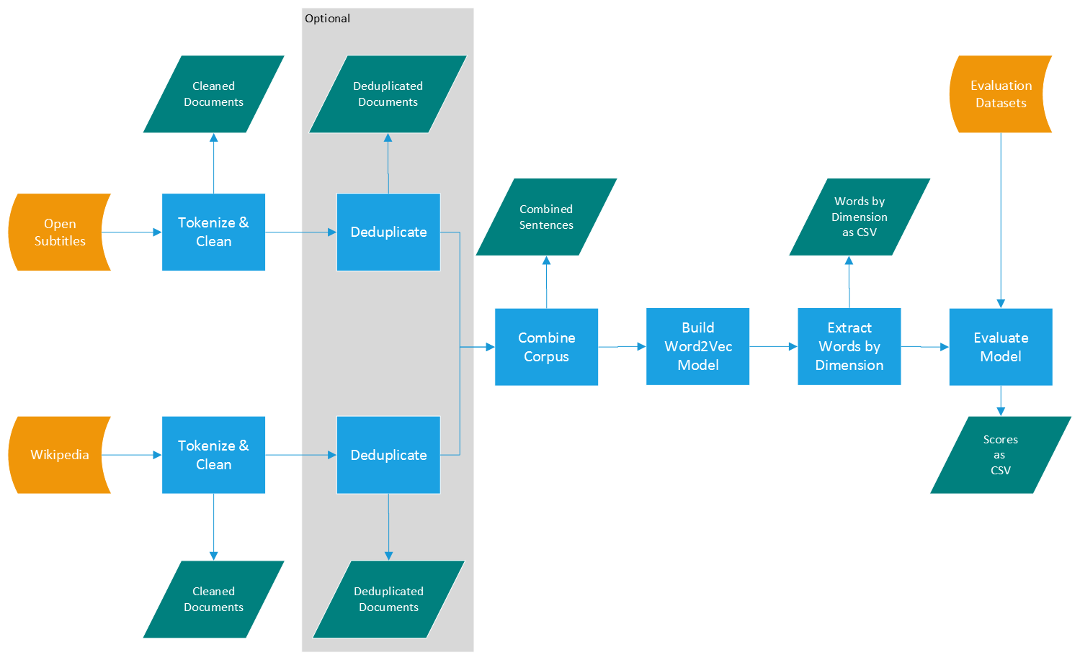
Process Flow Chart
Notes:
The process we're using to train the models closely mirrors the process from the van Paridon and Thompson paper, although there are some differences.

Slide 7
Process Flow Chart
Notes:
The data for each language is downloaded from the OpenSubtitles archive and the Wikipedia dump archive, and then pre-processed into a combined corpus.
The cleaning process includes removing all markup (html and xml), punctuation, arranging the documents so that they contain one sentence per line, and normalizing to lowercase.
Van Paridon and Thompson's process included intra-document sentence deduplication, while some earlier work with these same corpora used document deduplication. We feel that sentence deduplication removes important information about common phrase usage, so we have opted not to do that. Also, because both Wikipedia and OpenSubtitles are well-curated corpora, we feel that document deduplication is unnecessary. Once the first run of analysis is complete, we will perform some additional analysis to show that that is the case.
Once the cleaned, combined corpus is assembled, the FastText model is trained and evaluated for each combination of parameters.

Slide 8

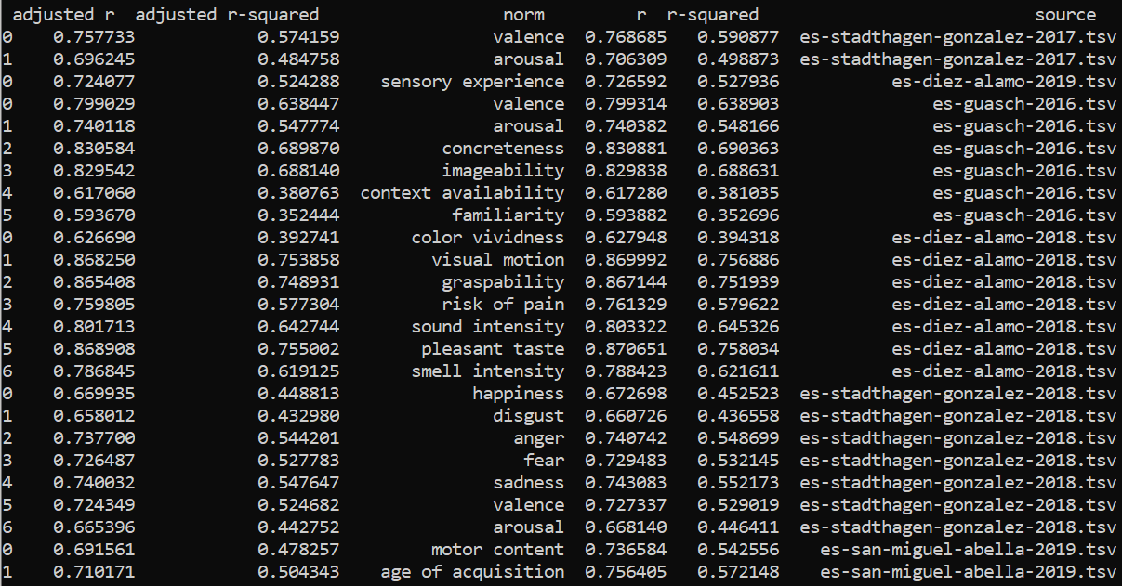
Model Evaluation
110 Models Per Language
Number of Dimensions: 50, 100, 200, 300, 500
Window Size: 3, 4, 5, 6, 7, 8, 9, 10, 11, 12, 13
Algorithm: CBOW, SkipGram
Use each model to predict norms using k-fold Ridge Regression, with k = 10
The most successful model will be the simplest model with the highest r-squared.
Notes:
Using our process we will generate 110 models per language, varying the number of dimensions, the window size, and the algorithm.
For each of these models, we will use ridge regression to predict norms. Ridge regression will help insulate against multicollinearity given the very large datasets we're using.
We will collect the r-squared values for each test into 1% buckets, then choose the best model for each language. We define the best model as the one with the lowest number of dimensions and smallest window size.

Slide 9
Model Evaluation
Notes:
Here is some of the preliminary output, using data from the van Paridon and Thompson study. We are expanding the scope of the test datasets to offer a wider range of norm data.

Slide 10
Thanks!
Data processing is ongoing, very computationally expensive.
We look forward to entertaining your questions and comments.

