Slide 1
Final project
A.Semberuu
ID: 202455469

Slide 2
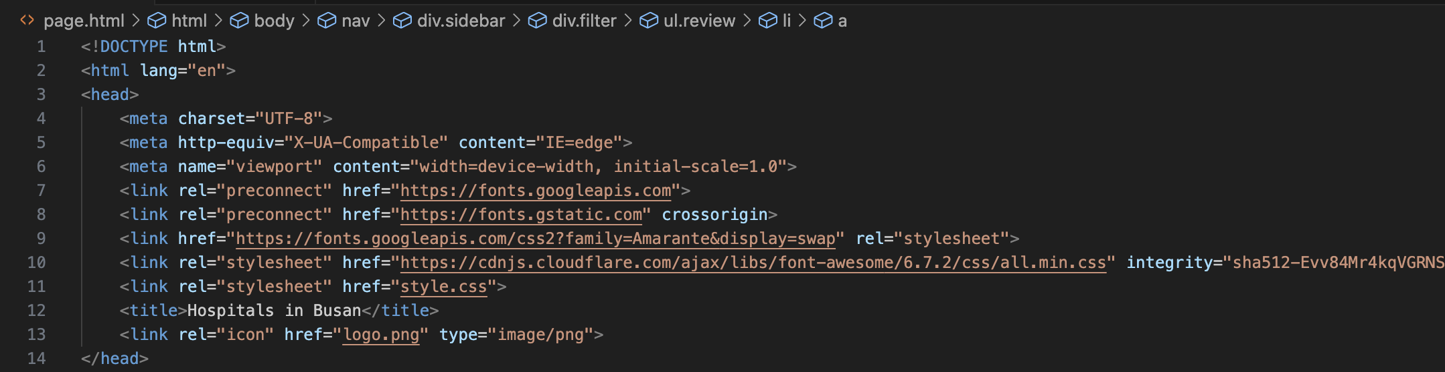
<head> section:

Slide 3
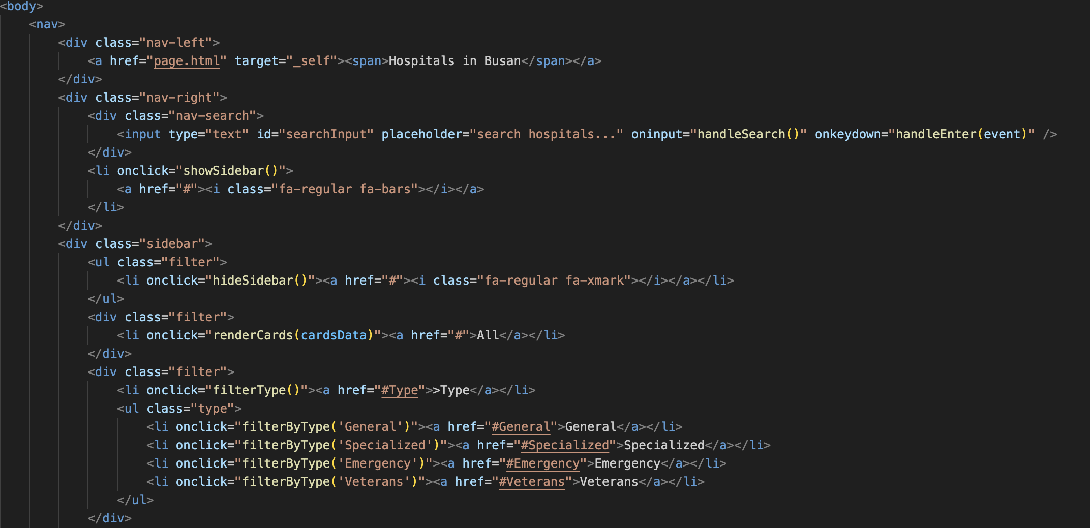
Nav bar:

Slide 4
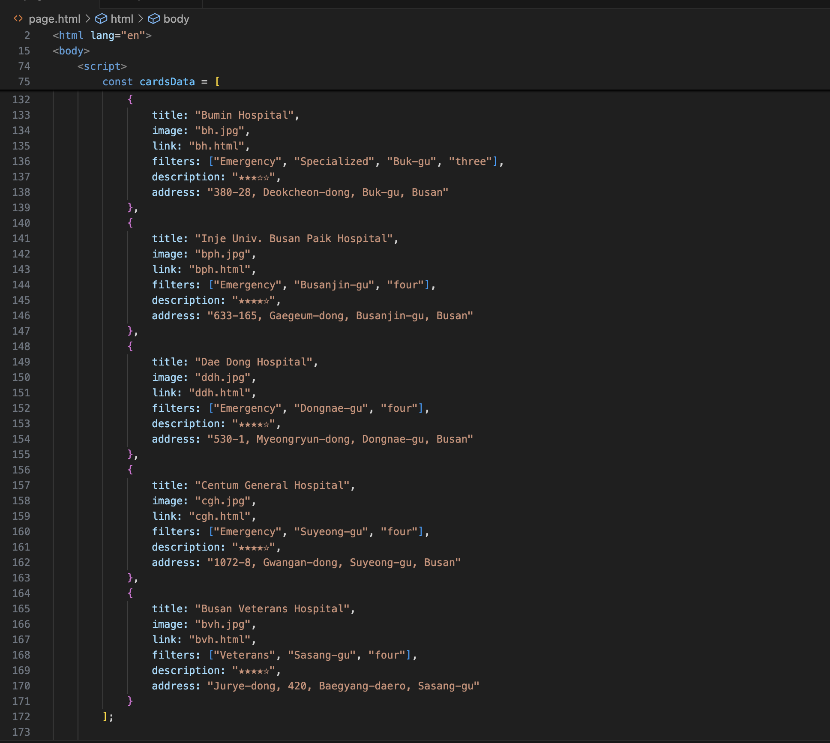
Data stored in JS array:

Slide 5
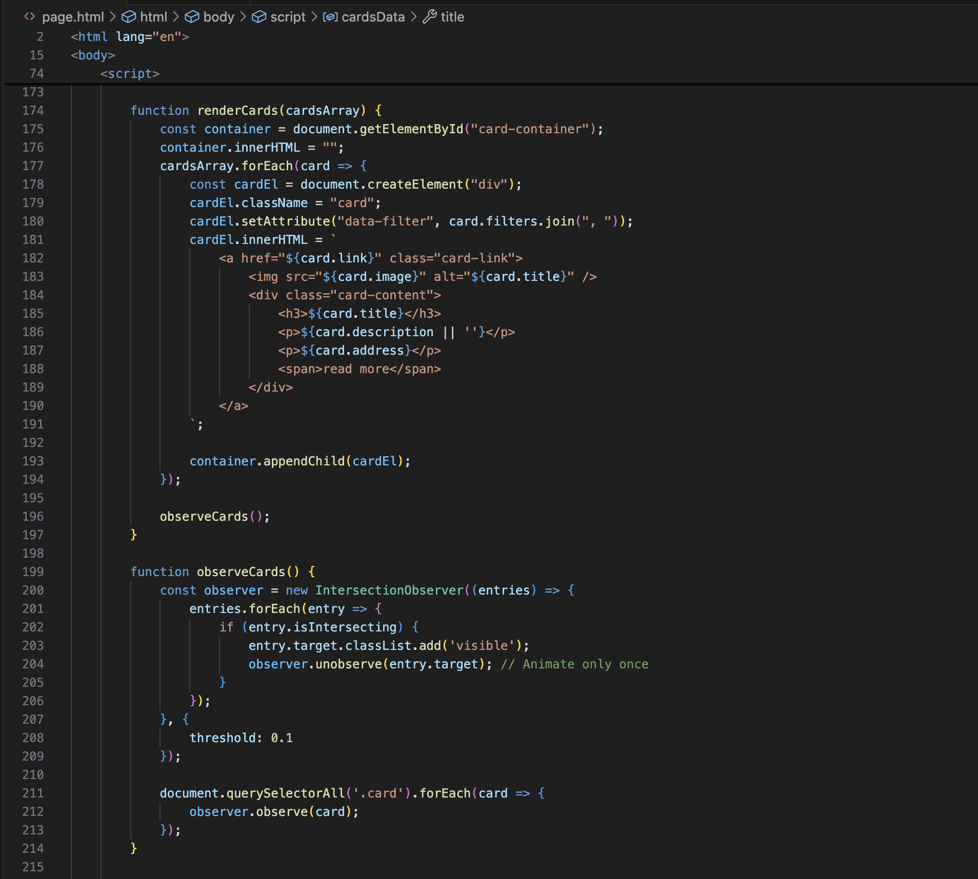
Function for the cards to appear:

Slide 6
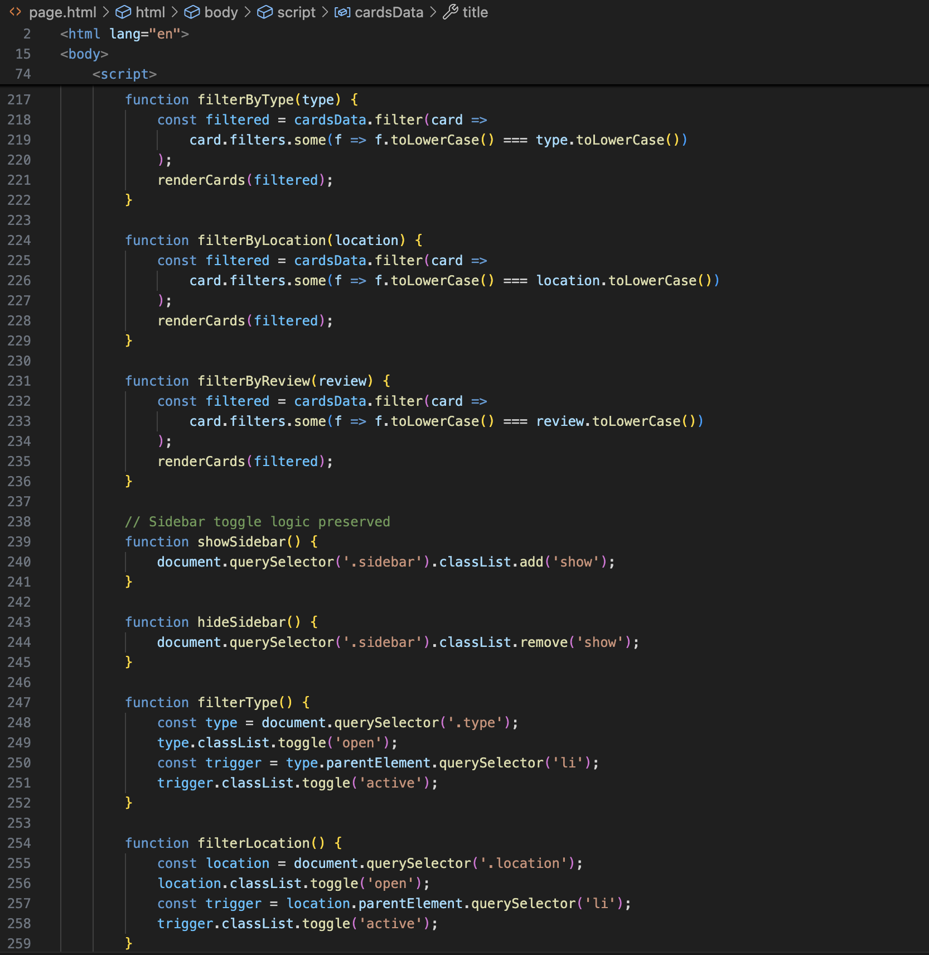
Function for filtering cards:

Slide 7
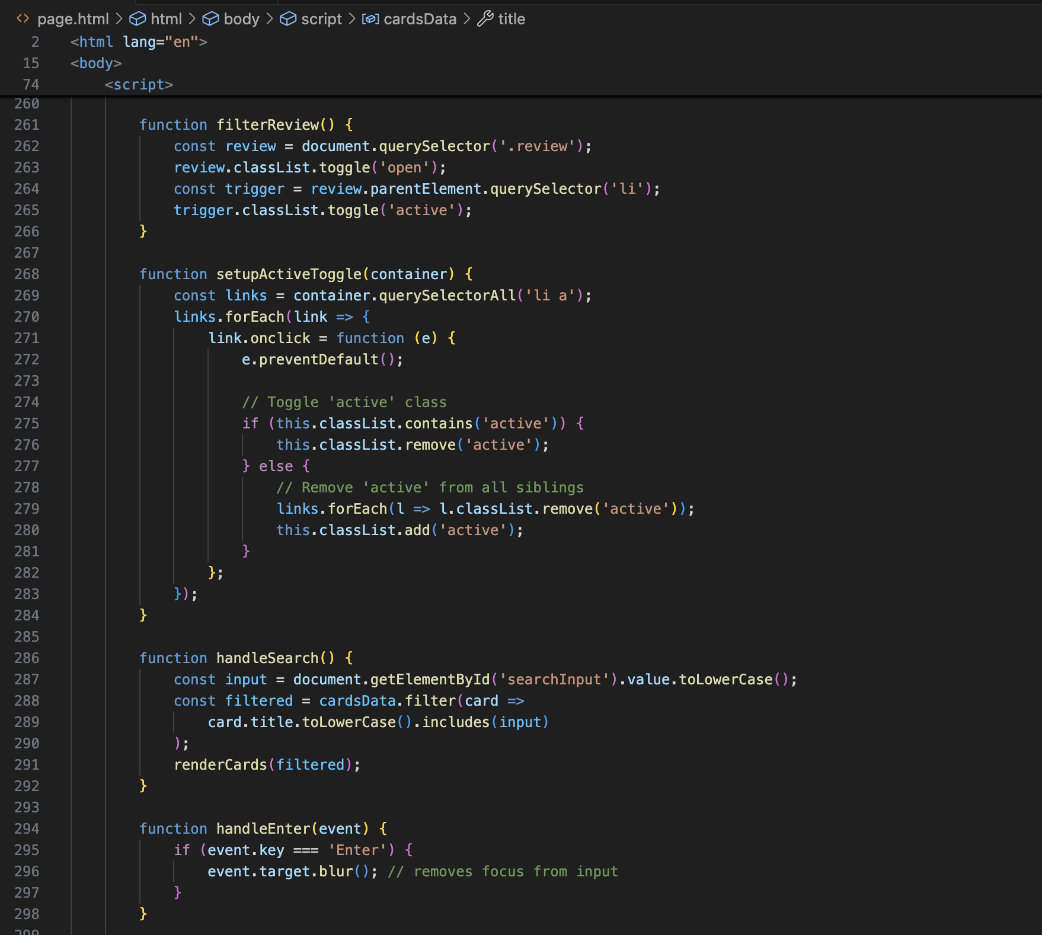
Functions for toggle active indicator and search bar:

Slide 8
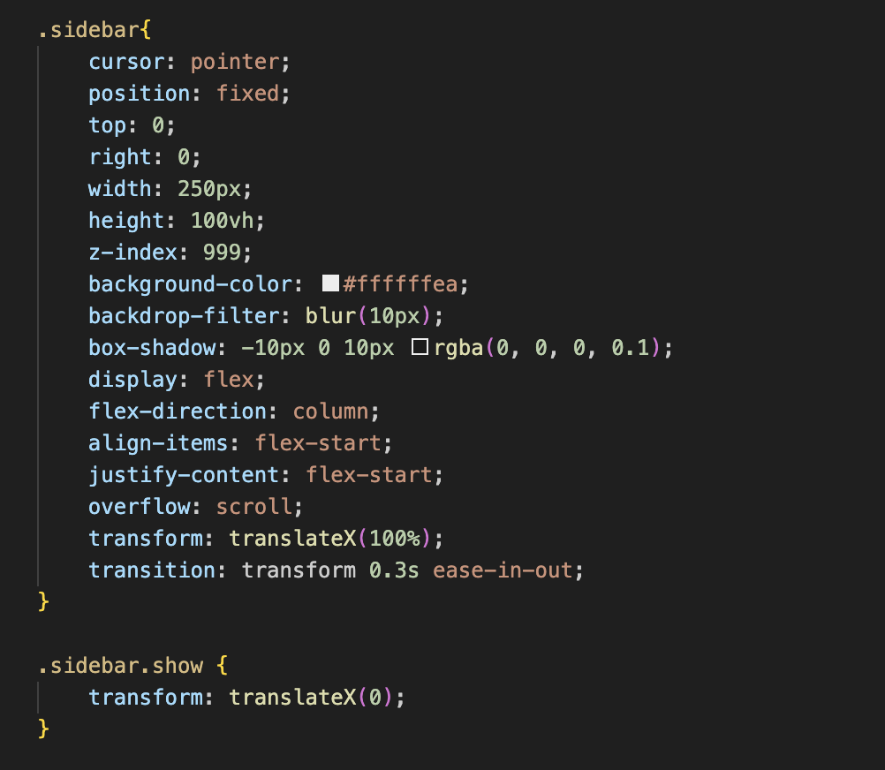
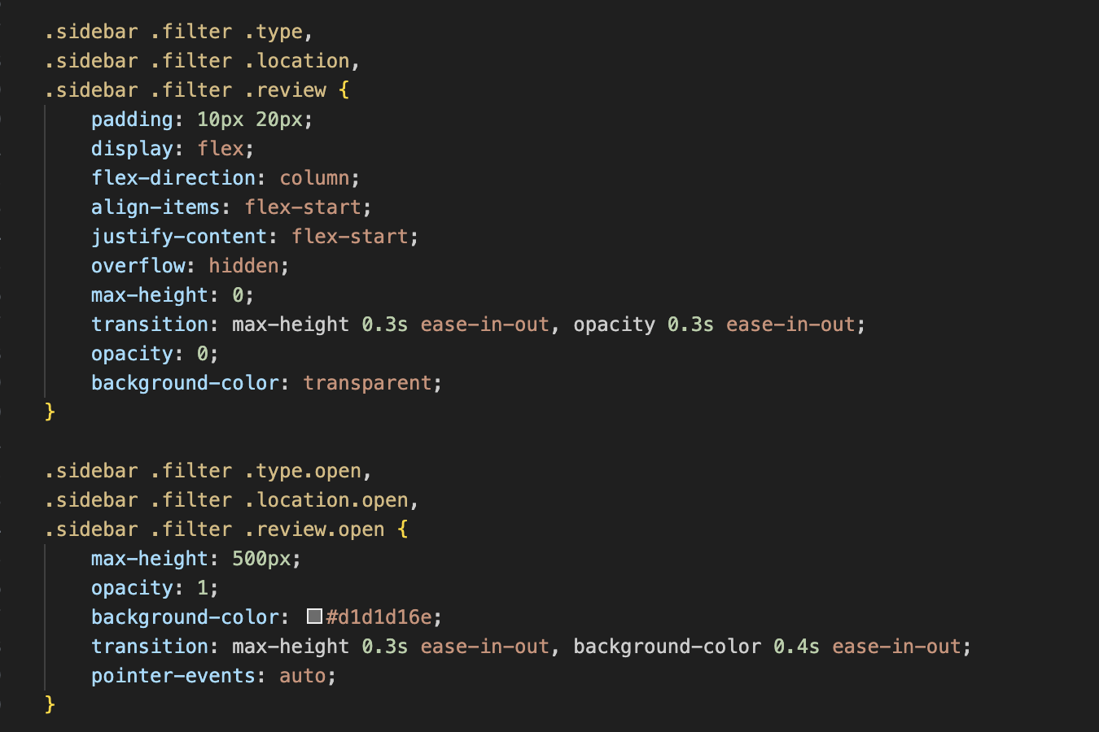
Sidebar entrance/exit animation:

Slide 9
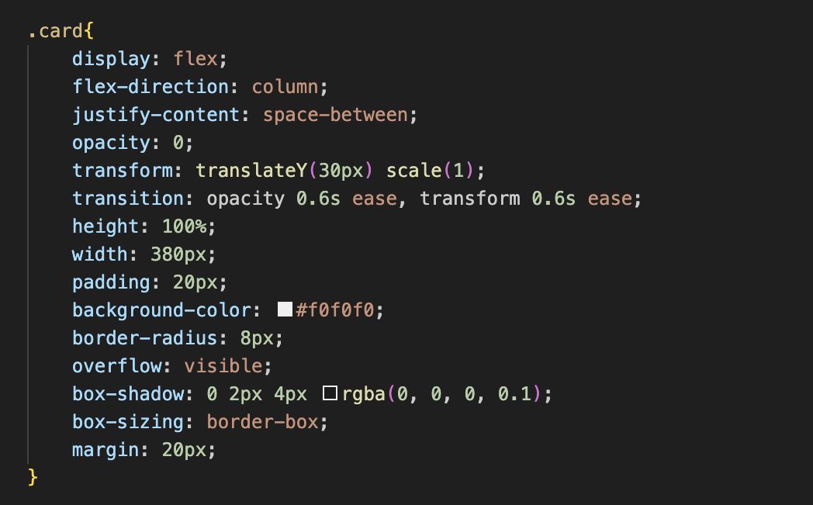
Cards entrance animation and overall style:

Slide 10
Thank you. -Semberuu

