Slide 1

Asset Lead Performance Contract South-East
TotalEnergies Team
06 October 2025

Slide 2
Agenda
Safety moment
PC24 key achievement and implementation today
PC25 key achievement today
Yearly achievements / Current progress
Growth P5
Production
Asset performances & Growth (AiP5)
EOR
Support to operation: Lean Operated Model & Integrity/Corrosion
Technologies
People
Capex / Opex optimization
Low carbon sustainability

Slide 3
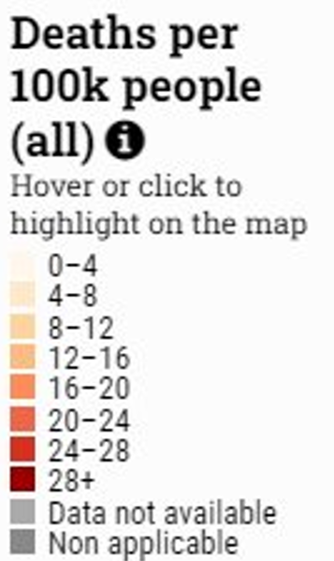

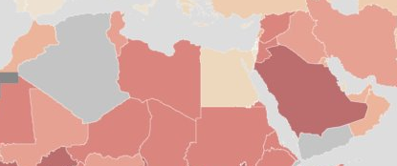
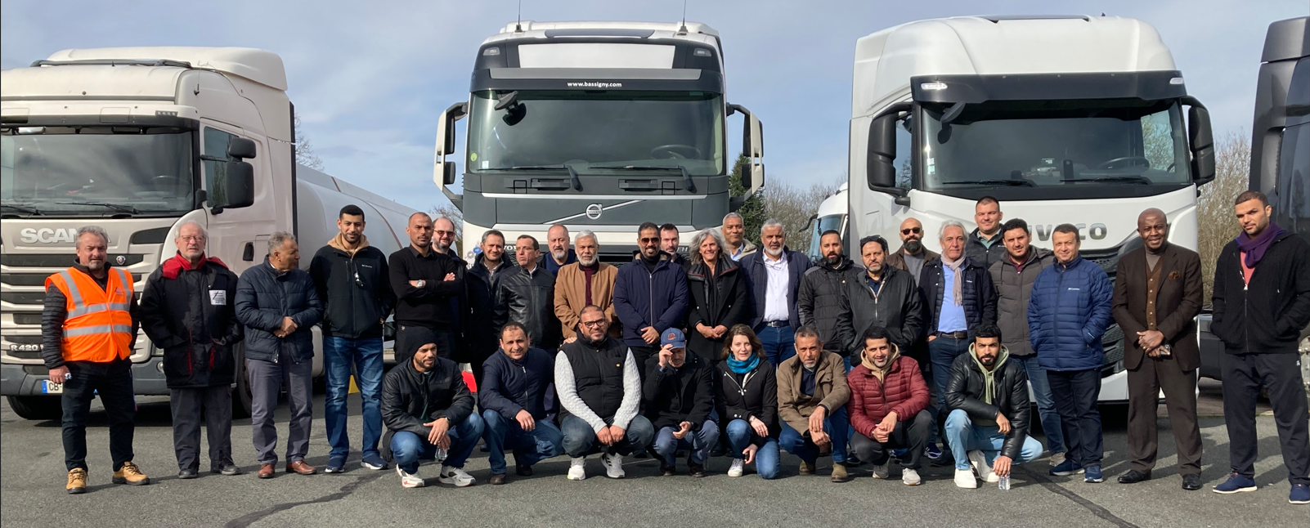
Safety Moment
Safety moment performed during all key meeting to maintain high level of vigilance and share good practices
Road safety and Drilling identified as key focus area
Road Safety
TTE organized 3 days Road Safety Workshop in Abu Dhabi in November (24-26)
Safe drive overview / Audit / Innovations
Land Transport management System / How to monitor road safety / Accident & REX
Embedded equipment / Operational requirements
AON participates to Yearly Road Safety Forum organized by TTE HQ in France (2024) or Tunis (2025)
Drilling Safety
Cross-Fertilization being organized 23rd October (Teams) & in UAE mid November with TTE experts
Adopt the no BLAMING culture to recover unsafe actions and disseminate best practices

Slide 4
PC24 - Key Achievement & Implementation
9 Implemented
Full implementation of support flare out / EOR: Siwap Asab KH2 / Full AON Team immersion / Support for gate approval
Partial implementation of de-risking of tight reservoirs / Support +15 Mbp mandate / Shah Water Shut off / EOR Sahil KH1 low salinity pilot / QW RF improvement
3 In progress
Techno: Wide business case / Techno: Demeter / Sahil Lower completion
3 planned for next year
Integrated Asset Planning follow up (but secondee arrived in Sept-25) / Asab WAG / Secondment
1 not applicable
Emulsion handling, alternative solution find by AON
PC 2024 - Tracking implementation of previous years’ recommendations
~80% fully/partially/in progress implemented

Slide 5
ADNOC Onshore Asset Lead PC25
Yearly Achievements
25
17
In support
Asset Lead Support Group in HQ
Numerous specialists from TTE HQ lined up on all objectives: Best in class expertise in reservoir simulation, well performance, Corrosion/integrity, EOR. GHG reduction leaders, Digital factory managers, Operations Excellence
PC Objectives
Frequent communication & Workshops
All objectives defined and kicked off before end March
Strong interaction between focal points
200+
9
People developed through
Full immersion trip to TotalEnergies Technical Excellence centers
14 advanced trainings: G&R, Drilling, Prod. Opti.
14 knowledge sharing sessions: HSE, G&R, Drilling, Production, Prod. Opti., Digital
Technologies
HSE: GRIF Safety
G&R: WISH
Drilling: Laser Downhole Operations
Ops: FCW / Pipeline Integrity Automation / Robots can read gauges values
Planning: Phaser
Digital: Prod./Planning/RM Dashboards / Digital Rock Physics

Slide 6
PC 2025 – Current progress
7 OP removed without impacting production mandate (Asab KH-1)
Asab – Shuaiba-2: 30 Mbd could be achieved with less wells
Plateau level to 160 (+10) Mbd, duration + 6 years, RF: +3%, more to come with infills
Received CEO approval for 1 secondee as Petroleum Architect
Methane Permanent Monitoring and Energy Efficiency: sharing knowledge sessions
LOM: 1-week WS in Abu Dhabi for road map definition – Debriefing 06/10
Performance contract: good progress, all objectives will be finalized by year end

Slide 7

Growth P5
Production | Asset Performance | Growth (AiP5) | EOR | Integrity & Operations | Technology | People Development | OPEX / CAPEX Optimization | Sustainability
100% Achieved
Good Progress of P5 South East Project / Optimization of Contractual strategy→ TTE proposal to split of EPCm in 2 phases
Continuous support of Asset Lead (new compressor supplier, Contracts approval, 2025 Budget Variation Approval)

Slide 8
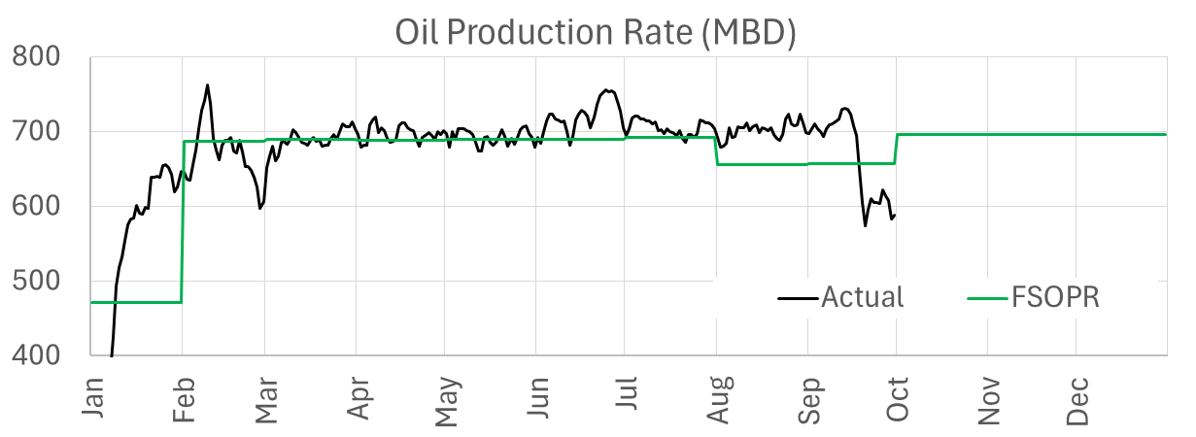

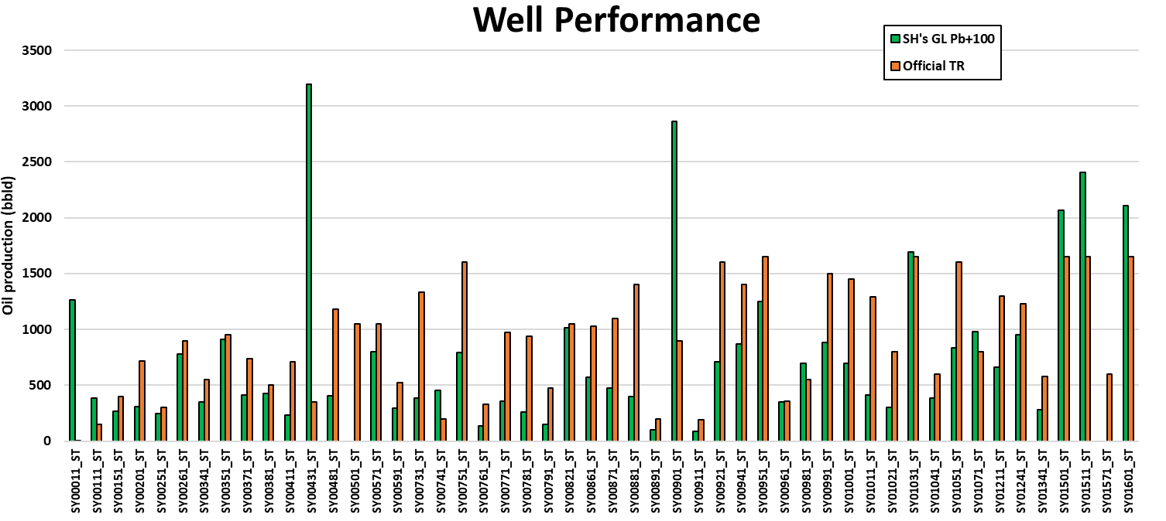
Production
Production (adhering to the reservoir guidelines) 30% | Asset Performance | Growth (AiP5) | EOR | Integrity & Operations | Technology | People Development | OPEX / CAPEX Optimization | Sustainability
100% Achieved
FSOPR: support production growth
Asset Lead support to assure achieving 2025, 2026 and 2027 Business Plan FSOPR
South-East
Identify additional potential for Shah/QW through AL methodology and automatic tool
Shah: 11 MBD of unconstrained potential identified → +2 MBD already achieved
QW: 4 MBD of unconstrained potential identified → +3 MBD already achieved
Asset​ | FSOPR ​ YTD | Actual YTD​ Production | Variance
South-East​ | 657 | 669 | +12
SH’s GL Pb+100
Official TR
Production higher than FSOPR during the first 3 quarters
➔ Challenging respect of VRR guidelines due to high production targets in Asab and Sahil
Challenges to produce FSOPR in Qusahwira and Shah:
➔ QW: gas lift compressor availability limitation
➔ Shah: water treatment & disposal capacity increase delayed vs plan
2024: production higher than FSOPR (+1 MBD)
Strong performance of South-East supporting ADNOC high production

Slide 9
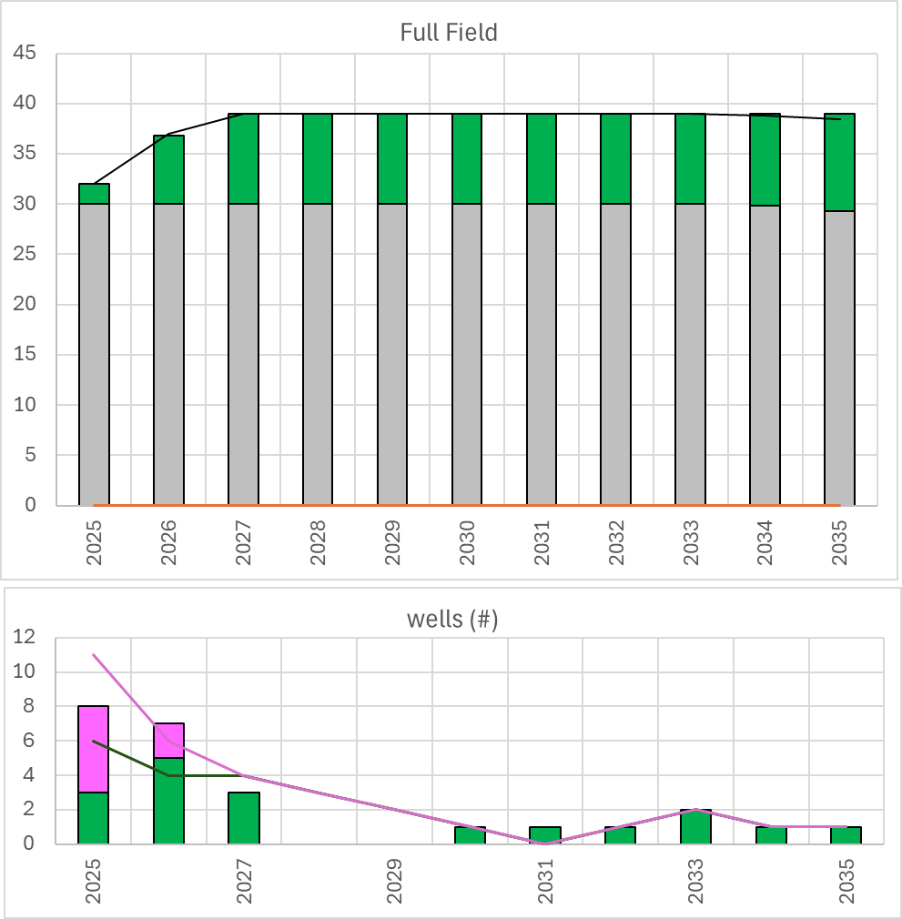
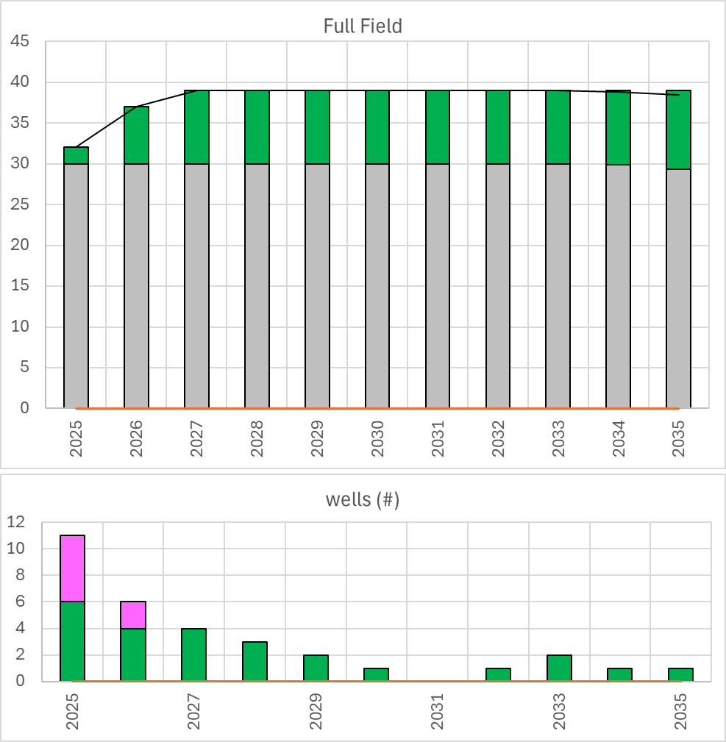
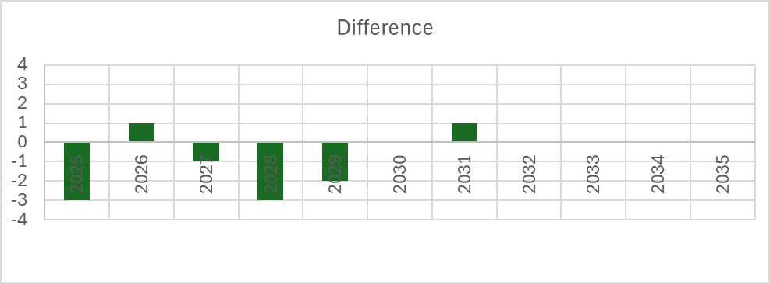
Asset
Performance
Production | Asset Performance | Growth (AiP5) | EOR | Integrity & Operations | Technology | People Development | OPEX / CAPEX Optimization | Sustainability
100% Achieved
Optimized DWS
Original DWS
DWS optimization objective: align the production capacity with BP25-29 production mandate
ASAB KH-1 DWS optimization of 7 OP KH-1 C1 from DWS
Green: Producers
Purple: Injectors
Black line: Production profile from BP25-29 which includes P4 and P5 and Base Case
Grey column: Base case production BP25-29
Green column: P4 and P5 production BP25-29
Asab KH-1: 7 OP removed without impacting production mandate → Capex optimization
TTE methodology & guidelines transfer to Asset team for implementation on all fields

Slide 10
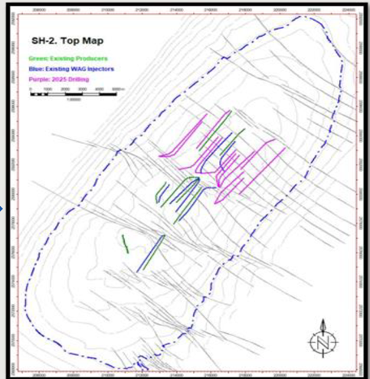
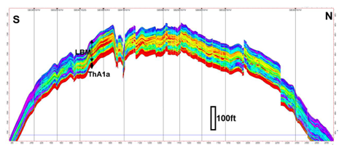
Growth P5
Production | Asset Performance | Growth (AiP5) | EOR | Integrity & Operations | Technology | People Development | OPEX / CAPEX Optimization | Sustainability
100% Achieved
Asab – Shuaiba2 de-risking for P5 development
Reservoir characterization → Confirmed fault communication SH-1/SH-2 & better reservoir properties in central region
Well performance → Achieved 4 MBD (Q1-25)
Pressure Support → Validated dual injector configuration in central part. Next validation in north & south parts
Technology Validation → Limited Entry Liner completions are optimum
Drillalbility Constraints → Shorted lateral (35% less) but delivering expected production. Asset lead to support asset in 2026 on drillalbility.
No additional wells required in the BP period to achieve 30 Mbd compared to initial plan
Asab – Shuaiba2: derisking scope almost completed (Core area).
30 Mbd could be achieved with less wells or higher plateau could be achieved with same number of wells
Notes:
For long term sustainability additional work required with additional data

Slide 11
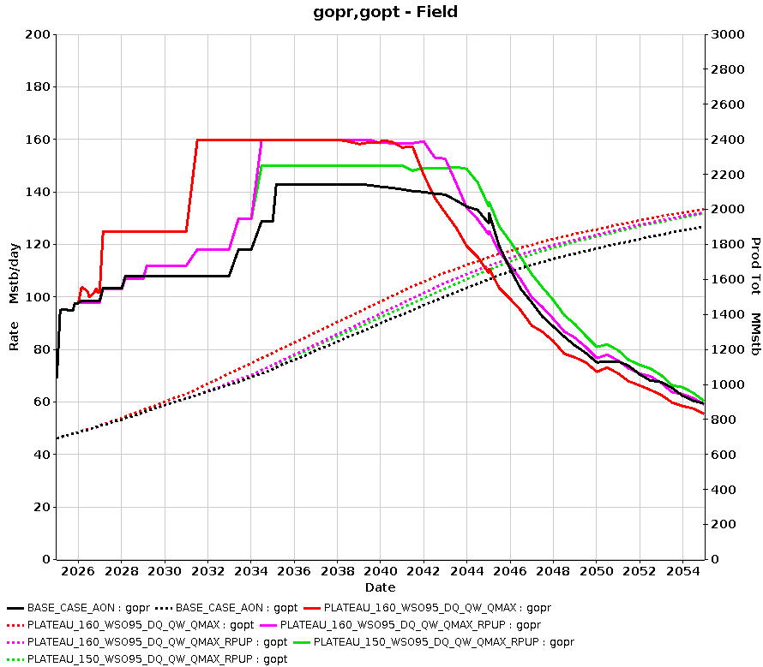
Asset Performance & Growth (AiP5)
Production | Asset Performance | Growth (AiP5) | EOR | Integrity & Operations | Technology | People Development | OPEX / CAPEX Optimization | Sustainability
Sahil FDP optimization
Define best scenario while optimizing production constraints per reservoir level
2 stages plateau 135 Mstb/d (125 for UT) and 160 Mstb/d (UT only)
WAG Cycle period assessed: 6 months cycle confirmed to be the most optimum
VRR target (1,3) maintained in the short/mid term, long term improvement ongoing
Water/gas ShutOff assessed → Best strategy: @ 95% Wcut (up to 2y plateau). Gas shutoff no added value
Gas lift optimization → implemented
Ongoing: drilling sequence and infill drilling optimization to maximize oil recovery and extend plateau
Upper Thamama
 | PLATEAU RATE | PLATEAU END | CUMOIL | RF YE2054
CASE | Mstb/d | Year | MMstb | %
Current | 143 | 2039 | 1902.5 | 46%
OPT1 | 150 | 2044 | 1977.7 | 48%
OPT2 | 160 | 2042 | 1982.8 | 48%
OPT3 | 160 | 2041 | 2003.9 | 49%
Sahil FDP Optimization: Plateau level to 160 Mbd (+10 Mbd LT), duration + 6 years, RF: +3%. Potential further improvement with additional infills (in progress)
Notes:
Plateau - 2032
- SH1 – 28-30 Mbd
- KH2 – 120-125 Mbd
- KH1 – 8-10 Mbd
- LK15-16 - 1 Mbd
- Lower Thamama: 10 Mbd

Slide 12
Asset Performance & Growth (AiP5)
Production | Asset Performance | Growth (AiP5) | EOR | Integrity & Operations | Technology | People Development | OPEX / CAPEX Optimization | Sustainability
QW
Identification of additional unconstrained potential: 13 wells → + 4 Mbd. 2 Mbd already implemented, additional subject to gas lift availability and water disposal injectivity improvement.
Full Control of Well implemented with positive results → Faster gas-lift restart (x3 in some cases) and Smoother ESP restarts (less spikes in load)
Contributed to FSOPR Task Force
Transferred of methodology to implement Hydraulic Frac in SH-5 reservoir model
Shah
Identification of additional unconstrained potential: 26 wells → + 11 Mbd. 3 Mbd already implemented (8 wells), additional subject to resolution of water treatment issues (water tank + water disposal) and reservoir management optimization
Pilot follow up and AL supports the acceleration of the full field water injection, key performance
Support new model (SCAL review and alignment with field measurement)
Added value: + 2 Mbd & 3 Mbd materialized respectively on QW & Shah

Slide 13
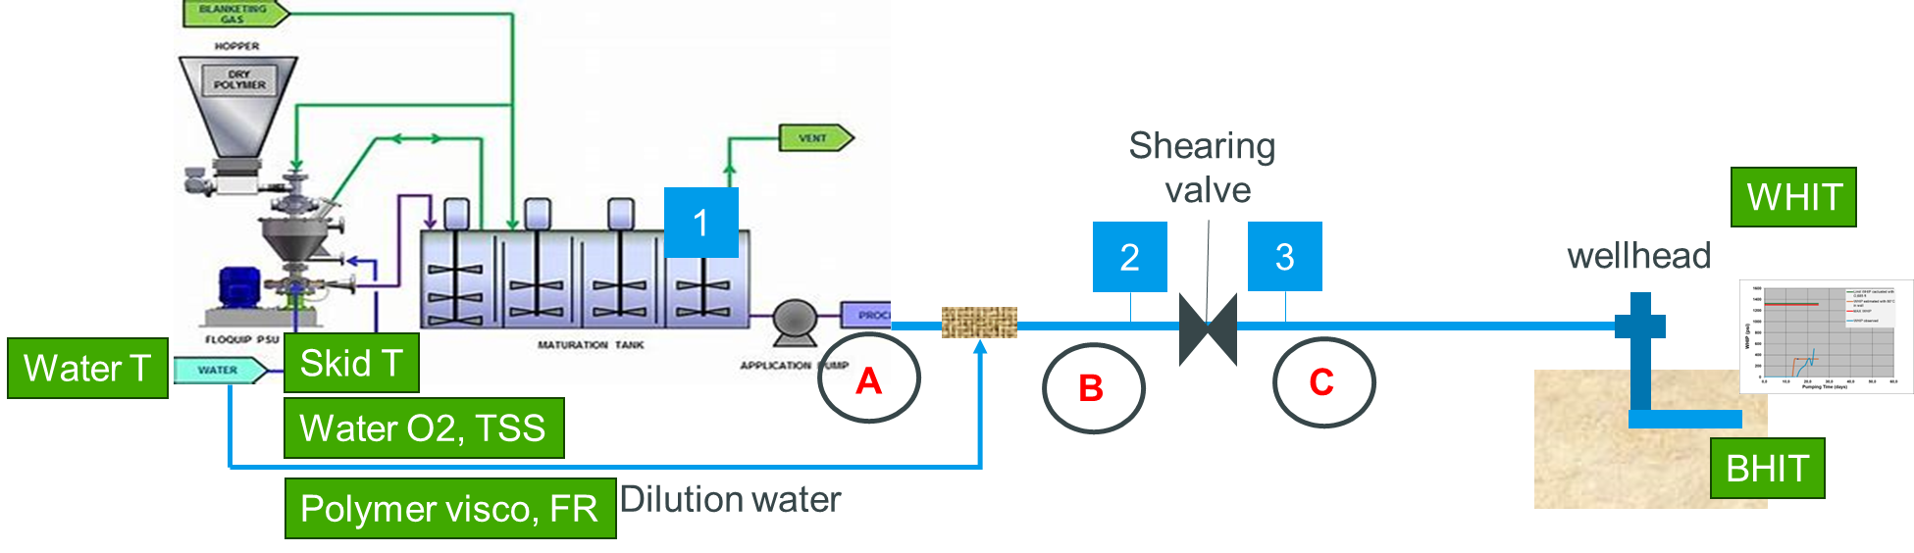
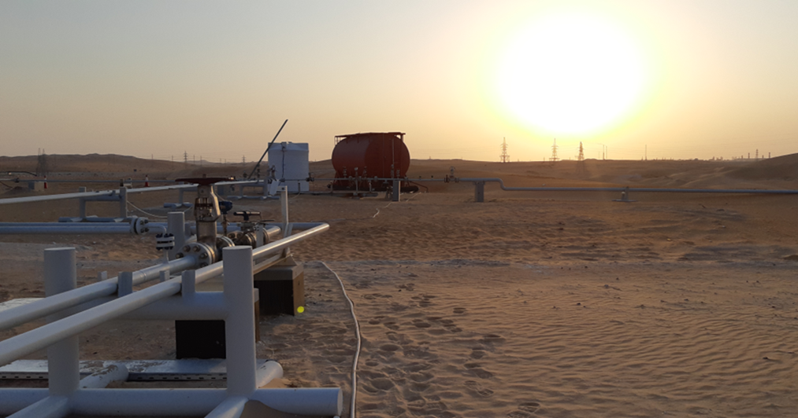
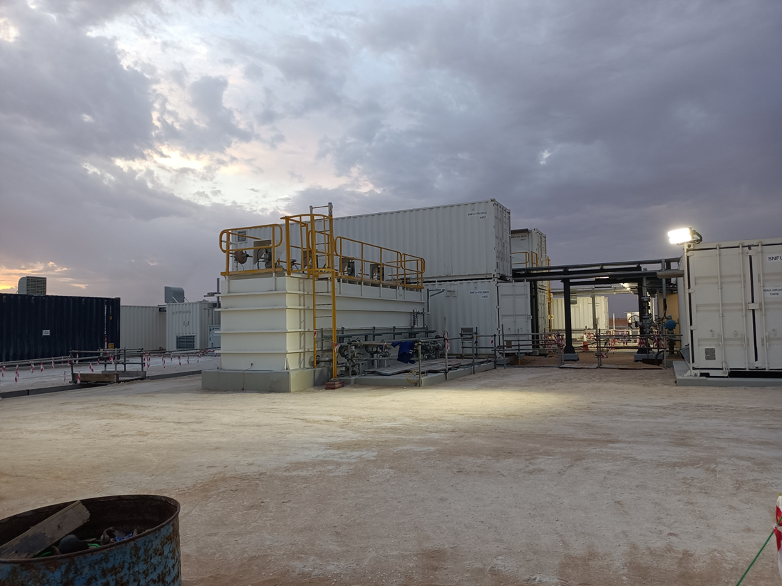


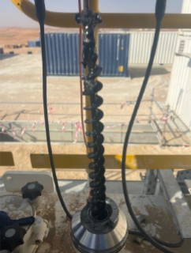
EOR
Production | Asset Performance | Growth (AiP5) | EOR | Integrity & Operations | Technology | People Development | OPEX / CAPEX Optimization | Sustainability
Asab Sh1/Kh1 WAG CO₂ optimisation
Support asset optimizing CAPEX by analyzing multiple gas recycle scenarios (in progress)
Asab Kh2 SIWAP pilot:
Successful Pilot ongoing since Feb. Support to start-up and follow-up. Model updated to HM pilot and simulate FF SIWAP
+240 MMSTB resources & CO2 storage
(Obj.: surface costs reduction and Subsurface optimization)
Full field Gate-0 preparation
+200 MMSTB
Reach target concentration (2100 ppm) and injection flowrate 4000 bpd. Excellent water and polymer solution quality
To be captured in BP26-30
Continuous support provided to mature EOR development. SIWAP is very promising while EOR-CO2 projects remain very challenging especially in already developed reservoirs

Slide 14
Integrity & Operations
Production | Asset Performance | Growth (AiP5) | EOR | Integrity & Operations | Technology | People Development | OPEX / CAPEX Optimization | Sustainability
LOM – 7 Pillars
Support to Lean Operation Model implementation in SQM
1 week workshop (29/09 to 03/10). Quick wins:
Reduced ratio of HSECEs ratio (50% to 15%)
Productivity improvement: 12 hrs shifts vs 8 hrs
Operators rounds review
1st line maintenance: multi-skilling operators
1 secondee: Integrated Operating planning
Additional secondees should be required to implement LOM
IOC
Change management
Digitalization
Maintenance & integrity re-engineering
Efficiency
Lean Core crew
Maintenance work by campaign
Corrosion treatment, chemical selection and monitoring for multiphase systems
Support AON Integrity Hub in continuing expertise to prevent corrosion of flowlines (Risk #1 of AON):
Lab equipment deployment
Gas CI chemical qualification
Phase II biocide optimization for storage tanks
Corrosion lab visit in Pau and collaborative workshop achieved in Jun’25
2 ADIPEC 2025 papers accepted
LOM 7 pillars proposed to be developed → Expected gain up to 10% OPEX Reduction
Integrity / Corrosion continuous support provided
Notes:
Health, Safety, and Environmental Critical Equipment and Systems

Slide 15
Integrity & Operations
Production | Asset Performance | Growth (AiP5) | EOR | Integrity & Operations | Technology | People Development | OPEX / CAPEX Optimization | Sustainability
Lean Operation Model - Planning
Q1
Q2
Q3
Q4
Q5
Q6
Q7
Q8
Q9
Oct
Nov
Backlog
Outliers
SQM Opex Budget 2025 (175 M$) w/o gas usage & FUJ pipeline
6.5 M$/y of savings assessed with 10 workstreams (out of 20)
Considering the whole 20 workstreams a potential Opex reduction of 10% is estimated
Benefit can be extended to full AON
Maintenance
HSECES re-engineering
PM re-engineering
Campaign through service contract
Organization
Productivity improvement – Working hours
First line maintenance – Multi skill
Operations
Operators round review
PQLA
ESP material re-use
Large development of PMM ESP
Corrosion inhibitor optimization
Demulsifier formulation & optimization
Chemical
Biocide optimization
Chemical bulk transportation
Digital
Digital tools deployment
Planning subject to a dedicated organization

Slide 16
TECHNOLOGY
Production | Asset Performance | Growth (AiP5) | EOR | Integrity & Operations | Technology | People Development | OPEX / CAPEX Optimization | Sustainability
TotalEnergies proactive in proposing / implementing technologies within ADNOC Onshore
2024 | 2025 | 2026+
SAFT Batteries – pilot completed
KAPPA Automate – pilot completed
OPEX reduction: 2M$/y
For Application at ADNOC level, contractual discussions ongoing with the vendor
Drilling Rig Automation (PC24)
Expected Performance improvement: 5%
TECHROAD: 40+ Technologies proposed
AIDT (TECHROAD) – 23 proposals
Tank Viscometer for Polymer injection – Started but temporarily S/D
Operations
NTC: 2024
RotaCem – Waiting for signature to start the pilot
NTC: 2024, BC: 2-5% Better prod. allocation
WiDe – Ongoing ( 1st milestone – FAT finalization)
NTC: 2024 (PC24), Accurate GHG estimation
DEMETER – Ongoing (started with BUH; SE to follow)
Trial approved, expected well uptime to 90%
Asphaltene Inhibitor Injection – Ongoing (samples collected, en route to lab in France)
TechRoad 2024 selected for trial
Asphaltene Cleaner High Flash - Feasibility study planned Dec-25
TechRoad 2024 selected for trial
Integrated solutions to mitigate loading risks (Business Case to develop)
CEO Onshore 2024 approval
FCW QW – Successfully configured and on-line
PC25: 12+ technologies proposed, currently 6 under screening. 25 papers proposed to ADIPEC
FCW / DEMETER / WiDe / Asphaltene Inhibitor - Ongoing
Notes:
Technology
1- Smart Padlock (LoRa) - Digital lock replacing multiple mechanical locks.
2- Job ID Card (challenging TTE Cloud). → Knowledge transfer instead of tool
3- STORM – Leak detection and remote monitoring; effective but cloud-dependent → Knowledge transfer instead of tool
4- Safe Hub – Bolt replacement on live pipes without shutdown; this is an innovative solution that has great savings potential. Technical session will be conducted for further details.
5- GRIF risk & 6- GRIF safety: TÜV SÜD-certified reliability & safety suite; We understand some modules were tested previously (RAM study in BUH), but other certified modules (e.g., SIL, TREE) could be explored if ADNOC is interested in safety-related applications.

Slide 17

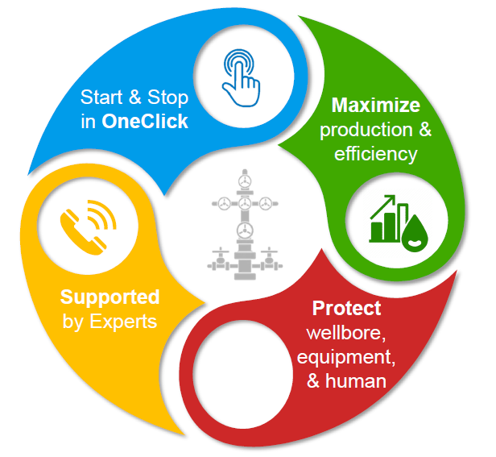


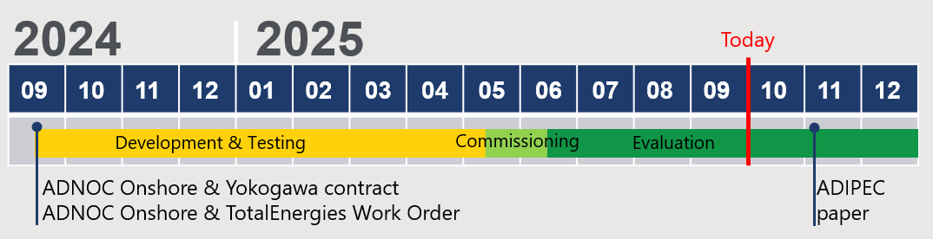
The Full Control of Well (FCW) pilot on Qusahwira
FCW = In-house Control Algorithms for ESP/Gas-lift/Natural flow/Injectors implemented in the plant Distributed Control System (DCS)
Fully automates well control (start-up, production, shut-down) to:
Increase well availability/optime
Increase production efficiency
Protect well & equipment
Limited cost compared to commercial solutions:
~10-30 kUSD/well (TBC) in CAPEX, no OPEX
~10 times cheaper than robowell (AIQ)
Qusawirah pilot: 6 gas-lifted and 4 ESP wells
Good preliminary pilot results:
Strong operator adoption (activation >85% of time)
Faster gas-lift restart (x3 in some cases)
Smoother ESP restarts (less spikes in load)
Production at target: +5% production in some wells (TBC)
-30% gas-lift use in some wells (TBC)
17

Slide 18
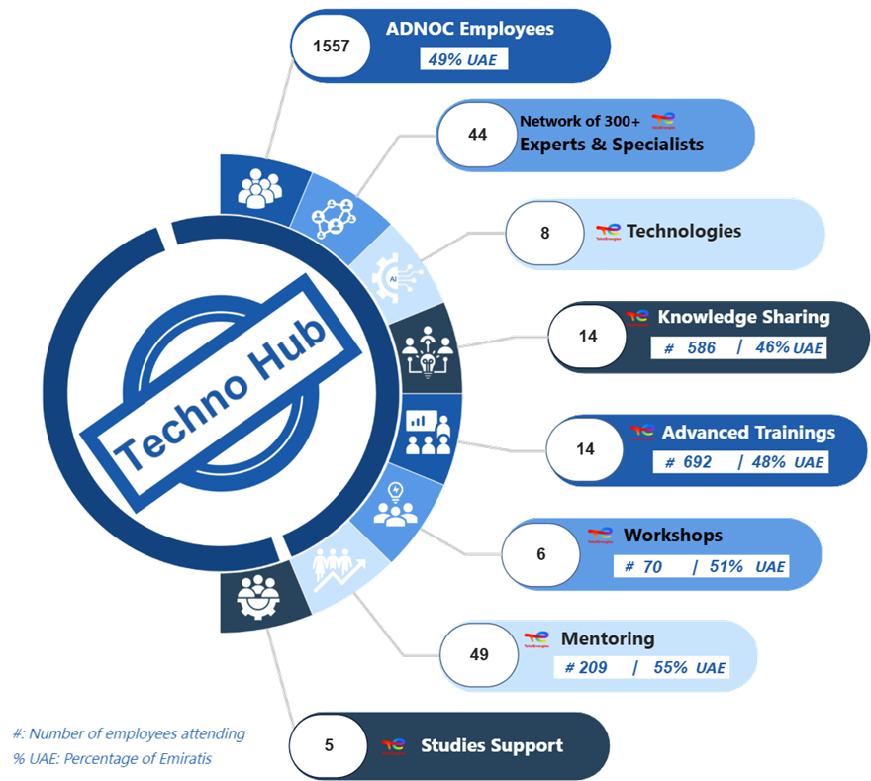




TECHNOLOGY
HUB
Production | Asset Performance | Growth (AiP5) | EOR | Integrity & Operations | Technology | People Development | OPEX / CAPEX Optimization | Sustainability
activities
DASHBOARD ACTIVITIES – End Sept-25
Process Quick-Look Assessment (29/4)
HSE Incident Management (7/7)
SAFE DRIVER tool (8/7)
GRIF for Safety (22/9)
Bean up procedure (1/7)
WISH (20/10)
Well Integrity & Management System (28/4)
Laser Downhole Operations (27/5)
Global Technology P&A Roadmap update (7/10)
Rotating machines commissioning (25/2)
Robots can read / interpret gauges values (17/6)
Risk Based Inspection (15/7)
Pipeline Risk Based Inspection (13/10)
3D printing (24/11)
Building a Choke Model (8/4)
Production Optimization (20/6)
Digital Rock Physics (12/5)
30 Years of Research on AI & Applications (1/7)
HSE
HSE
GRIF Safety
WISH
Laser Downhole Operations
FCW
Pipeline Integrity Automation
Robots can read gauges values
Phaser
Prod./Planning/RM Dashboards
Digital Rock Physics
G&R
TO COME
G&R
DRILLING
TO COME
OPS
DRILLING
TO COME
PLANNING
OPS
DIGITAL
HSE
Road Safety (24-26/11)
Geomechanical issues (11/6)
Losses decision tree & practices (Q4)
Pipeline Integrity Automation (13/1)
Inspection & Corrosion (3/2)
Robots (30/6)
Corrosion / metallurgy selection criteria (17/7)
Business Plan Process (8/4)
TO COME
TO COME
DRILLING
P.O.
OPS
TO COME
DIGITAL
G&R
Intersect (Reservoir Simulation) 5 modules (14-18/4)
Formation Damage (5/5)
Acid stimulation & field cases (6/5)
Water Shut-off (7/5)
Uncertainty Management 3G (16-17/6)
Well Test Interpretation (23-24/6)
Dynamic Uncertainties Management & HM (8-9/7)
Thermodynamic modeling (15-17/9)
Water Management Optimization (Intersect) (12/11)
Core Measurements (CCA & SCAL & QA/QC) (6-8/10)
EOR (CO2-Smart WI-Polymeres-WAG) (13-16/10)
GeoSteering for reservoir management (11-12/6)
Well performance | Gas lift & ESP (22-26/9)
PLANNING
OPS
FCW
Prod./Planning/RM Dashboards
DIGITAL
G&R
RM4 HM QC (SE/Asab)
FCW (SE/QW)
Phaser feasibility light IOP (BUH)
Dashboard (SE/BUH)
Digital Rock Physics (SE/Asab)
OPS
PLANNING
TO COME
DIGITAL
DRILLING
P.O.

Slide 19

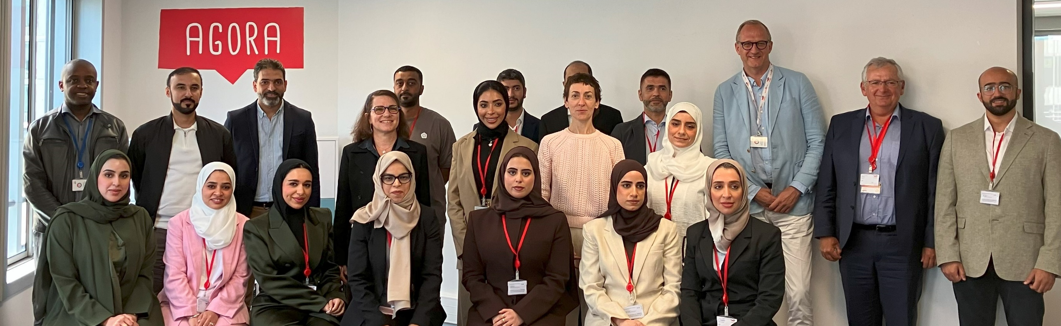






People development
Production | Asset Performance | Growth (AiP5) | EOR | Integrity & Operations | Technology | People Development | OPEX / CAPEX Optimization | Sustainability
Full immersion mission in TTE Digital, Research & Technology centers achieved on 19^{th -} 23rd May
Secondee in TTE
Multiple programs proposed by TotalEnergies
AON selected Petroleum Architect role – 1 AON engineer followed Petroleum Archietct training
TotalEnergies engaged with 3rd parties to clarify ADNOC all administrative requirements
All set by TotalEnergies: program finalized, Xavier Poirier-Coutansais, our VP ASLG, proposed to be mentor: regular meeting, coaching, advisor…
ADNOC approval granted → Follow/support administrative process
Continuous mentoring by secondees
Knowledge Sharing & training sessions via Technology Hub & various ALPC objectives
Focus on AI integrations, IoT technologies, and digital tools for operational excellence and GHG reduction for future cooperation & networking
Successful mission in Paris – All sets to launch secondment program in France

Slide 20

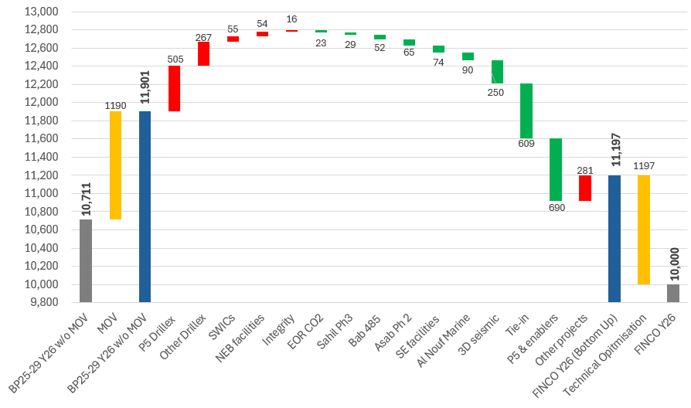
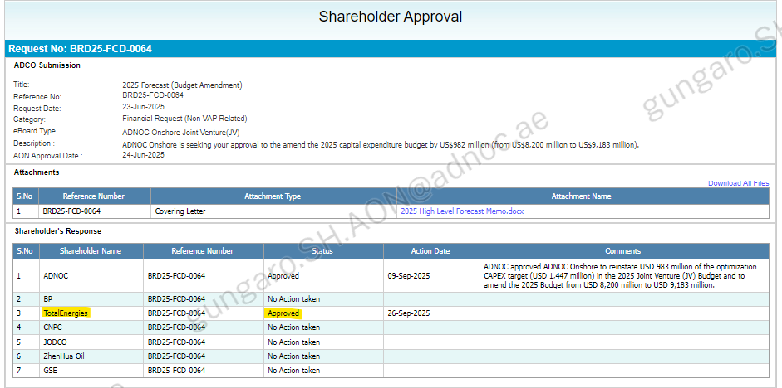
CAPEX / OPEX Optimization
Production | Asset Performance | Growth (AiP5) | EOR | Integrity & Operations | Technology | People Development | OPEX / CAPEX Optimization | Sustainability
2026
Active participation to the deep dive review sessions organized by ADNOC as part of the Capex review taskforce
48 reductions opportunities identified following July IAG EC (half by TTE) leading to significant CAPEX optimization
2025
TTE supported ADNOC approving 2025 revised budget while being very active in proposing optimization for 2026

Slide 21







Sustainability
Production | Asset Performance | Growth (AiP5) | EOR | Integrity & Operations | Technology | People Development | OPEX / CAPEX Optimization | Sustainability
Methane Permanent Monitoring
Establish a permanent surveillance of methane emissions on upstream sites using existing and proven technologies enabling quick detection and repair of any gas leak.
Proven technologies shared with ADNOC:
Wireless sensors,
Cameras and pyrometers
+ Predictive Emission Monitoring System for evaluating continuously stationary combustion (flare and fuel)
Energy Efficiency: workshop done by TTE
PQLA technology: implemented within ADNOC + methodology transferred to ADNOC
Solar Plant proposal to reduce emissions and OPEX
Continuous support provided by 1 secondee specialists on GHG/CH4 deployed within ADNOC Onshore
From Periodic detection (Site Level)
Satellites
Drones (Ausea)
Tracking mega emitters; Spot Tasking
Alert & Crisis management
Site Level quantification
& Reconciliation to meet OGMP2.0
To Continuous detection (Source Level)
Wireless sensors
Cameras & Pyrometers
Predictive Emission Monitoring Systems
Methane from Fugitives & incidents
Methane from Fugitives, incidents & Flame-out detection
Methane from Fuel gas combustion, flaring & venting
Continuous engagement with ADNOC to support GHG/CH4 reduction and Energy Efficiency

Slide 22
Disclaimer – COPYRIGHT reservation
Definition ​
TotalEnergies / Company​
The term "TotalEnergies" used in this disclaimer is used to refer to TotalEnergies SE and its affiliates and their officers and employees. ​
It cannot be inferred from the use of these expressions that TotalEnergies SE or any of its affiliates is involved in the business or management of any other company of the TotalEnergies group. ​
Know-How ​
Know-How means the slides, spreadsheets, handout materials and other documents, data or materials presented by TotalEnergies at workshops or meetings or provided by e-mail, together with the TotalEnergies General Specification Referential documents and any additional documents from TotalEnergies’s referential as may be shared from time to time by TotalEnergies with ADNOC. ​
​
Disclaimer​
TotalEnergies is willing to share certain Know-How with ADNOC and its Affiliates for the sole purpose of assisting ADNOC or its Affiliates to prepare and develop their own know-how, rules, standards, policies and procedures (“Purpose”) and shall not be used for any other purpose whatsoever. ​
By accepting Know-How ADNOC agrees for and on behalf of itself and its Affiliates and their directors, officers, employees, advisors, contractors, agents and other representatives to use the Know-How solely for the Purpose and not to divulge any Know-How to any other entity person. ​
In the event that ADNOC or its Affiliate wishes to use any part of the Know-How, such Know-How will be adapted and customized to the extent necessary to suit ADNOC’s or the relevant Affiliate’s’ needs, environment, circumstances and procedures. TotalEnergies shall not be under any obligation to revise, update or adapt the Know-How after the date of presentation or transmission to ADNOC. ADNOC must ensure that any references to TotalEnergies, are removed from electronic and paper documents derived from Know-How.​
TotalEnergies does not make any warranty or representation (express or implied) to ADNOC or its Affiliates concerning Know-How, including but not limited to warranties and representations as to the accuracy, completeness, quality, reliability, adaptability or fitness for any purpose. Any use of Know-How shall be entirely at the risk of ADNOC. ​
ADNOC hereby irrevocably and unconditionally waives its rights to assert any claim or action against TotalEnergies arising out of or in relation any Know-How, whether by reason of negligence (whether sole, joint or concurrent), gross negligence, strict liability or other legal fault of TotalEnergies or any other cause whatsoever. ​
This disclaimer shall be governed by and construed in accordance with the laws of England and Wales. ​
​
Copyright​
All copyright, design rights, data base rights and other rights arising in relation to the creation of Know-How are reserved and the reproduction of any Know-How is not permitted without the express written agreement of TotalEnergies.​
​

