Slide 1
PC26 — Objective 1.1C
Shah SIMSIMA R1 — Stimulation Candidates Roadmap
TotalEnergies ALSG × ADNOC Onshore
23 April 2026
PI decline ranking · 5 stimulation candidates · final-5 defers SY-131, SY-133 backup
1
ADNOC Upstream - TotalEnergies - 2026-04-23

Slide 2
Executive summary
Five stimulation candidates selected from a seven-well screen
▪ Five stimulation candidates selected from 7-well screen (SY-131 deferred; SY-133 backup only).
▪ SY-110 is the lead: PI collapses 8.9 → 0.8 over 5.6 years (−91 %), stable Pres → skin-driven.
▪ SY-069 recent-window decline D = 62 %/yr, longest history (135 tests, 2015-2026).
▪ SY-074 lacks post-ST2 pressure data — PI not computable; formal PBU survey mandatory pre-stim.
▪ SY-120 decline is pressure-driven (ΔPres ≈ −200 psi), only 6 %/yr PI degradation — sustain play.
▪ No formal stim-event logs in dataset: only 4 confirmed events (recompletion/ST2/startup); rest inferred from Qo step-ups.
Final-5 (in execution order): SY-110 · SY-069 · SY-074 · SY-120 · SY-146
2
ADNOC Upstream - TotalEnergies - 2026-04-23

Slide 3
Reservoir context — Shah SIMSIMA R1
Dual-media fractured carbonate — only one in ADNOC Onshore
STOOIP 3,439 MMSTB
Np (12/2022) 590 MMBBL
Recovery factor 17.2%
Bubble point Pb 392 psi
Solution GOR 100 scf/stb
Oil API 30°
Oil viscosity @ Pb 2.3 cp
Reservoir type Dual-media fractured carbonate (only one in ADNOC Onshore)
SH Guideline Max Qo (R1 H) 2,000 BOPD
SH Guideline Max GOR 450 scf/bbl
SH Guideline Min BHFP 1,232 psia
SH Guideline Max WI rate 1,800 bwpd
SH Guideline Max BHIP 7,400 psia
3
ADNOC Upstream - TotalEnergies - 2026-04-23

Slide 4
Candidate overview
All seven wells · D %/yr is log-linear fit of valid PI points
Well
Category
Status
Tests
PI pts
PI first → last
PI Δ %
D %/yr
R²
Qo last
SY-069
PI degradation
Final
135
27
1.99 → 0.28
-86%
+46.2
0.34
136
SY-110
PI degradation (deposition flagged)
Final
79
62
9.21 → 0.77
-92%
+41.4
0.59
275
SY-120
High dolomitization (best performer, declining)
Final
100
20
29.62 → 44.62
+51%
-6.9
0.17
651
SY-074
High dolomitization (recent sidetrack, fastest decline)
Final
30
0
— → —
—
—
—
144
SY-146
Water injector — poor injectivity (KoM scope)
Final
0
—
— → —
—
—
—
—
SY-133
PI degradation (worst performer, high WC)
Backup
81
79
2.01 → 0.56
-72%
+16.5
0.23
58
SY-131
PI degradation (KoM example list)
Defer
80
59
1.03 → 1.42
+38%
+2.6
0.01
326
4
ADNOC Upstream - TotalEnergies - 2026-04-23

Slide 5
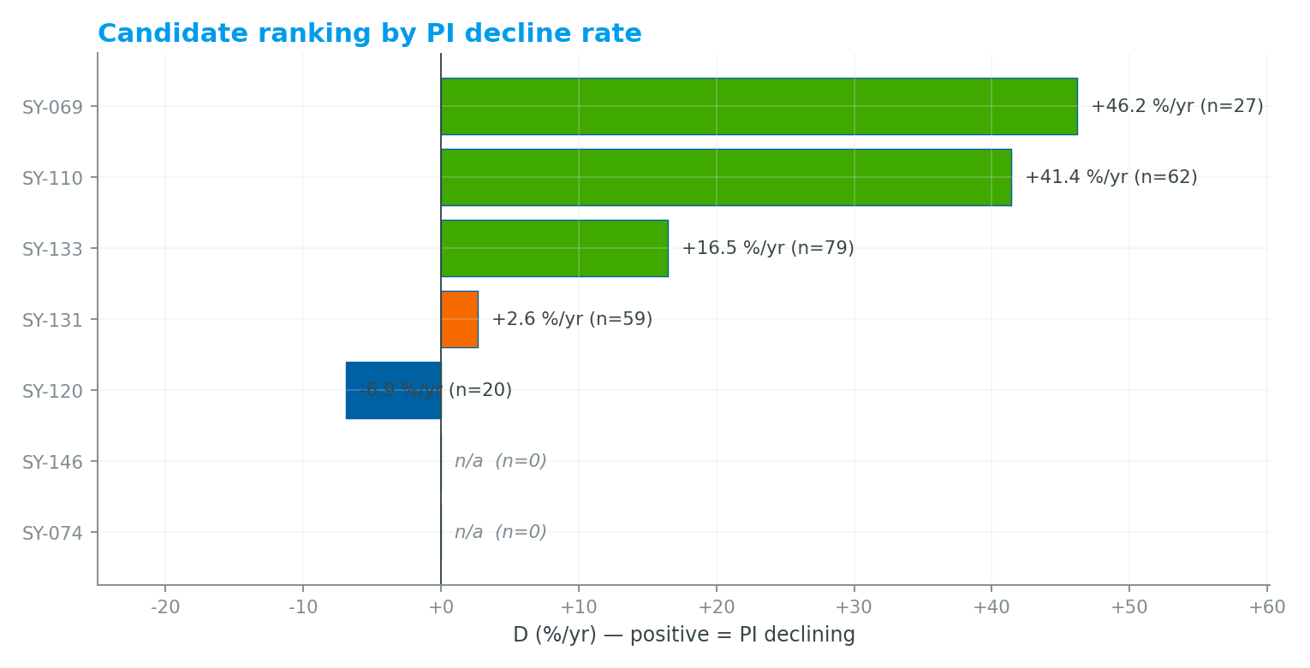
PI decline ranking
Log-linear fit of valid PI points (BHFP = PIP + Δ per well)
Interpretation
▪ Green: D ≥ 15 %/yr — active PI degradation
▪ Amber: 0–15 %/yr — mild decline
▪ Blue: D < 0 — PI actually increased
▪ SY-074 not rendered — insufficient PI points
▪ SY-146 not rendered — water-injector, no oil PI
SY-069 and SY-110 dominate the ranking · SY-131 deferred (PI grew) · SY-120 is the sustain-play case
5
ADNOC Upstream - TotalEnergies - 2026-04-23

Slide 6
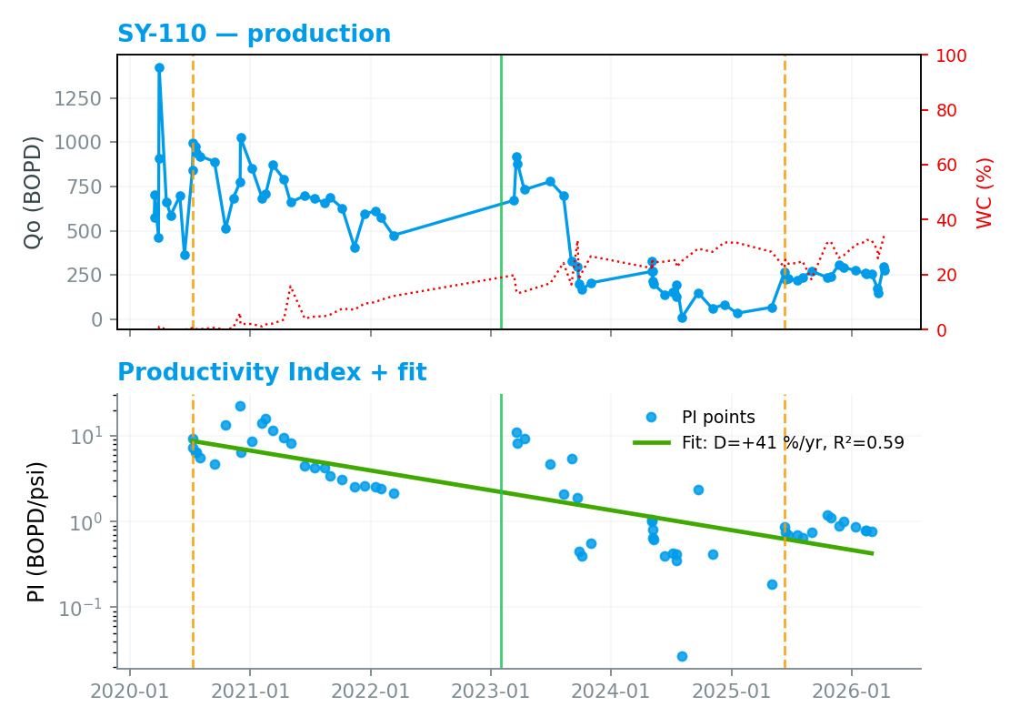
SY-110 — PI degradation (deposition flagged)
SIMSIMA R1 · Horizontal · completion 2023-01-31
Key finding
Most severe candidate: D = 53 %/yr, PI collapses 8.9 → 0.8 (−91 % over 5.6 y). Reservoir pressure stable 985→1015 psi — decline is skin/deposition-driven, not depletion.
Why now
Longest, most severe decline; stable Pres → skin-driven. Recipe: scale-dissolver pre-flush + HCl. No Y-tool: budget rig time for ESP pull.
6
ADNOC Upstream - TotalEnergies - 2026-04-23

Slide 7
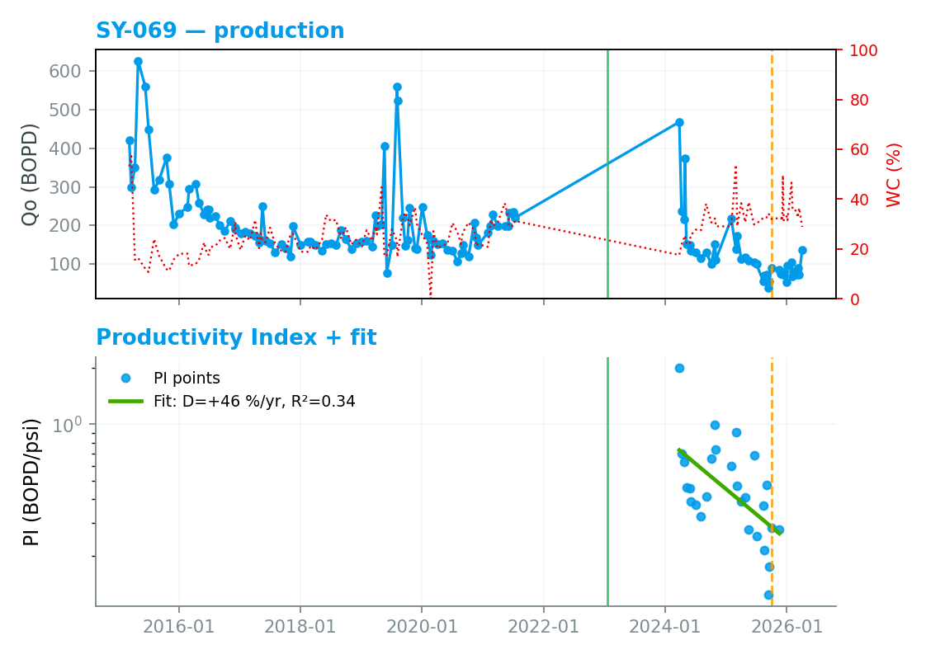
SY-069 — PI degradation
SIMSIMA R1 · Horizontal · completion 2023-01-17
Key finding
Recent-window D = 62 %/yr (shorter valid window — only one formal Pres survey in Nov-2024 limits PI calculation to ±365 d around that date). Longest history in set (135 tests, 2015-2026) ideal for benchmarking.
Why now
135-test history ideal for bench-marking; decline accelerating. Baseline recipe: 15 % HCl + naphtha 2-stage. PIP < pump optimum.
7
ADNOC Upstream - TotalEnergies - 2026-04-23

Slide 8
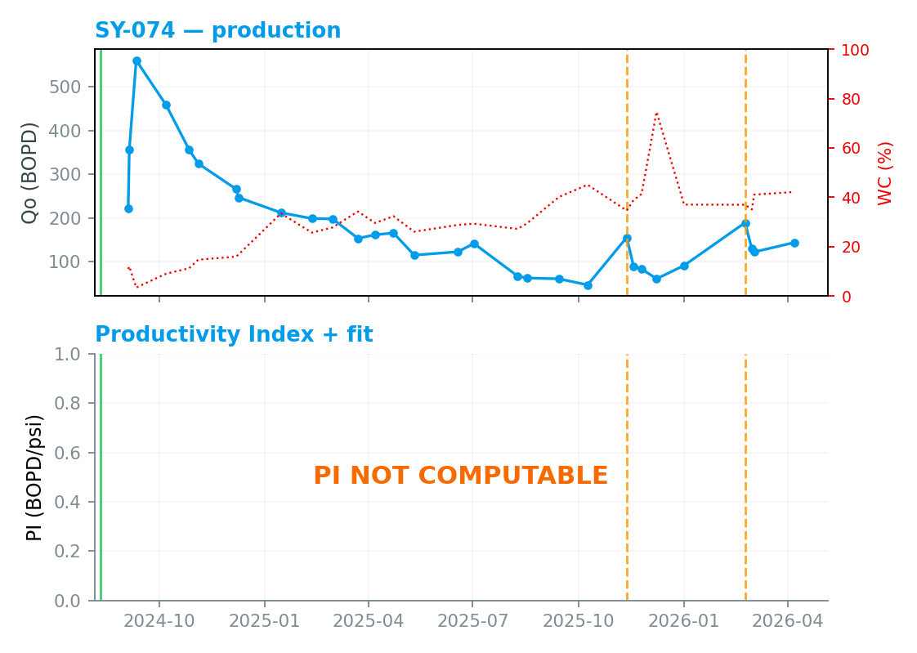
SY-074 — High dolomitization (recent sidetrack, fastest decline)
SIMSIMA R1 · Horizontal (ST2 side-tracked Q3-2024) · completion 2024-08-11
Key finding
PI NOT computable — only the 2016 pre-sidetrack GRAD survey is available and the current well is on the new ST2 lateral (Aug-2024). Qualitative case is clear: 560 → 144 BOPD (−74 %) in 18 months, WC 3.5 → 42 %. Pre-stim formal PBU mandatory.
Why now
New ST2 lateral (Aug-2024) never stimulated; mud-cake damage likely. Formal PBU survey + pre-job PLT mandatory.
8
ADNOC Upstream - TotalEnergies - 2026-04-23

Slide 9
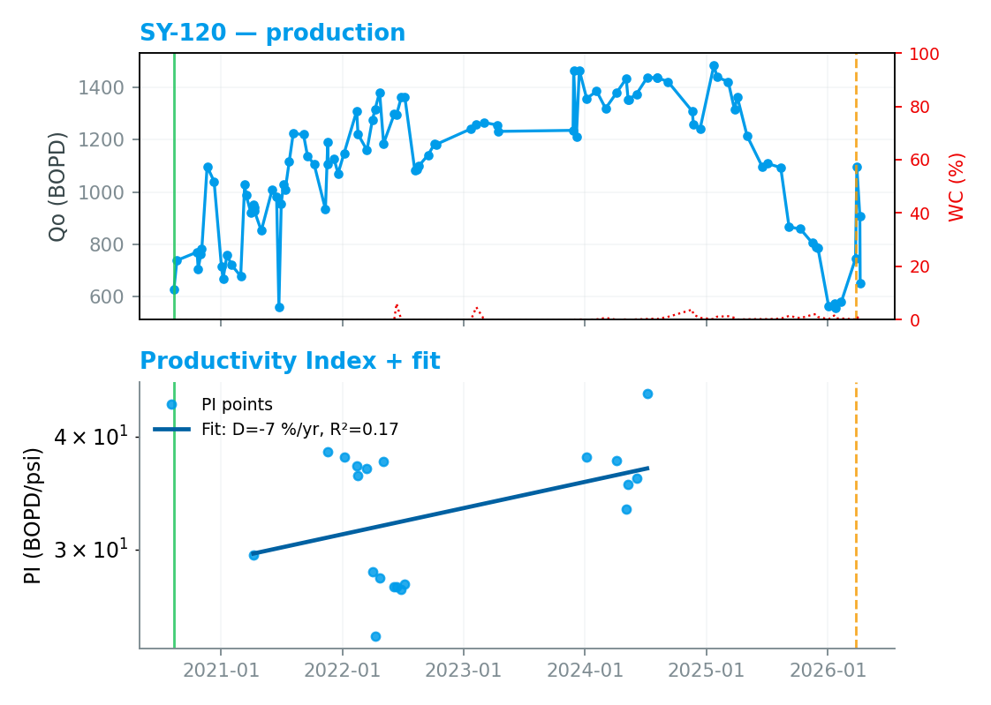
SY-120 — High dolomitization (best performer, declining)
SIMSIMA R1 · Horizontal · completion ~2020
Key finding
Only 6 %/yr PI decline despite ~200 psi Pres depletion (932 → 735 psi, 2021→2024). Decline is pressure-driven, not skin — stimulation gain will be modest; candidate is about sustaining peak deliverability (still producing 651 BOPD, recent peak 1486 BOPD).
Why now
Sustain-play — avoid over-drawdown (Pb = 392 psi). Dolomite-tailored recipe; Y-tool allows CT-conveyed treatment.
9
ADNOC Upstream - TotalEnergies - 2026-04-23

Slide 10
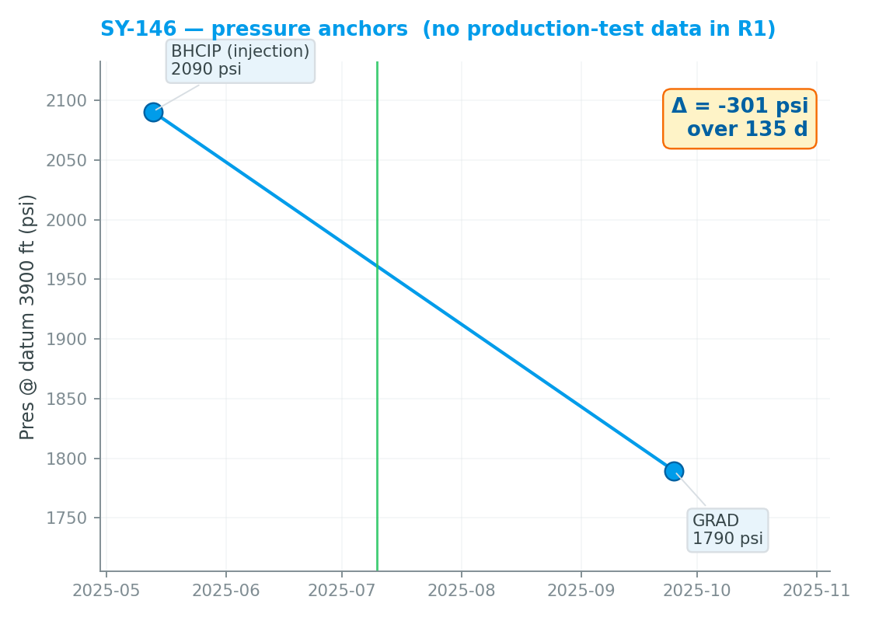
SY-146 — Water injector — poor injectivity (KoM scope)
SIMSIMA R1 · Horizontal water injector · completion 2025-07-10
Key finding
Supporting candidate — data-only: 2 formal pressure anchors (May-2025 BHCIP 2090 psi, Sep-2025 GRAD 1790 psi). No production PI applies (water injector). Narrative pending additional post-completion injectivity data.
Why now
Injectivity stim — naphtha pre-flush + HCl main stage. Hall-plot analysis pre/post; baseline needed post-completion.
10
ADNOC Upstream - TotalEnergies - 2026-04-23

Slide 11
Data gaps & caveats
Interpretation risks the rig schedule must acknowledge
▪ No formal stimulation-event database — only completion/sidetrack/startup dates are confirmed.
▪ SY-074 has a single pre-ST2 (2016, R2 layer) pressure survey — cannot calibrate PI for current ST2 lateral.
▪ SY-069 has a single formal Pres survey (Nov-2024) — valid PI window is ±365 d around that date.
▪ SY-131 PI trend is positive +15 % — narrative-level examples from KoM list are not supported by the data.
▪ SY-133 decline is water-coning dominated (WC 1.7 → 51 %) — PI fit D = 24 %/yr masks the true mechanism.
▪ Shah Q2-2026 Allowable workbook was not accessible to the pipeline — survey anchors and BHFP Δ taken from the prior v1 deliverable and the resume-prompt calibration table.
Only 4 confirmed events on record (recompletion / ST2 / startup) — request formal stim-event register
11
ADNOC Upstream - TotalEnergies - 2026-04-23

Slide 12
Conclusions & next steps
Stimulation sequence, pre-job acquisition, and gating checklist
▪ Execute SY-110 first — highest decline, stable Pres, clear skin/deposition signal, deposition-tailored recipe (scale pre-flush + HCl).
▪ Queue SY-069 second — long history + recent steep decline; 15 % HCl + naphtha 2-stage baseline.
▪ SY-074 requires a formal PBU survey before stim; pre-job PLT mandatory to map ST2 inflow.
▪ SY-120 is the sustain-play candidate — dolomite-tailored recipe, avoid over-drawdown (Pb = 392 psi).
▪ SY-146 injectivity stim: naphtha pre-flush + HCl main stage; Hall-plot analysis pre/post.
▪ Defer SY-131 (no real PI degradation); hold SY-133 as backup (needs WSO + PLT).
▪ Request Q2-2026 Allowable + formal stim-event register from operator before rig schedule finalisation.
Lead: SY-110 · Queue: SY-069 → SY-074 (post-PBU) → SY-120 → SY-146
12
ADNOC Upstream - TotalEnergies - 2026-04-23

