Slide 1
Programming
Basic problem solving techniques
1st lecture

Slide 2

Summary …
How (to start) to think like a programmer?
Problem solving strategy
How to describe a problem at all? - Descriptive language
How to cook coffee?
Slide <number>/15
1st lecture
© Jernej Vičič, Branko Kavšek

Slide 3
Thinking like programmers
HTTLAP?
(How to think like a programmer? – HTTLAP)
  Problem understanding and problem solving
  Write the solution in structured form (algorithm)
  Write the algorithm in (a) programming language (JAVA)
Slide <number>/15
1st lecture
© Jernej Vičič, Branko Kavšek

Slide 4
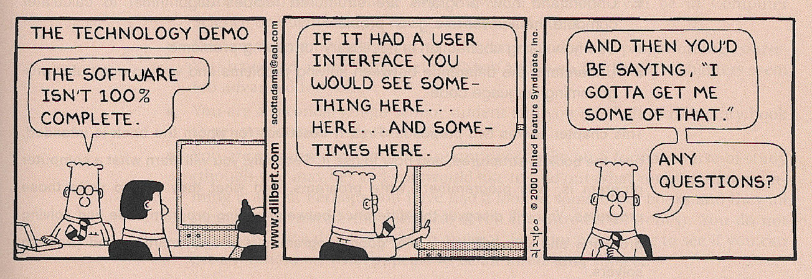
Thinking like a programmer ☺
Slide <number>/15
1st lecture
© Jernej Vičič, Branko Kavšek

Slide 5
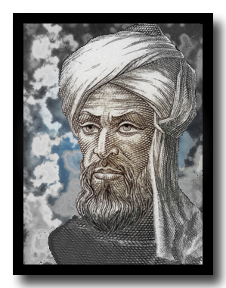
What is an algorithm?
The algorithm is a rule - a finite number of steps - which brings us to the solution of a (mathematical) problem
The origin of the word algorithm:
Abu Ja'far Mohammed ibn-Musa (a.k.a. al-Khwarizmi)
It always stops !!!
Slide <number>/15
1st lecture
© Jernej Vičič, Branko Kavšek

Slide 6
Problem-solving process
high
Abstraction level
low
Writing the
program in a
programming
language
Problem solving
algorithm
numeric formats, arithmetic rules, data storage, ...
people, activities, objects, things, …
programming
Slide <number>/15
1st lecture
© Jernej Vičič, Branko Kavšek

Slide 7
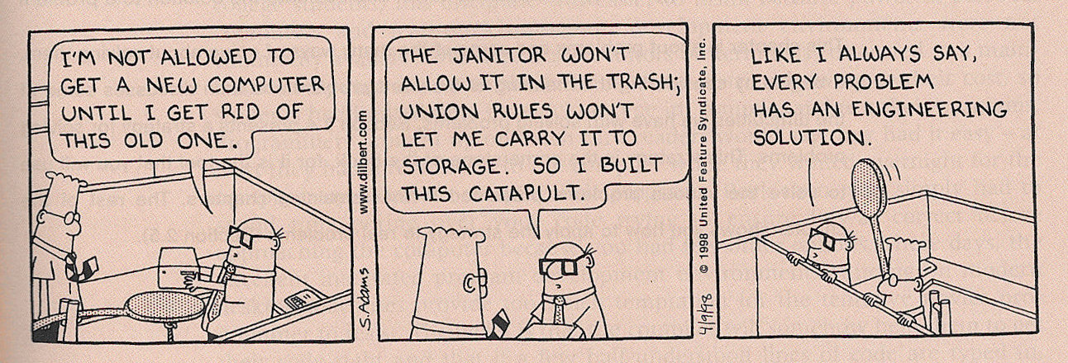
How do we solve the problem? ☺
Slide <number>/15
1st lecture
© Jernej Vičič, Branko Kavšek

Slide 8
Problem solving strategy
HTTLAP strategy:
  Understand the problem
  Develop a plan to solve the problem
  Realize plan
  Evaluate the solution (what we might have forgotten?)
  Describe what we have to learned in the process of solving (this particular) problem
  Explain/document solutions
Slide <number>/15
1st lecture
© Jernej Vičič, Branko Kavšek

Slide 9
Ways of describing problems
In natural language
Tackle the real problem? (third level failure)
With diagrams, photographs, ... → visual
By using mathematical approaches (formulae, ...) → algebraic
With the help of physical models (in architecture, construction, engineering, ...)
Pseudo-code (structured natural language)
Slide <number>/15
1st lecture
© Jernej Vičič, Branko Kavšek

Slide 10
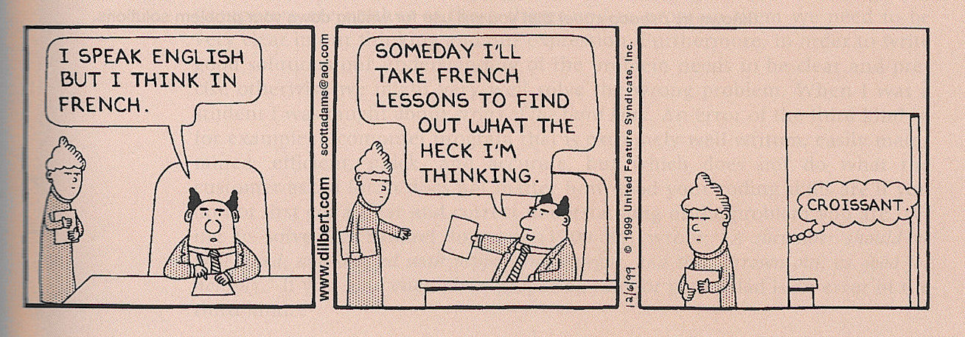
Ways of describing problems ☺
Slide <number>/15
1st lecture
© Jernej Vičič, Branko Kavšek

Slide 11
Examples of problems + description modes
Car driving
Ant and crumbs
A fly and spilt juice
Another ... mathematical task:
  morning wake up
Slide <number>/15
1st lecture
© Jernej Vičič, Branko Kavšek

Slide 12

Let’s brew some coffee …
Problem:
  Let us brew some coffee and pore it in a cup with the help of "kafetjera“
Descriptive language:
  Pseudo-code
Solving srategy:
  HTTLAP
Slide <number>/15
1st lecture
© Jernej Vičič, Branko Kavšek

Slide 13
Summary
What did we just learn?
  What did we just learn?
  Describe a (concrete) problem
  Use (HTTLAP) strategy for problem solving
  Think like programmers
  Cook (good) coffee
Slide <number>/15
1st lecture
© Jernej Vičič, Branko Kavšek

Slide 14
References
Paul Vickers: How To Think Like A Programmer: Problem-solving for the Bewildered. Course Technology, 2008.
http://www.bbc.co.uk/dna/h2g2/alabaster/A632990
http://www.mathsisgoodforyou.com/people/alkhwarizmi.htm
(slika Abu Ja'far Mohammed ibn-Musa al-Khwarizmi)
Slide <number>/15
1st lecture
© Jernej Vičič, Branko Kavšek

Slide 15
Homework
Use HTTLAP solving strategy for the following problem:
  “Refueling at the service station."
Which descriptive language did you use to describe the problem and why?
How many "steps" do you have in your solution?
Did your you deliberately simplify in you solution / released?
Slide <number>/15
1st lecture
© Jernej Vičič, Branko Kavšek

