Slide 1

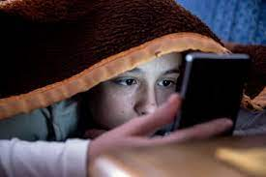
WonderReadWorld
The child is constantly watching videos/TikTok's on his/her phone

Slide 2
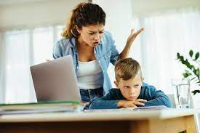
The mother is unhappy with her child watching videos all day and she wants the child to start reading

Slide 3
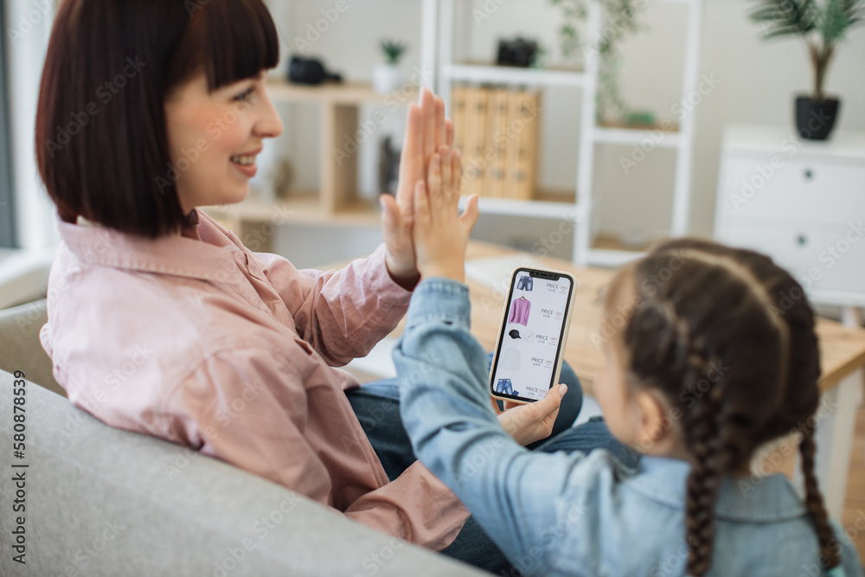
The mom finds an application that has unique way to get children to start reading enchanting to her child

Slide 4
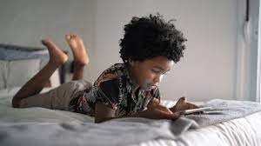
The child starts the application

Slide 5
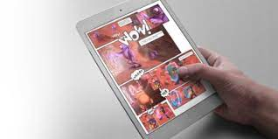
The book is voiced and animated and easy to read and follow for the child

Slide 6
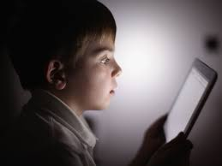
The child gets interested in the story and continues reading when the audio portion ends

Slide 7
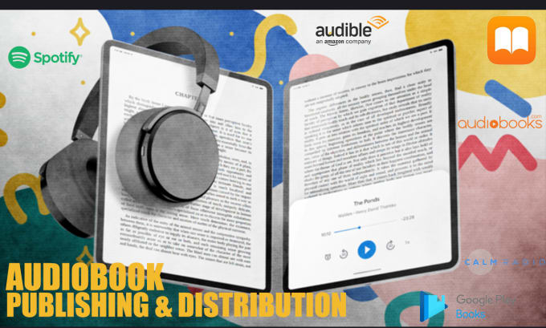
After some time, the book gets more difficult which gives incentive for progressive learning for the child

