Slide 1
Semiconductor Automatic Test Equipment
Semi-ATE
TED
Freiburg, Germany
November 2020

Slide 2

Code is your enemy!
The more code that is written :
The longer it takes to write the code
The more bugs are introduced (industry standard is between 15 & 50 bugs per 1000 lines of code)
The longer it takes to “see” the bug
The longer it takes to “find” the bug
The longer it takes to “fix” the bug
… and what about the bugs that you don’t “see” ?!?
The less easy it is for a 3rd party to “understand” the code
Minimizing code is thus the name of the game, but how ?
Chose the right programming language
Expressive (the breadth of ideas that can be represented and communicated in that language)
Versatile (easy to use & fast to develop)
The bigger the community the better, as the more libraries are available
Readable (for yourself & others)
Universal (not specialized for one or the other domain)
Utilize a “Test Execution Software” (ATE’ have this already long time, and even NI does have this concept, there it is called “TestStand”)
PEP20 : The Zen of Python
Our Test Execution Software = TES, and a part of Semi-ATE

Slide 3
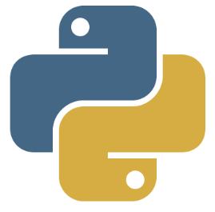



Integrated Design Environment (IDE)
The IDE must be an open source one.
Extensions (read: ‘tools’) that users write should be:
Able to convert the IDE plugin
Able to convert to Semi-ATE plugin
IDE must be able to “remote” to the ATE (Screen, keyboard, mouse for each ATE is from last century)
IDE written in- and for Python
Spyder Home page : https://www.spyder-ide.org
Spyder Repo : https://github.com/spyder-ide/spyder
Spyder Releases : https://github.com/spyder-ide/spyder/releases ^{(elaborate on 4.x & 5.x)}
Semi-ATE Repo : https://github.com/Semi-ATE/Semi-ATE
spyder-remote Repo : https://github.com/Semi-ATE/spyder-remote
Plug-ins to Spyder & Semi-ATE : all on https://github.com (elaborate on “open source” and GitHub)

Slide 4




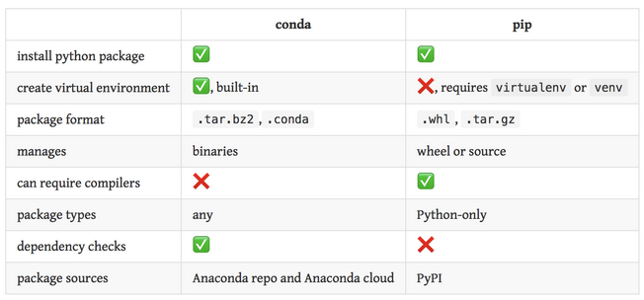

Software Distribution
feedstock
https://conda-forge.org
setup.py
setup.py
Anaconda inc.
https://github.com
https://pypi.org
https://docs.anaconda.com
private channel
pip

Slide 5
Semi-ATE name definitions
MaskSet
flow
Die
Package
Device
flow
Product
MaskSet
flow
Die
Probing
aka
Wafer Sort
Assembly
Aka
packaging
Final Test

Slide 6
Semi-ATE name definitions
MaskSet = an untested (or not fully tested) wafer
Die = a fully tested wafer
Device = an untested (or not fully tested) DUT
Product = a fully tested DUT → this is what we sell
A Flow is a sequence of 0 or more test programs
A Test Program is a sequence of 1 or more tests
A MaskSet can yield multiple Dies (depending on the flow)
A Device can yield multiple Products (depending on the flow)
A flow can be customer specific !
There are different kinds of flows for different kind of use-cases, but all of them use the same ‘tests’ !
Checker flow (normally 1 test program for loadboard the checker used by all)
Maintenance flow (normally 1 test program used in production for test-cell verification) * should maybe change this name
Production (zero or more test programs, dependent on the BASE FT/PR used in production)
Engineering flows (used in the LAB able to shmoo!)
Validation flows (used by the designers for validation of initial silicon)
Quality (used by Quality to test customer returns)
Qualification flow(s) (only in FT)
…
A test program is created without writing code!
A Test is the only thing that needs writing (in python)

Slide 7
Semi-ATE
Semi-ATE is an open-source system to create and maintain semiconductor tests, test programs and test flows.
Semi-ATE is tester agnostic Test Execution Software and accompanying GUI.
One can make a ‘tester’ plug-ins to Semi-ATE:
The SCT platform is of course doing so.
“Tinzy” is a candidate.
“NI lab set-ups” might be a candidate (not sure if the result will warrant the effort)
…
Semi-ATE is NOT Micronas Specific ! But Semi-ATE has the ability to use company specific plugins to make Semi-ATE work with the “IT infrastructure”. This way, tests that are written in IC-Sense, Asama, InvenSense, … can all be used in Micronas!!!

