Slide 1
Beforehands

Slide 2
OMOptim
C++ code
Stored on subversion solver
Using Qt libraries (GUI, Model/View, Containers, Threads, XML…)

Slide 3
Main classes

Slide 4
Class Project
The Core of the program
One project at a time
Contains main items
Modelica tree of models, package… (ModClassTree)
List of problems and results
List of ModModelPlus
Misc. Informations : save files, files loaded
Main functions
Problems should be launched from Project
Threads management

Slide 5
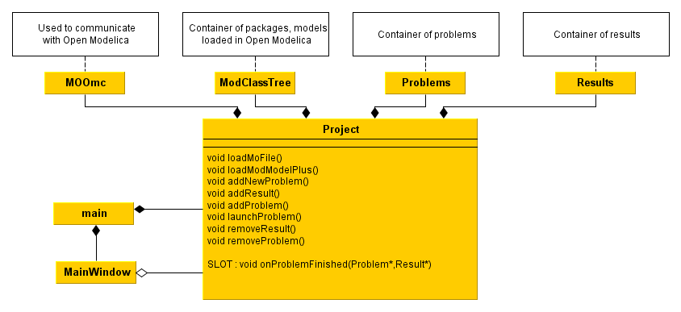
Class Project

Slide 6
GUI
Widgets
Modelica
ModClassTree
Problems
Problem
Dialogs
ModPlusCtrl
ModModelPlus
Result
ProblemInterface
Treeviews
Tableviews
ModClass

Slide 7
ModelicA - Models

Slide 8
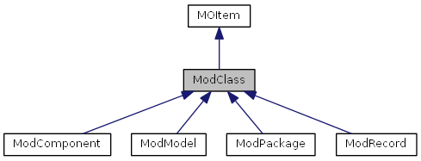
ModClass
Basic class, corresponding to an item in modelica
Each instance stores name and children
Inheritance diagram

Slide 9
ModClassTree
Contains modelica models, packages, classes names

Slide 10
ModModelPlus
ModModelPlus
ModModel* pointer to a modelica model
void compile()
void readVariables()
ModModelPlus allows to store information about a modelica model (ModModel*).
Especially :
Input variables
Connections between components
It also provides compiling and reading functions. Still, those functions require ModPlusCtrl.

Slide 11
ModPlusCtrl
Simulation software controler :
Specific for each simulation software
Provide interface functions :
Set simulation parameters
Writing / Reading variables
Compiling model
Simulating model
Set Parameters :
Simulation time
Solver
Tolerances
…

Slide 12
ModReader & MOOmc
Offering modelica reading functions
MOOmc : link between OpenModelica & OMOptim (use Corba protocol)
QString getFlattenedModel (const QString &modelName)
bool addConnection (QString org, QString dest)
void getInheritedComponents (QString parentClass, QStringList &names, QStringList &classes)
…

Slide 13
Model management
MOOMC
Reading model
Corba communication with OpenModelica
MyFile.mo
ModClassTree
OMOptim
Model A
Model B
ModPlusCtrl
OpenModelica controler
Dymola controler
MathModelica controler
Compiling
Simulating
Reading/Writing variables

Slide 14
Problems

Slide 15
Launching a problem
User
project->launchProblem(myProblem)
SLOT
project->onProblemFinished(myProblem,myResult)
Create Problem Thread
myProblem->launch()
… separate thread …
Post-computation procedure :
Result storage
GUI creation
SIGNAL
emit finished(myProblem,myResult)
Project
Problems* _problems;
Results* _results;
void launchProblem(Problem*);
SLOT : void onProblemFinished(Problem*,Result*);
Separate
thread
ProblemThread
void run();
SIGNAL : void finished (Problem*,Result*);

Slide 16
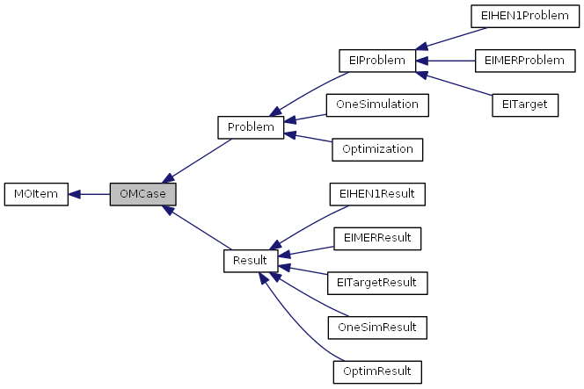
Problem
An abstract class defining basic functions.
Inherits OMCase which contains more basic virtual functions.

Slide 17
One Simulation
Problem1 [OneSimulation]
OverwritedVariables
ModPlusControler
ModModelPlus*
Project
ModClassTree
Package 1
Package 2 [ModPackage]
Model a
Model b [ModModel]
ModModelPlus
ModModelPlus

Slide 18
One Simulation
OneSimResult
ModModelPlus*
Linked to ModModel (node in ModClassTree)
ModPlusCtrl*
Simulator choice and parameters
Overwritedvariables*
Variables with new values set by the user
Model initial variables
FinalVariables
Simulation variables at final time
OneSimulation
A copy of the problem

Slide 19
Problems’ plugin
Plugin loading :
dynamic or static
Shared OMOptim :
OneSimulation
Optimization
Energy Integration
PluginEI
.dll
My Sensitivity analysis
Method: implement new inheritances of following abstract classes
- ProblemInterface
- Problem
- Result

Slide 20
Energy integration

Slide 21
Energy integration
EI is a plugin offering new problems
EIMER : Minimum energy requirement
EITarget : Utilities targetting
EIHEN1 : Heat Exchanger Network

Slide 22
Energy integration
ModPlusCtrl
Modelica model
MOOmc
EIProblem
-MER
-Target
-HEN
Cplex
Cbc
GLPK
MILP Solver
MILP optimization problem

Slide 23
GUI

Slide 24
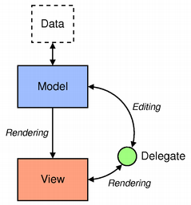
GUI – Core links
Often use Qt model-view programming
Data / GUI more independent

Slide 25
Conventions used in code
Class name always start with an uppercase : MyClass
Members always start with _ + lowercase
_myInstance
Local variables start with lowercase
myLocalVariable
Documentation generated through Doxygen

