Slide 1
Beforehands

Slide 2
OMOptim
C++ code
Stored on subversion solver
Using Qt libraries (GUI, Model/View, Containers, Threads, XML…)

Slide 3
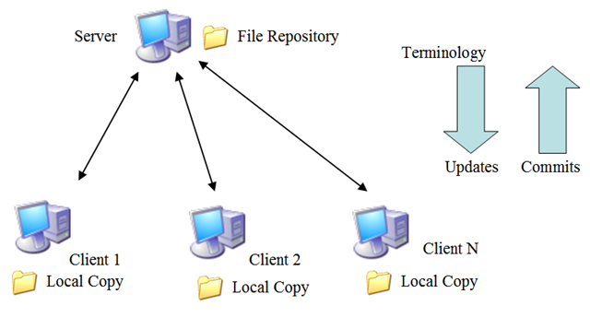
Subversion repository

Slide 4
Main classes

Slide 5
Class Project
The Core of the program
One project at a time
Contains main items
Modelica tree of models, package… (ModClassTree)
List of problems and results
List of ModModelPlus
Misc. Informations : save files, files loaded
Main functions
Problems should be launched from Project
Threads management

Slide 6
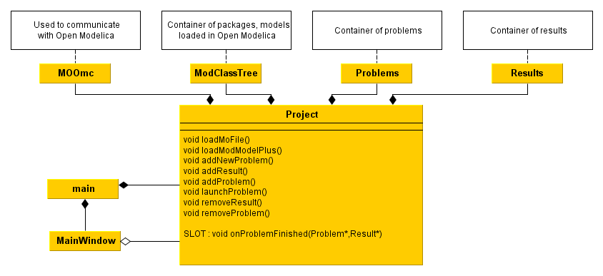
Class Project

Slide 7
GUI
Widgets
Modelica
ModClassTree
Problems
Problem
Dialogs
ModPlusCtrl
ModModelPlus
Result
ProblemInterface
Treeviews
Tableviews
ModClass
OMOptim

Slide 8
ModelicA - Models

Slide 9
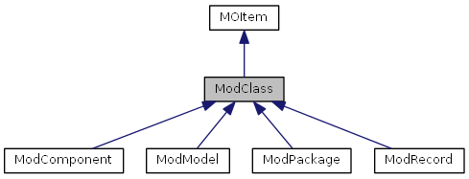
ModClass
Basic class, corresponding to an item in modelica
Each instance stores name and children
Inheritance diagram

Slide 10
ModClassTree
Contains modelica models, packages, classes names

Slide 11
ModModelPlus
ModModelPlus
ModModel* pointer to a modelica model
void compile()
void readVariables()
ModModelPlus allows to store information about a modelica model (ModModel*).
Especially :
Input variables
Connections between components
It also provides compiling and reading functions. Still, those functions require ModPlusCtrl.

Slide 12
ModPlusCtrl
Simulation software controler :
Specific for each simulation software
Provide interface functions :
Set simulation parameters
Writing / Reading variables
Compiling model
Simulating model
Set Parameters :
Simulation time
Solver
Tolerances
…

Slide 13
ModReader & MOOmc
Offering modelica reading functions
MOOmc : link between OpenModelica & OMOptim (use Corba protocol)
QString getFlattenedModel (const QString &modelName)
bool addConnection (QString org, QString dest)
void getInheritedComponents (QString parentClass, QStringList &names, QStringList &classes)
…

Slide 14
Model management
MOOMC
Reading model
Corba communication with OpenModelica
MyFile.mo
ModClassTree
OMOptim
Model A
Model B
ModPlusCtrl
OpenModelica controler
Dymola controler
MathModelica controler
Compiling
Simulating
Reading/Writing variables

Slide 15
Problems

Slide 16
Launching a problem
User
project->launchProblem(myProblem)
SLOT
project->onProblemFinished(myProblem,myResult)
Create Problem Thread
myProblem->launch()
… separate thread …
Post-computation procedure :
Result storage
GUI creation
SIGNAL
emit finished(myProblem,myResult)
Project
Problems* _problems;
Results* _results;
void launchProblem(Problem*);
SLOT : void onProblemFinished(Problem*,Result*);
Separate
thread
ProblemThread
void run();
SIGNAL : void finished (Problem*,Result*);

Slide 17
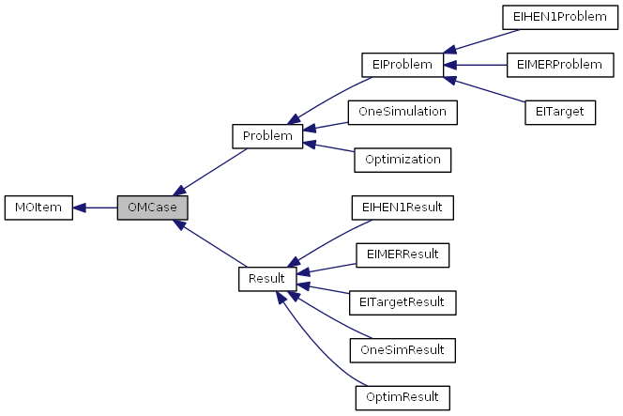
Problem
An abstract class defining basic functions.
Inherits OMCase which contains more basic virtual functions.

Slide 18
One Simulation
Problem1 [OneSimulation]
OverwritedVariables
ModPlusControler
ModModelPlus*
Project
ModClassTree
Package 1
Package 2 [ModPackage]
Model a
Model b [ModModel]
ModModelPlus
ModModelPlus

Slide 19
One Simulation
OneSimResult
ModModelPlus*
Linked to ModModel (node in ModClassTree)
ModPlusCtrl*
Simulator choice and parameters
Overwritedvariables*
Variables with new values set by the user
Model initial variables
FinalVariables
Simulation variables at final time
OneSimulation
A copy of the problem

Slide 20
Problems’ plugin
Plugin loading :
dynamic or static
Shared OMOptim :
OneSimulation
Optimization
Energy Integration
PluginEI.dll
My Sensitivity analysis
Method: implement new inheritances of following abstract classes
- ProblemInterface
- Problem
- Result

Slide 21
Energy integration

Slide 22
Energy integration
EI is a plugin offering new problems
EIMER : Minimum energy requirement
EITarget : Utilities targetting
EIHEN1 : Heat Exchanger Network

Slide 23
Energy integration
ModPlusCtrl
Modelica model
MOOmc
EIProblem
-MER
-Target
-HEN
Cplex
Cbc
GLPK
MILP Solver
MILP optimization problem

Slide 24
GUI

Slide 25
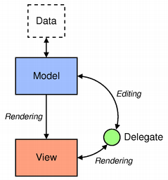
GUI – Core links
Often use Qt model-view programming
Data / GUI more independent

Slide 26
Conventions used in code
Class name always start with an uppercase : MyClass
Members always start with _ + lowercase
_myInstance
Local variables start with lowercase
myLocalVariable
Documentation generated through Doxygen

Slide 27
OMOptim
PluginEI
PluginEI
OMOptim
Modelica
OMOptimBasis
Variables, Problems, Settings, GUI

Slide 28
Source code storage

Slide 29
Documentation

