Slide 1
2024
Exploring the Meme Popularity With Desicion Tree
A study about predicting meme popularity.
Mahmut Semih Güner

Slide 2
Table of contents
01
03
02
04
What are Memes
What did I Found Out
A simple explanation to memes
My findings after the evaluation
Data Overwiev
Conclusion
Aim of this Project.

Slide 3
2024
01
What are Memes
A breif explanation to memes

Slide 4
2024
Meme Definition
Memes are cultural elements, typically in the form of images, videos, or text, that spread rapidly and often humorously on the internet. These digital artifacts convey a particular idea, behavior, or style that is easily imitated and shared among users.

Slide 5
2024
Where did that Word came from
The term "meme" was coined by British evolutionary biologist Richard Dawkins in 1976 in his book "The Selfish Gene’. Dawkins used the term to describe an idea or behavior that spreads within a culture, analogous to the way genes propagate in biological evolution.

Slide 6
2024
What is the Aim of This Project?
The primary goal of this project is to analyze social media content, specifically memes, using a decision tree model. The project focuses on understanding the factors that contribute to the popularity of memes.

Slide 7
2XXX
02
Data Overview
What are my data looks like

Slide 8
2024
Classes and features
Features:
Humor Type
Format
Featuring Song
Visual Features
OP Platform
Target Variable: IsPopular

Slide 9
2024
Humor Types
Type of humor that the meme directed on Absurdism, Dark, Sarcasm/Irony, Rage-Bait, Wholesome, Satirical, Dank, Relatable

Slide 10
2024
Format
Format of the meme
Photo, Video, Text

Slide 11
2024
Featuring Song
IF the meme features song or not Yes, No

Slide 12
2024
Visual Features
Visual features that meme have 'MultipleFeatures', 'Reaction', 'Absurd', 'Animals', 'PopCulture', 'Surreal', 'DeepFried'

Slide 13
2024
OP Platform
Original poster’s platform 'Twitter(X)', 'Instagram', 'TikTok', 'Unknown', 'Youtube', 'FaceBook', 'Reddit'

Slide 14
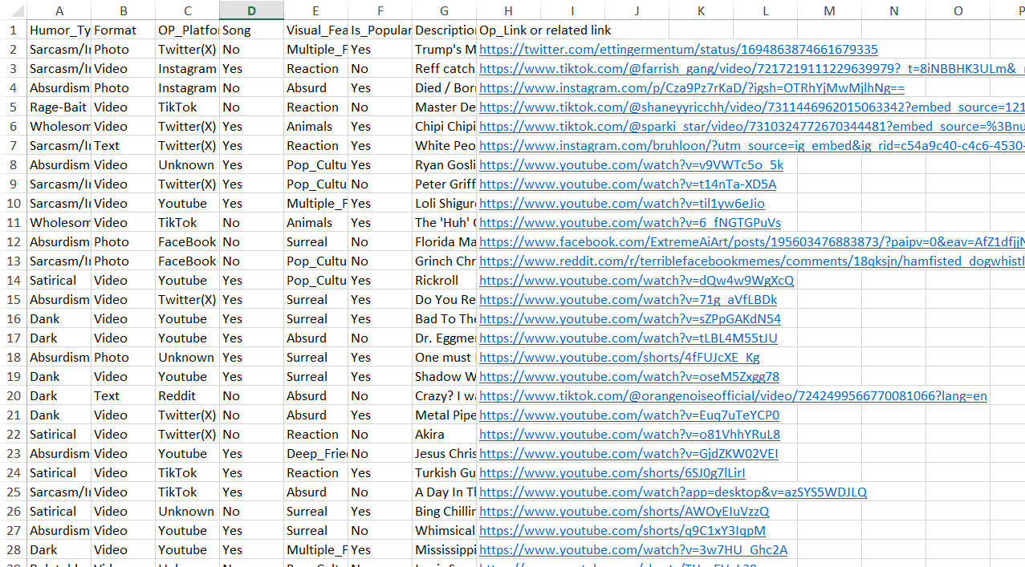
How my dataset looks

Slide 15
2XXX
What did I found out
03
My findings
SLIDESGO.COM

Slide 16
My outputs
Confusion Matrix - Fold 1:
[[8 4]
[7 8]]
Predictions - Fold 1:
[0 1 0 1 0 1 1 1 0 0 0 1 0 0 0 1 1 1 1 1 0 0 0 0 0 0 1]
Classification Report - Fold 1:
precision recall f1-score support
0 0.53 0.67 0.59 12
1 0.67 0.53 0.59 15
accuracy 0.59 27
macro avg 0.60 0.60 0.59 27
weighted avg 0.61 0.59 0.59 27
Confusion Matrix - Fold 2:
[[9 5]
[8 4]]
Predictions - Fold 2:
[1 1 0 0 0 0 0 1 0 0 0 0 0 0 0 1 0 1 1 0 1 1 1 0 0 0]
Classification Report - Fold 2:
precision recall f1-score support
0 0.53 0.64 0.58 14
1 0.44 0.33 0.38 12
accuracy 0.50 26
macro avg 0.49 0.49 0.48 26
weighted avg 0.49 0.50 0.49 26

Slide 17
My outputs
Confusion Matrix - Fold 3:
[[10 3]
[ 5 8]]
Predictions - Fold 3:
[0 0 1 0 1 1 0 1 1 0 0 0 0 1 0 1 1 0 0 0 1 0 1 0 0 1]
Classification Report - Fold 3:
precision recall f1-score support
0 0.67 0.77 0.71 13
1 0.73 0.62 0.67 13
accuracy 0.69 26
macro avg 0.70 0.69 0.69 26
weighted avg 0.70 0.69 0.69 26
Confusion Matrix - Fold 4:
[[11 6]
[ 3 6]]
Predictions - Fold 4:
[1 0 1 0 0 0 1 1 0 1 0 0 0 1 0 1 0 0 0 1 1 0 1 0 1 1]
Classification Report - Fold 4:
precision recall f1-score support
0 0.79 0.65 0.71 17
1 0.50 0.67 0.57 9
accuracy 0.65 26
macro avg 0.64 0.66 0.64 26
weighted avg 0.69 0.65 0.66 26

Slide 18
2XXX
04
Conclusion

Slide 19
To Wrap Up
In conclusion, this project delved into the intriguing realm of memes, seeking to decipher the elements that contribute to their popularity on social media platforms. We embarked on a journey through the evolution of memes, explored the dataset's features, and trained a decision tree model to predict their popularity.

Slide 20
2024
Thanks!
Do you have any questions?
Mahmut Semih Güner 190101033

