Slide 1
Reinforcement Learning

Slide 2
First environment: Cartpole

Slide 3
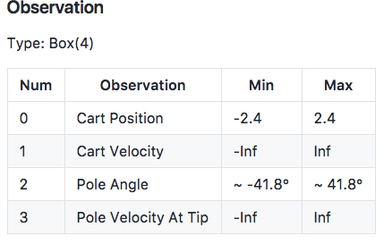
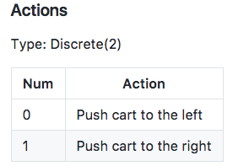
First environment: Cartpole

Slide 4
Second environment: MountainCar

Slide 5
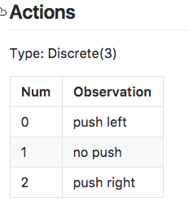
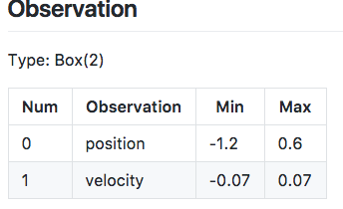
Second environment: MountainCar

Slide 6
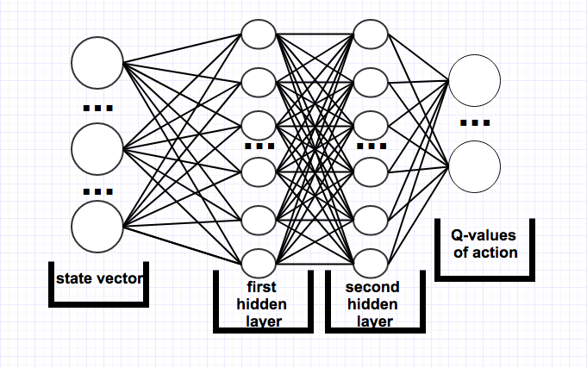
First model
First hidden layer – 24 neurons (relu activation)
Second hidden layer – 24 neurons(relu activation)

Slide 7
Second Model
Two same models to increase training stability: target model and basic model
Fisrt we train on basic model and every n iterations update target model
First hidden layer – 32 neurons (relu activation)
Second hidden layer – 16 neurons(relu activation)

Slide 8
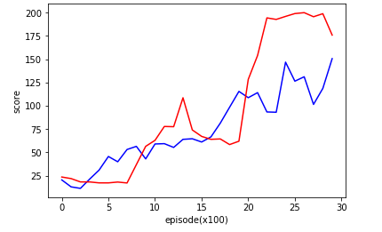
Results (cartpole)

Slide 9
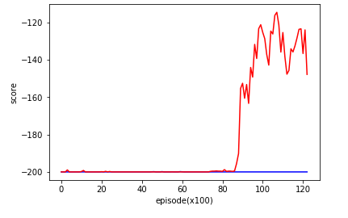
Results (mountain car)

