Slide 1
Fundamentals of Operating Systems
husseinnasser
Build efficient software by understanding how the OS works

Slide 2
Introduction
husseinnasser

Slide 3
Introduction
husseinnasser
Welcome
Who this course is for?
Course Outline

Slide 4
Introduction to OS
husseinnasser
Understanding the need of an OS

Slide 5
Why OS?
husseinnasser
Why do we need an operating system?

Slide 6




OS
Operating System is a Software
Resources needs to be managed
Your apps talk to the OS
Most OSs are general purpose

Slide 7
Scheduling
Scheduling is critical
Fair share of resources to all processes
CPU/Memory/IO
P1
P2

Slide 8
Why OS
OS APIs abstracts the hardware
Your app works on any hardware*
Occasional breaking changes (64bit/32bit)
Can you build your app without OS?

Slide 9
Understand the OS
OS shouldn’t be a black box
Building efficient apps
OS?
Your App
Notes:
If you understand how operating systems work you can build your own if needed, but most importantly you can finesse your app around the quirks of the OS and make the app flow with the OS like water flowing through a river.

Slide 10
Summary
Operating System manages resources
Schedules different processes
Maintains compatibility
Understanding it makes a better engineer

Slide 11
System Architecture
husseinnasser
The components the operating system operates

Slide 12
System Architecture
System has resources
The Kernel is OS core component
The Kernel manages the resources
OS has more tools for usability

Slide 13
CPU
Central Processing Unit
Consists of cores
Each core has a clock speed
Executes machine level instructions
Fast Caches

Slide 14
Memory
Random Access Memory
Fast but Volatile
Store process states and data
Limited
Slower than CPU cache

Slide 15

Storage
Persisted storage
HDD, SSD
Slower than memory

Slide 16
Network
Communicates with other hosts
NIC (Network Interface Controller)
Protocol implementations

Slide 17
Kernel
The core of the OS
We focus in this course on the kernel tasks
Manages the resources
The OS is more than the kernel
GUI, command lines, UI and tooling
E.g. top is a tool that extracts processes
Distros is all about this extra tooling

Slide 18
File System
Storage is mostly blocks of bytes
We like to work files
File system is an abstraction
How files stored on disk
btrfs, ext4, fat32, NTFS, tmpfs

Slide 19
Program vs Process
postgres pid 1
postgres.exe
postgres pid 2
Program is the compiled executable
Process is an instance of the program
Process is a program in motion
Program is a process at rest
Execution file format
postgres pid 3
mysql.bin
Mysql pid 1
Mysql pid 2

Slide 20
Process Management
postgres pid 1
postgres pid 2
Kernel manages processes
Schedules process for a CPU
Switches a process for another
Grant access to resources like storage
postgres pid 3

Slide 21
User space vs Kernel Space
0xFFFFFFFF
Kernel
0xC0000000
User
User space
Browser
Postgres
Protected kernel space
Kernel code
Device drivers
TCP/IP Stack
Isolated, (io_uring kind of broke that rule)
0x00000000
Process

Slide 22
Device Drivers
Drivers are software in the kernel
Manages hardware devices
NVMe, Keyboard, NIC, etc.
Interrupt Service Routine

Slide 23
System Calls
To jump from User to Kernel mode
User makes a system call
read() write() malloc()
Mode switch

Slide 24
Summary
System has resources
The Kernel is OS core component
The Kernel manages the resources
OS has more tools for usability

Slide 25
The Anatomy of a Process
husseinnasser
What is in a process

Slide 26
Program vs Process
husseinnasser
Process is a Program in motion

Slide 27
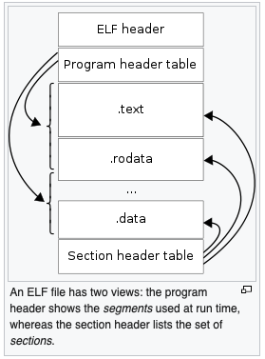
Program
Code is compiled and linked for a CPU
Produces executable file program
Only works on that CPU architecture
At rest it follows an executable file format
Lives on disk

Slide 28
Process
Max address
Stack
Heap
Data+static
text/code
When a program is run, we get a process
Process lives in memory
Uniquely identified with an id
Instruction pointer/program counter
Process Control Block (PCB)
Min address

Slide 29
Program vs Process
postgres.exe
postgres
pid 1
Pc 0x111111
postgres
pid 2
Pc 0x222222
postgres
pid 3
Pc 0x333333

Slide 30
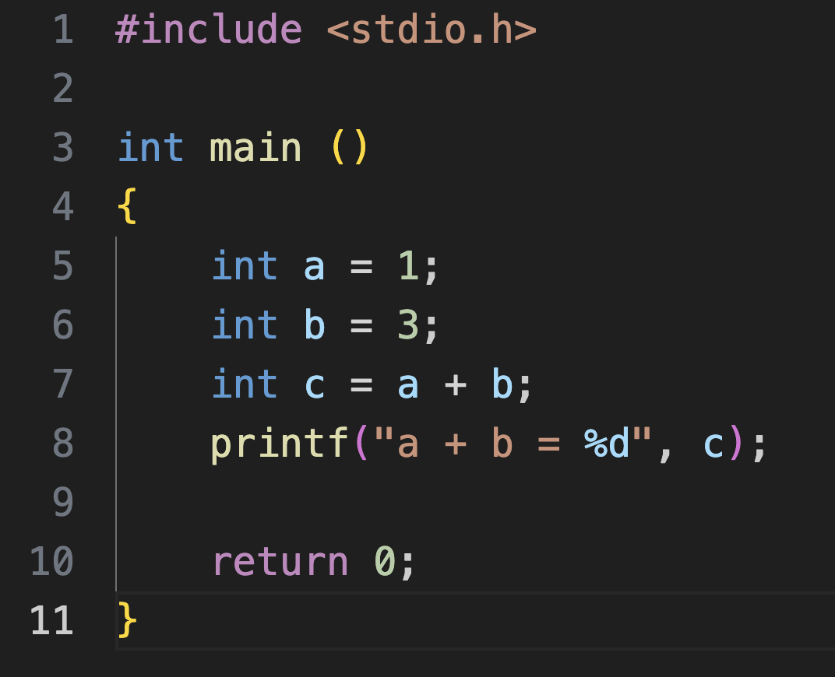
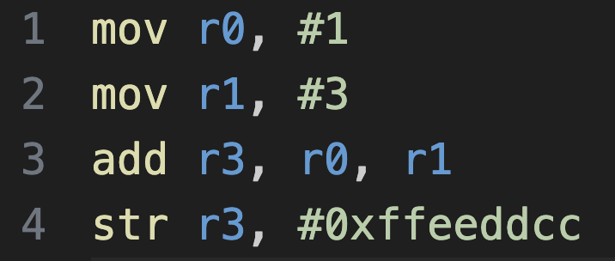
Producing machine code
Compile
Assembly
C code

Slide 31
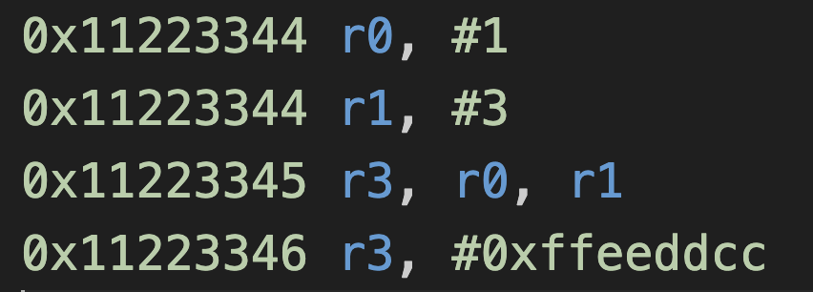
Compiling
Assembly
Machine code
Note, machine code is different from assembly,
For sake of illustration I’ll use assembly as machine code for readability
as most instructions are 1 to 1

Slide 32
Program
Executable file (program)

Slide 33
Process
r0
r1
pc
1
3
0xaabbcc00
c: 4
stack
4
0xffeeddcc
r2
r3
CPU
Heap
static
0xaabbcc12
0xaabbcc08
Text (code)
0xaabbcc04
0xaabbcc00
Process (in memory)

Slide 34
Demo
Spin a process in linux
Use debugger to attach to process
Inspect and look at the program counter
Notes:
Compile with
gcc -g -o your_program your_program.c
Gdb ./test
Run ./a.out (from cputest.c)
Ps
Get the process id
Sudo gdb -p [pid]
Then do
Info registers
r0 0x51e4c359 1373946713
r1 0x8e437a1 149174177
r2 0xbc873c92 3162979474
r3 0xffffffff 4294967295
r4 0xe6bffeb 241958891
r5 0x8e437a1 149174177
r6 0x102e0 66272
r7 0x0 0
r8 0x0 0
r9 0x0 0
r10 0x76fc1000 1996230656
r11 0x7ed75534 2128041268
r12 0x7ed755b0 2128041392
sp 0x7ed75518 0x7ed75518
lr 0x76e30718 1994589976
pc 0x10404 0x10404 <main+52>
cpsr 0x20000010 536870928
fpscr 0x0 0

Slide 35
Summary
A Process is a program in motion
Program has an execution file format
Process has counter for the current instruction
Process states stored in the PCB

Slide 36
Simple Process Execution
husseinnasser
Walking through a simple process
focus program counter

Slide 37
Producing machine code
Compile
Assembly
C code

Slide 38
Compiling
Assembly
Machine code
Note, machine code is different from assembly,
or sake of illustration I’ll use assembly as machine code for readability
as most instructions are 1 to 1

Slide 39
Program
Executable (program)

Slide 40
Run the program
Process 1
Process 2
Process 3
Your Process
Memory

Slide 41
Cost time!
Register access - 1ns
L1 Cache - 2ns
L2 Cache - 7ns
L3 Cache - 15ns
Main Memory - 100 ns
SSD - 150 us
HDD -10 ms

Slide 42
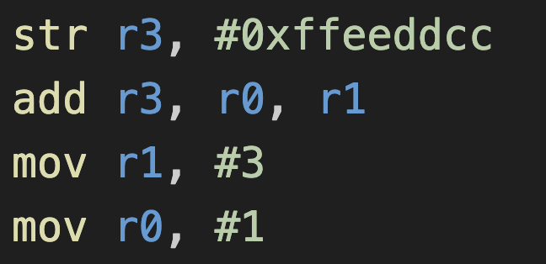
New Process
Process 1
Memory
Process 2
Process 3
0xffeeddcc
Your Process
0xaabbcc12
0xaabbcc08
Text (code)
0xaabbcc04
0xaabbcc00
Machine code is often read bottom to top
Low address to high address
Notes:
A new process is spun up, the text code and many other data is loaded in memory, the program counter or instruction pointer points to where the first instruction is, usually specified in the program

Slide 43
Start
r0
r1
pc
0xaabbcc00
0xffeeddcc
r2
r3
CPU
0xaabbcc12
0xaabbcc08
Text (code)
0xaabbcc04
Instruction
Pointer / program counter (pc)
0xaabbcc00
Process (in memory)
Notes:
We start the program, the instruction pointer or program counter points to the first instruction, the pc register is updated with the memory address of the program counter

Slide 44
Load/fetch instruction
r0
r1
pc
0xaabbcc00
ir
0xffeeddcc
r2
r3
Memory read!
CPU
0xaabbcc12
0xaabbcc08
0xaabbcc04
0xaabbcc00
pc
Process (in memory)
Notes:
Next, we load the instruction from memory to the cpu IR register or instruction register, after all cpu need to know what the instruction is.

Slide 45
Execute Instruction
r0
r1
pc
1
0xaabbcc00
ir
0xffeeddcc
r2
r3
CPU
0xaabbcc12
0xaabbcc08
0xaabbcc04
0xaabbcc00
pc
Process (in memory)
Notes:
Next, we load the instruction from memory to the cpu IR register or instruction register, after all cpu need to know what the instruction is.

Slide 46
Increment PC
r0
r1
pc
1
0xaabbcc04
0xaabbcc00
ir
0xffeeddcc
r2
r3
CPU
0xaabbcc12
0xaabbcc08
0xaabbcc04
pc
0xaabbcc00
pc
We add 4 bytes, that is the size of instruction
Depends on the CPU
Notes:
Next, we load the instruction from memory to the cpu IR register or instruction register, after all cpu need to know what the instruction is.

Slide 47
Load next instruction
r0
r1
pc
1
0xaabbcc04
ir
0xffeeddcc
r2
r3
CPU
0xaabbcc12
0xaabbcc08
0xaabbcc04
pc
0xaabbcc00
Note, that while I’m representing second instruction fetch as a memory access, it is often retrieved from the CPU L caches. This is because when we fetch data from the memory we fetch not only what we need, but much more, what is called burst.
This is the beauty of understanding caches and power of using near by code..
Notes:
Next, we load the instruction from memory to the cpu IR register or instruction register, after all cpu need to know what the instruction is.

Slide 48
Execute
r0
r1
pc
1
3
0xaabbcc04
ir
0xffeeddcc
r2
r3
0xaabbcc12
0xaabbcc08
0xaabbcc04
pc
0xaabbcc00
Notes:
Next, we load the instruction from memory to the cpu IR register or instruction register, after all cpu need to know what the instruction is.

Slide 49
Increment
r0
r1
pc
1
3
0xaabbcc08
ir
0xffeeddcc
r2
r3
0xaabbcc12
0xaabbcc08
pc
0xaabbcc04
0xaabbcc00
Notes:
Next, we load the instruction from memory to the cpu IR register or instruction register, after all cpu need to know what the instruction is.

Slide 50
Load
r0
r1
pc
1
3
0xaabbcc08
ir
0xffeeddcc
r2
r3
0xaabbcc12
0xaabbcc08
pc
0xaabbcc04
0xaabbcc00
Notes:
Next, we load the instruction from memory to the cpu IR register or instruction register, after all cpu need to know what the instruction is.

Slide 51
Execute add
r0
r1
pc
1
3
0xaabbcc08
ir
4
0xffeeddcc
r2
r3
0xaabbcc12
0xaabbcc08
pc
0xaabbcc04
0xaabbcc00
Notes:
Next, we load the instruction from memory to the cpu IR register or instruction register, after all cpu need to know what the instruction is.

Slide 52
Increment/Fetch
r0
r1
pc
1
3
0xaabbcc12
ir
4
0xffeeddcc
r2
r3
0xaabbcc12
pc
0xaabbcc08
0xaabbcc04
0xaabbcc00
Notes:
Next, we load the instruction from memory to the cpu IR register or instruction register, after all cpu need to know what the instruction is.

Slide 53
Execute, store to memory
r0
r1
pc
1
3
0xaabbcc12
ir
4
0xffeeddcc
c=4
Memory
write!
r2
r3
0xaabbcc12
pc
0xaabbcc08
0xaabbcc04
0xaabbcc00
Writing from the CPU to memory, also involves the CPU L caches which we will discuss further as we progress through the course
Notes:
Next, we load the instruction from memory to the cpu IR register or instruction register, after all cpu need to know what the instruction is.

Slide 54
Summary
Walked a simple process
Program counter (pc) is important
PC points the current instruction
Fetch, Load, Execute cycle!

Slide 55
The Stack
husseinnasser
Introducing the Stack

Slide 56
Stack
Stack
0xff999999
int a
int b
int c
0xff999995
Stack is brilliant data structure
Function has local variables
Each function gets a frame
Grows from high to low
Stack space is limited
0xff999991
function1
int z
function2
int y
function3

Slide 57
Stack Pointer
0xff999999
int a
int b
int c
Move using pointers
Stack pointer (CPU Register)
Allocate, deallocate memory
Points at the end
sp
0xff999991
main
deallocate
Allocate (push)
allocate
0xff999999
0xff999999
0xff999999
int a
int a
int b
int a
int b
int c
0xff999995
main
sp
main
sp
0xff999991
main
0xff99998d
(12 bytes)

Slide 58
Base Pointer
bp
0xff999999
int a
int b
int c
0xff999995
Stack pointer changes
Need a fixed reference
Base pointer (frame pointer)
Also a cpu register
To reference variable a, use bp;
Variable b is bp - 4
0xff999991
main
sp
0xff99998d

Slide 59
Nested calls
1024
Stack
int a
int b
int c
1020
Main calls func1
Main pauses, func1 executes
Base and stack pointer change
1018
main
bp
1014
int x
int y
1010
func1
sp
1006
From now on I’ll switch to use decimal for readability of memory addresses

Slide 60
Nested calls
1024
Stack
int a
int b
int c
1020
But what if func1 returns?
sp = sp + 8
We lost main’s base pointer
We need to save it
1018
main
bp
1014
sp
int x
int y
1010
func1
1006
From now on I’ll switch to use decimal for readability of memory addresses

Slide 61
Previous bp
bp
1024
int a
int b
int c
1020
main calls func1
1018
main
sp
1014
1010
1006

Slide 62
Previous bp
bp
1024
Stack
int a
int b
int c
1020
CPU allocates func1 memory
bp, x and y needs 12
sp = sp - 12
1018
main
1014
1010
1006
func1
sp
1002

Slide 63
Previous bp
1024
Stack
int a
int b
int c
1020
bp can be safely changed
bp and sp now references func1
func1 is active
1018
main
bp
1014
old bp (main bp)
int x
int y
1010
1006
func1
sp
1002

Slide 64
Func1 returns
bp
1024
Stack
int a
int b
int c
1020
When func1 is done,
Use oldbp to store the current bp
That is a memory read
1018
main
1014
old bp (main bp)
int x
int y
1010
1006
func1
sp
1002

Slide 65
Func1 returns
bp
1024
Stack
int a
int b
int c
1020
Set sp back
Deallocate, sp = sp + 12
Main is now active
But where in main should we go?
1018
main
sp
1014
old bp (main bp)
int x
int y
1010
1006
func1
1002

Slide 66
Return address
bp
1024
Stack
int a
int b
int c
1020
Main has still work to do
It called func1 but lost it’s place
Need to store return address
Which becomes the pc
Stored in link register in CPU
1018
main
sp
1014
old bp (main bp)
main’s return address
int x
int y
1010
1006
1002
func1
998

Slide 67
Summary
Stack grows from high to low
Used for function calls
Stack variables die quickly, (Watch out for pointers)
Works with CPU registers, bp, sp, lr, pc

Slide 68
Process Execution with Stack
husseinnasser
One function calling another

Slide 69
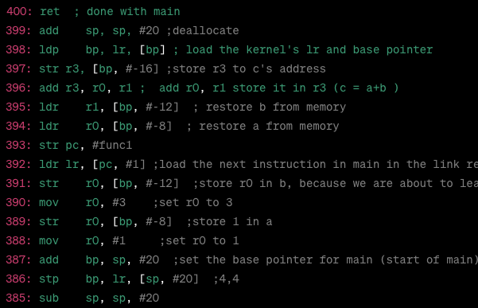
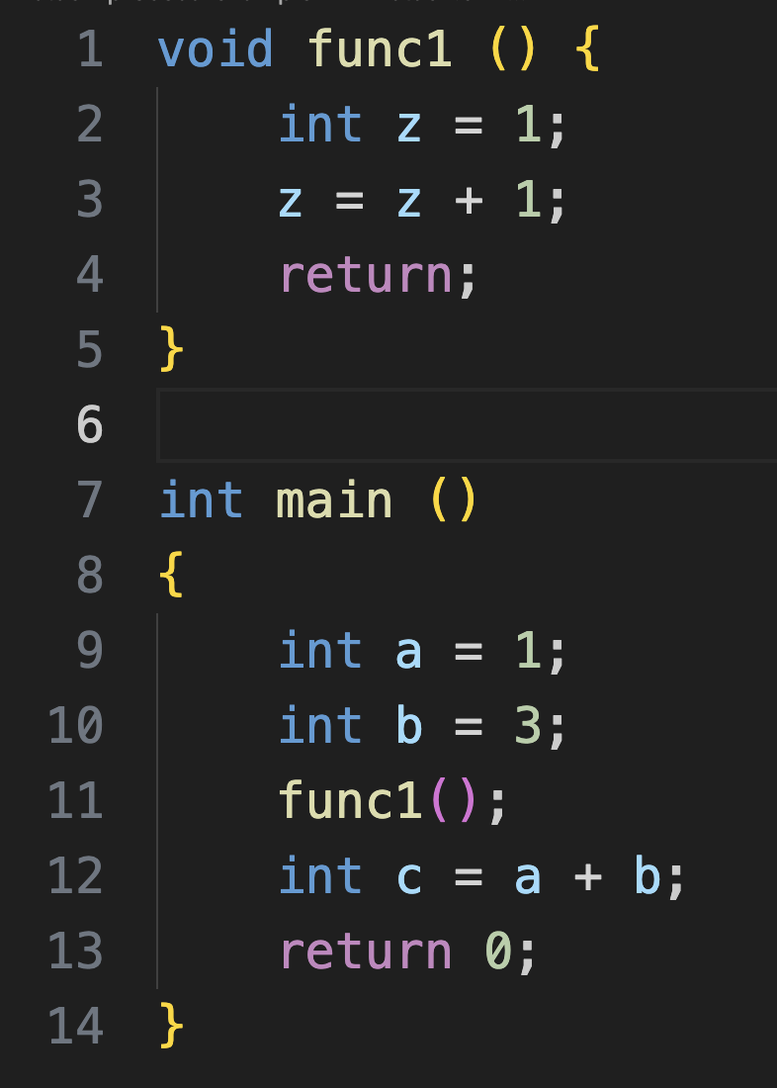
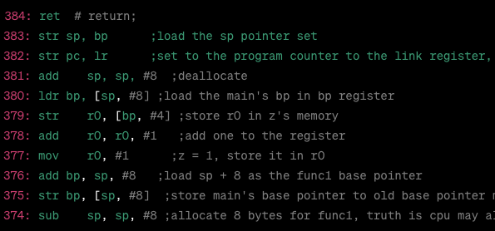
Example
main
Main start
func1
To make it readable, I made the memory addresses read as sequential integers. In reality each instruction is 4 bytes which makes each address jump by 4 bytes. So 400-396-362 and so on..
func1 start

Slide 70
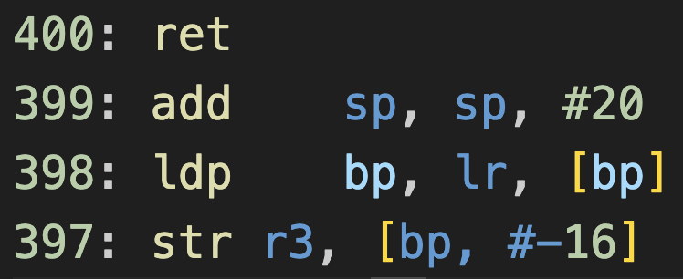
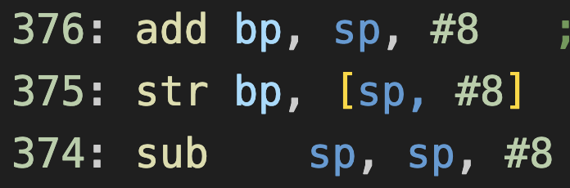
Start a process
1024
400
…
…
code
374
Program is started, a process is created, code loaded in the code section.
Notes:
Next, we load the instruction from memory to the cpu IR register or instruction register, after all cpu need to know what the instruction is.

Slide 71
Process starts
cpu
sp
1024
pc
bp
sp
0
1024
r0
r1
r3
lr
0
400
…
code
374
Process registers initialized , sp points to the top of stack by default, bp, lr points to where the kernel was before process executes
Notes:
Next, we load the instruction from memory to the cpu IR register or instruction register, after all cpu need to know what the instruction is.

Slide 72
Main called
cpu
1024
pc
bp
sp
386
0
1004
sp
1004
main
r0
r1
r3
lr
0
Current pc
pc (main)
400
…
code
374
Main called, set pc = 385, we fetch instruction from memory, execute and expand the stack by 20, once we fetched it we increment the pc , so pc points to the next one
Notes:
Next, we load the instruction from memory to the cpu IR register or instruction register, after all cpu need to know what the instruction is.

Slide 73
Save registers
cpu
1024
pc
bp
sp
bp=0 (4 bytes)
lr=0 (4 bytes)
1020
387
0
1004
sp
1004
main
r0
r1
r3
lr
0
pc
400
…
code
374
Add one to pc to execute the next instruction and fetch it and execute it, save the bp and lr to our stack because we might overwrite them
Notes:
Next, we load the instruction from memory to the cpu IR register or instruction register, after all cpu need to know what the instruction is.

Slide 74
Set base pointer
cpu
bp
1024
pc
bp
sp
bp=0 (4 bytes)
lr=0 (4 bytes)
1020
388
1024
1004
sp
1004
main
r0
r1
r3
lr
pc
0
400
…
code
374
Next instruction, Set our base pointer for main
Notes:
Next, we load the instruction from memory to the cpu IR register or instruction register, after all cpu need to know what the instruction is.

Slide 75
a = 1
cpu
bp
1024
pc
bp
sp
bp=0 (4 bytes)
lr=0 (4 bytes)
1020
389
1024
1004
sp
1004
main
r0
r1
r3
1
lr
pc
0
400
…
code
374
Next instruction, store 1 in r0 this is a pure cpu operation
Notes:
Next, we load the instruction from memory to the cpu IR register or instruction register, after all cpu need to know what the instruction is.

Slide 76
a = 1
cpu
bp
1024
pc
bp
sp
bp=0 (4 bytes)
lr=0 (4 bytes)
a=1 (4 bytes)
1020
390
1024
1004
1016
r0
r1
r3
sp
1004
main
1
pc
lr
0
400
…
code
374
Next instruction, store r0 to memory
Notes:
Next, we load the instruction from memory to the cpu IR register or instruction register, after all cpu need to know what the instruction is.

Slide 77
b = 3
cpu
bp
1024
pc
bp
sp
bp=0 (4 bytes)
lr=0 (4 bytes)
a=1 (4 bytes)
b=3 (4 bytes)
1020
392
1024
1004
1016
1012
r0
r1
r3
1004
main
pc
sp
3
lr
0
400
…
code
374
We execute the next two instructions at once, set 3 in r0 and store it in memory
Notes:
Next, we load the instruction from memory to the cpu IR register or instruction register, after all cpu need to know what the instruction is.

Slide 78
call func1
cpu
bp
1024
pc
bp
sp
bp=0 (4 bytes)
lr=0 (4 bytes)
a=1 (4 bytes)
b=3 (4 bytes)
1020
393
1024
1004
1016
1012
r0
r1
r3
pc
sp
1004
main
3
lr
394
400
…
code
374
We prepare to call func1, first we need to set the return address to the next instruction in main, lr will be 394 in this case
Notes:
Next, we load the instruction from memory to the cpu IR register or instruction register, after all cpu need to know what the instruction is.

Slide 79
Jump to func1
cpu
bp
1024
pc
bp
sp
bp=0 (4 bytes)
lr=0 (4 bytes)
a=1 (4 bytes)
b=3 (4 bytes)
1020
375
1024
996
1016
1012
r0
r1
r3
1004
main
3
sp
996
lr
394
func1
400
…
code
374
pc
We set the program counter to the first line in func1 which is 374, load instruction and increment pointer
Start func1
Notes:
Next, we load the instruction from memory to the cpu IR register or instruction register, after all cpu need to know what the instruction is.

Slide 80
Store main’s bp in func1
cpu
bp
1024
pc
bp
sp
bp=0 (4 bytes)
lr=0 (4 bytes)
a=1 (4 bytes)
b=3 (4 bytes)
1020
376
1024
996
1016
1012
r0
r1
r3
1004
main
3
bp=1024
sp
996
lr
394
func1
400
…
code
374
pc
We store the bp for main which is in the register to func1 for later..
Notes:
Next, we load the instruction from memory to the cpu IR register or instruction register, after all cpu need to know what the instruction is.

Slide 81
Set bp for func1
cpu
1024
pc
bp
sp
bp=0 (4 bytes)
lr=0 (4 bytes)
a=1 (4 bytes)
b=3 (4 bytes)
1020
377
1004
996
1016
1012
r0
r1
r3
bp
1004
main
3
bp=1024
sp
996
lr
394
func1
400
…
code
pc
374
Now we have bp stored, we can use the register for func1
Notes:
Next, we load the instruction from memory to the cpu IR register or instruction register, after all cpu need to know what the instruction is.

Slide 82
z=1
cpu
1024
pc
bp
sp
bp=0 (4 bytes)
lr=0 (4 bytes)
a=1 (4 bytes)
b=3 (4 bytes)
1020
378
1004
996
1016
1012
r0
r1
r3
bp
1004
main
1
bp=1024
sp
996
lr
394
func1
400
pc
…
code
374
We store 1 in r0 and push it to func1 memory
Notes:
Next, we load the instruction from memory to the cpu IR register or instruction register, after all cpu need to know what the instruction is.

Slide 83
z=z+1
cpu
1024
pc
bp
sp
bp=0 (4 bytes)
lr=0 (4 bytes)
a=1 (4 bytes)
b=3 (4 bytes)
1020
379
1004
996
1016
1012
r0
r1
r3
bp
1004
main
2
bp=1024
sp
996
lr
394
func1
pc
400
…
code
374
Add 1 to r0,
Notes:
Next, we load the instruction from memory to the cpu IR register or instruction register, after all cpu need to know what the instruction is.

Slide 84
z=z+1
cpu
1024
pc
bp
sp
bp=0 (4 bytes)
lr=0 (4 bytes)
a=1 (4 bytes)
b=3 (4 bytes)
1020
380
1004
996
1016
1012
r0
r1
r3
main
2
bp
1004
bp=1024
z=2
1000
lr
sp
996
394
func1
pc
400
…
code
374
Store r0 to z’s address, bp -4 , address 1000
Notes:
Next, we load the instruction from memory to the cpu IR register or instruction register, after all cpu need to know what the instruction is.

Slide 85
About to exit func1
cpu
bp
1024
pc
bp
sp
bp=0 (4 bytes)
lr=0 (4 bytes)
a=1 (4 bytes)
b=3 (4 bytes)
1020
381
1024
996
1016
1012
r0
r1
r3
main
2
1004
bp=1024
z=2
1000
lr
sp
996
394
func1
pc
400
…
code
374
We load bp back to original main’s bp
Notes:
Next, we load the instruction from memory to the cpu IR register or instruction register, after all cpu need to know what the instruction is.

Slide 86
Jump to main, restore vars
cpu
bp
1024
pc
bp
sp
bp=0 (4 bytes)
lr=0 (4 bytes)
a=1 (4 bytes)
b=3 (4 bytes)
1020
395
1024
1004
1016
pc
1012
r0
r1
r3
main
1
sp
1004
bp=1024
z=2
1000
lr
996
394
func1
400
…
code
374
We deallocate func1 and jump to main setting pc = lr, load instruction 394 execute and restore the a from memory to r0, r0 is 1, because we lost them when we executed func1
Notes:
Next, we load the instruction from memory to the cpu IR register or instruction register, after all cpu need to know what the instruction is.

Slide 87
Restore b
cpu
bp
1024
pc
bp
sp
bp=0 (4 bytes)
lr=0 (4 bytes)
a=1 (4 bytes)
b=3 (4 bytes)
pc
1020
396
1024
1004
1016
1012
r0
r1
r3
main
1
3
sp
1004
bp=1024
z=2
1000
lr
996
394
func1
400
…
code
374
Restore b to r1
Notes:
Next, we load the instruction from memory to the cpu IR register or instruction register, after all cpu need to know what the instruction is.

Slide 88
c=a+b
cpu
bp
1024
pc
bp
sp
pc
bp=0 (4 bytes)
lr=0 (4 bytes)
a=1 (4 bytes)
b=3 (4 bytes)
1020
397
1024
1004
1016
1012
r0
r1
r3
main
1
3
4
sp
1004
bp=1024
z=2
1000
lr
996
394
func1
ir
400
…
code
374
Add r0, r1 and store it in r3
Notes:
Next, we load the instruction from memory to the cpu IR register or instruction register, after all cpu need to know what the instruction is.

Slide 89
c=a+b
cpu
pc
bp
1024
pc
bp
sp
bp=0 (4 bytes)
lr=0 (4 bytes)
a=1 (4 bytes)
b=3 (4 bytes)
c=4 (4 bytes)
1020
398
1024
1004
1016
1012
1008
r0
r1
r3
main
1
3
4
sp
1004
bp=1024
z=2
1000
lr
996
394
func1
400
…
code
374
Store r3 in memory
Notes:
Next, we load the instruction from memory to the cpu IR register or instruction register, after all cpu need to know what the instruction is.

Slide 90
Terminate main
cpu
pc
bp
1024
pc
bp
sp
bp=0 (4 bytes)
lr=0 (4 bytes)
a=1 (4 bytes)
b=3 (4 bytes)
c=4 (4 bytes)
1020
399
0
1004
1016
1012
1008
r0
r1
r3
main
1
3
4
sp
1004
bp=1024
z=2
1000
lr
996
0
func1
400
…
code
374
Restore the kernel’s bp,lr and quit
Notes:
Next, we load the instruction from memory to the cpu IR register or instruction register, after all cpu need to know what the instruction is.

Slide 91
Terminate main
cpu
pc
sp
1024
pc
bp
sp
bp=0 (4 bytes)
lr=0 (4 bytes)
a=1 (4 bytes)
b=3 (4 bytes)
c=4 (4 bytes)
1020
400
0
1024
1016
1012
1008
r0
r1
r3
main
1
3
4
1004
bp=1024
z=2
1000
lr
996
0
func1
400
…
code
374
Sp is popped back to the top ,
Notes:
Next, we load the instruction from memory to the cpu IR register or instruction register, after all cpu need to know what the instruction is.

Slide 92
Stack overflow
Protect against infinite function calls
Recursion
Large local variables
Stack has a limit
Limit can be overridden by compiler

Slide 93
Summary
Kernel does so much work
Stack play an important rule in function calls
Add parameters and return values

Slide 94
Data Section
husseinnasser
Fixed size, Global and static variables, all functions share

Slide 95
Data section
Stack
0xff999999
int a
0xff999995
function
0xff999991
Stores static and global variables
Referenced directly by memory address
Read only and read write
All functions can access
Fixed size, like code section
Data (static)
Text / code

Slide 96
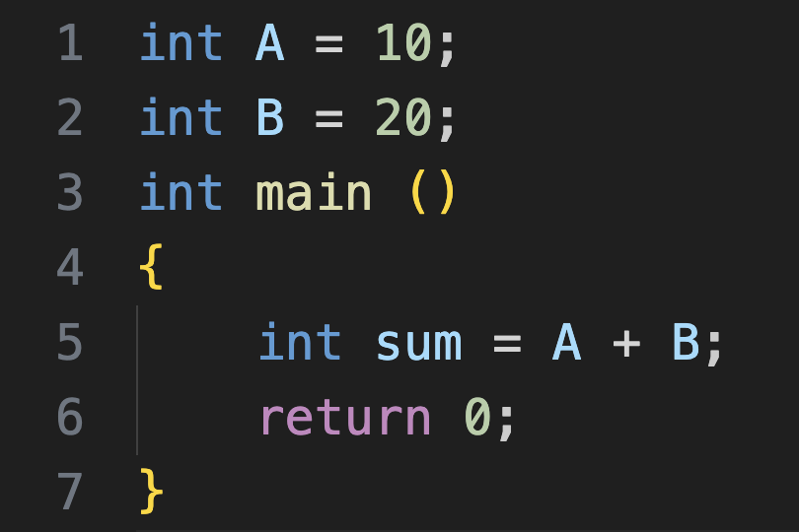
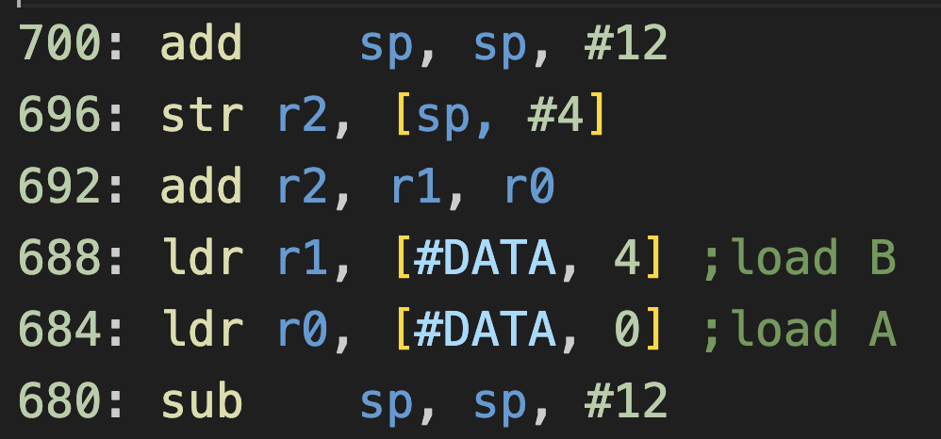
Example
-

Slide 97
Start a process
bp
1024
pc
bp
sp
sp
bp=0 (4 bytes)
lr=0 (4 bytes)
680
1024
1024
r0
r1
r2
main
r3
0
#DATA
708
A=10
B=20
704
700
-
pc
680
Program is started, a process is created, code loaded in the code section, data section filled with the global variables
Notes:
Next, we load the instruction from memory to the cpu IR register or instruction register, after all cpu need to know what the instruction is.

Slide 98
Load A
bp
1024
bp=0 (4 bytes)
lr=0 (4 bytes)
pc
bp
sp
1020
688
1024
1012
1016
sp
1012
main
r0
r1
r2
10
r3
0
#DATA
708
A=10
B=20
704
pc
-
To load global A, we need to reference the start of the data section + 0 where A is, put it in r0
Notes:
Next, we load the instruction from memory to the cpu IR register or instruction register, after all cpu need to know what the instruction is.

Slide 99
Load B
bp
1024
bp=0 (4 bytes)
lr=0 (4 bytes)
pc
bp
sp
1020
692
1024
1012
1016
sp
1012
r0
r1
r2
main
10
20
r3
0
#DATA
708
A=10
B=20
704
-
pc
-
To load global B, we need to reference the start of the data section - 4 where B is, put it in r1
Notes:
Next, we load the instruction from memory to the cpu IR register or instruction register, after all cpu need to know what the instruction is.

Slide 100
Sum and store in local var b
bp
1024
bp=0 (4 bytes)
lr=0 (4 bytes)
sum=30
pc
bp
sp
1020
700
1024
1012
1016
sp
1012
r0
r1
r2
main
10
20
30
r3
0
#DATA
708
A=10
B=20
704
pc
-
We sum r0, and r1 store it in r2 and store that in sum local variable which is at sp-4 offset
Notes:
Next, we load the instruction from memory to the cpu IR register or instruction register, after all cpu need to know what the instruction is.

Slide 101
Summary
Data section stores globals and static
Shared between all functions
Read and write
Watch out for concurrency

Slide 102
Heap
husseinnasser
Large, dynamic place for memory allocations

Slide 103
Heap section
Stack
0xff999999
int a
0xff999995
function
0xff999991
Stores large data
Remain until explicitly removed
All functions can access
Dynamic, grows low to high
malloc, free, new
Heap
0x1000005
Heap
0x1000001
Data (static)
Text / code
0x0099991

Slide 104
Pointers
Stack
int *a=0x333333
function
Point to a memory address in the heap
A pointer can in stack, data or heap
Stores the address of first byte
Pointer type helps determine size
Heap
0x333333
9000
0x222222
d
Heap
Data (static)
char *c=0x222222
Text / code

Slide 105
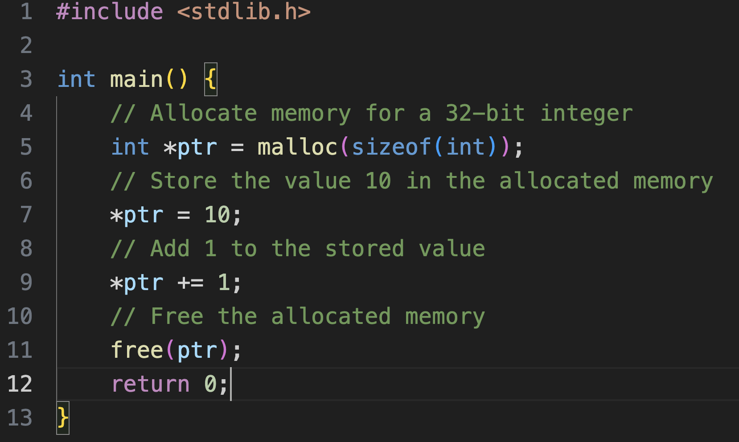
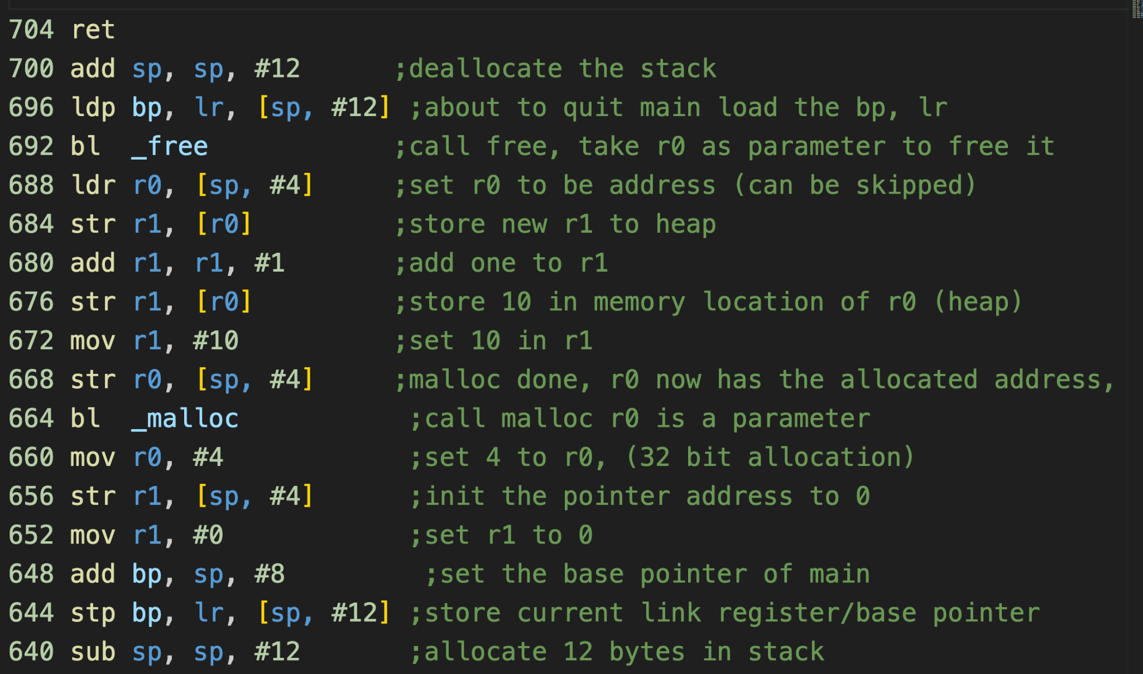
Example

Slide 106
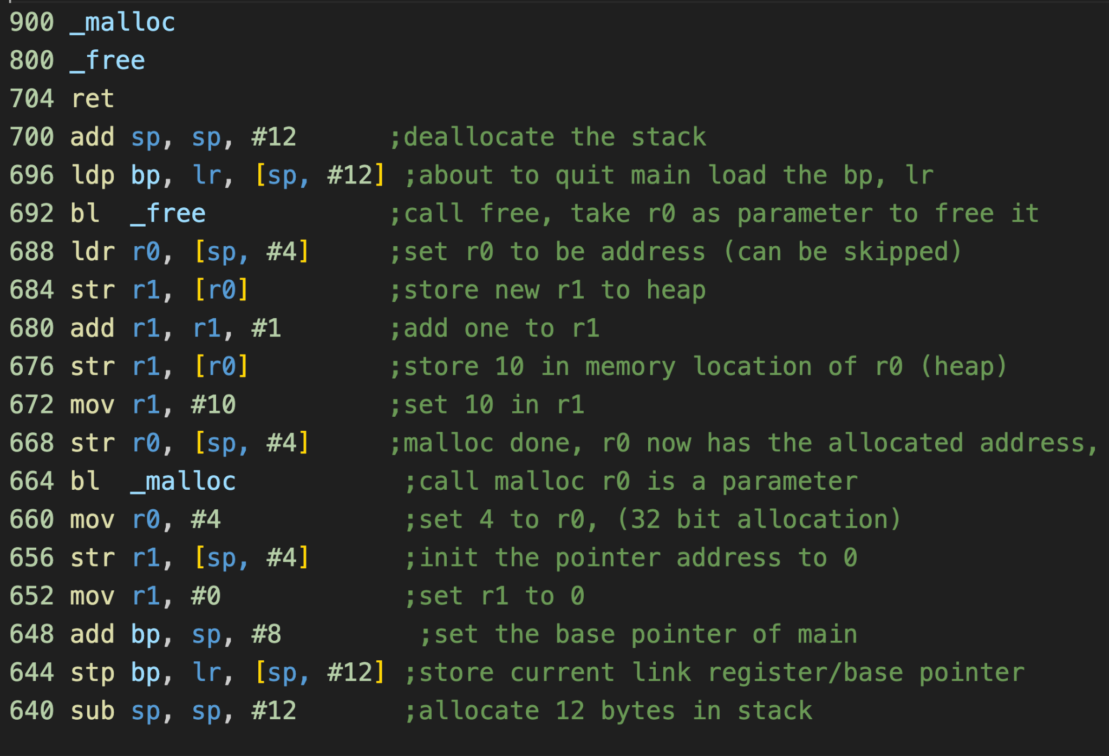
Start a process
bp
2048
pc
bp
sp
sp
bp=0 (4 bytes)
lr=0 (4 bytes)
ptr=NA (4 bytes)
640
2048
2048
r0
r1
r2
main
r3
lr
900
_malloc
_free
….
Mycode
….
800
704
pc
640
pc
Program is started, a process is created, code loaded in the code section, malloc and free are also in the code section. (Shared memory)
Notes:
Next, we load the instruction from memory to the cpu IR register or instruction register, after all cpu need to know what the instruction is.

Slide 107
Init pointer
bp
2048
bp=0 (4 bytes)
lr=0 (4 bytes)
ptr=0 (4 bytes)
pc
bp
sp
664
2048
2036
r0
r1
r2
sp
2036
main
4
0
r3
lr
pc
900
_malloc
_free
….
Mycode
….
800
704
640
We load and execute, 640-656
Notes:
Next, we load the instruction from memory to the cpu IR register or instruction register, after all cpu need to know what the instruction is.

Slide 108
Calling malloc
2048
bp=0 (4 bytes)
lr=0 (4 bytes)
ptr=0 (4 bytes)
pc
bp
sp
pc
900
2036
2028
r0
r1
r2
2036
main
bp
4
0
bp=2048 (4 bytes)
lr=668 (4 bytes)
sp
2028
malloc
r3
lr
668
900
_malloc
_free
….
Mycode
….
800
704
640
We call malloc, it saves the bp, lr of the main so we know where to return
Notes:
Next, we load the instruction from memory to the cpu IR register or instruction register, after all cpu need to know what the instruction is.

Slide 109
Calling malloc
2048
bp=0 (4 bytes)
lr=0 (4 bytes)
ptr=0 (4 bytes)
pc
bp
sp
pc
900
2036
2028
r0
r1
r2
2036
main
bp
1024
0
bp=2048 (4 bytes)
lr=668 (4 bytes)
sp
2028
malloc
r3
lr
668
1024
*ptr=NA
900
_malloc
_free
….
Mycode
….
800
704
640
Malloc uses r0 as a parameter to allocate 4 bytes on the heap (it's actually more, but then return the address back to r0
Notes:
Next, we load the instruction from memory to the cpu IR register or instruction register, after all cpu need to know what the instruction is.

Slide 110
Malloc returns
bp
2048
bp=0 (4 bytes)
lr=0 (4 bytes)
ptr=1024 (4 bytes)
pc
bp
sp
672
2048
2036
r0
r1
r2
sp
2036
main
1024
0
bp=2048 (4 bytes)
lr=668 (4 bytes)
2028
malloc
r3
lr
0
1024
*ptr=NA
pc
900
_malloc
_free
….
Mycode
….
800
704
640
Malloc exist, pc is set to lr , bp, sp is set back to the main, we store the address in the main stack where ptr is
Notes:
Next, we load the instruction from memory to the cpu IR register or instruction register, after all cpu need to know what the instruction is.

Slide 111
Store value to heap
bp
2048
bp=0 (4 bytes)
lr=0 (4 bytes)
ptr=1024 (4 bytes)
pc
bp
sp
680
2048
2036
r0
r1
r2
sp
2036
main
1024
10
bp=2048 (4 bytes)
lr=668 (4 bytes)
2028
malloc
r3
lr
pc
0
1024
*ptr=10
900
_malloc
_free
….
Mycode
….
800
704
640
We load 10 to r1 and write it to [r0] which is where the address of pointer is
Notes:
Next, we load the instruction from memory to the cpu IR register or instruction register, after all cpu need to know what the instruction is.

Slide 112
Add 1
bp
2048
bp=0 (4 bytes)
lr=0 (4 bytes)
ptr=1024 (4 bytes)
pc
bp
sp
688
2048
2036
r0
r1
r2
sp
2036
main
1024
11
bp=2048 (4 bytes)
lr=668 (4 bytes)
pc
2028
malloc
r3
lr
0
1024
*ptr=11
900
_malloc
_free
….
Mycode
….
800
704
640
We add 1 and store the r1 again in the heap
Notes:
Next, we load the instruction from memory to the cpu IR register or instruction register, after all cpu need to know what the instruction is.

Slide 113
Call free
2048
bp=0 (4 bytes)
lr=0 (4 bytes)
ptr=1024 (4 bytes)
pc
bp
sp
800
2036
2028
pc
r0
r1
r2
bp
2036
main
1024
11
bp=2048 (4 bytes)
lr=696 (4 bytes)
sp
2028
free
r3
lr
696
1024
*ptr=11(freed)
900
_malloc
_free
….
Mycode
….
800
704
640
Load the pointer into r0 which becomes the first parameter, call free, update pc, we free address
Notes:
Next, we load the instruction from memory to the cpu IR register or instruction register, after all cpu need to know what the instruction is.

Slide 114
Main returns
sp
2048
pc
bp
sp
bp
bp=0 (4 bytes)
lr=0 (4 bytes)
ptr=1024 (4 bytes)
800
2048
2036
pc
r0
r1
r2
2036
main
1024
11
bp=2048 (4 bytes)
lr=696 (4 bytes)
2028
free
r3
lr
0
1024
*ptr=11(freed)
900
_malloc
_free
….
Mycode
….
800
704
640
Free exits, set pc to lr, return control to kernel
Notes:
Next, we load the instruction from memory to the cpu IR register or instruction register, after all cpu need to know what the instruction is.

Slide 115
Memory leaks
Stack
int *a=0x333333
function
Free the heap memory is important
We get memory leak in the heap
Losing a pointer in the stack when function returns
Refcounting, Garbage collection
Heap
0x333333
9000 (leaked)
0x222222
d
Heap
Data (static)
char *c=0x222222
Text / code
Notes:
Refcounting is custom implication in C/C++ to do memory management (doesn’t exist by default)

Slide 116
Dangling pointers
*a is a dangling pointer
Stack
int *a=0x333333
fun1
int *b=0x333333
fun2
Memory freed but active pointers exist
Leads to errors segfault
fun2 frees *b 0x333333 and returns
fun1 tries to use *a but fails
0x333333
9000 (freed)
0x222222
d
Heap
Data (static)
char *c=0x222222
Text / code
Notes:
Refcounting is custom implication in C/C++ to do memory management (doesn’t exist by default)

Slide 117
Double-free
Fun1 tries to free and crashes the app
Stack
int *a=0x333333
fun1
int *b=0x333333
fun2
Memory freed twice
Leads to crash
fun2 frees *b 0x333333 and returns
fun1 also tries to free *a
0x333333
9000 (freed)
0x222222
d
Heap
Data (static)
char *c=0x222222
Text / code
Notes:
Refcounting is custom implication in C/C++ to do memory management (doesn’t exist by default)

Slide 118
Performance
Stack has built in memory management
Stack variables are close together
Stack space Limited
Heap is random
Cache locality in Stack

Slide 119
Escape analysis
Heap
Stack
bp=0 (4 bytes)
lr=0 (4 bytes)
ptr=1024 (4 bytes)
bp=0 (4 bytes)
lr=0 (4 bytes)
ptr=1024 (4 bytes)
*ptr=11
Allocates in the stack when possible
Go, Java,
main
main
*ptr=11
….
Mycode
….
….
Mycode
….

Slide 120
Program Break
bp=0 (4 bytes)
lr=0 (4 bytes)
ptr=1024 (4 bytes)
Where the process ends
Points to the top of the heap
Using brk, sbrk to allocate/deallocate
Not recommended
main
New Program break
*ptr=11
New allocated
Program break
….
Mycode
….

Slide 121
Summary
Stores large data
Remain until explicitly removed
All functions can access
Dynamic, grows low to high
malloc, free, new

Slide 122
Memory Management
husseinnasser
What is memory and how does the OS manages it

Slide 123
What is memory?
husseinnasser
Random access memory

Slide 124
Memory
Stores data
Volatile
RAM - Random access memory
Non-Volatile
ROM - Read only memory

Slide 125
Static RAM
SRAM
Complex, expensive but fast
1 bit -> 1 flip flop -> 6 transistors
Flip-flops, constant power
Used it CPU caches, SSDs
Access is always fast

Slide 126
Dynamic RAM
DRAM
Abundant, cheaper, but slower
1 bit -> 1 capacitor, 1 transistor
Capacitors, lose their state
need to be refreshed
Access is slow
Read -> lose the charge
Store it
Write it back
Notes:
https://docs.amd.com/r/en-US/pg313-network-on-chip/DRAM-Addressing

Slide 127
Asynchronous DRAM
Asynchronous is slow (missed cycles)
Wasted clock signals
Cycle wasted on refresh
Response (1/3)
Response (2/3)
Response (3/3)
Received
Delay
Delay
Delay
Delay
Read

Slide 128
Synchronous DRAM
SDRAM
Synchronized RAM and CPU clocks
No wasted cycles
Response (1/n)
Response (2/n)
Response (3/n)
Received
Read

Slide 129
Double Data Rate
DDR SDRAM
Two transfers per cycle
Up and down
Response (1/n)
Response (2/n)
Response (3/n)
Received
Read

Slide 130
DDR4 SDRAM
DDR4 SDRAM
(64 pin io bus)
Read address X
64 bytes
(8 x 8)
64 data lines, 64 pins
DDR4 Prefetch buffer = 8 bit per io pin
64 pins x 8 bit each = 64 bytes
CPU often needs 64 bytes min
Called a burst
Many cycles required for a “read”
Prefetch buffer is how much bits I can transfer per memory access,
Notes:
We always read in bursts for efficiency as accessing DRAM is slow, especially the first bit, once a row is opened, reading becomes faster so we want to read as much as possible. Burst length is the number of data words RAM can transfer in a single read. 64 bytes is the defacto that fits CPU cache lines

Slide 131
DDR5 SDRAM
DDR5 SDRAM
Channel A
(32 pin io bus)
Channel B
(32 pin io bus)
Two channels, 32 pins each
DDR5 Prefetch buffer = 16 bit per pin
16 x 32 bit = 64 bytes each channel
Double bandwidth, less contention
Read address Y
Read address X
64 bytes
(16 bit x 32 pins)
64 bytes
(16 bit x 32 pins)
Notes:
Benefits of DDR5
Higher Effective Bandwidth: By splitting the memory into two independent channels, DDR5 can handle two separate memory requests simultaneously, effectively doubling the data access paths compared to a single 64-bit channel. This allows for better utilization of the memory bandwidth, as each channel can be accessed independently or in parallel, leading to improved overall throughput.
Reduced Latency: With two channels, the memory controller can manage and respond to memory requests more efficiently. If one channel is busy, the other can still handle requests, potentially reducing wait times and improving latency.
Improved Power Efficiency: Splitting the DIMM into two channels allows for more granular power management. Each 32-bit channel can be operated and powered independently. This means that if one channel is not in use, it can be powered down to save energy, enhancing the power efficiency of the memory module.
Enhanced Reliability and Fault Tolerance: With two separate channels, there's a level of redundancy that can improve the overall reliability of the memory system. In some configurations, if one channel encounters an error or a problem, the other can continue to function, providing a level of fault tolerance.
Flexibility in Memory Operations: Having two channels increases the flexibility in handling memory operations. For example, one channel could be dedicated to read operations while the other handles write operations, or they could be used to handle different types of data or processes, optimizing performance based on workload requirements.
Scalability and Future Compatibility: This architecture provides a foundation for future scalability in memory design. As memory technology continues to evolve, having a dual-channel architecture allows for more innovations in how memory bandwidth and operations are managed.

Slide 132
DRAM Internals
DIMM
Bank
Rows
Columns
Cells (1 cell 1 bit)
The 64 bit physical memory address is encoded with these parameters so the CPU knows which RAM to access, called the DRAM address

Slide 133
Opening a row
Inactive row
Column
Bank has many rows (e.g. 32K)
A row has many columns (e.g . ~1024)
A column has many cells (e.g.,16, 32 bits)
Each cell is a capacitor storing 1 bit ( 0, or 1)
Can only have one opened row in a bank
Slow
Many banks help
Opened row
bank
More on this, consider looking up sense amplifiers, shared in each bank. Opened row is cached in the amplifiers. So to open another row we need to close and flush the cache to the row. When a write happens, the write goes to the shared amplifiers as well first
Notes:
https://en.wikipedia.org/wiki/Sense_amplifier
https://tayloredge.com/reference/Electronics/Memory/dram1.pdf

Slide 134
Summary
RAM
DRAM
SDRAM
Prefetch buffer io
DDR4, DDR5

Slide 135
Read/Write from memory
husseinnasser
How CPU reads and writes

Slide 136
Read from Memory
2048
bp=0 (4 bytes)
lr=0 (4 bytes)
ptr=1024 (4 bytes)
RAM
2036
main
bp=2048 (4 bytes)
lr=668 (4 bytes)
2028
malloc
1024
*ptr=11
900
_malloc
_free
….
Mycode
….
800
704
pc
640

Slide 137
Read from Memory
2048
bp=0 (4 bytes)
lr=0 (4 bytes)
ptr=1024 (4 bytes)
RAM
2036
main
bp=2048 (4 bytes)
lr=668 (4 bytes)
Read address 640
(pc)
2028
malloc
1024
*ptr=11
900
_malloc
_free
….
Mycode
….
800
704
pc
640
The kernel wants to read the instruction at the pc, so it asks the CPU to load the instruction on the 640 address.

Slide 138
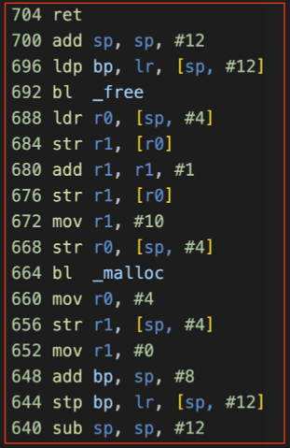
Read from Memory
2048
bp=0 (4 bytes)
lr=0 (4 bytes)
ptr=1024 (4 bytes)
RAM
2036
main
Read address 640
(pc)
64 bytes
(50-100ns)
bp=2048 (4 bytes)
lr=668 (4 bytes)
2028
malloc
1024
*ptr=11
900
_malloc
_free
….
Mycode
….
800
704
pc
640
We get back not only one instruction but 64 bytes worth! Remember burst length, it is then cached in the cpu L caches. This takes around 100 ns,

Slide 139
Write to Memory
2048
bp=0 (4 bytes)
lr=0 (4 bytes)
ptr=1024 (4 bytes)
RAM
2036
main
bp=2048 (4 bytes)
lr=668 (4 bytes)
2028
malloc
1028
*ptr=11
1024
900
_malloc
_free
….
Mycode
….
800
704
640
We want to set the value of 22 to the pointer on 1024, 4 bytes.

Slide 140
Write to Memory
2048
bp=0 (4 bytes)
lr=0 (4 bytes)
ptr=1024 (4 bytes)
RAM
2036
main
bp=2048 (4 bytes)
lr=668 (4 bytes)
Write to address 1024
Value 22
4 bytes
2028
malloc
1028
*ptr=22
1024
900
_malloc
_free
….
Mycode
….
800
704
640
We write and check for errors,

Slide 141
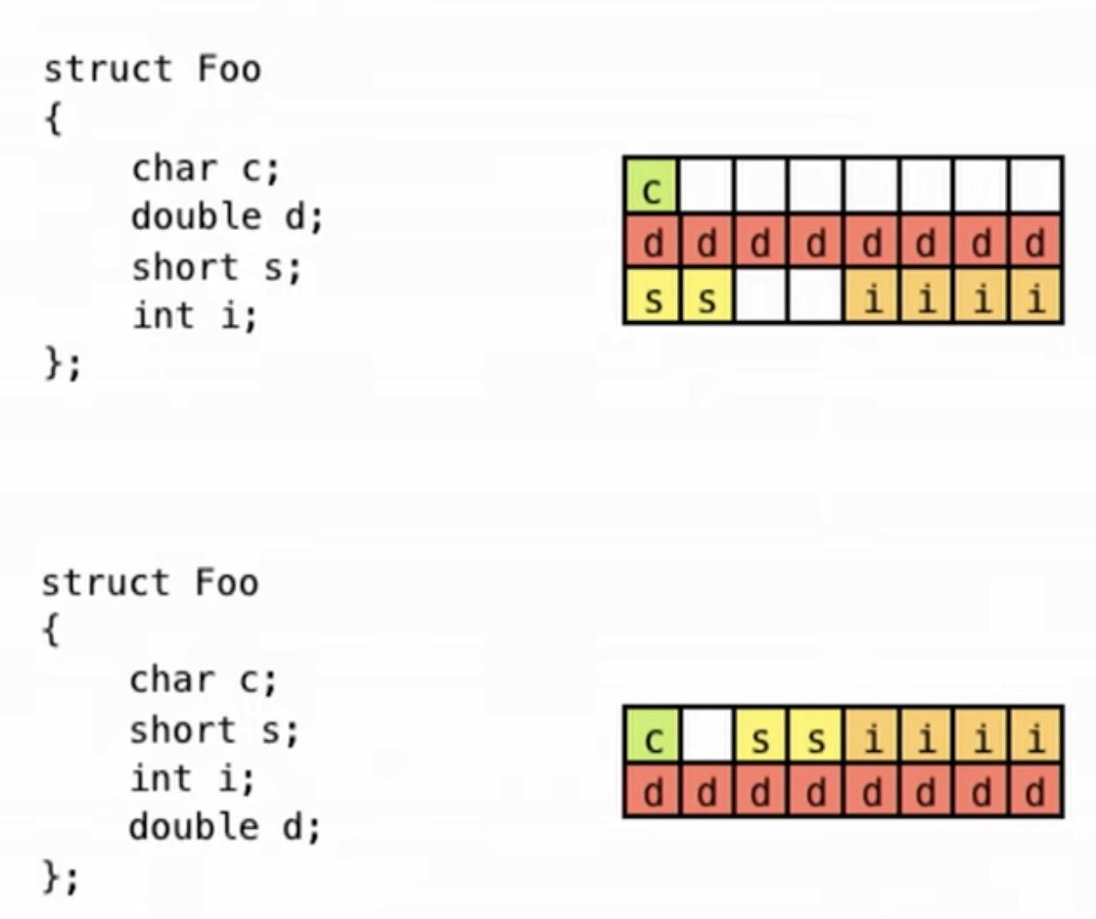
Note about alignment
0 1 2 3 4 5 6 7
8 9 10 11 12 13 14 15
16 17 18 19 20 21 22 23
Data types are aligned
1, 4 or 8 bytes
Certain sizes are placed in specific addresses
E.g. 4 bytes placed in addressed divisible by 4
First figure, structure allocated char one byte (that can go anywhere), but next we need a double and that must go in a /8 address the next one available is address 0x8, leaving bytes 1-7 empty, followed 2 bytes short which we can put on the address 0x16 then the 4 byte int on address 0x20
However in the second figure we allocated less memory for the structure as we defined the 1 byte character on 0x1, then the short which lived in a 2 byte address 0x2 then 4 byte address right after on address 0x4 (divisible by 4) then we allocated the double on 0x8

Slide 142
Summary
Memory access takes 50-100ns
CPU sends read or write request
We get a burst of sequential data

Slide 143
Virtual memory
husseinnasser
Layer on top of physical memory

Slide 144
Agenda
Limitations of Physical memory
What is Virtual Memory
Example
Limitations of Virtual memory

Slide 145
Limitations of Physical memory
Fragmentation
Shared Memory
Isolation
Large Programs

Slide 146
Fragmentation

Slide 147
Fragmentation
One space
Memory must be contiguous
1,000,000
…
8
4
0

Slide 148
Fragmentation
Process 1 is loaded
Large Process 2 is loaded
Process 3 is loaded
1,000,000
Process 3
800,000
Process 2
10,000
Process 1
8
4
0

Slide 149
Fragmentation
Process 4
Process 1, 3 terminates
Large process 4 wants to load
1,000,000
Process 3
800,000
Process 2
10,000
Process 1
8
4
0

Slide 150
Fragmentation
1,000,000
Process 4 can’t load
Enough space but fragmented
800,000
Process 2
Process 4
10,000
8
4
0

Slide 151
External vs Internal Fragmentation
Memory allocation happens in blocks
External fragmentation
Internal fragmentation

Slide 152
External Fragmentation
We get space but its not contiguous
Happens often with variable size blocks
e.g. segmentation
Example of external fragmentation
(no space for purple process)

Slide 153
Internal Fragmentation
Large block
Small block
Fixed-allocated blocks
Internal space is wasted
OS doesn’t know the space is unused
Happens with fixed-size blocks, especially large size
Example of internal
fragmentation

Slide 154
Virtual memory and fragmentation
Let us use fixed block size call it paging
Each process has virtual address space
We map logical page to physical page
Mapping stored in process page table
Page size is often 4kb
Many to 1

Slide 155
Virtual memory and fragmentation
10,000
10,000
A.P4
P4
Process A VM
P3
A.P3
P2
A.P2
…
P1
4
B.P3
0
B.P2
A.P1
10,000
C.P5
Process B VM
P3
Mapping
P2
C.P4
P1
C.P3
…
4
B.P1
0
C.P2
C.P1
10,000
Process C VM
P5
P4
4
P3
0
…
P2
4
Physical memory
P1
0

Slide 156
Page Tables
Another layer requires translation
Map virtual address to physical
Page table has this mapping
Each process has its own page table
Page table is stored in memory

Slide 157
Page tables
52,000
A
B
C
48,000
A.P4
16,000
16,000
20,000
44,000
P4
16,000
P5
A.P3
12,000
12,000
P3
40,000
8,000
P3
P2
12,000
P4
A.P2
P2
8,000
8,000
P3
36,000
4,000
4,000
P1
B.P3
2,000
P1
4,000
P2
32,000
0
P1
B.P2
0
0
28,000
A.P1
24,000
C.P5
A page table
B page table
C page table
20,000
C.P4
16,000
VMA | PA
4000 | 28,000
8000 | 40,000
12,000 | 44,000
16,000 | 48,000
VMA | PA
8000 | 12,000
12,000 | 32,000
16,000 | 36,000
VMA | PA
4000 | 4000
8000 | 8000
12,000 | 16,000
16,000 | 20,000
20,000 | 24,000
C.P3
12,000
B.P1
8,000
C.P2
4,000
C.P1
0
Actual page tables store page numbers for more compact storage, the CPU stores the pointer to the current process page table in the PTBR (page table base register)

Slide 158
P4
P3
P2
P1
A.P2, B.P1
P3
P2
P1
Shared Memory

Slide 159
Shared memory
Sharing memory is a challenge
Spin 5 processes of the same program
All processes have same code
Lots of duplicate memory
Process 5 Code
Process 4 Code
Process 3 Code
Duplicate
Process 2 Code
Process 1 Code
Physical memory

Slide 160
Shared memory and Virtual Memory
With virtual memory, we load the code once and we map all virtual pages to the same physical address!
P4
Process A VM
P3
P2
P1
A.P2, B.P1
Process B VM
P3
P2
P1

Slide 161
Shared Libraries
Most processes use libraries
OS loads the library code once
Map the virtual page to the library physical code
Libc
/proc/[pid]/maps

Slide 162
Use cases for shared memory
Multi-processes / multi-threading
Databases shared buffers
NGINX/Proxies
forking
CoW - copy on write

Slide 163
10,000
P4
Process A VM
P3
P2
…
P1
4
0
10,000
Process B VM
P3
P2
P1
…
4
0
10,000
Process C VM
P5
P4
P3
…
P2
Isolation
4
P1
0

Slide 164
Isolation
Physical memory addresses tells process where it is
Process can attempt to load an address they aren’t supposed to
Virtual memory solves this
Each process has full virtual address
Most of it isn’t mapped

Slide 165
Isolation with Virtual memory
Process A VM
10,000
P4
Process A address 1000 is different from Process B’s 1000
They point to different physical address
Process has no way to reference specific physical addresses directly
8
4
0
Process B VM
10,000
…
4
0
Process C VM
10,000
…
4
0

Slide 166
A
P4
A.P4
P3
P2
A.P3
P1
A.P2
P5
B.P3
P4
B.P2
P3
A.P1
B
P3
C.P5
P2
P1
C.P4
Offloaded to disk
C.P3
B.P1
C.P2
C
P5
P4
C.P1
P3
P2
P1
Swap (large programs)

Slide 167
Not enough memory
Physical memory has a limit
If I load too many processes, we ran out of memory
So we fail to spin up new processes
But virtual memory helps!

Slide 168
Swap
A
P4
A.P4
P3
P2
A.P3
P1
A.P2
P5
B
B.P3
P4
B.P2
P3
P3
A.P1
P2
C.P5
P1
C.P4
Offloaded to disk
(swap)
C.P3
C
B.P1
C.P2
P5
P4
C.P1
P3
P2
P1
C’s P3, P4 and P5 haven’t been used for a while, so the OS keeps those VM entries but frees the physical memory allocation.

Slide 169
Swap
A
P4
A.P4
P3
P2
A.P3
P1
A.P2
P5
B.P3
P4
B.P2
P3
A.P1
B
P3
P2
P1
Load from disk!
(swap)
B.P1
Memory read of an address in P4
C.P2
P5
C
P4
C.P1
P3
P2
C.P4
P1
The next time the process C access P3, P4 or P5 the OS will issue a page fault, remember the mapping entry still exist but there is a bit that says hey this page isn’t in physical memory, so the OS loads it from swap file to memory, update the new physical address (because we might load it somewhere completely different). This also means that the index of swap file is stored in the page table to know where in the swap file the page lives.

Slide 170
Limitations of Virtual Memory
Additional layer of translation (CPU can’t read virtual addresses)
More maintenance (page tables)
Page faults (kernel mode switch)
More complex CPU architecture (MMU/TLB)
TLB cache misses (MySQL 8.x vs 5.x)

Slide 171
DMA
husseinnasser
Direct Memory Access

Slide 172
Peripherals Read
Data from network/disk must pass through CPU
Keyboard -> CPU -> RAM
Network -> CPU -> RAM
Slow at times with large transfers

Slide 173
DMA
Allow direct access from network/disk to RAM
DMA controller initializes the operation
Start the direct transfer
DMA Controller
Notes:
https://www.science.unitn.it/~fiorella/guidelinux/tlk/node87.html#:~:text=First%20of%20all%20the%20DMA,address%20space%20of%20a%20process.

Slide 174
Notes about DMA
Must be Physical addresses
DMA doesn’t often have MMU
Knows nothing of the virtual memory
Kernel allocated memory must not be swapped
IOMMU (allows IO)
Notes:
https://www.science.unitn.it/~fiorella/guidelinux/tlk/node87.html#:~:text=First%20of%20all%20the%20DMA,address%20space%20of%20a%20process.

Slide 175
O_DIRECT
Very important option in file systems and databases
Allows bypassing the file system cache
Direct from disk to user-space (database)
Uses DMA

Slide 176
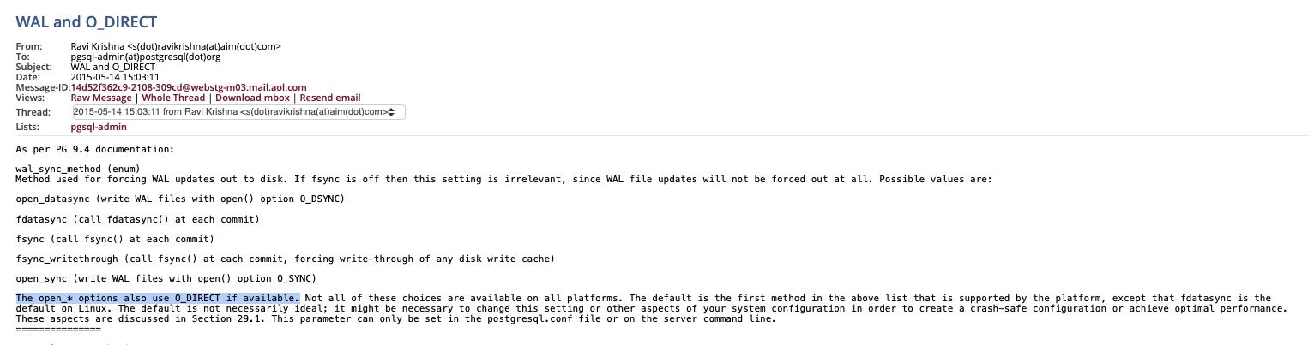

Slide 177
Pros and Cons
Efficient transfers
No VM Management
Less CPU overhead
But security concerns and complexity
Initialization cost
Can’t be used for interrupts (Keyboard/mouse), CPU is faster

Slide 178
Summary
Large transfers takes time
Going from peripheral to CPU then memory
DMA allow direct access
Has limitations and requires lots of work to get right

Slide 179
Inside the CPU
husseinnasser
How the CPU works

Slide 180
CPU Components
husseinnasser
Basic components of the CPU

Slide 181
Basic Components
CPU
ALU
ALU (Arithmetic logic unit)
CU (Control unit)
MMU (Memory management Unit)
Registers
Caches (L1, L2, L3)
Bus
CU
Registers
MMU
L1
L2

Slide 182
Processor
CPU Core #2
CPU Core #1
ALU
ALU
CU
CU
Registers
Registers
MMU
MMU
L1
L1
L2
L2
L3

Slide 183
CPU Core #2
CPU Core #1
Main Memory
ALU
ALU
CU
CU
Registers
Registers
MMU
MMU
L1
L1
L2
L2
L3
Bus

Slide 184
Main Memory
(DIMM1)
Main Memory
(DIMM2)
Core 1
Core 2
Core 3
Core 4
L2
L2
L2
L2
L3
L3
Bus
Bus
DSM
Notes:
Distributed Shard memory connects the two buses, so core 3 can access DIMM1 RAM but its non-uniform.

Slide 185
ALU
ALU
Arithmetic Logic Unit
Arithmetic +-/*
Logic XOR/OR/AND
Core of compute
CU
Registers
MMU
L1
L2

Slide 186
CU
ALU
CU
Control Unit
Fetches Instructions
Decodes Instructions
Executes Instructions
Registers
MMU
L1
L2

Slide 187
Registers
ALU
CU
Small ultrafast unit of storage
32 or 64 bit
In the CPU core
Many registers types
PC, IR, SP, BP
General purpose
Registers
MMU
L1
L2
Notes:
https://www.phoronix.com/news/Linux-Kernel-Faster-memchr

Slide 188
MMU
ALU
CU
Memory management Unit
Responsible for memory access
Translating virtual to physical address
TLB Translation Lookaside buffer
TLB must* be flushed on context switch
Registers
MMU
TLB
L1
L2

Slide 189
L Caches
CPU Core #2
CPU Core #1
L1, L2 and L3
L1 local to core
1 ns, ~128KB
L2 local to core
5 ns, ~256-2MB
L3 shared between all cores
15 ns, ~64 MB
Main Memory
50-100 ns
ALU
ALU
CU
CU
Registers
Registers
MMU
MMU
L1
L1
L2
L2
L3

Slide 190
L Caches
CPU Core #2
CPU Core #1
ALU
ALU
Memory reads are cached at all levels
L1 cache is two types
L1D (Data) L1I (Instructions)
CU can fetch data and instructions at same time
L2, L3 unified
Cache invalidation challenges
Some CPUs only have L1, and L2 (shared)
CU
CU
Registers
Registers
MMU
MMU
L1D/L1I
L1D/L1I
L2
L2
L3

Slide 191
CPU Architecture
RISC - Reduced Instruction Set
Simple instructions - each single task - single cycle
Low power, predictable
Arm
CISC - Complex Instruction Set
One instruction, lots of tasks, multiple cycle
More power, unpredictable
x86 (Intel/AMD)

Slide 192
CISC vs RISC - Example
Example a = a + b, where b and a are integers
CISC - 1 instruction
ADD a,b (a and b here are addresses)
Takes two memory locations
Reads , adds then store in a
RISC - 4 instructions
LDR r0, a
LDR r1, b
ADD r0, r1
STR a1, r0
Notes:
https://www.spiceworks.com/tech/tech-general/articles/risc-vs-cisc/#:~:text=In%20RISC%20processors%2C%20instruction%20decoding,%2C%20Power%20Architecture%2C%20and%20SPARC.

Slide 193
Clock Speed
How many cycles per second
e.g. 3GHz = 3 billion clock cycles per second
In RISC could mean 3 billion instructions per second
Less in CISC
Remember cost of fetching/decoding (pipelining helps)

Slide 194
Display CPU Info (mac)
Show L caches
sysctl -a | grep cachesize
Show number of cores
sysctl -n hw.physicalcpu
Show CPU architecture
uname -m

Slide 195
Summary
CPU internals
Caches
Architecture

Slide 196
Instruction Life Cycle
husseinnasser
Fetch, Decode, Execute, Read, write

Slide 197
Instruction
Fetch from memory (MMU)
Decode (CU)
Execute (ALU)
Memory read (optional)
Write (to register/memory)

Slide 198
Example
RAM
2048
bp=0 (4 bytes)
lr=0 (4 bytes)
ptr=1024 (4 bytes)
2036
main
bp=2048 (4 bytes)
lr=668 (4 bytes)
2028
malloc
1024
*ptr=11
900
_malloc
_free
….
Mycode
….
800
704
pc
640

Slide 199
Fetch
RAM
Read address 640
(pc)
ALU
64 bytes
(50-100ns)
CU
Registers
MMU
L1
L2
pc
We fetch that instruction by asking the MMU, the MMU translates the virtual memory address to a physical memory (640), and we check L caches, the address isn’t there so we go to memory, fetch a whole cache line 64 bytes.

Slide 200
Update L caches
RAM
ALU
CU
Registers
MMU
L1i
64 bytes
L2
64 bytes
pc
We then update the L caches with the 64 bytes we just receive, the L2 cache is a general cache, but L1i is the instruction based cache.

Slide 201
Decode
RAM
ALU
CU
Registers
MMU
L1i
64 bytes
L2
64 bytes
pc
The CU gets instruction at 640 and starts decoding it, remember instructions are opcodes that need to be converted to control signals understood by the ALU. Here sub is converted to a -

Slide 202
Decode
RAM
ALU
-
CU
100
registers
sp=100
MMU
L1i
64 bytes
L2
64 bytes
pc
The CU also fetches the values of the operands from the register (sp here) and prepare it for the ALU

Slide 203
Execute
RAM
ALU
sp = 100-12 (88)
-
CU
100
registers
sp=100
MMU
L1i
64 bytes
L2
64 bytes
pc
The ALU executes the instruction and prepares the result

Slide 204
Write
RAM
ALU
sp = 100-12 (88)
-
CU
100
registers
sp=88
MMU
L1i
64 bytes
L2
64 bytes
pc
The next step is to write the new value back to the sp register , the CU takes over to write, (ALU doesn’t write or read from/ to registers)

Slide 205
Fetch Next instruction
RAM
ALU
CU
registers
sp=88
Cache hit!
MMU
L1i
64 bytes
L2
64 bytes
pc
Increment the program counter and fetch the next instruction, luckily we have it hot in the L1i cache. Fast!

Slide 206
Teaser Question
What if you called a function
Function code is NOT within the 64 bytes cache
Cache misses!
Inlining
MySQL 8.x

Slide 207
Summary
Instruction life cycle
Each stage has component
Can be overlapped
RAM access is slower than cache

Slide 208
Pipelining and Parallelism
husseinnasser
Making CPU efficient

Slide 209
CPU mostly idle
Notice how parts of the CPU are mostly idle
Pipelining helps
While decoding, we can fetch another instruction
While ALU executing, we can decode another instruction
Instruction 1
Fetch
Decode
Execute
Write
Instruction 2
Fetch
Decode
Execute
Write

Slide 210
Pipelining
Without Pipelining
With Pipelining
Instruction 1
Fetch
Decode
Execute
Write
Instruction 2
Fetch
Decode
Execute
Write
Instruction 1
Fetch
Decode
Execute
Write
Instruction 2
Fetch
Decode
Execute
Write

Slide 211
Parallelism
App can spin multiple processes/threads
Each go into it in a CPU core
Big Task
Big Task
Process 1
Process 2
1
2
1
2

Slide 212
Hyper threading
Sharing cores
Hyper threading exposes a single core as multiple logical cores
Dedicated registers( e.g. pc)/shared CU/ALU/ L Cache
Process 2
queued
Process 1
Process 2
Process 1
Logical core/hardware thread
1
2
1

Slide 213
SIMD
Single Instruction Multiple data
With a single instruction add multiple values
Vectors
Instead of executing 4 instructions
1 instruction on 4
Gaming/DB Btrees
E.g. ARM Neon
Traditional
Add a1,b1
Add a2,b2
Add a3,b3
Add a4,b4
SIMD
Add [a1,a2,a3,a4], [b1,b2,b3,b4]

Slide 214
Summary
CPU Is mostly idle
Need to keep it busy
Pipelining
Parallelism
Hyperthreading
SIMD

Slide 215
CPU Wait times
husseinnasser
CPU cannot wait

Slide 216
CPU time is precious
CPU is precious
The more idle the CPU the more waste
IOs causes wait

Slide 217
CPU Wait times
Demo

Slide 218
Process Management
husseinnasser
A dive in processes

Slide 219
Process vs Thread
husseinnasser
Understanding the difference

Slide 220
Process
Stack
0xff999999
int a
0xff999995
function
An instance of a program
Has dedicated code, stack, heap, data section
Has context in the CPU (pc, lr, etc..)
Process Control Block
0xff999991
Heap
0x1000005
Heap
0x1000001
Data (static)
Text / code
0x0099991

Slide 221
Process Control Block (PCB)
Kernel needs metadata about the process
PCB Contains
PID, Process State, Program counter, registers
Process Control info (running/stopped, priority)
Page Table (Virtual memory to physical mapping)
Accounting (CPU/memory usage)
Memory management info (Pointer to code/stack etc.)
IO info (File descriptors)
IPC info, semaphores, mutexes, shared memory, messages.

Slide 222
Kernel Process Table
Process table (kernel)
PID | PCB
100 | 0x222222
200 | 0x333333
Kernel needs to manage processes
A mapping table from PID to PCB
Process Table
Quick lookup
In kernel space
PCB 100
int a
100, running,
0x555555, pc…
Heap
int a
Data (static)
Text / code
Heap
Data (static)
PCB 200
Text / code
200, stopped,
0x9999999,pc..

Slide 223
Thread
0xff999999
Stack
Main process stack
0xff999995
A thread is a light weight process
Shared code/heap,data and PCB
Stack is different and pc
Thread Stack lives in same VM
Thread 1 stack
0xff999991
Thread 2 stack
0x1000005
Heap
Heap
0x1000001
Data (static)
Text / code
0x0099991

Slide 224
Thread Control Block (TCB)
Kernel needs metadata about the thread
TCB Contains
TID, Thread State, Program counter, registers
Process Control info (running/stopped, priority)
Accounting (CPU/memory usage)
Memory management info (Pointer to stack etc.)
Pointer to parent PCB

Slide 225
Kernel Thread Table
Thread table (kernel)
PID | TID | TCB
100 | 1001 | 0x222222
100 | 1002 | 0x333333
Kernel needs to manage threads
A mapping table from TID to TCB
Thread Table
Quick lookup
In kernel space
TCB 1001
1001, running,
0x555555, pc1…
Main process stack
Thread 1 stack
TCB 1002
Thread 2 stack
1001, stopped,
0x9999999,pc2..
Heap
Data (static)
PCB 100
200, running,
0x4311332,pc..
Text / code
Notes:
Resource http://www.cs.iit.edu/~cs561/cs450/ChilkuriDineshThreads/dinesh%27s%20files/User%20and%20Kernel%20Level%20Threads.html#:~:text=Instead%20of%20thread%20table%20in,to%20create%20and%20manage%20threads.

Slide 226
Shared Memory
Multiple processes/threads can share memory
mmap
Virtual memory different, physical memory same
Shared Buffers in databases

Slide 227
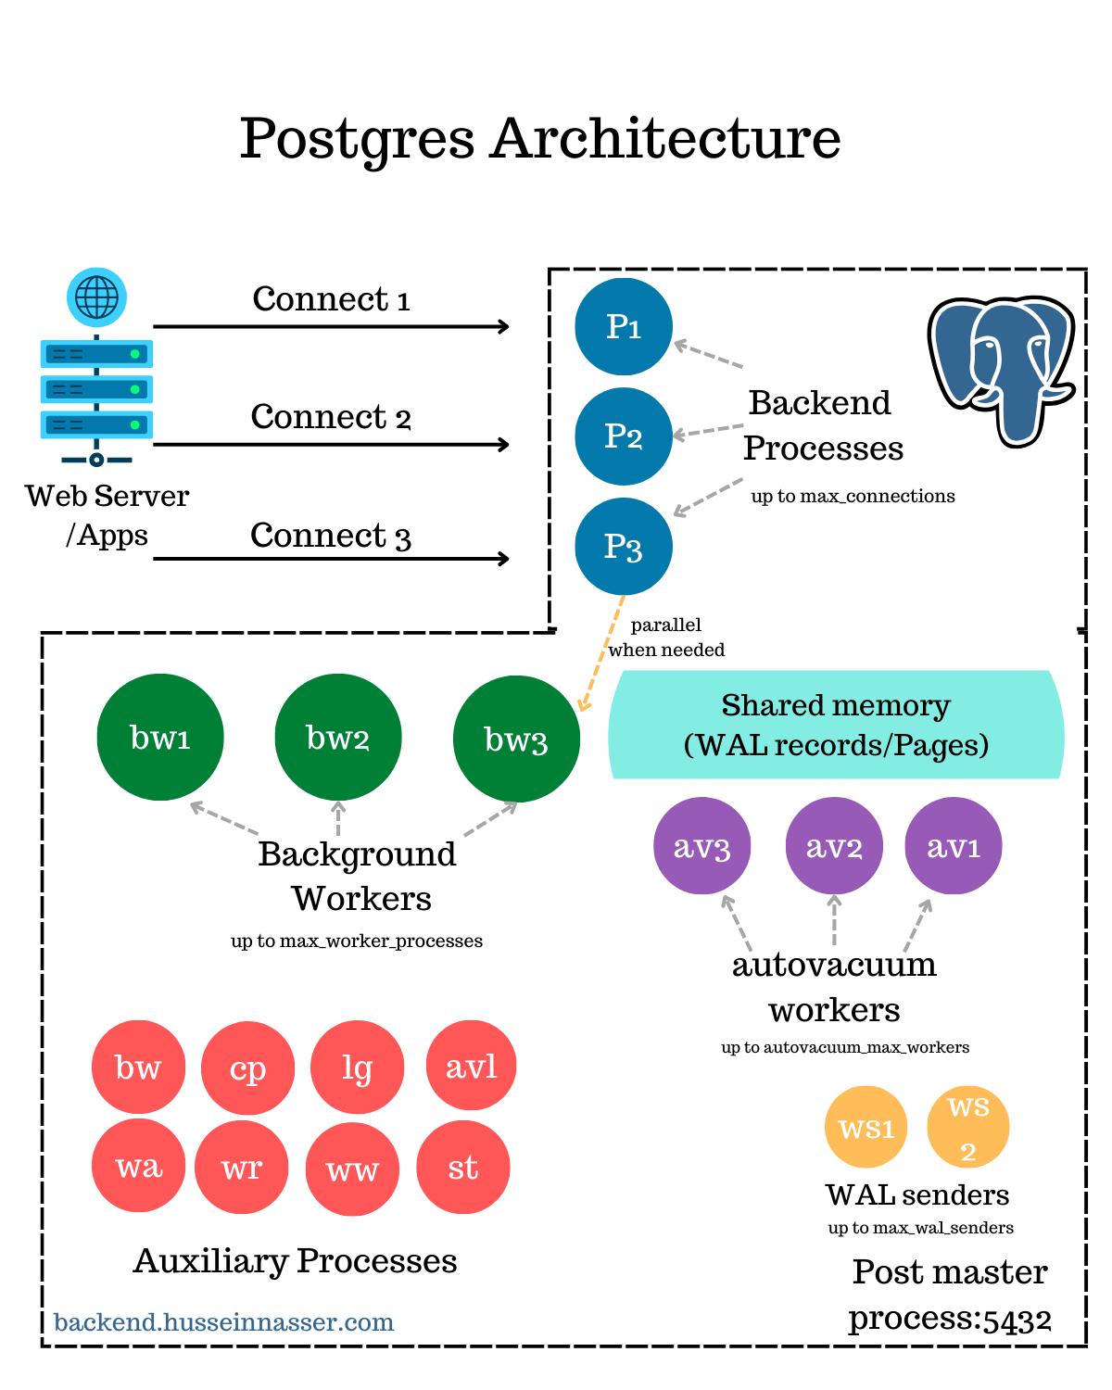
Postgres Processes
Postgres uses processes
Should Postgres move to threads?
Long running discussions
Notes:
https://www.postgresql.org/message-id/31cc6df9-53fe-3cd9-af5b-ac0d801163f4%40iki.fi

Slide 228
Fork
Fork creates a new process
Child must have new virtual memory
But OS uses CoW so pages can be shared unless a write happens
Redis Asynchronous durability

Slide 229
Copy on Write
52,000
A
48,000
A.P4
16,000
44,000
P4
A.P3
12,000
40,000
8,000
P3
A.P2
4,000
P2
36,000
2,000
P1
32,000
0
28,000
A.P1
24,000
A page table
20,000
VMA | PA
4000 | 28,000
8000 | 40,000
12,000 | 44,000
16,000 | 48,000
16,000
12,000
8,000
4,000
0
A is the only running process., B is about to be forked from A

Slide 230
Copy on Write
52,000
A
B
48,000
A.P4
16,000
16,000
44,000
P4
12,000
P4
A.P3
12,000
40,000
8,000
P3
8,000
P3
A.P2
4,000
P2
4,000
P2
36,000
2,000
P1
2,000
P1
32,000
0
0
28,000
A.P1
24,000
A page table
B page table
20,000
VMA | PA
4000 | 28,000
8000 | 40,000
12,000 | 44,000
16,000 | 48,000
16,000
VMA | PA
4000 | 28,000
8000 | 40,000
12,000 | 44,000
16,000 | 48,000
12,000
8,000
4,000
0
B is a fork of A, initially they are identical, their page tables point to the same physical memory

Slide 231
Copy on Write
52,000
A
B
48,000
A.P4
16,000
16,000
44,000
P4
12,000
P4
A.P3
12,000
40,000
8,000
P3
8,000
P3
A.P2
4,000
P2
4,000
P2
36,000
2,000
P1
2,000
P1
32,000
0
0
28,000
change
A.P1
24,000
A page table
B page table
20,000
VMA | PA
4000 | 28,000
8000 | 40,000
12,000 | 44,000
16,000 | 48,000
16,000
VMA | PA
4000 | 28,000
8000 | 40,000
12,000 | 44,000
16,000 | 48,000
12,000
8,000
4,000
0
A makes a change to an address in Page P1, P1 needs to be copied for B

Slide 232
Copy on Write
52,000
A
B
48,000
A.P4
16,000
16,000
44,000
P4
12,000
P4
A.P3
12,000
40,000
8,000
P3
8,000
P3
A.P2
4,000
P2
4,000
P2
36,000
2,000
P1*
2,000
P1
32,000
0
0
28,000
A.P1
24,000
A page table
B page table
20,000
VMA | PA
4000 | 28,000
8000 | 40,000
12,000 | 44,000
16,000 | 48,000
16,000
VMA | PA
4000 | 12,000
8000 | 40,000
12,000 | 44,000
16,000 | 48,000
12,000
B.P1
8,000
4,000
0
New page is allocated for B, A.P1 is copied in it, page table is updated to point to it.

Slide 233
Python CoW bug
Python bug None, True, False
Refcounting was constantly updated
Forks were triggering CoW
Notes:
Read full article https://codeconfessions.substack.com/p/a-war-story-involving-a-python-a

Slide 234
Summary
Processes have dedicates VM
Threads belong to the same process
Threads share parent process memory

Slide 235
Context Switching
husseinnasser
A critical OS function

Slide 236
CPU Process
CPU doesn’t really know what a process is
OS loads data into CPU registers (pc, sp, bp, etc.)
Pointer to Page Table mapping (ptbr)
Called “Context”
Executes instructions

Slide 237
Context Switch
To switch “context” we save current context and load new context
“Save” the current registers to current process PCB (memory write)
“Load” the new process PCB to CPU registers (Memory read)
pc, bp, sp, lr, ptbr and more

Slide 238
Process 100
Process 200
int a
int a
Heap
pc=4008
ptbr=0x555555
Heap
Data (static)
Data (static)
pc=4008
pc=8008
Text / code
Text / code
100’s page table
0x555555
PCB 100
200’s page table
0x444444
Process table (kernel)
PCB 200
VMA | PA
4000 | 28,000
8000 | 40,000
12,000 | 44,000
100, running,
Page table: 0x555555, pc=4008
PID | PCB
100 | 0x222222
200 | 0x333333
200, ready,
Page table: 0x444444, pc=8008
VMA | PA
4000 | 8,000
8000 | 16,000
12,000 | 20,000
The CPU is executing process 100’s instructions, lots of registers are in place but we will only show pc and ptbr for simplicity. Ptbr is the page table base register, pointing to the page table physical memory address where mapping is stored. Pc is the program counter which points to the virtual memory address of the current instruction.

Slide 239
Process 100
Process 200
int a
int a
Heap
pc=4012
ptbr=0x555555
Heap
Data (static)
Data (static)
pc=4012
pc=8008
Text / code
Text / code
100’s page table
0x555555
PCB 100
200’s page table
0x444444
Process table (kernel)
PCB 200
VMA | PA
4000 | 28,000
8000 | 40,000
12,000 | 44,000
100, running,
Page table: 0x555555, pc=4008
PID | PCB
100 | 0x222222
200 | 0x333333
200, ready,
Page table: 0x444444, pc=8008
VMA | PA
4000 | 8,000
8000 | 16,000
12,000 | 20,000
CPU moves to the next instruction, pc register is currently 4012 , but the PCB pc value in memory still has the old values.

Slide 240
Process 100
Process 200
int a
int a
Heap
pc=4012
ptbr=0x555555
Heap
Data (static)
Data (static)
pc=4012
pc=8008
Text / code
Text / code
100’s page table
0x555555
PCB 100
200’s page table
0x444444
Process table (kernel)
PCB 200
VMA | PA
4000 | 28,000
8000 | 40,000
12,000 | 44,000
100, ready,
Page table: 0x555555, pc=4012
PID | PCB
100 | 0x222222
200 | 0x333333
200, ready,
Page table: 0x444444, pc=8008
VMA | PA
4000 | 8,000
8000 | 16,000
12,000 | 20,000
OS initiates a context switch, process 100 state must be saved to its PCB, the process now becomes in a ready state

Slide 241
Process 100
Process 200
int a
int a
Heap
pc=8008
ptbr=0x444444
Heap
Data (static)
Data (static)
pc=4012
pc=8008
Text / code
Text / code
100’s page table
0x555555
PCB 100
200’s page table
0x444444
Process table (kernel)
PCB 200
VMA | PA
4000 | 28,000
8000 | 40,000
12,000 | 44,000
100, ready,
Page table: 0x555555, pc=4012
PID | PCB
100 | 0x222222
200 | 0x333333
200, running,
Page table: 0x444444, pc=8008
VMA | PA
4000 | 8,000
8000 | 16,000
12,000 | 20,000
OS then loads Process 200’s PCB into the CPUs registers. Process 200 is now executing. We also need to flush the TLB as well, process 200 is now in running state

Slide 242
TLB flush
TLB stores Virtual memory mapping cache
Processes CANNOT share VM mapping
Slow
Threads of same process are faster to switch
Same memory, paging
As long as threads of the same process
Notes:
TLB flush more details here https://lass.cs.umass.edu/~shenoy/courses/fall12/lectures/notes/Lec06_notes.pdf
More reading on sharing page tables mshare method https://lwn.net/Articles/895217/
More readings

Slide 243
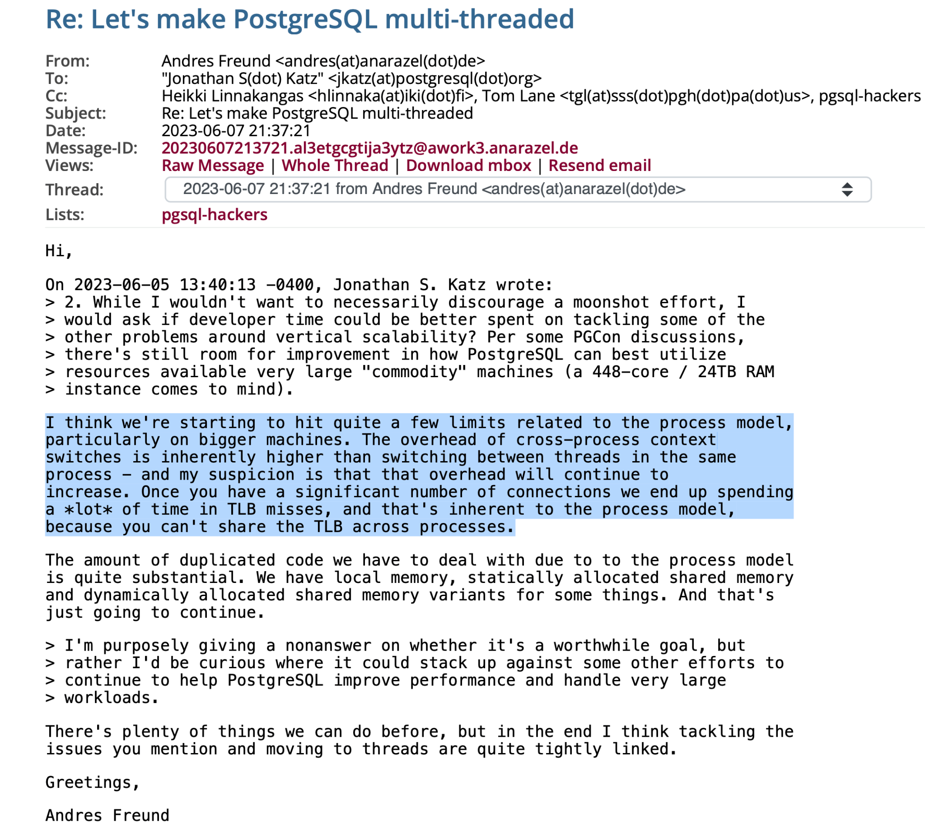
Notes:
https://www.postgresql.org/message-id/20230607213721.al3etgcgtija3ytz%40awork3.anarazel.de

Slide 244
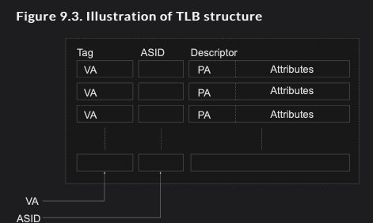
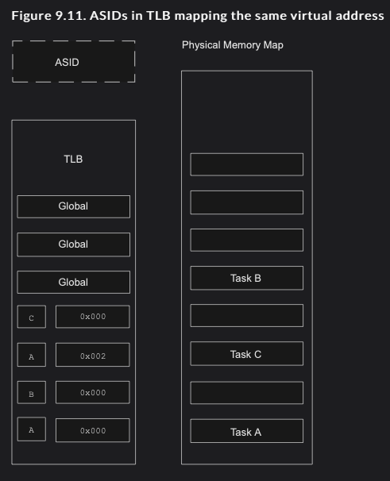
TLB ASID
Address space id
Identify the process in the TLB
255 values
Avoid TLB flushing on context switch
ARM/Intel
Credit arm.com
Notes:
https://developer.arm.com/documentation/den0013/d/The-Memory-Management-Unit/Multi-tasking-and-OS-usage-of-translation-tables/Address-Space-ID

Slide 245
When does context switch happens
Scheduling algorithms
Preemptive multitasking
IO wait
Notes:
TLB flush more details here https://lass.cs.umass.edu/~shenoy/courses/fall12/lectures/notes/Lec06_notes.pdf

Slide 246

Preemptive multitasking
Some processes run for a long time
OS must switch those out
Time slice
Windows 3.1 bug where other processes starve

Slide 247
Scheduling algorithms
What processes/ threads get what CPU core for how long
Many papers have been written on this topic
Complex and hard to find a fair algorithm
You want to schedule threads of same process on the same core
Notes:
TLB flush more details here https://lass.cs.umass.edu/~shenoy/courses/fall12/lectures/notes/Lec06_notes.pdf

Slide 248
Scheduling algorithms
First come first serve
Shortest Job First
Round Robin
Notes:
TLB flush more details here https://lass.cs.umass.edu/~shenoy/courses/fall12/lectures/notes/Lec06_notes.pdf

Slide 249
Note about alignment
0 1 2 3 4 5 6 7
8 9 10 11 12 13 14 15
16 17 18 19 20 21 22 23
Data types are aligned
1, 4 or 8 bytes
Certain sizes are placed in specific addresses
E.g. 4 bytes placed in addressed divisible by 4
First figure, structure allocated char one byte (that can go anywhere), but next we need a double and that must go in a /8 address the next one available is address 0x8, leaving bytes 1-7 empty, followed 2 bytes short which we can put on the address 0x16 then the 4 byte int on address 0x20
However in the second figure we allocated less memory for the structure as we defined the 1 byte character on 0x1, then the short which lived in a 2 byte address 0x2 then 4 byte address right after on address 0x4 (divisiable by 4) then we allocated the double on 0x8

Slide 250
Summary
Context is an OS concept
CPU execute instructions only
Context is saved or loaded (thus switched)
Threads are more efficient in context switch

Slide 251
Concurrency
husseinnasser
Split your program into processes or threads

Slide 252
CPU time is precious
CPU commodity
Need to keep it busy
Can one task be split to concurrent tasks

Slide 253
CPU Bound vs IO Bound Workload
CPU Bound workload mostly use CPU
Encryption, Compression, DB planning, sorting, Protocol Parsing (HTTP/2, QUIC)
We want to limit starvation of those
IO Bound Workload is mostly does IO
Database queries, network connection write/read, file reads/writes

Slide 254
Multi-threaded vs Multi-process
P1
P2
Multi-process
Spin multiple processes
Isolated
e.g. NGINX, Postgres
Multi-threaded
parent process spins multiple threads
Share memory with parent
E.g. MySQL, libuv
P3
T1
T2

Slide 255
Concurrency issues
With concurrency comes challenges
Two threads touching the same variable (thread safety)
Two processes writing to the same shared memory
a=1
T1
a++
T2
a++
Read a=1
a=a+1
a=2
Store a=2
Read a=1
a=a+1
a=2
Store a=2

Slide 256
Concurrency issues
Two threads, both increments a global variable
T1 reads a value 1, T2 reads a value 1
T1 increments a in register, T2 also increments,
T1 stores 2 to memory, T2 also stores 2, (should be 3)
a=1
T1
a++
T2
a++
a=2
Read a=1
a=a+1
a=2
Store a=2
Read a=1
a=a+1
a=2
Store a=2
a=2

Slide 257
Mutexes
M
a=1
T1
a++
T2
a++
Mutex is binary lock (mutual exclusion)
Thread 1 acquires a mutex succeeds.
Thread 2 tries to acquire the same mutex, waits(blocks)
Thread 1 does the change and release
Thread 2 immediately unblocks, gets the mutex and change
a=2
Read a=1
a=a+1
a=2
Store a=2
Read a=2
a=a+1
a=3
Store a=3
a=3

Slide 258
a=1
M
T1
a++
T2
a++
Acquire Mutex
Acquire Mutex (waits)
Even if both threads attempts to obtain the mutex at the same time, the OS will serialize them the second one to come in will be blocked (its atomic), or one will be chosen by the OS. Here thread 1 wins. Both T1 and T2 are executing on different cores (T2 will get switched out probably making room for other threads)

Slide 259
a=1
M
T1
a++
T2
a++
Read a
a=1
a=a+1
a=2
Acquire Mutex (waits)
Thread 1 reads a increments it (CPU executes instructions), a is now 2 in T1’s core register

Slide 260
a=2
M
T1
a++
T2
a++
Read a
a=1
a=a+1
a=2
Write a=2
Acquire Mutex (waits)
Thread 1 writes a back to the stack/heap memory a is now 2 in memory

Slide 261
a=2
M
T1
a++
T2
a++
Release mutex
Acquire Mutex(unblocked)
Thread 1 releases the mutex, immediately T2 gets it (OS will context switch T2 back)

Slide 262
a=2
M
T1
a++
T2
a++
Release mutex
Acquire Mutex
Thread 1 releases the mutex, immediately T2 gets it (OS will context switch T2 back)

Slide 263
a=3
M
T1
a++
T2
a++
Release mutex
a=2
a=a+1
a=3
Write a
Release mutex
Thread 2 resumes, get the latest version of a which is 2, increments it to 3, writes back to memory, releases

Slide 264
a=3
M
T1
a++
T2
a++

Slide 265
Mutexes Gotchas
Mutex has ownership
The thread that locks Mutex MUST unlock
If a thread terminates the mutex can remain locked
Can cause deadlock

Slide 266
Semaphores
Semaphores can be used for mutual exclusion
Signal increments, Wait decrements (atomically)
Wait blocks when semaphore = 0
Any thread with access to the semaphore can signal/wait

Slide 267
Summary
Concurrent programming improves performance
Can use processes or threads
Challenging as need to deal with race conditions
Using Mutex/Semaphores help

Slide 268
Storage Management
husseinnasser
The internals of disk storage

Slide 269
Persistent Storage
husseinnasser
Why Persist?

Slide 270
Persistence
RAM is volatile, if power goes we lose data
Need to persist data for certain use cases
Megantic Tape, HDD, SSD, Flash

Slide 271
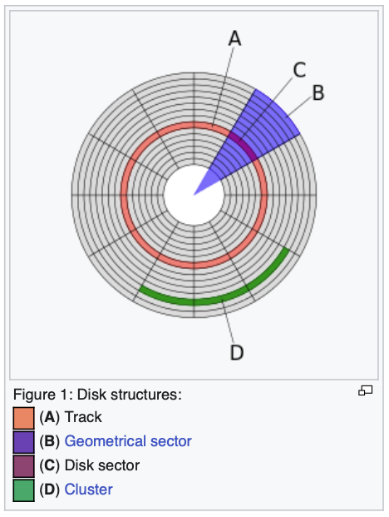
HDD
HDD consists of platters, heads, tracks and sectors
Traditionally the OS addressed using CHS method
Cylinder/ Head / Sector
Geometrical Sector vs Disk sector
The OS “knows” the physical layout of the HDD
head
cylinder
1
G
F
Geometrical sector
2
A
E
B
C
D
3
Disk sector
Access disk sector: Cylinder yellow, Head 2, Sector C

Slide 272
LBA
Later OS exposes a new API LBA
Logical Block Addressing
The entire disk is an array of blocks
Disk Controller does the “Translation”
Additional Cost but disks can be improved
LBAs
1
2
3
4
5
6
7
8
1
G
F
2
A
E
B
C
D
Access LBA 3 -> controller translates to Cylinder yellow, Head 2, Sector C
3
Disk sector

Slide 273
SSD
SSD uses NAND technology
Physical Page (4 KiB, 16 KiB etc.)
Physical Block (collection of pages)
Min read/write is page, erase by block
Logical blocks maps to pages (Flash translation layer)
LBAs
1
2
3
4
5
6
7
8
A
E
B
F
C
G
D
H
LBA 1 maps to page A, 7 to G and so on..

Slide 274
SSD Write
We want to write to LBA 1
We find a free physical block and map it
1
2
3
4
5
6
7
8
A
E
B
F
C
G
D
H
We write to LBA 1 , which maps to PBA A.

Slide 275
SSD Write
Write 4 KiB to LBA 1
Now we want to update LBA 1 with new content
No update in SSD, its a remove and add.
1
2
3
4
5
6
7
8
A
E
B
F
C
G
D
H
We write to LBA 1 , which maps to PBA A.

Slide 276
SSD Write - Update
LBA 1 is now maps to PPA B
A is marked invalid (must be erased before used)
Can’t erase a single page
1
2
3
4
5
6
7
8
A
E
B
F
C
G
D
H
We write to LBA 1 , which maps to PBA B.

Slide 277
SSD Write - More update
We continue writing
LBA1 points to D,
F, G and H are used by 6, 7 and 8
One more update to LBA 1
1
2
3
4
5
6
7
8
A
E
B
F
C
G
D
H

Slide 278
SSD Write - More Updates
LBA 1 now points to E
One more update to LBA 1 but everything is full
Entire block is now invalid we can safely erase it
1
2
3
4
5
6
7
8
A
E
B
F
C
G
D
H

Slide 279
SSD Write Garbage collection
First erase block
Then we update LBA 1
1
2
3
4
5
6
7
8
A
E
B
F
C
G
D
H
Erasing block

Slide 280
SSD Write Amplification
Now we have LBA 1 points to A
E is invalid
This is called Write amplification
We wanted to do a single write but end up doing more
1
2
3
4
5
6
7
8
A
E
B
F
C
G
D
H
A write amplification occurred when we try to write a page but end up doing more work behind the scene slowing the operation

Slide 281
Wear leveling
NAND cells have write limit
Write endurance/ program
Cold vs hot pages
Page written once and never touched
While other pages are updated all the time
Some pages will die before others
1
2
3
4
5
6
7
8
A
E
B
F
C
G
D
H
Page A, B, C and D written once and never been touched ever. pages E, F, G and H are always getting used. E, F, G and H will be weared before the rest, and this part of the SSD becomes unusable.

Slide 282
Over-provisioning
SSD over-provision an area for GC/WL
OP
1
2
3
4
5
6
7
8
A
E
B
F
C
G
D
H
Page A, B, C and D written once and never been touched ever. pages E, F, G and H are always getting used. E, F, G and H will be weared before the rest, and this part of the SSD becomes unusable.

Slide 283
Over-provisioning
SSD over-provision an area for GC/WL
Cold pages are moved to OP
OP
1
2
3
4
5
6
7
8
A
E
A
B
F
B
C
G
C
D
H
D

Slide 284
Over-provisioning
SSD over-provision an area for GC/WL
Cold pages are moved to OP
Erase cold block
OP
1
2
3
4
5
6
7
8
E
A
F
B
G
C
H
D

Slide 285
Over-provisioning
SSD over-provision an area for GC/WL
Cold pages are moved to OP
Erase cold block
Move hot pages
OP
1
2
3
4
5
6
7
8
E
A
F
B
G
C
H
D

Slide 286
Mismatch block to page size
LBA doesn’t have to match page size!
e.g. LBA = 4KiB and Page is 8 KiB
Mapping to addresses in a page
Causes issues
1
2
3
4
5
6
7
8
A
C
B
D
LBA 1 maps to Page A at address 0 and LBA 2 maps to Page A on address 2000

Slide 287
Summary
We need persisted storage
Storage is abstracted as blocks
The OS access logical blocks

Slide 288
File Systems
husseinnasser
Layer above storage

Slide 289

File System
An abstraction above present storage
Users like files/directories
Writing and reading to a file translates to blocks
Promotes caching
Must allocate a block (1 or more LBAs)
File System
(OS)
Notes:
Linux, to find the logical/physical sector size
lsblk -o NAME,PHY-SeC,LOG-SEC
Windows
Get-PhysicalDisk | Select-Object DeviceID, FriendlyName, LogicalSectorSize, PhysicalSectorSize

Slide 290
Examples of File Systems
FAT (FAT16, FAT32)
NTFS
APFS (Apple File System)
EXT4
XFS
btrfs
Notes:
Linux, to find the logical/physical sector size
lsblk -o NAME,PHY-SeC,LOG-SEC
Windows
Get-PhysicalDisk | Select-Object DeviceID, FriendlyName, LogicalSectorSize, PhysicalSectorSize

Slide 291
Some terminologies
PBA - Physical Block Address - Internal to the drive
Aka physical sector size
LBA - Logical Block Address - Exposed to OS
aka logical sector size
File System Block Size
Minimum read/write size by the fs
1 PBA -> 1 or more LBAs
1 FS Block = 1 or more LBAs
Example
FS block 1
LBA 1
PBA 1
LBA 2
FS block 2
LBA 3
LBA 4
2048 fs block
1024 LBA
4096 PBA
Notes:
Linux, to find the logical/physical sector size
lsblk -o NAME,PHY-SeC,LOG-SEC
Windows
Get-PhysicalDisk | Select-Object DeviceID, FriendlyName, LogicalSectorSize, PhysicalSectorSize

Slide 292
FAT32
File Allocation Table
Basic Idea is Array of 32 bit integers
The index is the LBA (or Logical Sector traditionally)
The content is the next LBA, until we reach end.
test.txt
LBA
0
1
2
3
4
5
6
7
-
-
3
E
-
-
2
-
File
Name: test.txt
Start LBA: 6
File test.txt starts at LBA 6, to read the entire file we read go to position 6 , find out that the next LBA is 2, we go to the LBA 2 and find out the next LBA is 3, we go to LBA 3 and find out that it is the end of the file no more chain! So to read the entire file we read LBAs 6, 2 and 3.
Notes:
Linux, to find the logical/physical sector size
lsblk -o NAME,PHY-SeC,LOG-SEC
Windows
Get-PhysicalDisk | Select-Object DeviceID, FriendlyName, LogicalSectorSize, PhysicalSectorSize

Slide 293
32 bit is really 28
We need to reserve some bits
End of chain, Is dirty, free, other uses
LBA = 512 byte (the old standard)
So we can only address 2^28 *512 bytes ~ = 128 GB!
Very low! So we need to play a trick
Meet clusters
Notes:
Linux, to find the logical/physical sector size
lsblk -o NAME,PHY-SeC,LOG-SEC
Windows
Get-PhysicalDisk | Select-Object DeviceID, FriendlyName, LogicalSectorSize, PhysicalSectorSize

Slide 294
Clustering
Cluster is a logical grouping of LBAs (aka blocks)
LBA size = 512 byte
E.g. 8 LBAs = 1 cluster (4 KiB)
E.g. Cluster 0 -> LBAs 0-7, Cluster 1 -> LBAs 8- 15 (C * 8)
We can address much more (~1 TB)
test.txt
0
4
6
7
Blocks
1
2
3
5
-
-
-
E
-
-
3
-
LBAs/logical sectors
File
Name: test.txt
Start Block/Cluster: 6
File test.txt starts at Cluster 6, to read the entire file we read go to position 6 , find out that the next cluster is 3, we go to the cluster 3 and find out the its the end of file. So to read the file we need to convert clusters 6, and 3 to LBAs, cluster 6 is LBAs (48-55) and cluster 3 to LBAs (24-31)
Notes:
Linux, to find the logical/physical sector size
lsblk -o NAME,PHY-SeC,LOG-SEC
Windows
Get-PhysicalDisk | Select-Object DeviceID, FriendlyName, LogicalSectorSize, PhysicalSectorSize

Slide 295
Clustering
The larger the cluster, the more disk we can address
But creates more internal fragmentation
Wasted space, can’t be used by others.
used
waste
Notes:
Linux, to find the logical/physical sector size
lsblk -o NAME,PHY-SeC,LOG-SEC
Windows
Get-PhysicalDisk | Select-Object DeviceID, FriendlyName, LogicalSectorSize, PhysicalSectorSize

Slide 296
Blocks everywhere
When formatting a file system you specify a file system block size
Must not exceed virtual page size 1024, 2048, 4096 bytes
LBA size = Logical sector block
PBA size = Physical sector block (on device)
Fs block maps to collection of LBAs (derived like clusters)
FS block 1
LBA 1
PBA 1
FS block 1
LBA 1
PBA 1
FS block 1
LBA 1
PBA 1
LBA 2
PBA 2
LBA 3
PBA 3
LBA 2
LBA 2
LBA 4
PBA 4
LBA 5
PBA 5
LBA 3
PBA 2
LBA 3
LBA 6
PBA 6
LBA 7
PBA 7
LBA 4
LBA 4
LBA 8
PBA 8
4096 -> 512 -> 512
4096 -> 1024 -> 2048
4096 -> 1024 -> 4096
Notes:
Linux, to find the logical/physical sector size
lsblk -o NAME,PHY-SeC,LOG-SEC
Windows
Get-PhysicalDisk | Select-Object DeviceID, FriendlyName, LogicalSectorSize, PhysicalSectorSize

Slide 297
OS Page Cache
File system blocks read from disk are cached
Block number maps to virtual memory page
FS Block <= OS VM Page (often)
Reads checks the cache first then disk and updates cache
Writes go to the cache first, then disk
Block number maps to LBAs
Notes:
Linux, to find the logical/physical sector size
lsblk -o NAME,PHY-SeC,LOG-SEC
Windows
Get-PhysicalDisk | Select-Object DeviceID, FriendlyName, LogicalSectorSize, PhysicalSectorSize

Slide 298
OS Page Cache (Cached Read)
User wants to read block number 3
OS first checks the page cache
Block 3 is cached and mapped to a VM page
content is copied to the user buffer
Read Block 3 (hit)
Page cache
(memory)
Disk
Notes:
Linux, to find the logical/physical sector size
lsblk -o NAME,PHY-SeC,LOG-SEC
Windows
Get-PhysicalDisk | Select-Object DeviceID, FriendlyName, LogicalSectorSize, PhysicalSectorSize

Slide 299
OS Page Cache (Missed Read)
User wants to read block number 7
OS first checks the page cache
Block 7 isn’t in the page cache, we go to disk
Translate block 7 to LBAs and read from disk and update the cache
1 Block = 8 LBAs (B * 8 + 7)
Read Block 7 (miss)
Read LBAs 56-63
Page cache
(memory)
Disk
Notes:
Linux, to find the logical/physical sector size
lsblk -o NAME,PHY-SeC,LOG-SEC
Windows
Get-PhysicalDisk | Select-Object DeviceID, FriendlyName, LogicalSectorSize, PhysicalSectorSize

Slide 300
OS Page Cache (Write)
User wants to write to Block 7
OS writes to the page cache creating a new entry
LATER the OS flushes the page cache to disk
OR until fsync() is called
(Buffered)
Write Block 7
Write LBAs 56-63
Page cache
(memory)
Disk
Notes:
Linux, to find the logical/physical sector size
lsblk -o NAME,PHY-SeC,LOG-SEC
Windows
Get-PhysicalDisk | Select-Object DeviceID, FriendlyName, LogicalSectorSize, PhysicalSectorSize

Slide 301
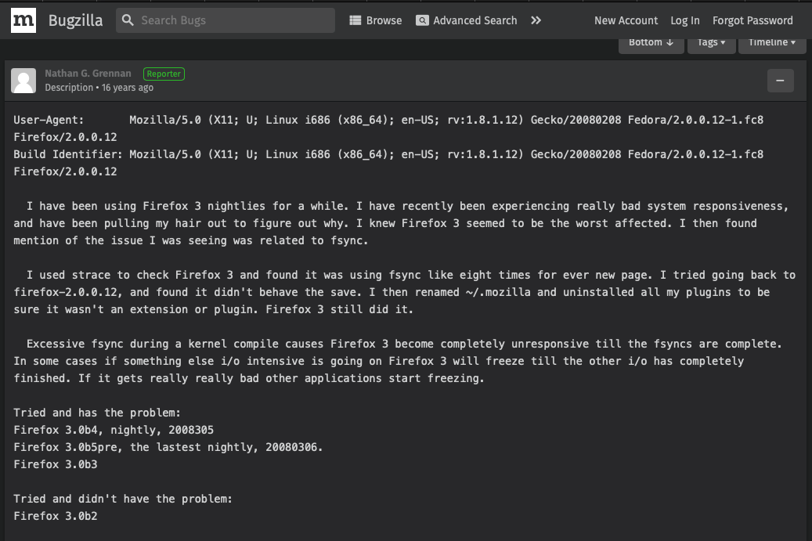
Too many fsync is not good…
Notes:
https://bugzilla.mozilla.org/show_bug.cgi?id=421482

Slide 302
Page cache woes
Faster reads
two apps can page cache files
Can cause corruption
Write goes to cache then OS crashes
Torn database pages

Slide 303
File Modes
A file must be opened to be used
Different modes in open
Some examples
O_APPEND - append mode
O_DIRECT - skips page cache
O_SYNC - write always flushes cache (slow)

Slide 304
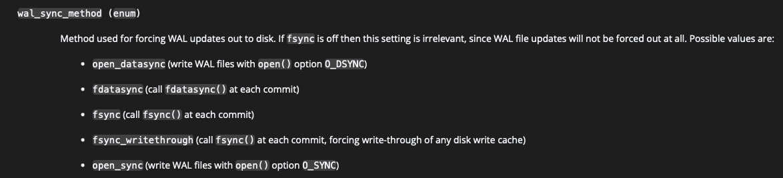
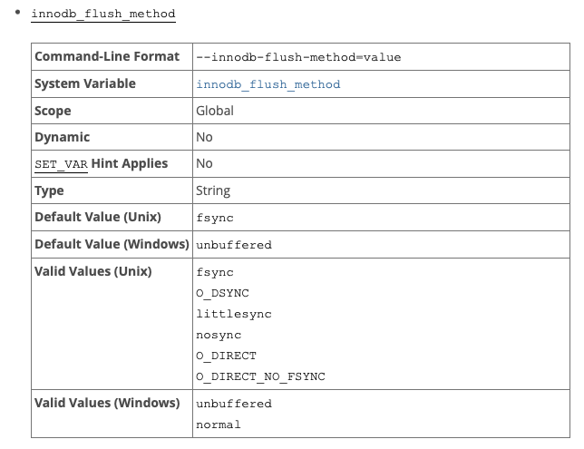


Postgres/MySQL and File Modes in WAL

Slide 305
Partitions
P1
LBA 1
LBA 2
LBA 3
Disks are exposed as big array of LBAS (logical sectors)
Partitions start from LBA and end in an LBA
Provides logical segmentation
E.g. Partition 1 - is LBA 1 - LBA 4
Each partition can have its own FS
Each FS different Block size (cluster)
LBA 4
P2
LBA 5
LBA 6
LBA 7
LBA 8
LBA 9
LBA 10
LBA 11
LBA 12
LBA 13
P3
LBA 14
LBA 15
LBA 16
……

Slide 306
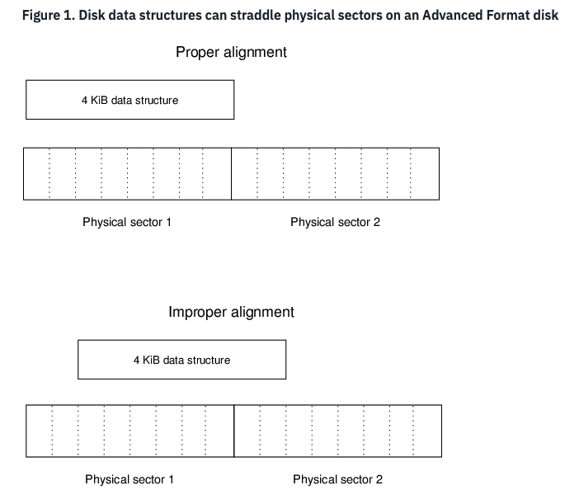
Partition Alignment
Partition starting at an odd LBA
Say 8 LBAs map to 1 PBA
FS Block size is 8 LBAs
Partition starts at LBA 2
One fs block is 2-9 LBAs
Means PBA 1 & PBA 2
Overlapping!
Performance issues
Credit: IBM
Notes:
Reference
https://web.archive.org/web/20190503044834/https://developer.ibm.com/tutorials/l-linux-on-4kb-sector-disks/

Slide 307
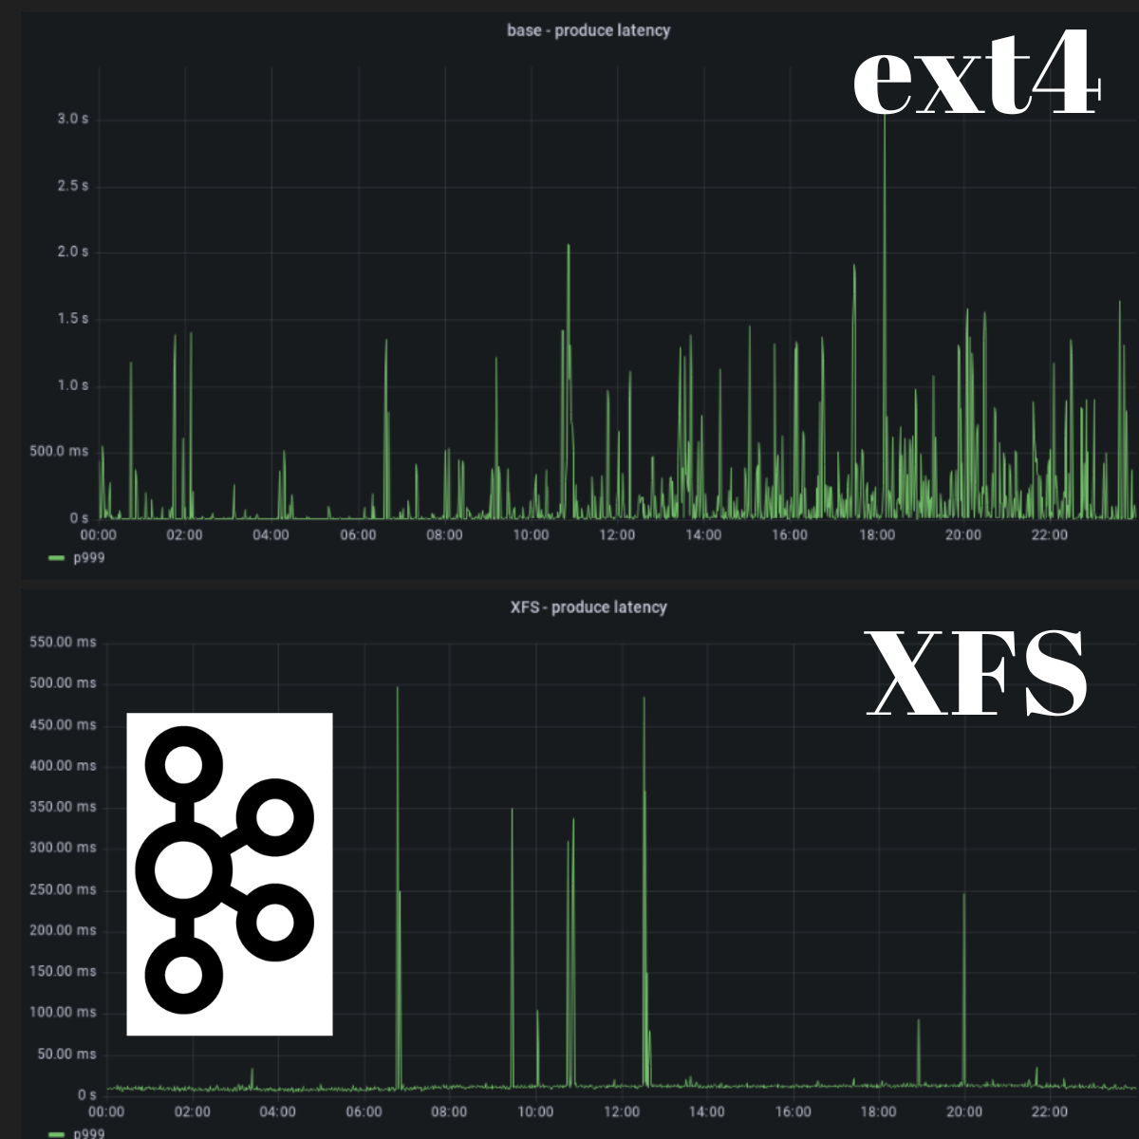
Moving File Systems
Success moves of file systems
Allegro moved their Kafka from ext4 to XFS
The cost of journal commits
Metadata updates

Slide 308
Summary
File systems exposes files and directories
Itself has a structure and storage
Linked to the OS page cache
Translation of POSIX read, fs block, to pages

Slide 309
A simple read
husseinnasser
What really happens behind a read?

Slide 310


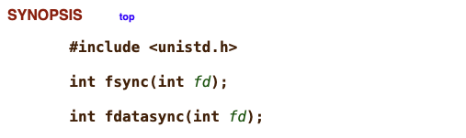
POSIX
Notes:
Linux, to find the logical/physical sector size
lsblk -o NAME,PHY-SeC,LOG-SEC
Windows
Get-PhysicalDisk | Select-Object DeviceID, FriendlyName, LogicalSectorSize, PhysicalSectorSize

Slide 311
Read example
Test.dat (5000 bytes)
Read entire file “test.dat”, 5000 bytes
Logical sector size 4096, physical sector size 4096
Page size 4096
File system block 4096
1 Block = 1 LBA (sector)
Two blocks:
One full block and
another block with 1000 bytes

Slide 312
Read file Blocks
Issue read command on the file
The OS reads the file system metadata
Find the start block, follow until end of file
Blocks 6,3 (Still need LBAs)
test.dat
Block
0
1
2
3
4
5
6
7
File
Name: test.dat
Start Block: 6
-
-
-
E
-
-
3
-

Slide 313
Check the page cache
Page cache
Block | VM memory
Query the OS file system page cache
Block 3 is cached but 6 is not.
Next we send a command to disk controller
1
x
2
y
3
z

Slide 314
Read from disk controller
Page cache
Block | VM memory
The OS sends a read command to the disk
Block 6 is LBA 6 (1 Block = 1 LBA)
LBA 6, for length 1
Disk controller converts LBA to PBA
Returns the data to OS
1
x
2
y
3
z
LBA 6

Slide 315
OS updates cache
Page cache
Block | VM memory
OS gets the content and update its cache
1
x
2
y
3
z
6
j

Slide 316
OS return to user
Page cache
Block | VM memory
OS takes content from z, j
Z has 4096 bytes, but user only asks for 1000
Copies the memory to the user buffer
Return success/unblocks
1
x
2
y
3
z
6
j

Slide 317
Summary
So many layers
Translation of POSIX read, fs block, to pages
Page cache/delayed

Slide 318
Socket Management
husseinnasser
The networking part of the OS

Slide 319
Network Fundamentals
husseinnasser
Brief intro on Networking

Slide 320


Client-Server Architecture
A revolution in networking

Slide 321
Client-Server Architecture
Machines are expensive, applications are complex
Seperate the application into two components
Expensive workload can be done on the server
Clients call servers to perform expensive tasks
Remote procedure call (RPC) was born

Slide 322
Client-Server Architecture Benefits
Servers have beefy hardware
Clients have commodity hardware
Clients can still perform lightweight tasks
Clients no longer require dependencies
However, we need a communication model

Slide 323

OSI Model
husseinnasser
Open Systems Interconnection model

Slide 324
Why do we need a communication model?
husseinnasser
Agnostic applications
Without a standard model, your application must have knowledge of the underlying network medium
Imagine if you have to author different version of your apps so that it works on wifi vs ethernet vs LTE vs fiber
Network Equipment Management
Without a standard model, upgrading network equipments becomes difficult
Decoupled Innovation
Innovations can be done in each layer separately without affecting the rest of the models

Slide 325
What is the OSI Model?
husseinnasser
7 Layers each describe a specific networking component
Layer 7 - Application - HTTP/FTP/gRPC
Layer 6 - Presentation - Encoding, Serialization
Layer 5 - Session - Connection establishment, TLS
Layer 4 - Transport - UDP/TCP
Layer 3 - Network - IP
Layer 2 - Data link - Frames, Mac address Ethernet
Layer 1 - Physical - Electric signals, fiber or radio waves

Slide 326
The OSI Layers - an Example (Sender)
husseinnasser
Example sending a POST request to an HTTPS webpage
Layer 7 - Application
POST request with JSON data to HTTPS server
Layer 6 - Presentation
Serialize JSON to flat byte strings
Layer 5 - Session
Request to establish TCP connection/TLS
Layer 4 - Transport
Sends SYN request target port 443
Layer 3 - Network
SYN is placed an IP packet(s) and adds the source/dest IPs
Layer 2 - Data link
Each packet goes into a single frame and adds the source/dest MAC addresses
Layer 1 - Physical
Each frame becomes string of bits which converted into either a radio signal (wifi), electric signal (ethernet), or light (fiber)
Take it with a grain of salt, it's not always cut and dry

Slide 327
The OSI Layers - an Example (Receiver)
husseinnasser
Receiver computer receives the POST request the other way around
Layer 1 - Physical
Radio, electric or light is received and converted into digital bits
Layer 2 - Data link
The bits from Layer 1 is assembled into frames
Layer 3 - Network
The frames from layer 2 are assembled into IP packet.
Layer 4 - Transport
The IP packets from layer 3 are assembled into TCP segments
Deals with Congestion control/flow control/retransmission in case of TCP
If Segment is SYN we don’t need to go further into more layers as we are still processing the connection request
Layer 5 - Session
The connection session is established or identified
We only arrive at this layer when necessary (three way handshake is done)
Layer 6 - Presentation
Deserialize flat byte strings back to JSON for the app to consume
Layer 7 - Application
Application understands the JSON POST request and your express json or apache request receive event is triggered
Take it with a grain of salt, it's not always cut and dry

Slide 328

Client sends an HTTPS POST request
Client
Server
Application
Application
Presentation
Presentation
Session
Session
Transport
Segment
Transport
Network
Packet
Network
Data Link
Frame
Data Link
Physical
Physical

Slide 329
Client
Server
SPORT
DPORT
SPORT
DPORT
SIP
DIP
SIP
DIP
SMAC
DMAC
SMAC
DMAC

Slide 330
Across networks
Client
Server
Application
Application
Presentation
Presentation
Session
Session
Transport
Router
Transport
Network
Switch
Network
Network
Data Link
Data Link
Data Link
Data Link
Physical
Physical
Physical
Physical

Slide 331
Across networks
Layer 7 Load Balancer/CDN
Client
Backend Server
Application
Application
Application
Presentation
Presentation
Presentation
Layer 4 Proxy, Firewall
Session
Session
Session
Transport
Transport
Transport
Transport
Network
Network
Network
Network
Data Link
Data Link
Data Link
Data Link
Physical
Physical
Physical
Physical

Slide 332
The shortcomings of the OSI Model
husseinnasser
OSI Model has too many layers which can be hard to comprehend
Hard to argue about which layer does what
Simpler to deal with Layers 5-6-7 as just one layer, application
TCP/IP Model does just that

Slide 333
TCP/IP Model
husseinnasser
Much simpler than OSI just 4 layers
Application (Layer 5, 6 and 7)
Transport (Layer 4)
Internet (Layer 3)
Data link (Layer 2)
Physical layer is not officially covered in the model

Slide 334
OSI Model Summary
husseinnasser
Why do we need a communication model?
What is the OSI Model?
Example
Each device in the network doesn’t have to map the entire 7 layers
TCP/IP is simpler model

Slide 335
Host to Host communication
husseinnasser
A
B
How messages are sent between hosts

Slide 336
Host to Host communication
husseinnasser
I need to send a message from host A to host B
Usually a request to do something on host B (RPC)
Each host network card has a unique Media Access Control address (MAC)
E.g. 00:00:5e:00:53:af
A
B
00:00:5e:00:53:aa
00:00:3a:12:31:0b

Slide 337
Host to Host communication
husseinnasser
A sends a message to B specifying the MAC address
Everyone in the network will “get” the message but only B will accept it
B
A
C
D

Slide 338
Host to Host communication
husseinnasser
Imagine millions of machines?
We need a way to eliminate the need to send it to everyone
The address needs to get better
We need routability, meet the IP Address

Slide 339
Host to Host communication
husseinnasser
The IP Address is built in two parts
One part to identify the network, the other is the host
We use the network portion to eliminate many networks
The host part is used to find the host
Still needs MAC addresses!

Slide 340

Host A on network N1 wants to talk to Host B on network N2
A
A
B
B
C
C
N1
N2

Slide 341
Host 192.168.1.3 wants to talk to 192.168.2.2
192.168.1.3
192.168.2.3
192.168.1.2
192.168.2.2
192.168.1.1
192.168.2.1
192.168.1.0/24
192.168.2.0/24

Slide 342
But my host have many apps!
husseinnasser
It's not enough just to address the host
The host is runnings many apps each with different requirements
Meet ports
You can send an HTTP request on port 80, a DNS request on port 53 and an SSH request on port 22 all running on the same server!

Slide 343
Host to Host communication - Summary
husseinnasser
Host needs addresses
MAC Addresses are great but not scalable in the Internet
Internet Protocol Address solves this by routing
Layer 4 ports help create finer addressability to the process level

Slide 344
The IP building blocks
husseinnasser
1.2.3.4
Understanding the IP Protocol

Slide 345
IP Address
husseinnasser
Layer 3 property
Can be set automatically or statically
Network and Host portion
4 bytes in IPv4 - 32 bits

Slide 346
Network vs Host
husseinnasser
a.b.c.d/x (a.b.c.d are integers) x is the network bits and remains are host
Example 192.168.254.0/24
The first 24 bits (3 bytes) are network the rest 8 are for host
This means we can have 2^24 (16777216) networks and each network has 2^8 (255) hosts
Also called a subnet

Slide 347
Subnet Mask
husseinnasser
192.168.254.0/24 is also called a subnet
The subnet has a mask 255.255.255.0
Subnet mask is used to determine whether an IP is in the same subnet

Slide 348
Default Gateway
husseinnasser
Most networks consists of hosts and a Default Gateway
Host A can talk to B directly if both are in the same subnet
Otherwise A sends it to someone who might know, the gateway
The Gateway has an IP Address and each host should know its gateway

Slide 349
E.g. Host 192.168.1.3 wants to talk to 192.168.1.2
192.168.1.3 applies subnet mask to itself and the destination IP 192.168.1.2
255.255.255.0 & 192.168.1.3 = 192.168.1.0
255.255.255.0 & 192.168.1.2 = 192.168.1.0
Same subnet ! no need to route
192.168.1.3
192.168.2.3
192.168.1.2
192.168.2.2
192.168.1.1
192.168.2.1
192.168.1.0/24
192.168.2.0/24

Slide 350
E.g. Host 192.168.1.3 wants to talk to 192.168.2.2
192.168.1.3 applies subnet mask to itself and the destination IP 192.168.2.2
255.255.255.0 & 192.168.1.3 = 192.168.1.0
255.255.255.0 & 192.168.2.2 = 192.168.2.0
Not the subnet ! The packet is sent to the Default Gateway 192.168.1.100
192.168.2.100
192.168.1.3
192.168.2.3
192.168.1.2
192.168.1.100
192.168.2.2
192.168.1.1
192.168.2.1
192.168.1.0/24
192.168.2.0/24

Slide 351
Summary
husseinnasser
IP Address
Network vs Host
Subnet and subnet mask
Default Gateway

Slide 352
UDP
husseinnasser
User Datagram Protocol

Slide 353
UDP
husseinnasser
Stands for User Datagram Protocol
Layer 4 protocol
Ability to address processes in a host using ports
Simple protocol to send and receive data
Prior communication not required (double edge sword)
Stateless no knowledge is stored on the host
8 byte header Datagram

Slide 354
UDP Use cases
husseinnasser
Video streaming
VPN
DNS
WebRTC
A
B

Slide 355
Multiplexing and demultiplexing
husseinnasser
IP target hosts only
Hosts run many apps each with different requirements
Ports now identify the “app” or “process”
Sender multiplexes all its apps into UDP
Receiver demultiplex UDP datagrams to each app
App1-port 5555
App2-port 7712
App3-port 2222
AppX-port 53
AppY-port 68
AppZ-port 6978
10.0.0.1
10.0.0.2

Slide 356
Source and Destination Port
husseinnasser
App1 on 10.0.0.1 sends data to AppX on 10.0.0.2
Destination Port = 53
AppX responds back to App1
We need Source Port so we know how to send back data
Source Port = 5555
10.0.0.1
5555
53
10.0.0.2
App1-port 5555
App2-port 7712
App3-port 2222
AppX-port 53
AppY-port 68
AppZ-port 6978
10.0.0.1
10.0.0.2
53
5555
10.0.0.1
10.0.0.2

Slide 357
Summary
husseinnasser
UDP is a simple layer 4 protocol
Uses ports to address processes
Stateless

Slide 358
UDP Pros and Cons
husseinnasser
The power and drawbacks of UDP

Slide 359
UDP Pros
husseinnasser
Simple protocol
Header size is small so datagrams are small
Uses less bandwidth
Stateless
Consumes less memory (no state stored in the server/client)
Low latency - no handshake , order, retransmission or guaranteed delivery

Slide 360
UDP Cons
husseinnasser
No acknowledgement
No guarantee delivery
Connection-less - anyone can send data without prior knowledge
No flow control
No congestion control
No ordered packets
Security - can be easily spoofed

Slide 361
TCP
husseinnasser
Transmission Control Protocol

Slide 362
TCP
husseinnasser
Stands for Transmission Control Protocol
Layer 4 protocol
Ability to address processes in a host using ports
“Controls” the transmission unlike UDP which is a firehose
Connection
Requires handshake
20 bytes headers Segment (can go to 60)
Stateful

Slide 363
TCP Use cases
husseinnasser
Reliable communication
Remote shell
Database connections
Web communications
Any bidirectional communication
A
B

Slide 364
TCP Connection
husseinnasser
Connection is a Layer 5 (session)
Connection is an agreement between client and server
Must create a connection to send data
Connection is identified by 4 properties
SourceIP-SourcePort
DestinationIP-DestinationPort

Slide 365
TCP Connection
husseinnasser
Can’t send data outside of a connection
Sometimes called socket or file descriptor
Requires a 3-way TCP handshake
Segments are sequenced and ordered
Segments are acknowledged
Lost segments are retransmitted

Slide 366
Multiplexing and demultiplexing
husseinnasser
IP target hosts only
Hosts run many apps each with different requirements
Ports now identify the “app” or “process”
Sender multiplexes all its apps into TCP connections
Receiver demultiplex TCP segments to each app based on connection pairs
App1-port 5555
App2-port 7712
App3-port 2222
AppX-port 53
AppY-port 68
AppZ-port 6978
10.0.0.1
10.0.0.2

Slide 367
Connection Establishment
husseinnasser
App1 on 10.0.0.1 want to send data to AppX on 10.0.0.2
App1 sends SYN to AppX to synchronous sequence numbers
AppX sends SYN/ACK to synchronous its sequence number
App1 ACKs AppX SYN.
Three way handshake
10.0.0.1
5555
SYN
22
10.0.0.2
AppX-port 22
AppY-port 443
AppZ-port 80
App1-port 5555
App2-port 7712
App3-port 2222
10.0.0.2
22
SYN/ACK
5555
10.0.0.1
10.0.0.1
10.0.0.2
10.0.0.1:5555:10.0.0.2:22
10.0.0.1:5555:10.0.0.2:22
10.0.0.1
5555
ACK
22
10.0.0.2
File descriptor
File descriptor

Slide 368
Sending data
husseinnasser
App1 sends data to AppX
App1 encapsulate the data in a segment and send it
AppX acknowledges the segment
Hint: Can App1 send new segment before ack of old segment arrives?
10.0.0.1
5555
ls
22
10.0.0.2
AppX-port 22
AppY-port 443
AppZ-port 80
App1-port 5555
App2-port 7712
App3-port 2222
10.0.0.2
22
ACK
5555
10.0.0.1
10.0.0.1
10.0.0.2
10.0.0.1:5555:10.0.0.2:22
10.0.0.1:5555:10.0.0.2:22
File descriptor
File descriptor

Slide 369
Acknowledgment
husseinnasser
App1 sends segment 1,2 and 3 to AppX
AppX acknowledge all of them with a single ACK 3
10.0.0.1
5555
seq1
22
10.0.0.2
AppX-port 22
AppY-port 443
AppZ-port 80
App1-port 5555
App2-port 7712
App3-port 2222
10.0.0.1
5555
seq2
22
10.0.0.2
10.0.0.1
10.0.0.1
5555
seq3
22
10.0.0.2
10.0.0.1:5555:10.0.0.2:22
10.0.0.2
10.0.0.1:5555:10.0.0.2:22
File descriptor
File descriptor
10.0.0.2
22
ACK3
5555
10.0.0.1

Slide 370
Lost data
husseinnasser
App1 sends segment 1,2 and 3 to AppX
Seg 3 is lost, AppX acknowledge 3
App1 resend Seq 3
10.0.0.1
5555
seq1
22
10.0.0.2
AppX-port 22
AppY-port 443
AppZ-port 80
App1-port 5555
App2-port 7712
App3-port 2222
10.0.0.1
5555
seq2
22
10.0.0.2
10.0.0.1
10.0.0.1
5555
seq3
22
10.0.0.2
10.0.0.1:5555:10.0.0.2:22
10.0.0.2
10.0.0.1:5555:10.0.0.2:22
10.0.0.2
22
ACK2
5555
10.0.0.1
File descriptor
File descriptor
10.0.0.1
5555
seq3
22
10.0.0.2
10.0.0.2
22
ACK3
5555
10.0.0.1

Slide 371
Closing Connection
husseinnasser
App1 wants to close the connection
App1 sends FIN, AppX ACK
AppX sends FIN, App1 ACK
Four way handshake
10.0.0.1
5555
FIN
22
10.0.0.2
AppX-port 22
AppY-port 443
AppZ-port 80
App1-port 5555
App2-port 7712
App3-port 2222
10.0.0.2
22
ACK
5555
10.0.0.1
10.0.0.1
10.0.0.2
10.0.0.1:5555:10.0.0.2:22
10.0.0.1:5555:10.0.0.2:22
10.0.0.2
22
FIN
5555
10.0.0.1
File descriptor
File descriptor
10.0.0.1
5555
ACK
22
10.0.0.2

Slide 372
Summary
husseinnasser
Stands for Transmission Control Protocol
Layer 4 protocol
“Controls” the transmission unlike UDP which is a firehose
Introduces Connection concept
Retransmission, acknowledgement, guaranteed delivery
Stateful, connection has a state

Slide 373
Sockets, Connections and Queues
husseinnasser
Kernel networking structures

Slide 374
Socket
When a process listens on an IP/Port it produces a socket
Socket is a file (at least in linux)
The process owns the socket
Can be shared during fork
Process A
Socket file descriptor

Slide 375

SYN Queue, Accept Queues
Process A
Socket S
When a socket is created we get two queues with it
SYN Queue, stores incoming SYNs
Accept Queue, stores completed connections
The size of the queues is determined by the backlog
Not really queues but hash tables
S SYN Queue
S Accept Queue

Slide 376

Connection, Receive and Send queue
Process A
Socket S
S SYN Queue
Completed connections are placed in the accept queue
When a process “accepts” a connection is created
Accept returns a file desc for the connection
Two new queues created with the connection
Send queue stores connection outgoing data
Receive queue stores incoming connection data
S Accept Queue
Connection C
C Send Queue
C Receive Queue

Slide 377
Connection Establishment
TCP Three way handshake
SYN/SYN-ACK/ACK
But what happens on the backend?
SYN
SYN/ACK
ACK

Slide 378
Connection Establishment
Server Listens on an address:port
Client connects
Kernel does the handshake creating a connection
Backend process “Accepts” the connection

Slide 379
Connection Establishment
Kernel creates a socket & two queues SYN and Accept
Client sends a SYN
Kernels adds to SYN queue, replies with SYN/ACK
Client replies with ACK
Kernel finish the connection
Kernel removes SYN from SYN queue
Kernel adds full connection to Accept queue
Backend accepts a connection, removed from accept queue
A file descriptor is created for the connection

Slide 380
Connection Establishment
SYN
SYN Queue
SYN/ACK
ACK
Accept Queue
accept()
copy
PID

Slide 381
Problems with accepting connections
Backend doesn’t accept fast enough
Clients who don’t ACK
Small backlog

Slide 382
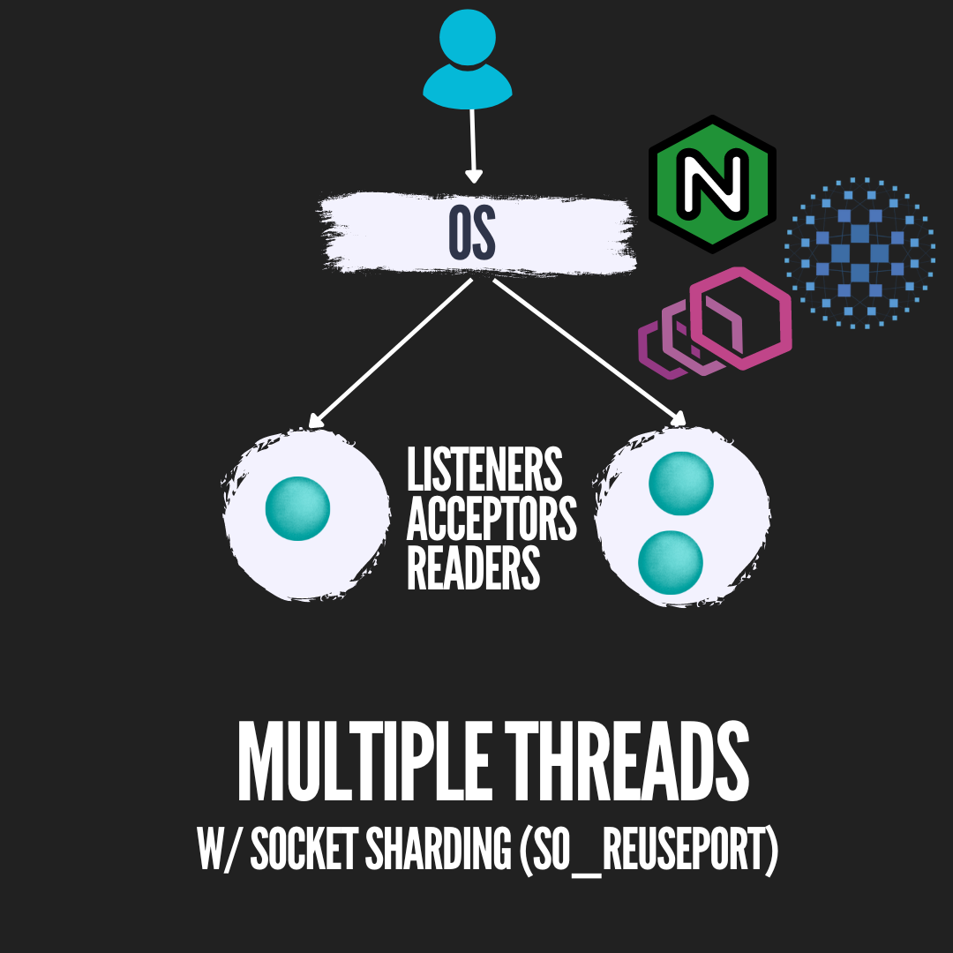
Socket Sharding
Normally listening on active port/ip fails
But you can override it with SO_REUSEPORT
Two distinct sockets different processes on the same ip/port pair

Slide 383
Summary
Kernel manages networking
Socket represents a port/ip
Each connected client gets a connection
Kernel managed data structures

Slide 384
Reading and Sending Data
husseinnasser
Receive vs Send buffers

Slide 385
Send and receive buffers
Client sends data on a connection
Kernel puts data in receive queue
Kernel ACKs (may delay) and update window
App calls read to copy data

Slide 386
Receive buffers
data
Receive buffer
ACK
read()
Copy
PID

Slide 387
Send buffers
data
Send buffer
ACK
send()
Copy
PID

Slide 388
Problems with reading and sending
Backend doesn’t read fast enough
Receive queue is full
Client slows down

Slide 389
Socket Programming Patterns
husseinnasser
Common socket patterns

Slide 390

Single Listener/Single Worker Thread

Slide 391

Single Listener/Multiple Worker threads

Slide 392
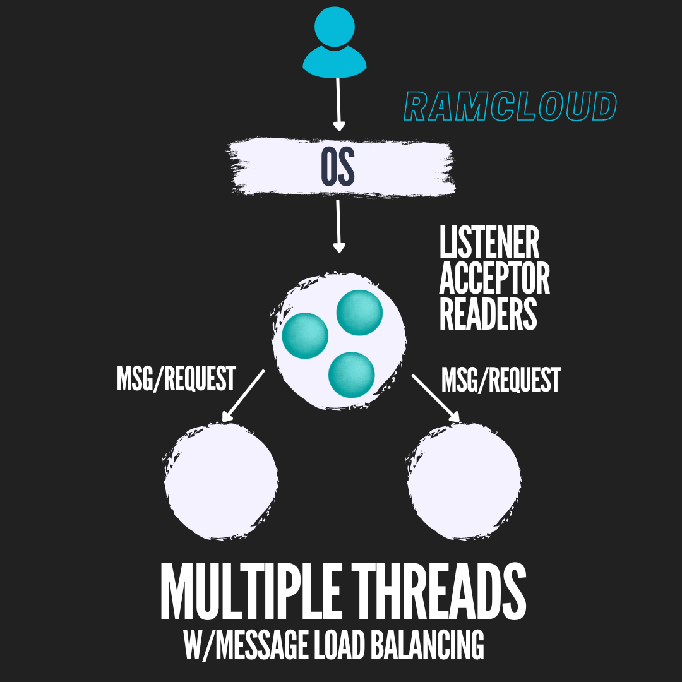
Single Listener/Multiple Worker threads with load balancing

Slide 393
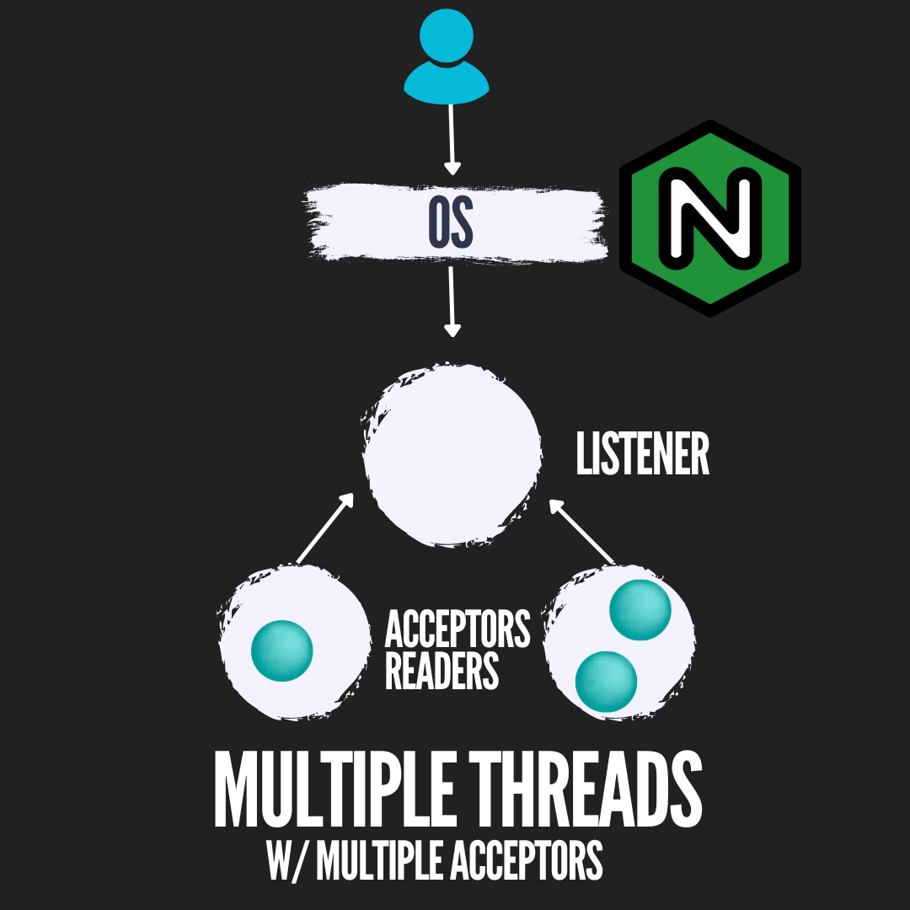
Multiple Acceptor Threads single Socket

Slide 394
Multiple Listeners on the same port

Slide 395
Asynchronous IO
husseinnasser
Non blocking reads and writes

Slide 396
Blocking operations
Read, write and accept are blocking
The process cannot move their Program counter
Read blocks when no data
accept blocks when no connections
Leads to context switches and slow down
Process
OS kernel

Slide 397

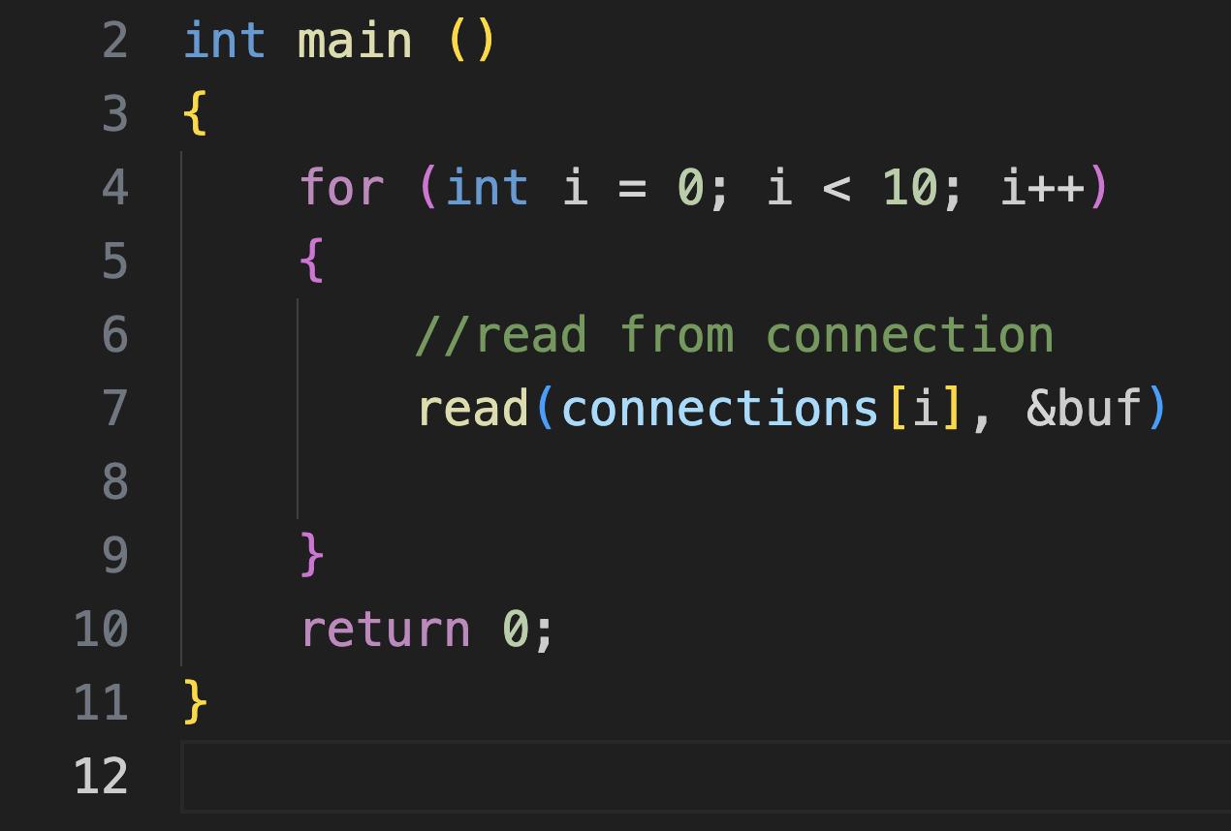

Blocking operations
read
con1
read
con2
read
con3
con4
con5
con6
con7
con8
con9
This is just a pseudo code for simplicity, green indicates the receive buffer for the connection has data to be read, gray indicates an empty receive buffer (client hasn’t sent anything). In this example the process gets blocked on reading connection 3 until some data arrives there, while the other connections are starved.
con10

Slide 398
Asynchronous I/O
Read blocks when no data in receive buffer
Accept blocks when no connections in accept queue
Ready approach
Ask the OS to tell us if a file is ready
When it is ready, we call it without blocking
Select,epoll, kqueue
Completion approach
Ask the OS (or worker thread to do the blocking io)
When completed notify
IOCP, io_uring
Doesn’t work with storage files

Slide 399
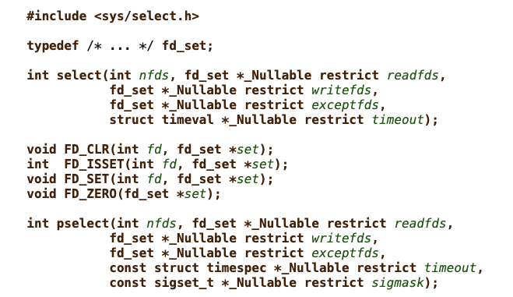
Select (polling)
Select takes a collection of file descriptors for kernel to monitor
Select is blocking (with a timeout)
When any is ready, select returns
Process checks which one is ready (loop w/FD_ISSET)
Process calls read/write/accept etc. on the file descriptor

Slide 400
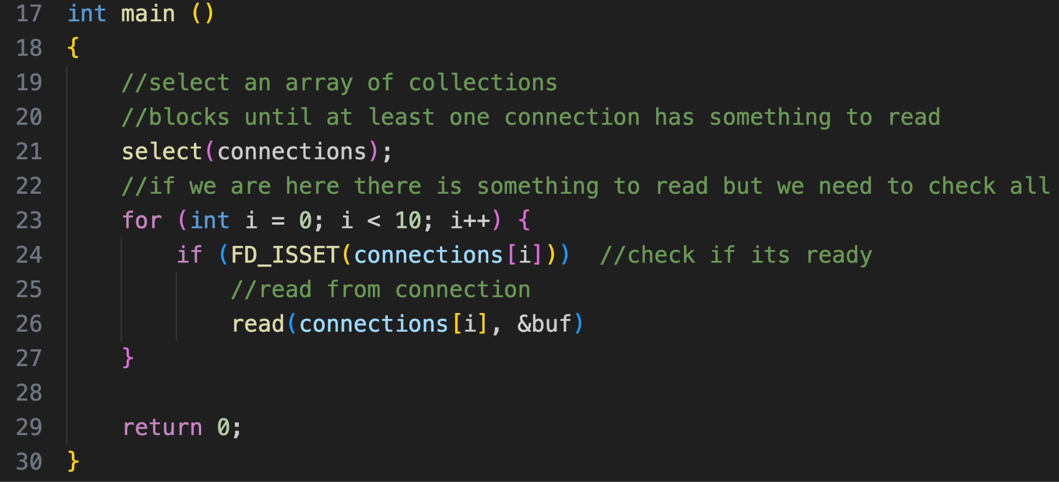
select
con1
con2
con3
con4
con5
select
con6
con7
con8
con9
In this example, only connection 9 has data in the receive buffer, but client is monitoring all 10 connections. The select call sends all 10 file descriptors, kernel checks one by one (all 10) discovers the connection 9 had data, unblocks and return
con10

Slide 401
select
con1
con2
con3
con4
con5
con6
con7
con8
con9
read
The client then gets its program counter incremented, loops through all connections and check which one is ready O(n). It finds that connection 9 is ready and issues the read on it with no blocking.
con10

Slide 402
Select pros and cons
Pros
Avoid reading (unready) resources
async
Cons
But slow we have to loop through all of them O(n)
Lots of copying from kernel/user space
Supports fixed size of file descriptors

Slide 403
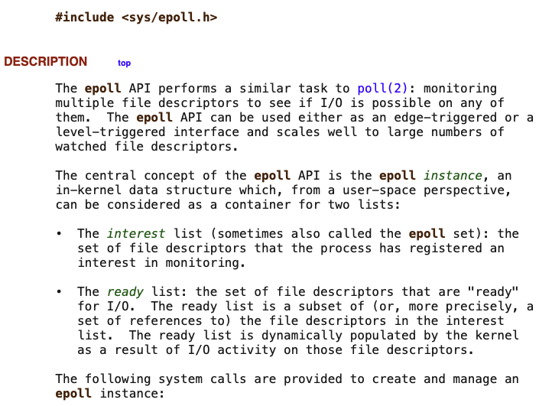
epoll (eventing)
Register an interest list of the fds (once) in the kernel
Kernel keeps working and updates the ready list
User calls epoll_wait, kernel builds an events array of ready list
Process
epoll_create con1,con2,con3 (1)
OS Kernel
epoll_wait (3)
events (4) - con3
con1
Incoming
Packets con3 (2)
con2
con3

Slide 404
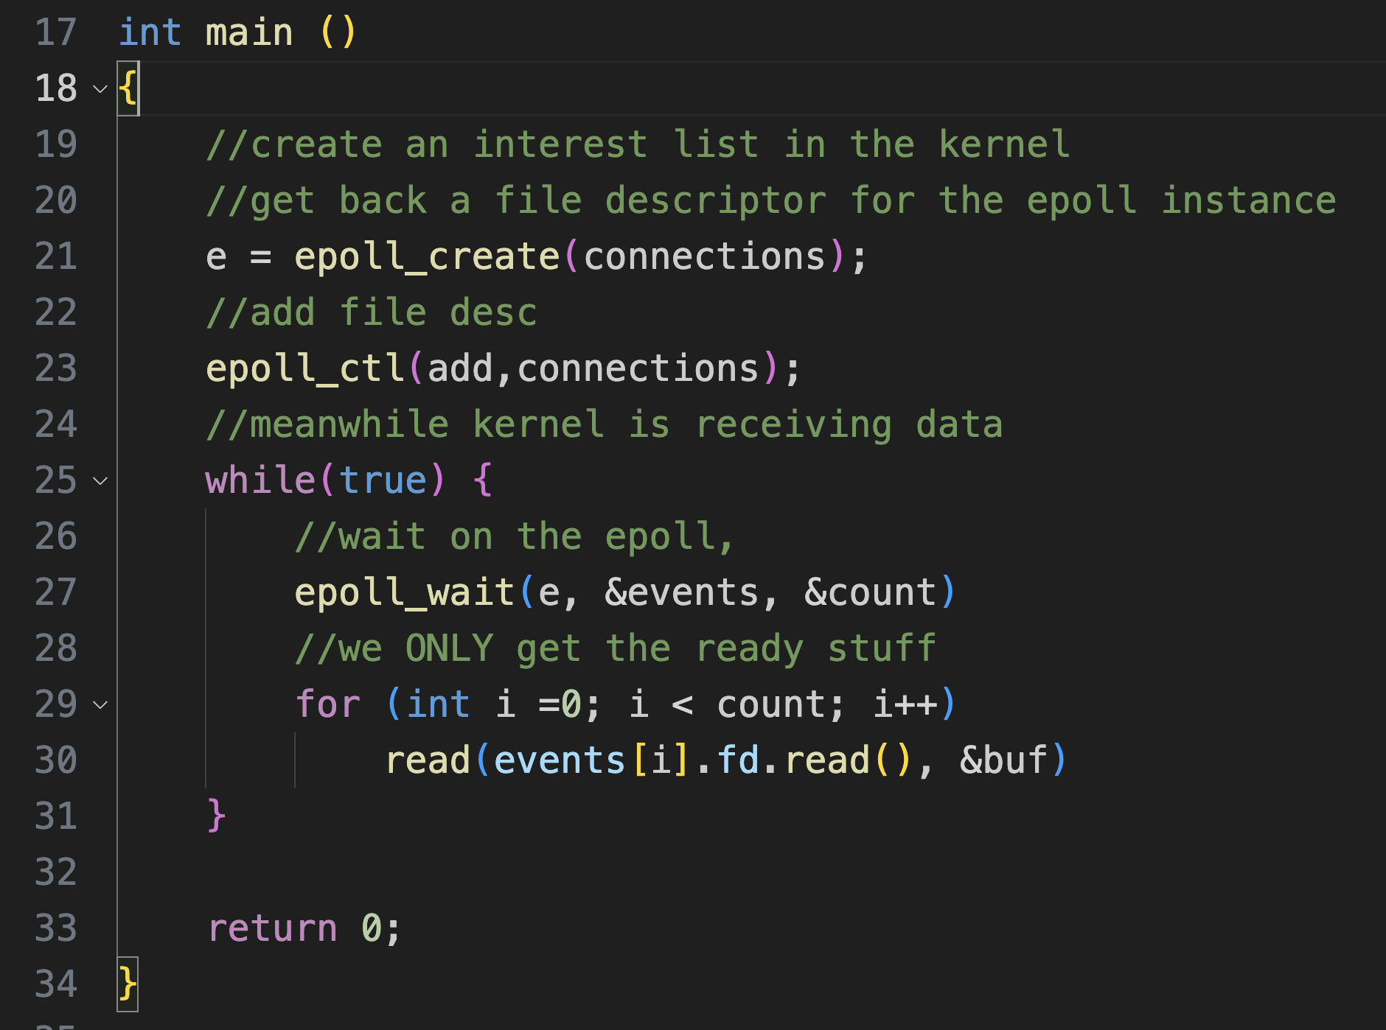
epoll
epoll e (kernel)
con1
con2
con3
con4
con5
con6
con7
con8
con9
Again this is pseudo code, we first create the epoll_instance, which lives in the kernel memory. Then we add the connections/file descriptors
con10

Slide 405
epoll
epoll e (kernel)
con1
con2
Events ready list:
[con4, con9]
con3
con4
con5
con6
con7
con8
con9
The code process moves on, meanwhile the kernel keeps receiving packets and as it does so, it will populate the ready list for those connections with data. In this case we got data for con9 and con4
con10

Slide 406
epoll
epoll e (kernel)
con1
con2
Events ready list:
[con4, con9]
con3
con4
con5
con6
con7
con8
con9
At some point, code calls epoll_wait, if the epoll instance is empty wait is blocked, else we immediately send back the array of events to the user space. Only what is ready. Events count is now 2 elements.
con10

Slide 407
epoll
epoll e (kernel)
con1
con2
Events ready list:
[]
con3
con4
con5
con6
con7
con8
con9
the user calls read as non-blocking on connection 9 and connection 4 emptying the receive buffers.
con10

Slide 408
epoll drawbacks
Complex
Level-triggered vs edge-triggered
Only in linux
Too many syscalls
Doesn’t work on files

Slide 409
io_uring
Based on completion
Kernel does the work
Shared memory, user puts “job”
kernel does the work and writes results

Slide 410
io_uring
Based on completion
Kernel does the work
Shared memory, user puts “job”
kernel does the work and writes results

Slide 411
io_uring
User process
Process writes a job to the submission queue tail
Process consumes results from the head
Shared memory
read()
write()
read()
write()
Submission
queue
write()
accept()
Completion queue
accept()
accept()
read()
Kernel writes completed job results in the tail
Kernel pops jobs from the head
Kernel

Slide 412
io_uring
Fast, non-blocking
Security is a big issue (shared memory)
Google disabled it for now

Slide 413
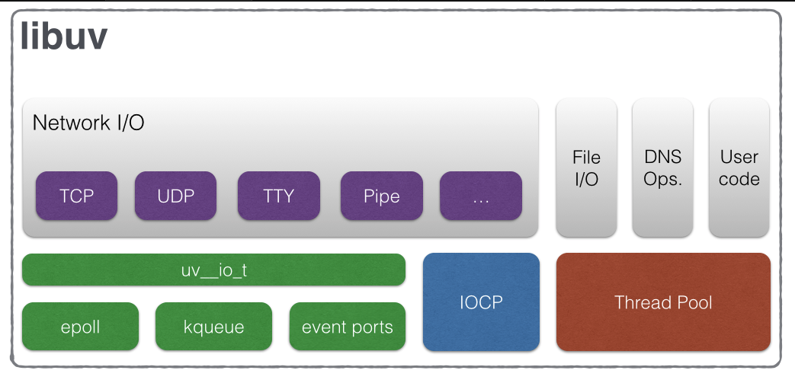
Cross platform
Node (through lib_uv) supports all platforms async io

Slide 414
Summary
Some kernel syscalls are blocking
Process put to sleep
Asynchronous io is a way around it
Ready based or completion based

Slide 415
More OS Concepts
husseinnasser

Slide 416
Compilers and Linkers
husseinnasser
On Programming Languages

Slide 417
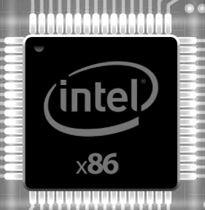


Machine Code
Programs run on machine code
Specific to the CPU
Each CPU has different instructions set
RISC vs CISC

Slide 418
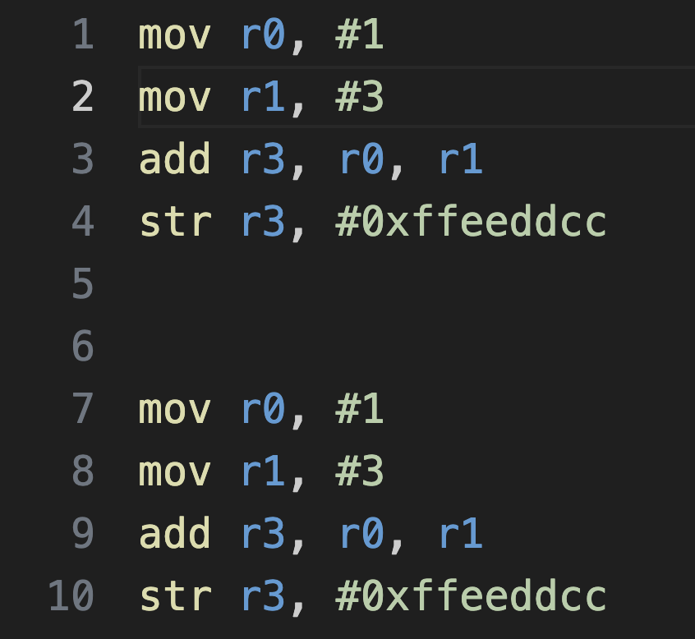
Assembly
Closest to the machine code
Still sometimes CPU specific
Easier to write
Not easy enough though

Slide 419
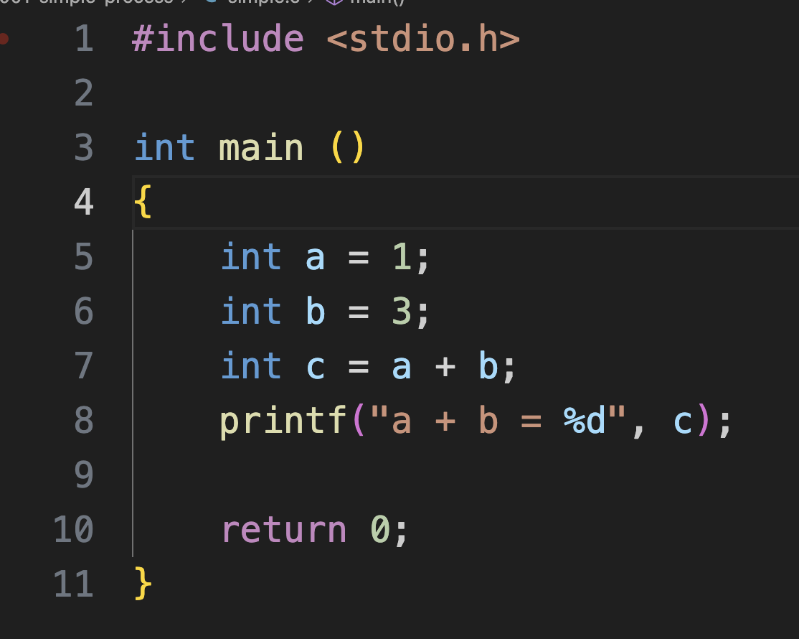
High level languages
HLL are more convenient
Abstractions to hide complexity*
Need to compile for a CPU
Compile turns code to machine code
Linking creates executable file
*That is good and bad

Slide 420
Compiling
Compile produces machine code in form of object files
Each object file may present a source file
Object files are not ready to be run
They need to be linked and create an executable
E.g. gcc, clang, rustc

Slide 421
Linking
Linkers creates an executable file
Finds and links all object files required and create one file
The file is an “executable”
Executable files have types
E.g. ld,gold linker,lld, mold (new)

Slide 422
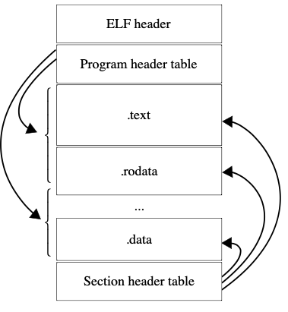
Executable files formats
The executable file is a program
Specific format so the OS knows how to create process
Created by linker
Example ELF linux

Slide 423
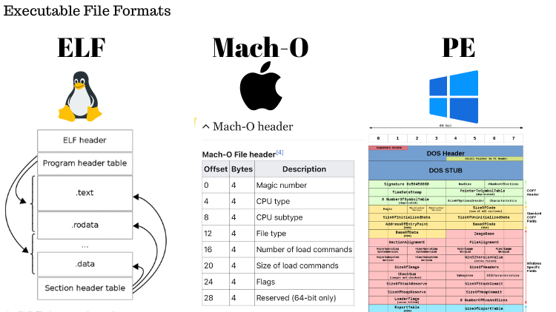
Executable files formats
exe PE -> windows
ELF -> Linux
Mach-O

Slide 424
Interpreted Languages
Compiled Program doesn’t work everywhere
Must match the CPU/OS
Can I write my code once and run it everywhere?
Interrupted languages
Python/Javascript/Java

Slide 425

Interpreted Languages
Must have a runtime, python.exe
Python.exe is a compiled program for every OS/CPU
Your code hello.py runs everywhere
Windows python.exe hello.py
Linux ./python hello.py
Same for Node and Javascript

Slide 426
Interpreted Languages
The trick is each line interrupted
If you see “+” do “this”, if you see “-” do “this”
Slower
Byte code (not string code)

Slide 427
Just in Time Compilation (JIT)
I’m interpreting this code a lot
Let me compile it directly to machine code
Put it on the heap
Mark memory as executable
Point the CPU program counter to it

Slide 428
Garbage Collection
Memory management is tricky
Some languages manages it for you
Go, Python, Java
Some languages you have to do it
C, C++
Garbage collection is part of the runtime
Tags every object and tracks it
Can cause slow downs

Slide 429
Summary
Compiling vs Linking
Compiled Languages
Interrupted Languages
Garbage collection

Slide 430
Kernel and User Space
Mode switch

Slide 431
Kernel vs User
0xFFFFFFFF
Kernel
0xC0000000
User
Virtual address of a process two parts
Kernel and User
Kernel maps to dedicated physical memory
User pages map to different physical memory
Page table help the mapping
0x00000000
Process

Slide 432
Modes
0xFFFFFFFF
Kernel
0xC0000000
User
The CPU can be in user or kernel mode
In user mode user code executes
When kernel mode kernel code executes
Syscalls, drivers
User mode can’t access kernel pages
Kernel mode can access both
0x00000000
Process

Slide 433
Kernel mode switch Cost
0xFFFFFFFF
Kernel
read()
0xC0000000
User
System code/stack lives in the kernel area
Kernel functions runs on the kernel stack
Process invokes syscall (e.g. read)
CPU is put on kernel mode
Happens in page faults
0x00000000
Process

Slide 434
Kernel mode switch
0xFFFFFFFF
Kernel
read()
bp
0xC0000000
User
Stores current base pointer on kernel stack
Stores return address as well
Store all user registers/state to memory
Once done, user registers are restored
User mode activates, execution resumes
0x00000000
Process

Slide 435
Cost
Mode switch (store all registers and restore them)
Memory access
Security check and validation
System call number lookup
Process stats and runtime different from kernel mode

Slide 436
Summary
Kernel mode vs user mode
Security to protect kernel
Kernel time is not process time
Cost of mode switch

Slide 437
Virtualization and Containerization
Modern OS techniques

Slide 438
One Machine One OS
Very limiting
One machine multiple OS?
One at a time (switch at startup)
Virtual Machines
Containerization (jails)

Slide 439
Multiple native OS
Many OS on top of the hard
One active at a time
Switch in runtime
High isolation
Full OS1
Full OS2
Full OS3
Kernel
Kernel
Kernel
Hardware

Slide 440
Virtualization
Full OS1
Full OS2
Full OS3
Many OS on top of One base OS
Hypervisor controls upper OS
Proxies syscalls to lower kernel
Full isolation but lots of redundancy
Hypervisor (software)
Base OS tools
Base Kernel
Hardware

Slide 441

Virtualization
Can limit CPU/Memory for each VM
E.g. VMWare Oracle virtualbox

Slide 442
Containerization
Containers isolated by namespace
Mount fs namespace
Network namespace
Process namespace
Limited by cgroups
CPU/Memory usage
All containers share kernel!
E.g. docker
Container1
Container2
Container3
Base OS tools
Base Kernel
Hardware

Slide 443
namespace
Kernel feature for isolation
Mount namespace -> isolates mounts
PID namespace -> isolates processes
NIC namespace -> isolates networks
Con1
Base OS tools
Base Kernel
Hardware

Slide 444
cgroup
Control group kernel feature
Assigns certain cpu and memory to processes
So that containers can’t starve others

Slide 445
What happens on a new container
New namespaces created
It can only see what is mounted
Usually a directory in host is created
Container gets 1 mount to that directory
Can’t see anything else

Slide 446
What happens on a new container
The OS necessary tools are loaded
E.g. ubuntu apt-get, ifconfig etc.
Then user code/processes are loaded
E.g. node
But there is a better way

Slide 447
overlayfs
new container gets its copy of base OS tools
This will quickly run the disk out
Meet overlay fs
Base layer os is read only (shared)
Only changes are maintained

Slide 448
network
new container gets its own NIC namespace
Won’t see host NICs (unless explicitly given)
Docker often has one network that adds all container to
New container gets a new mac address and get DHCPed

Slide 449
processes
New container can spin any number of processes
Container can only see its processes
PID 1 can exist in all containers, they are isolated
Each process has a globalid the base kernel sees
PID namespace

Slide 450
Summary
Hardware
Kernel
Virtual machines
Containers

