Slide 1
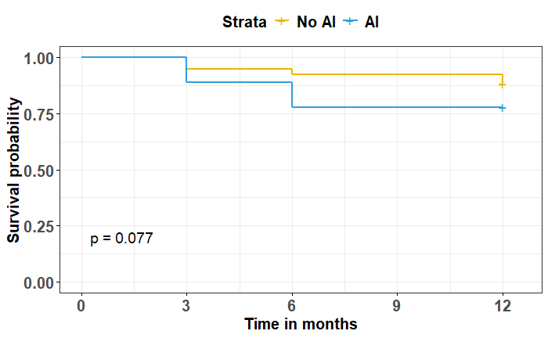
P = 0.093
P = 0.090
P = 0.421

