Slide 1
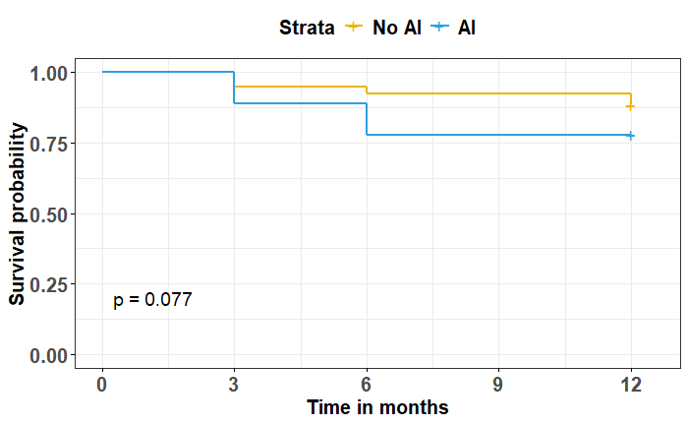
P = 0.173
P = 0.022
P = 0.063

