Slide 1
Movie Data Warehouse
Daniel Semple CIS-355 Spring 2020

Slide 2
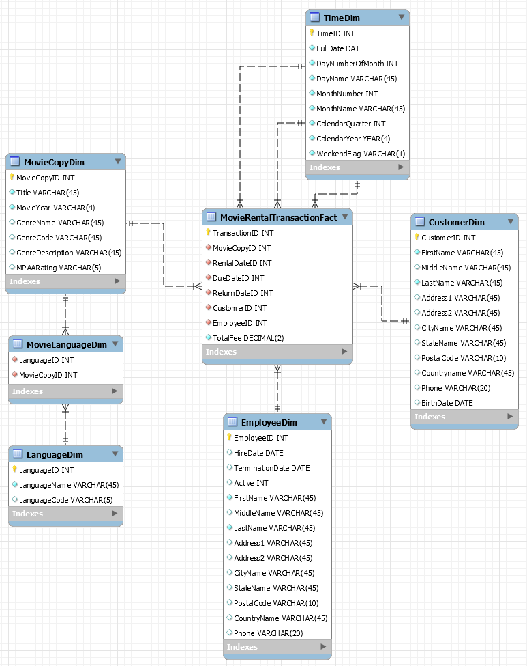
Star Schema

Slide 3
Source-to-Target Mapping

Slide 4
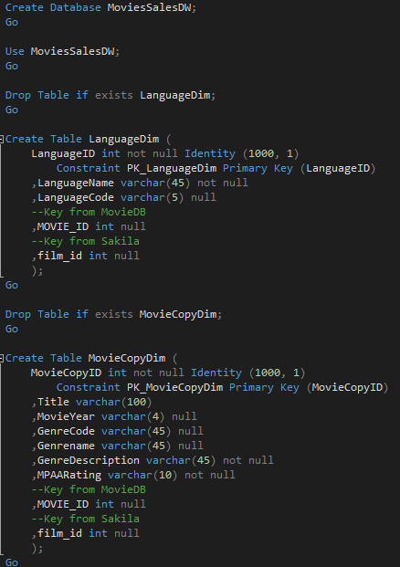
Building the Data Warehouse
Primary Keys from the original databases included.
MOVIE_ID
film_id
Needed to link the Data Warehouse Primary Keys and Foreign Keys.

Slide 5
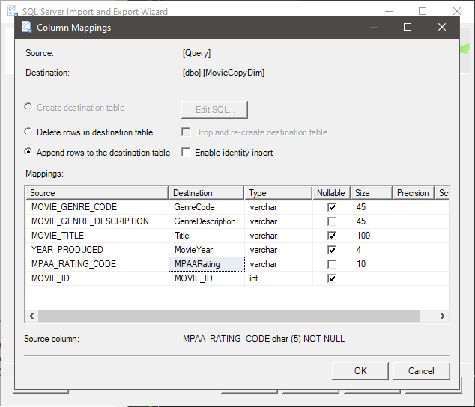
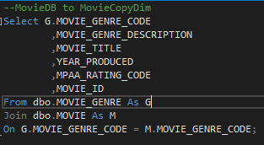
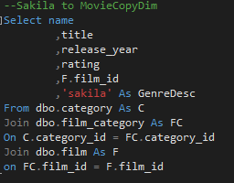
Building the Data Warehouse
Using SQL server import wizard and queries to import data.

Slide 6
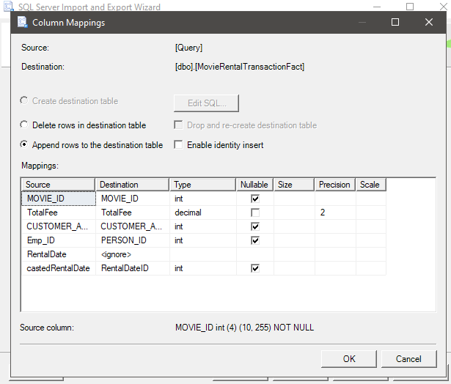
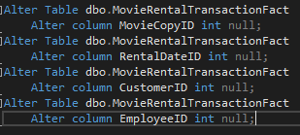
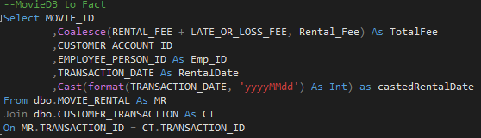
Creating the fact table
MovieDB to the Data Warehouse

Slide 7
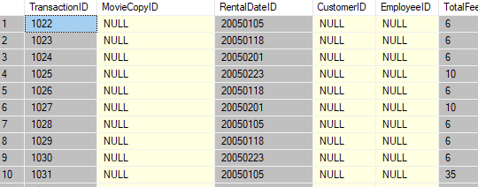
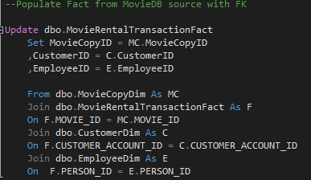
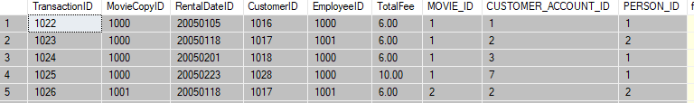
Creating the fact table
Populating the Fact table FK, keys MOVIE_ID and PERSON_ID.

Slide 8
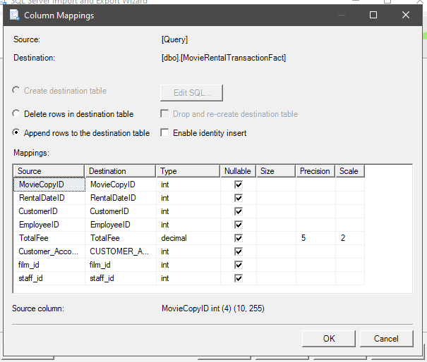
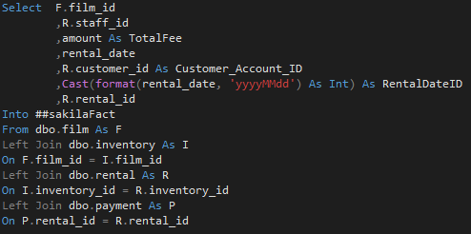
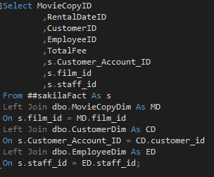
Creating the fact table
Sakila to the Data warehouse using temp table.

Slide 9
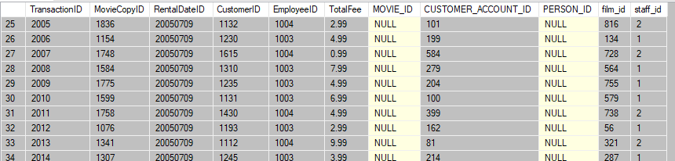
Creating the fact table
Populated the Fact table FK, keys film_id and staff_id.

Slide 10
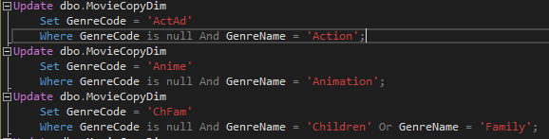
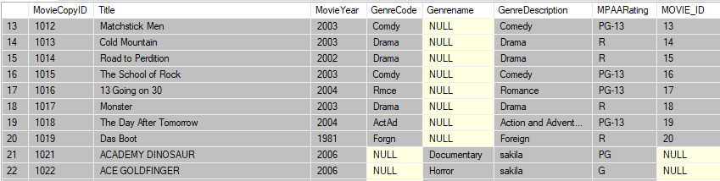
Updating data
Sakila had no GenreCode, updated codes to be consistent with the MovieDB.

Slide 11
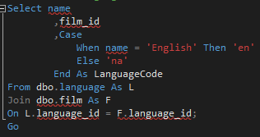
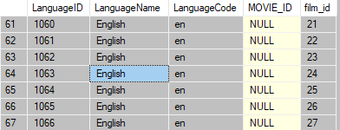
Updating data
Sakila had no LanguageCode, updated codes based on MovieDB.

