Slide 1
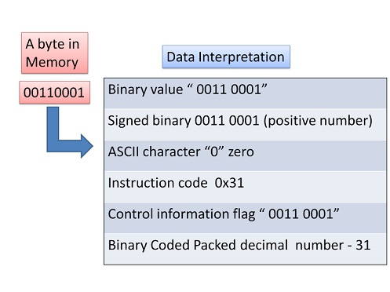
Data Representation and Computer Arithmetic.
Intro:
Data representation and computer arithmetic are fundamental concepts in computer science that involve how data is stored, processed, and manipulated within a computer system.
Computer arithmetic deals with the methods and algorithms used to perform mathematical operations like addition, subtraction, multiplication, and division on these binary-encoded data types.

Slide 2
Exact and Approximate numbers
Exact numbers are values known with complete precision, like integers or defined fractions. For example, the number of students in a class (e.g., 25) or the fraction 1/2 are exact.
Approximate numbers, on the other hand, involve some level of uncertainty or rounding, often seen in measurements or floating-point values. For example, π approximated as 3.14 or a table length of 2.5 meters are approximate numbers.
Exact numbers are precise; approximate numbers are close estimates.

Slide 3
The Concept of Significant Digits
The concept of significant digits (or significant figures) in a number refers to the digits that carry meaning and contribute to the precision of that number.
Key Rules for Identifying Significant Digits:
Non-zero digits are always significant. Example: In 123.45, all five digits are significant.
Zeros between non-zero digits are significant. Example: In 105, all three digits are significant.
Leading zeros (zeros before the first non-zero digit) are not significant. Example: In 0.0025, only the 2 and 5 are significant.
Trailing zeros in a decimal number are significant. Example: In 50.00, all four digits are significant.
Trailing zeros in a whole number without a decimal point may or may not be significant, depending on context or notation. Example: In 1500, the number of significant digits can be ambiguous unless clarified.

Slide 4
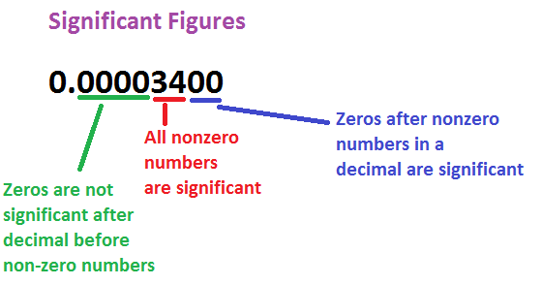
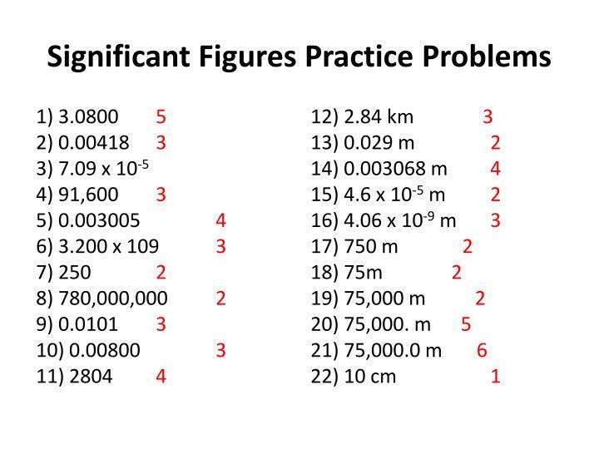

Slide 5
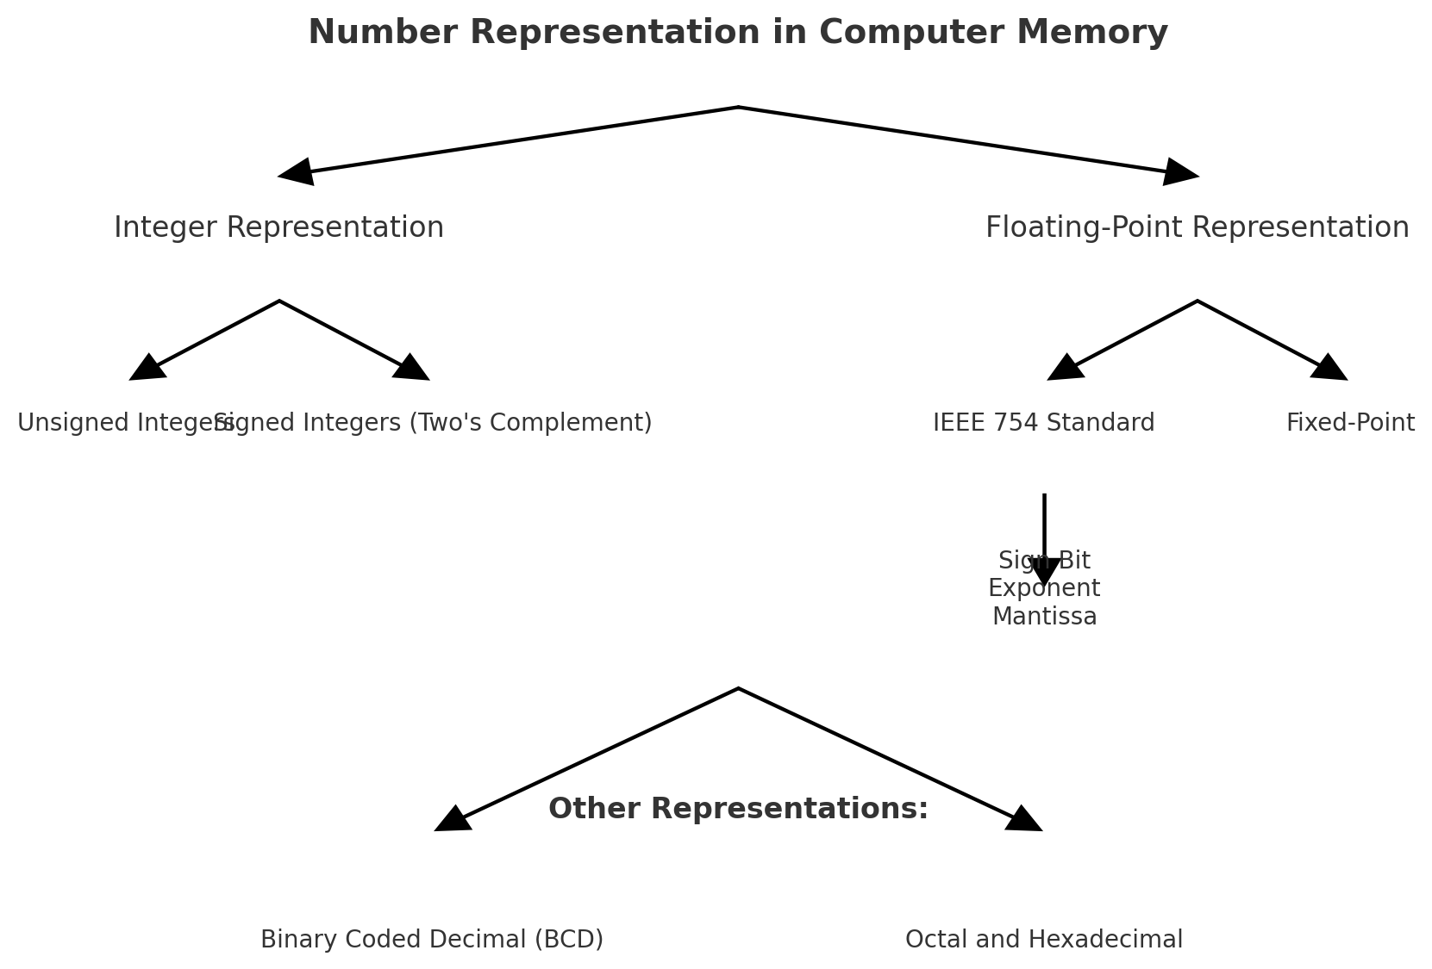
Representation of Numbers In Computer Memory.

Slide 6
Storage of Integer Numbers
Signed Representation: In signed representation, the most significant bit (MSB) of the binary number is used to indicate the sign of the number: 0 for positive numbers 1 for negative numbers. Example: ‘5’ in an 8-byte system: ‘00000101’ ‘-5’ in an 8-byte system: ‘11111010’
1's Complement Representation: In 1's complement representation, positive numbers are represented in the same way as in unsigned binary. To represent a negative number, you invert (complement) all the bits of its positive counterpart. Example: ‘5’ in an 8-byte system: ‘00000101’ ‘-5’ in an 8-byte system: ‘11111010’

Slide 7
Storage of Integer Numbers
3. 2's Complement Representation: 2's complement is the most widely used method for representing signed integers in computer systems. In this method, positive numbers are represented in the same way as in unsigned binary. To obtain the 2's complement of a negative number, you take the 1's complement of the number and then add 1 to the least significant bit (LSB). Example: ‘+5’ in an 8-byte system: ‘00000101’ ‘-5’ in an 8-byte system: ‘11111011’

Slide 8
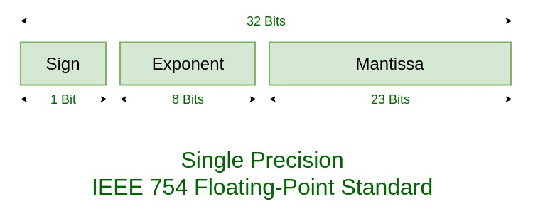
Storage of Floating Point Numbers
The floating-point form is used to represent real numbers of greatly varying magnitude although there is a maximum length to the digits that can be stored.
In the Floating-point form of representing real numbers, a real number is expressed as a combination of a mantissa and exponent.
For example: 2.998 X 10⁸ is written as 2.998E8.

Slide 9
Concept of Normalization
It is a standard practice to make mantissa less than 1 and greater than or equal to .1.
The shifting of the decimal point to the left of the most significant digit is called normalization and the representation of a number in this form is called normalized floating point numbers.
Example: the normalized form of the number 32.58 X 10⁶ is .3258E8.
Sign of mantissa Sign of exponent
Implied decimal point mantissa Exponent
3 | 4 | 5 | 6 | 0 | 8

Slide 10
Floating Point Arithmetic
Addition Operation (using the example of 0.4142×10⁶ and 0.5156×10⁶)
Represent the Numbers in Standard Floating Point Format 0.4142×10⁶ and 0.5156×10⁶
Align the Exponents: In this case, both numbers already have the same exponent of 6, so no further alignment is needed.
Add the Mantissas: 0.4142+0.5156=0.9298
Normalize the Result: The result of the addition is 0.9298×10⁶. This is already in normalized form, where the mantissa is between 0.5 and 1.0 (or in some cases between 1.0 and 2.0, depending on the floating-point representation).
Final Result: 0.9298×10⁶

Slide 11
Floating Point Arithmetic
2. Subtraction Operation (using the example of 0.5462E-99 and 0.5483E-99)
Represent the Numbers in Standard Floating Point Format 0.5462×10⁻⁹⁹ and 0.5483×10⁻⁹⁹
Align the Exponents: Since both numbers have the same exponent, -99, there is no need for alignment. We can directly proceed with the subtraction.
Subtract the Mantissas: 0.5483−0.5462=0.0021
Normalize the Result: In this case, the result 0.0021×10⁻⁹⁹ is already in a form that doesn't require further normalization. The mantissa is within a valid range for floating point representation.
Final Result: .0021E-99.

Slide 12
Floating Point Arithmetic
3. Multiplication Operation
The mantissa of two numbers are multiplied
Exponent of two numbers are added.
The final result is obtained by rounding off the mantissa to four decimal places after normalizing the mantissa and adjusting the exponent accordingly. Examples: i) .6534E5 X .2525E7 = .16498..E(5+7)=.1650E12 ii) .1122E15 X .1222E-20 = .1371E-6

Slide 13
Floating Point Arithmetic
4. Division Operation
The mantissa of numerator is divided by the mantissa of the denominator.
Exponent of the denominator is subtracted from the exponent of the numerator.
The final result is obtained by rounding off the mantissa to four decimal places after normalizing the mantissa and adjusting the exponent accordingly. Examples: i) .5431E0 / .4552E1 = .119310..E(0-1)=.1193E0 ii) .2753E1 / .9873E-2 = .2788E3

Slide 14
Errors
Errors in computer numerical calculations arise due to the limitations of digital representations of numbers and the algorithms used to perform arithmetic operations. These errors can accumulate and significantly affect the accuracy of results
In other words, the numerical results obtained are often approximate values i.e. have an error associated with it. The error associated with an approximate value is defined as the difference between the true value and the approximate value.

Slide 15
Sources of Errors
Mathematical Modeling Errors:
Occur when simplifying real-world problems into mathematical models.
Result from assumptions, approximations, and inadequate representation of complex phenomena.
Inherent Errors:
Arise from limitations in measurement instruments and natural variability.
Include uncertainties in physical constants and data.
Rounding Errors:
Caused by the finite precision of computers, leading to small discrepancies when numbers are rounded.
Can accumulate in successive calculations, affecting accuracy.

Slide 16
Sources of Errors
Truncation Errors:
Result from approximating infinite processes (e.g., series, integrals) with finite steps.
Common in numerical methods like integration, differentiation, and iterative algorithms.
Blunders:
Human errors such as incorrect data entry, programming mistakes, or misinterpretation of results.
Often preventable with careful attention and verification.

Slide 17
MEASURES OF ACCURACY
Absolute error: The absolute error is defined as the absolute difference between the true value of the quantity and its approximate value as given or obtained by measurement or calculation. Example: If x is the exact value and x* is the approximate value of a quantity then absolute error is given by: e_{abs} = |x - x*|

Slide 18
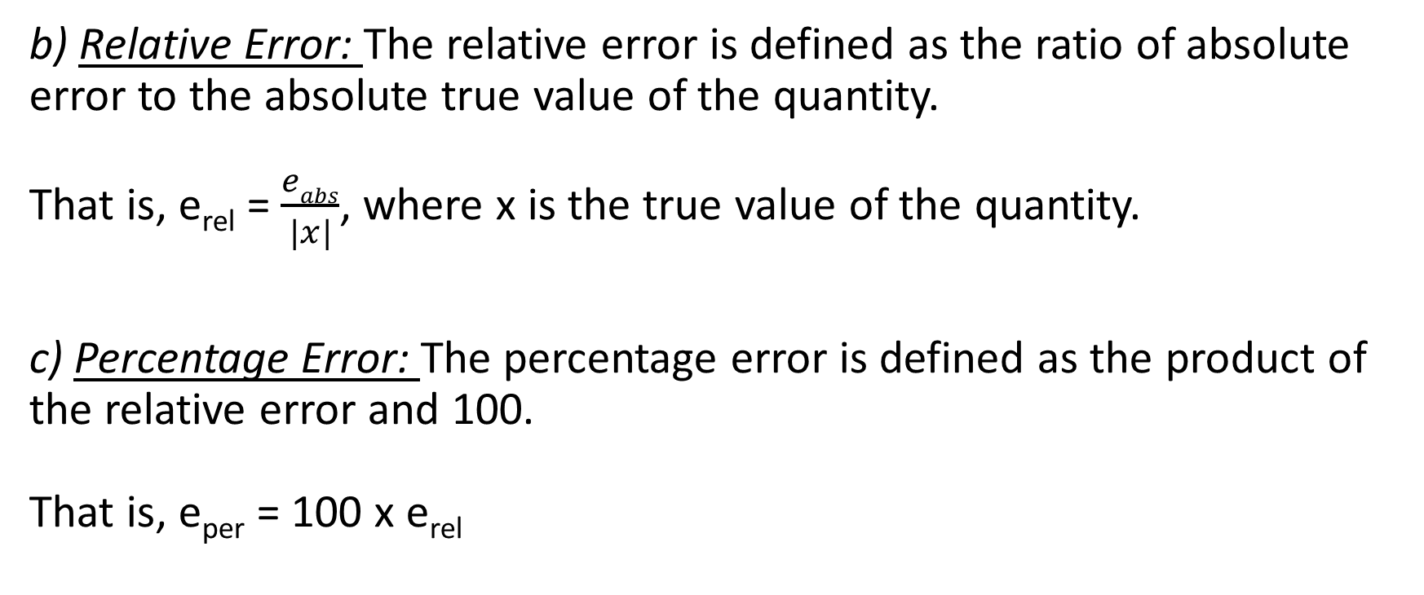
MEASURES OF ACCURACY
b) Relative Error: The relative error is defined as the ratio of absolute error to the absolute true value of the quantity. That is, e_{rel} = $\frac{eabs}{|x|}$, where x is the true value of the quantity.
c) Percentage Error: The percentage error is defined as the product of the relative error and 100. That is, e_{per} = 100 x e_{rel}

Slide 19
ERROR PROPAGATION
Propagated error in an arithmetic operation occurs due to approximate values of numbers taken by computer with only finite digits. (I) Propagation of error in addition operation Let X_{A} and Y_{A} be the approximate values of two numbers whose exact values are X and Y. Let e_{X} and e_{Y} be the errors in these numbers. Let Z denote the sum of X and Y That is, Z = X + Y Then ZA the approximate value of Z is given by Z_{A} =X_{A}+Y_{A}

Slide 20
ERROR PROPAGATION
The error in Z is e_{Z} = Z – Z_{A}
Now Z = X + Y Z_{A} + e_{Z} = (X_{A} +e_{X} ) + (Y_{A}+ e_{Y} ) Z_{A}+ e_{Z} =(X_{A}+Y_{A}) + (e_{X} + e_{Y} ) e_{Z} = e_{X} + e_{Y}
Therefor, the error in the sum of two numbers is equal to the sum of their errors. If eX and eY are of opposite signs; then the resultant error eZ is reduced. Further | e_{Z} | = | e_{X} +e_{Y} | => | e_{Z} | ≤| e_{x} | + | e_{y} | => The absolute error of a sum of two numbers is less than or equal to the sum of their absolute errors.

Slide 21
ERROR PROPAGATION
(II) Propagation of error in subtraction operation
Let XA and YA be the approximate values of two numbers whose exact values are X and Y. Let eX and eY be the errors in these numbers. Let Z denote the difference of X and Y That is, Z = X – Y Then ZA the approximate value of Z is given by Z_{A} = X_{A} – Y_{A}

Slide 22
ERROR PROPAGATION
(II) Propagation of error in subtraction operation
The error in Z is e_{Z} = Z – Z_{A} Now Z = X - Y Z_{A} + e_{Z} = (X_{A} +e_{X} ) - (Y_{A}+ e_{Y} ) Z_{A}+ e_{Z} =(X_{A}+Y_{A}) - (e_{X} + e_{Y} ) e_{Z} = e_{X} - e_{Y}
Therefor, the error in the difference of two numbers is equal to the difference of their errors. If eX and eY are of opposite signs; then the resultant error eZ is reduced. Further | e_{Z} | = | e_{X} -e_{Y} | | e_{Z} | ≤| e_{x} | + | e_{y} |
The absolute error of a difference of two numbers is less than or equal to the sum of their absolute errors.

Slide 23
ERROR PROPAGATION
(III) Propagation of error in multiplication operation
Let X_{A} and Y_{A} be the approximate values of two numbers whose
exact values are X and Y. Let e_{X} and e_{Y} be the errors in these
numbers.
Let Z denote the product of X and Y
That is,
Z = X_{Y}
Then ZA the approximate value of Z is given by
Z_{A} = X_{A}Y_{A}
The error in Z is
e_{Z} = Z - Z_{A}
Now
Z_{A} = X_{A}Y_{A}

Slide 24
ERROR PROPAGATION
Z - e_{Z} = (X - e_{X} ) (Y - e_{Y} )
Z- e_{Z} = X_{Y} - Xe_{Y} - Ye_{X} + e_{X}e_{Y}
Now neglecting the product eXeY which is very small being the products of errors.
e_{Z} ≈ Xe_{Y} + Ye_{X} Dividing both side by Z( = X_{Y})
𝑒_{𝑍}/𝑍 ≈ 𝑒_{𝑌}/ 𝑌 + 𝑒_{𝑋}/X Further |𝑒_{𝑍} /𝑍| ≈ |𝑒_{𝑌}/ 𝑌 + 𝑒_{𝑋} /𝑋|
|𝑒_{𝑍} / 𝑍| ≤ |𝑒_{𝑌} / 𝑌| + |𝑒_{𝑋} /𝑋| The relative error of a product of two numbers is less than or equal to the sum of the relative errors of the factors.

Slide 25
ERROR PROPAGATION
(IV) Propagation of error in division operation
Let X_{A} and Y_{A} be the approximate values of two numbers whose exact values are X and Y. Let e_{X} and e_{Y} be the errors in these numbers.
Let Z denote the product of X and Y That is, Z = 𝑋/Y Then Z_{A} the approximate value of Z is given by
Z_{A} = 𝑋_{𝐴}/ 𝑌_{A}
The error in Z is: e_{Z} = Z – Z_{A}
Now Z_{A} = 𝑋_{𝐴} / 𝑌_{A}

Slide 26
ERROR PROPAGATION
Z - e_{Z} = (X − e_{X}) /(Y − e_{Y})
e_{Z} = Z + (X − e_{X}) / (Y − e_{Y})
e_{Z} = (𝑋 / 𝑌) + (𝑋(1 − e_{X} /𝑋 )/ Y(1 − e_{Y} /𝑌 ))
By binomial expansion
(1 − e_{Y} /𝑌 ) ⁻¹ = (1 + e_{Y} /𝑌 )
e_{Z} ≈ 𝑒_{𝑋} / 𝑌 − 𝑋𝑒_{𝑌} /𝑌 ² + 𝑒_{𝑋} 𝑒_{𝑌} /𝑌 ²
Now neglecting the product 𝑒_{𝑋} 𝑒_{𝑌} /𝑌 ²which is very small being the products of errors e_{Z} ≈ 𝑒_{𝑋} / 𝑌 − 𝑋𝑒_{𝑌} /𝑌 ²

Slide 27
ERROR PROPAGATION
Dividing both side by Z( = 𝑋 / 𝑌 )
𝑒_{𝑍} /𝑍 ≈ 𝑒_{𝑋} /𝑋 − 𝑒_{𝑌} / Y
Further
|𝑒_{𝑍} /𝑍| ≈ |𝑒_{𝑋} /𝑋 − 𝑒_{𝑌} /Y|
|𝑒_{𝑍} /𝑍| ≤ |𝑒_{𝑌} /𝑌| + |𝑒_{𝑋} /X|
The relative error of a product of two numbers is less than or equal to the sum of their relative errors.

Slide 28

Submitted By: Kartik Kumar Sahu 4007/23 BCA - II Submitted To: Ms. Nisha Gupta

