Slide 1


WEBSITE
PRESENTATION
Presented By : Senoy, Suello, Veras
ASTRA | 2024

Slide 2


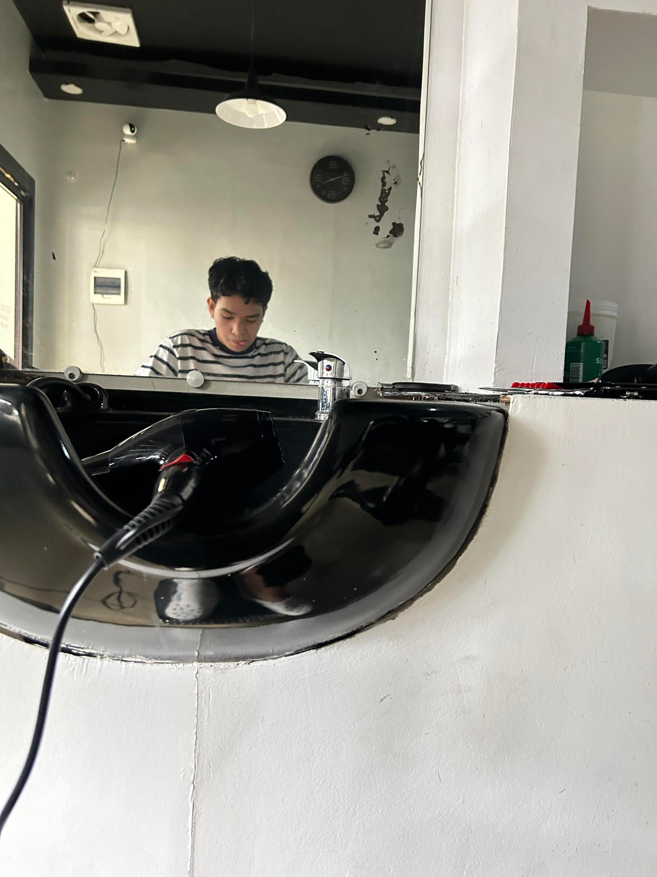
MEMBERS
Raymund Suello
-Attendance Backend/JS
Kyle Senoy
-CSS/Database/Backend
Reigh Sean Veras
-Login Backend/Logo

Slide 3
WEBSITE NAME
Automated System for Teachers Recording Attendance (ASTRA)
-a faculty-managed attendance system involves teachers recording, tracking, and managing student attendance through daily roll calls and electronic records which will be useful in gathering regular reporting.

Slide 4
OBJECTIVES
Objective 1
-to track the attendance for each class or subject to ensure students are attending all their scheduled lessons.
Objective 2
-useful for generating reports for school administration, district education boards, and other stakeholders.
Objective 3
-to create a structured and supportive learning environment, ensure student safety, and improve overall educational outcomes.
ASTRA| 2024

Slide 5
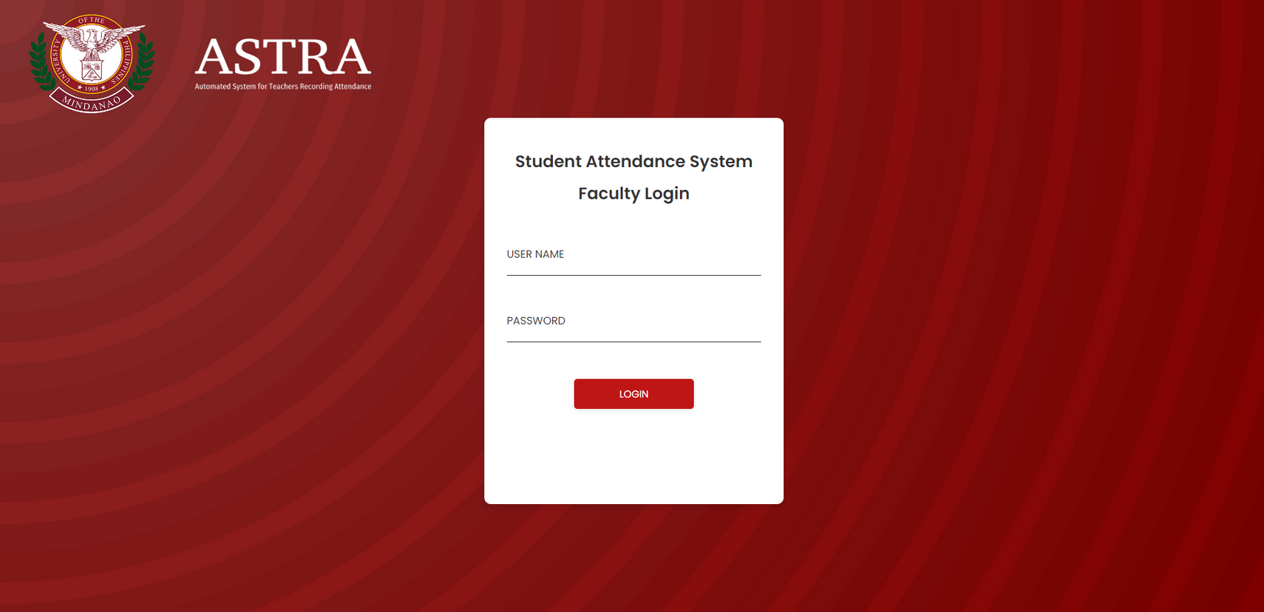

LOGIN PAGE

Slide 6
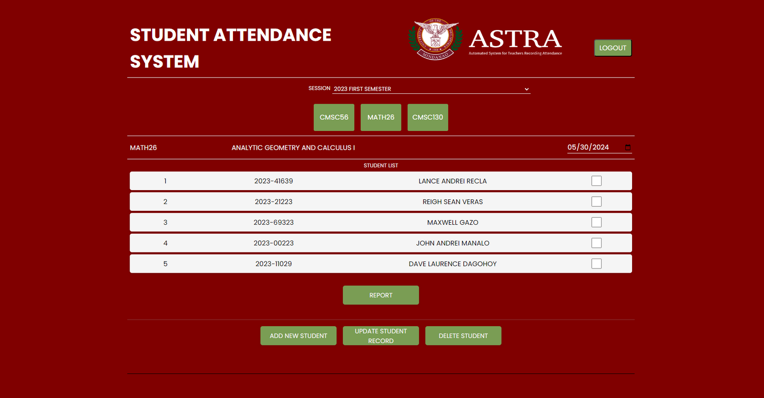
MAIN/ATTENDANCE PAGE

Slide 7

ADD STUDENT

Slide 8
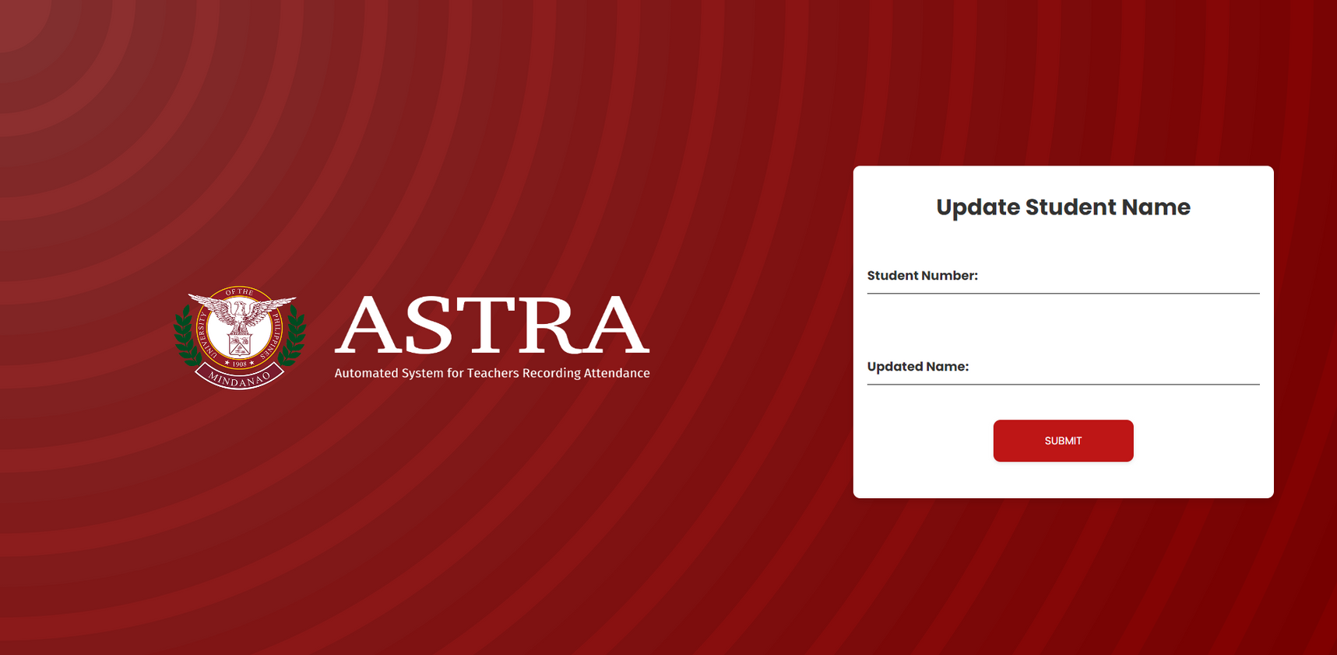
UPDATE DETAILS

Slide 9
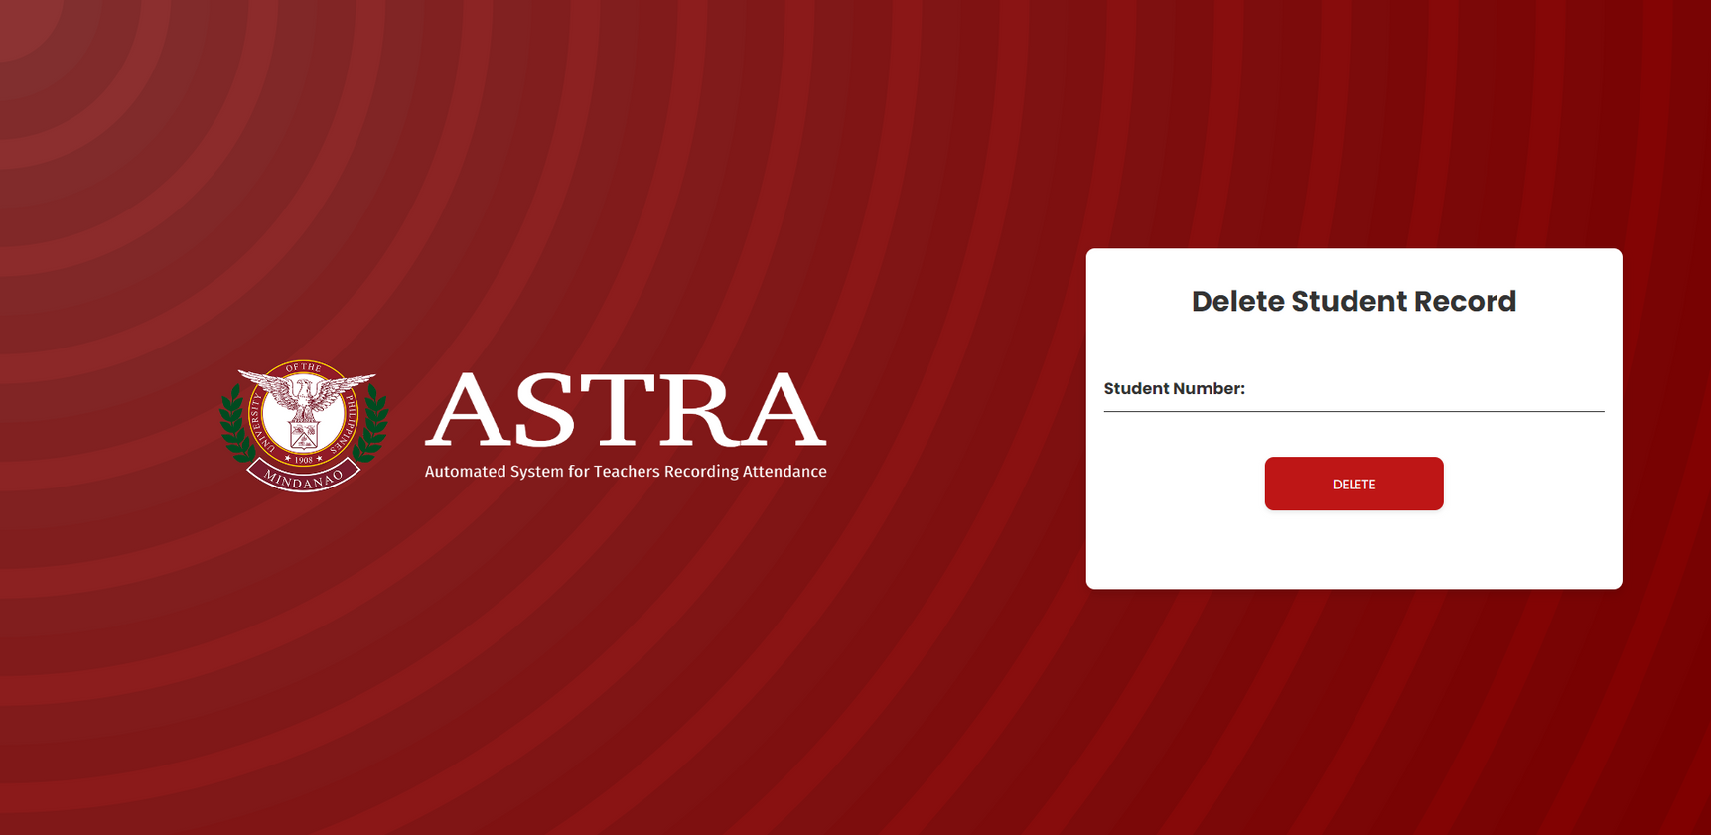
DELETE STUDENT

Slide 10
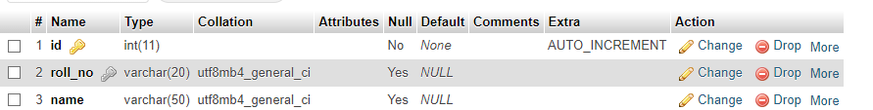
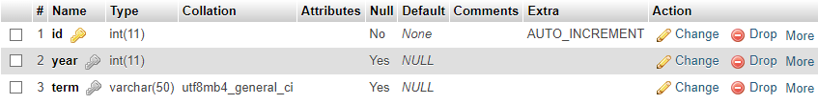
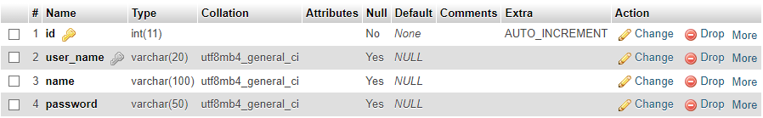
DATABASE TABLES
Student Details
Session Details
Faculty Details

Slide 11
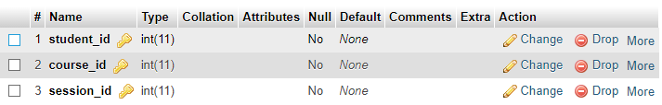
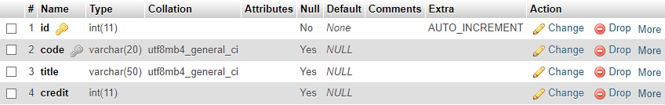
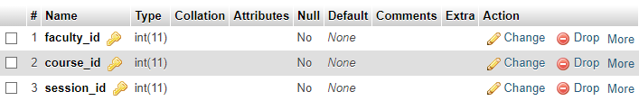
DATABASE TABLES
Course Registration
Course Details
Course Allotment

Slide 12
DATABASE TABLES
Attendance Details

Slide 13

THANK YOU
FOR LISTENING
(NEXT: LIVE DEMO)

