Slide 1

Homework 2
CHORD SYSTEM WALKTHROUGH
Sajib Sen
1

Slide 2
Features:
Insert
Delete
LoopUp
Stop

Slide 3
Features:
Insert
Example:
What operation you want to perform? (1)Insert, (2)Delete, (3)Lookup, (0)Stop
1
Node 0 contains nodes :
[6 7 8 9 10 11 12 13 14 15 16 17 18 19 20 21 22 23 24 25 26 27 28 29 30 31 32 33 34 35 36 37 38 39 40 41 42 43 44 45 46 47 48 49 50 51 52 53 54 55 56 57 58 59 60 61 62 63 64 65 66 67 68 69 70 71 72 73 74 75 76 77 78 79 80 81 82 83 84 85 86 87 88 89 90 91 92 93 94 95 96 97 98 99 100 101 102 103 104 105 106 107 108 109 110 111 112 113 114 115 116 117 118 119 120 121 122 123 124 125 126 127 128 0 ]
Node 5 contains nodes :
[1 2 3 4 5 ]
See the visualization window based on your choice
What operation you want to perform? (1)Insert, (2)Delete, (3)Lookup, (0)Stop

Slide 4
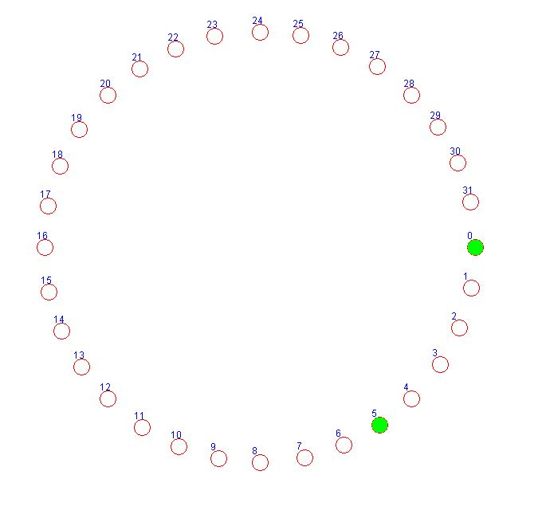
Features:
Insert
Example:

Slide 5
Features:
2. Delete
Example:
What operation you want to perform? (1)Insert, (2)Delete, (3)Lookup, (0)Stop
2
Insert the node ID which you want to delete:
5
Node 0 contains nodes :
[3 4 5 6 7 8 9 10 11 12 13 14 15 16 17 18 19 20 21 22 23 24 25 26 27 28 29 30 31 32 33 34 35 36 37 38 39 40 41 42 43 44 45 46 47 48 49 50 51 52 53 54 55 56 57 58 59 60 61 62 63 64 65 66 67 68 69 70 71 72 73 74 75 76 77 78 79 80 81 82 83 84 85 86 87 88 89 90 91 92 93 94 95 96 97 98 99 100 101 102 103 104 105 106 107 108 109 110 111 112 113 114 115 116 117 118 119 120 121 122 123 124 125 126 127 128 0 ]
Node 2 contains nodes :
[1 2 ]
See the visualization window based on your choice
What operation you want to perform? (1)Insert, (2)Delete, (3)Lookup, (0)Stop

Slide 6
Features:
3. LookUp
Example:
What operation you want to perform? (1)Insert, (2)Delete, (3)Lookup, (0)Stop
3
Insert the node ID which you want to lookup:
6
The lookup ID: 6 contains in node: 11
See the visualization window based on your choice
What operation you want to perform? (1)Insert, (2)Delete, (3)Lookup, (0)Stop

Slide 7
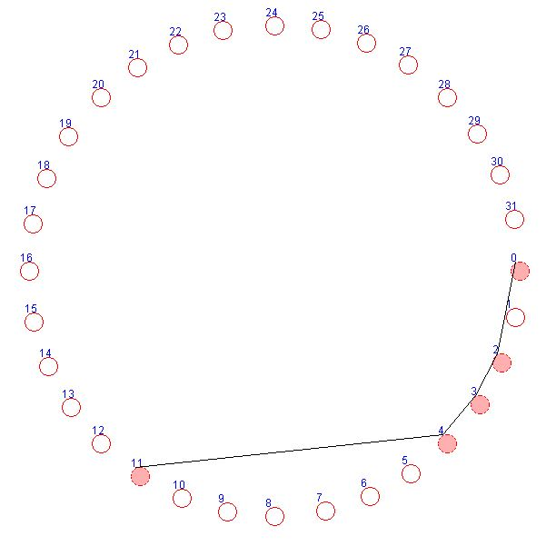
Features:
3. LookUp
Example:

Slide 8
Thanks

