Slide 1
CTR Prediction via Logistic Regression and Features Combination
By Sen Lin

Slide 2
Introduction
Development of advertising mode
Click-Through Rate (CTR)
Advertising Mechanism

Slide 3

Traditional form
Fixed images embedded in web pages
Dynamic Targeting
Based on web content and user characteristics

Slide 4
Click-Through Rate
Place the advertisement accurately for users, which might click the advertisement
Challenge in CTR prediction is feature selection and extraction
We mainly concentrate on the Factorization Machine (FM) and Field-aware Factorization Machine (FFM) in this paper

Slide 5
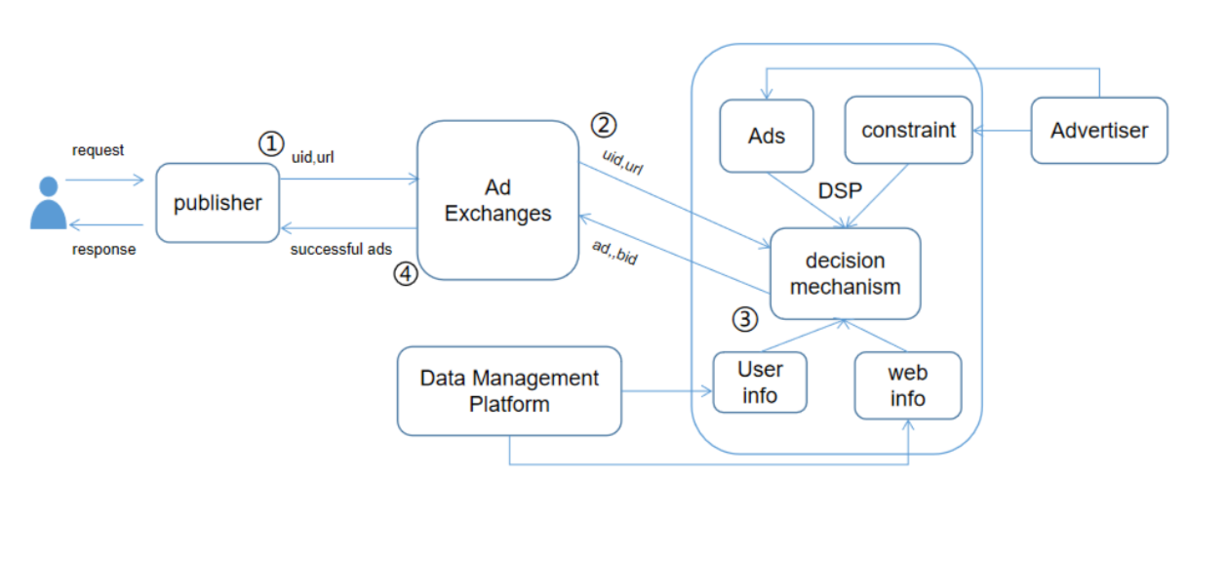
Advertising Mechanism

Slide 6

Formal Representation
DSP

Slide 7

Formal Representation
DSP
CTR

Slide 8
Methods
Logistic Regression
Factorization Machine

Slide 9
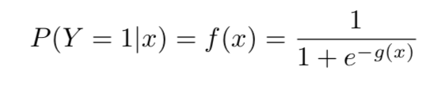
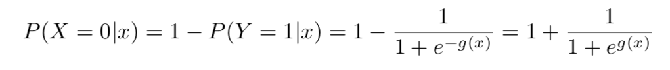
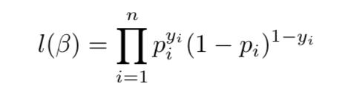
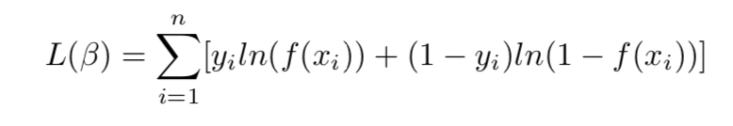
Logistic Regression
Using training to construct a logistic regression model

Slide 10
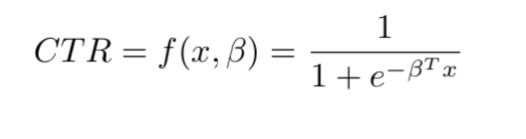
Logistic Regression
Using training to construct a logistic regression model

Slide 11
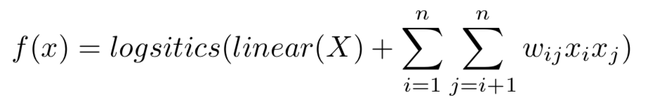
Factorization Machine

Slide 12

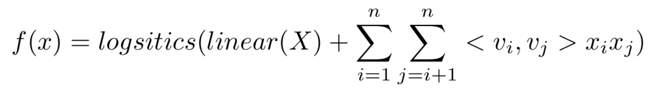
Factorization Machine

Slide 13
Experiment Design
Dataset
Preprocessing
Evaluation Metrics
Comparison

Slide 14
Dataset
Source: KDD cup 2012 track 2.
Including training set, test set and files for additional information
Training set : 155,750,158 instances
Each instances (#click, #impression, DisplayURL, AdID, AdvertiserID, Depth,QueryID,etc )

Slide 15
Preprocessing
For the category feature, we transfer them into numerical feature
Training data : validation data = 8: 2
5 fold validation to train the model

Slide 16
Evaluation Metrics and Comparison
AUC ( Area Under Curve) to count ROC ( Receiver Operating Characteristics)
To evaluate LR model, compare to others such as Navie Bayes, Ridge Regression

Slide 17
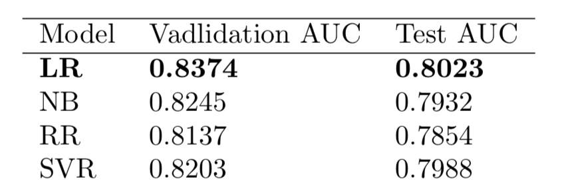
Result

Slide 18
Summary
LR model is POWERFUL
Using LR model to implement advertising CTR forecasting is calculation key research and hot issues in the field of advertising

Slide 19
END

