Slide 1
CloseClaw
Haotian Wang (z5576699)
Weiye Li (z5597115)
Yingxin Li (z5519793)
Yanjian Shen (z5541664)
Kejing Wang (z5526880)
Movie Review Sentiment
Analysis

Slide 2
Problems & Our task
Our Task:
Three-category film review sentiment analysis
Three-category:
0 represents neutral
1 represents positive
-1 represents negative
“The movie is really Good!” -> positive
“The movie is really bad!, I wont recommend it!!” -> negative
“This movie has very few redeeming qualities, but it's still watchable.” -> negative
Presenter: Jingying Gao (zxxxxxxx)

Slide 3
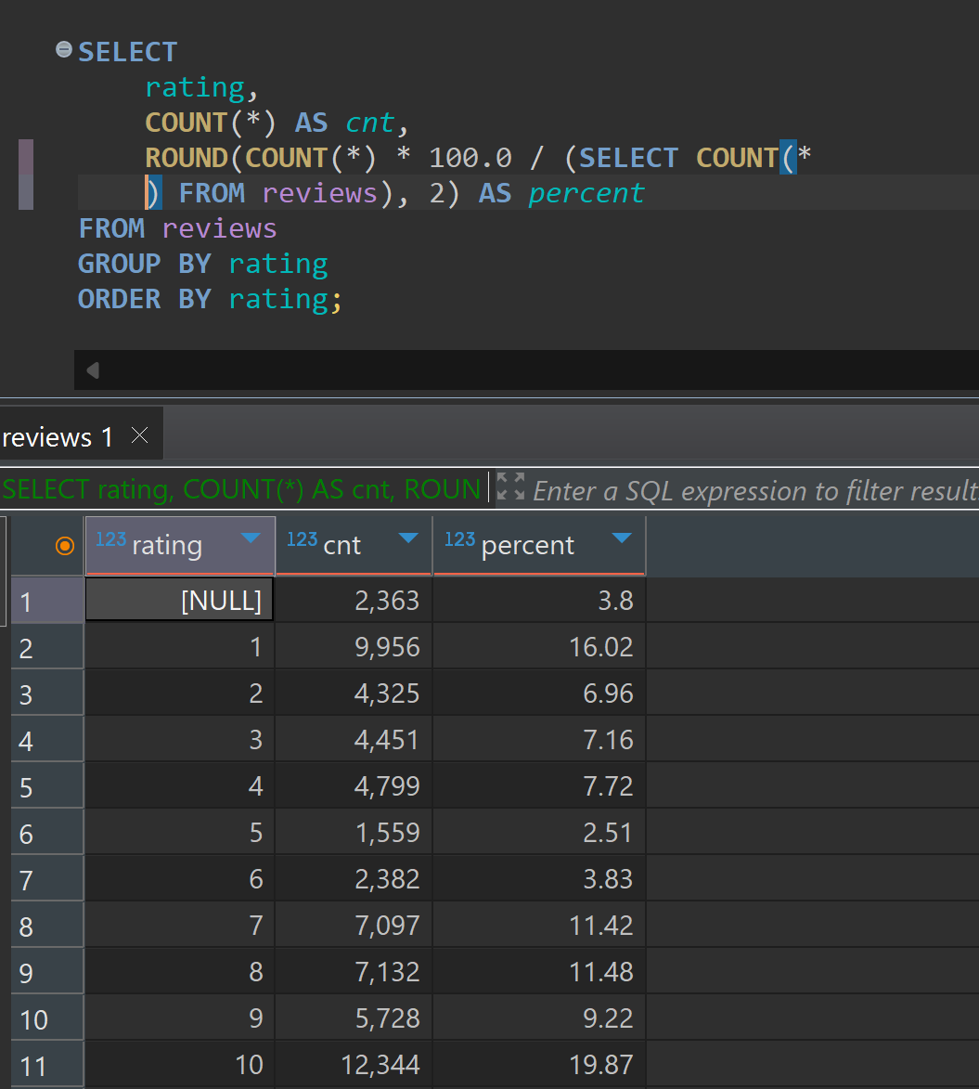
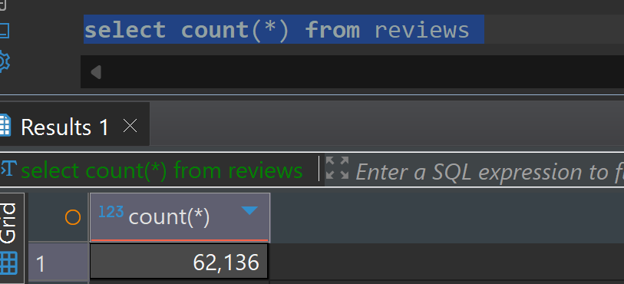
Data sources
Existing open source datasets
IMDB Large Movie Review Dataset (2011) (100k rows)
cornell-movie-review-data/rotten_tomatoes (10.67k rows)
Self-collected dataset
IMDB latest movies (2026) (25,618 rows)
Presenter: Jingying Gao (zxxxxxxx)

Slide 4
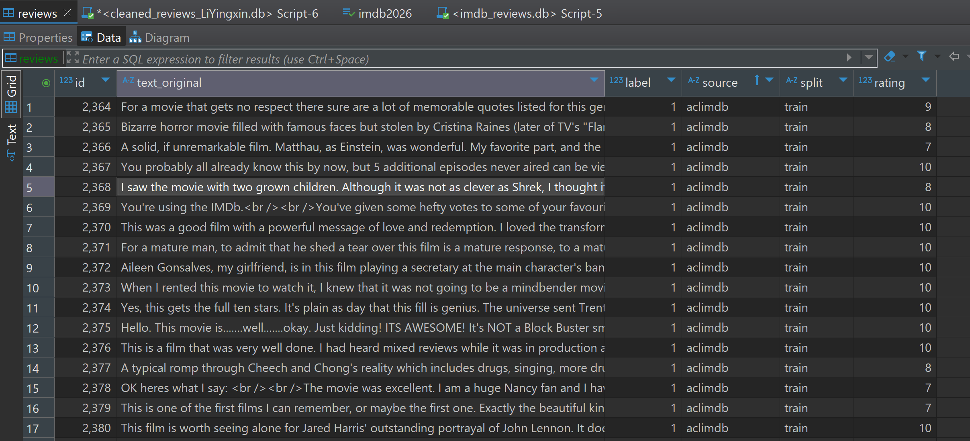
it looks like
Presenter: Jingying Gao (zxxxxxxx)

Slide 5
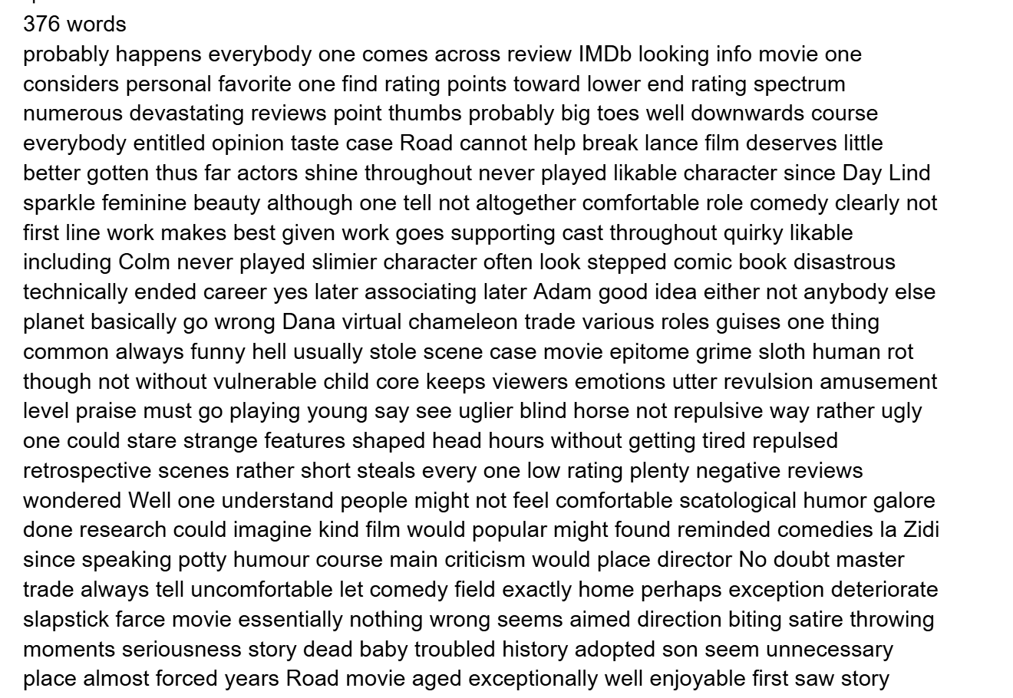
Dataset Analysis: 1. Length problem
For the best movie review input for later generic model training & evaluating, we want the [20, 200] words of the movie review.
For example, some reviews are very long. Even after removing high-frequency and low-meaning stopwords, they still contain 376 words, as shown below.
Presenter: Jingying Gao (zxxxxxxx)

Slide 6
Dataset Analysis: 2. Non-ASCII characters
NLP Large Model can understand English and possibly other languages. But for this project task, we filtered the reviews containing non-ASCII characters for the purity, just like emoji, non-English characters.
González
trémula
7º
½
Sööt
7º
años
Presenter: Jingying Gao (zxxxxxxx)

Slide 7
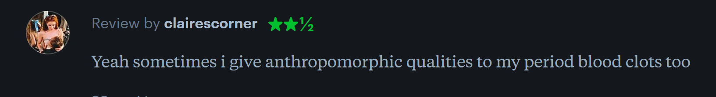
Dataset Analysis: 3. Satirical comments
There are many sarcastic reviews in the datasets, just like the review
look so good Yes, it cannot be better any more
literally we'd regard it as an optimistic review, but the reviewer gave only 1 marks as the lowest mark.
In the future, for avoidance of large model to be confused, we will re-annotate the labels by the other three large models.
Presenter: Jingying Gao (zxxxxxxx)

Slide 8
Dataset Analysis: 4. The centrists rated 5 or 6
For example, IMDB's rates is in [1, 10].
For [4, 7]. Because they are not clear enough to show the attitudes, later we'd consider re-annotate them again.
Besides, large models also need to learn some necessary centrists reviews as the training data.
Presenter: Jingying Gao (zxxxxxxx)

Slide 9
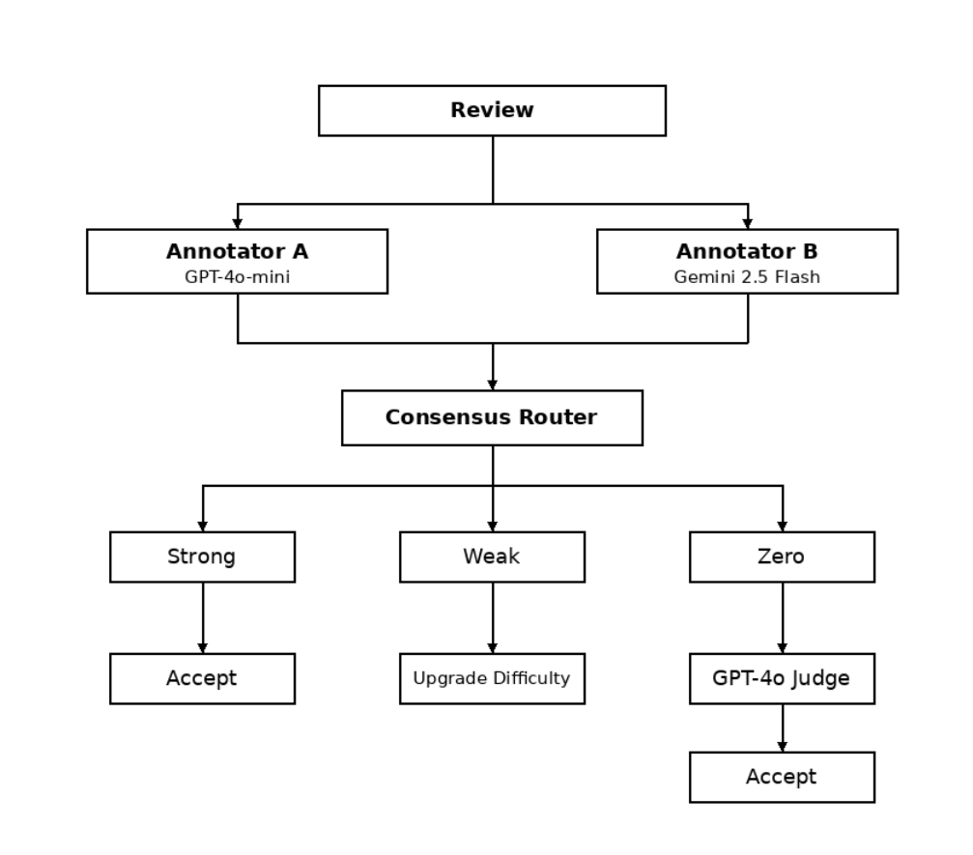
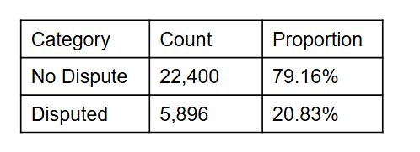
Multi-Model Annotation Pipeline
Goal: Use LLMs to automatically generate high-quality sentiment labels for movie reviews, serving as training data for the downstream fine-tuned model.
3-class labels: positive (+1) / negative (−1) / mixed (0)
Multi-LLM Consensus Mechanism (key design):
Annotator A: GPT-4o-mini (OpenAI)
Annotator B: Gemini-2.5-flash (Google)
Judge: GPT-4o (OpenAI)
Three-branch Consensus Routing:
Strong consensus: A & B agree on both sentiment and difficulty → accept directly
Weak consensus: Same sentiment, different difficulty → take the higher difficulty
Zero consensus: Sentiment conflict → invoke GPT-4o as Judge for final verdict
Presenter: Alan Blair (zxxxxxxx)

Slide 10
Multi-Model Annotation Pipeline
Each annotated record contains:
sentiment: label
difficulty: 1–3 (1=explicit, 2=contrastive, 3=implicit/sarcastic)
ambiguous_flag: whether reasonable disagreement remains
Output statistic：
Category | Count | Proportion
No Dispute | 22,400 | 79.16%
Disputed | 5,896 | 20.83%
Presenter: Fatemeh Morgani (zxxxxxxx)

Slide 11
The lexicon: VADER
Valence Aware Dictionary and sEntiment Reasoner (VADER) https://github.com/cjhutto/vaderSentiment
it can get sentiment value
from "[–4] Extremely Negative" to
"[4] Extremely Positive",
with allowance for “[0] Neutral”.
And we will make it simple as a binary labels.
Presenter: Jingying Gao (zxxxxxxx)

Slide 12
Method(s)
TF-IDF + LinearSVC
TF-IDF: From Text to Features
Design Choices
TF (Term Frequency): how often a word appears in this review
IDF (Inverse Document Frequency): how rare the word is across all reviews
Result: emotional words like "masterpiece" or "awful" get high scores; common words like "the" get near zero
sublinear_tf = True With it: dampens high-frequency word dominance
ngram_range = (1, 2): unigram + bigram
max_features = 50,000; min_df = 2 Only keep features appearing in at least 2 reviews to reduce noise
Presenter: Jingying Gao (zxxxxxxx)

Slide 13
Method(s)
TF-IDF + LinearSVC
LinearSVC: Learning the Decision Boundary
Default Configuration
Finds a hyperplane in 50,000-dimensional space that separates classes with the maximum margin
The closest points to the boundary are called support vectors — they define the boundary
For 3-class classification: One-vs-Rest strategy — trains 3 binary classifiers, takes the highest score
C = 1.0 balanced regularization, neither too strict nor too loose
class_weight = None
Presenter: Jingying Gao (zxxxxxxx)

Slide 14
Method(s)
BERT
Pre-training: BERT starts from 3.3 billion words of pre-training— unlike SVM which starts from zero, it already understands English grammar, semantics, and context
Bidirectional attention: BERT reads the whole sentence at once — every word attends to every other word simultaneously
[CLS] token: Special token added at the start, summarizes the whole sentence into a 768-dim vector after 12 layers. This vector → linear classification head → 3 class logits → softmax → prediction
Fine-tuning: Classification head is randomly initialized → before fine-tuning, predictions are near-random → fine-tuning adjusts all 110M parameters toward this specific task
Presenter: Jingying Gao (zxxxxxxx)

Slide 15
Method(s)
BERT
Fine-tuning Strategy: Setup and Best Checkpoint
MAX_LEN = 128
BATCH_SIZE = 16
EPOCHS = 3
LR = 2e-5
WARMUP_RATIO = 0.1
VAL_RATIO = 0.1
RANDOM_SEED = 42
Epoch | Val Accuracy | Val Macro-F1
1 | 0.888 | 0.692
2 | 0.898 | 0.713
3 | 0.885 | 0.742
Epoch 3: Accuracy slightly drops but Macro-F1 keeps rising → model improves on minority class
Why Macro-F1 over Accuracy: with class imbalance, accuracy can be high by ignoring neutral
Presenter: Jingying Gao (zxxxxxxx)

Slide 16
Method(s)
Qwen3 Supervised Fine-tuning
Overall workflow:
Built the Qwen supervised fine-tuning pipeline
Trained Qwen3-0.6B / 1.7B / 4.0B with LoRA to study scaling trends
Compared fine-tuned and non-fine-tuned performance
Key finding:
Fine-tuning consistently improved all Qwen variants;
Qwen3-4.0B achieved the best final performance, while Qwen3-1.7B showed the largest gain.
Presenter: Kejing Wang (z5526880)

Slide 17
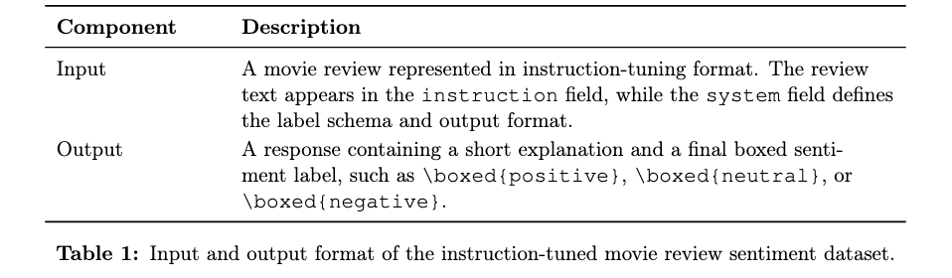
Method(s)
Qwen3 Supervised Fine-tuning -- Dataset construction
Presenter: Kejing Wang (z5526880)

Slide 18
Method(s)
Qwen3 Supervised Fine-tuning -- Motivation
Why CoT?
Easy to analysis.
Improve the accuracy of the model’s responses.
Better performance in complex judgment scenarios.
Presenter: Kejing Wang (z5526880)

Slide 19
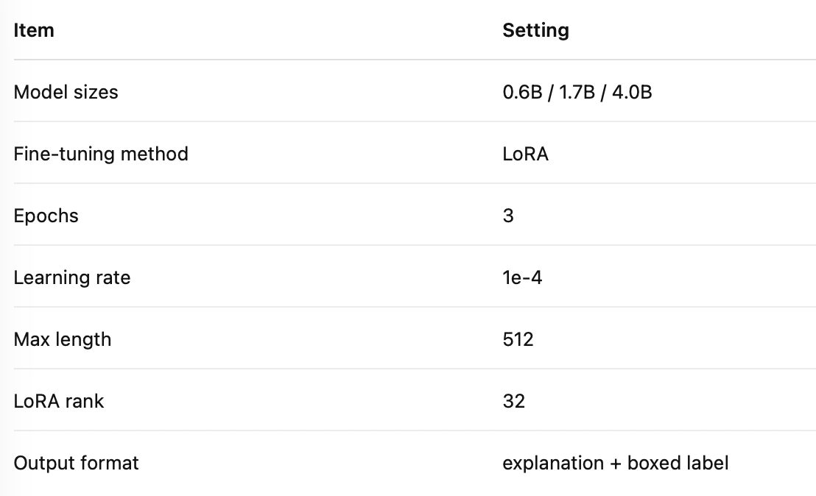
Method(s)
Qwen3 Supervised Fine-tuning -- Experients setting
Presenter: Kejing Wang (z5526880)

Slide 20

Evaluation Metrics
Primary Metric:
Macro-F1 – equal weight for all classes; measures balanced performance; key for evaluating neutral class
Supporting Metrics:
Weighted-F1 – reflects real data distribution; helps identify class bias
Accuracy – measures overall correctness; may be influenced by majority classes
Diagnostic Metrics:
Macro-Precision – evaluates prediction correctness
Macro-Recall – evaluates coverage of true samples
→ used to analyze model behavior and class preference
Key Insights
Given the difficulty of neutral classification, Macro-F1 is essential to reveal true model performance beyond majority classes.
Presenter: Weiye Li(z5597115)

Slide 21
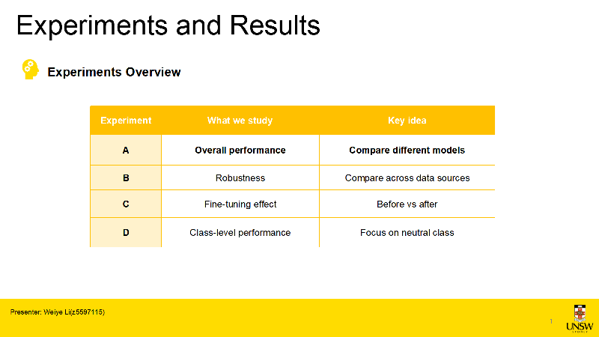

Slide 22

Experiments and Results
Experiment A : Single-Factor Augmentation
Objective:
Compare overall performance of different models on 3-class sentiment classification
Evaluate ability to distinguish positive, neutral, and negative sentiments
Models:
Traditional methods: Lexicon, SVM
Pretrained models: BERT (before / after fine-tuning)
Large language models: Qwen3 series (0.6B / 1.7B / 4.0B, before / after fine-tuning)
Evaluation Setup:
Primary metric: Macro-F1
Supporting metrics: Accuracy, Weighted-F1, Precision, Recall
Performance evaluated on both sources and averaged
Presenter: Weiye Li(z5597115)

Slide 23

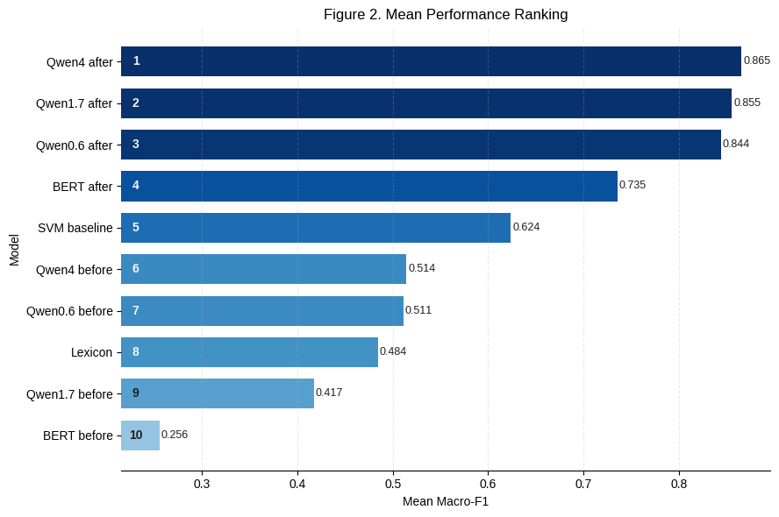
Experiments and Results
Key Findings
Fine-tuning leads to substantial improvements across all models
Large performance gaps exist between model families (Qwen > BERT > traditional methods)
Models show different performance across data sources, indicating sensitivity to input variation
Key Insights
Performance differences arise from both model capacity and data variability, motivating further analysis......
Presenter: Weiye Li(z5597115)

Slide 24
Experiments and Results
Experiment B : Cross-source Performance Analysis
Objective:
Analyze how model performance changes across different data sources
Evaluate robustness and generalization ability
Core Idea:
Same model, different sources → compare performance shift
Measure sensitivity to data distribution differences
Metric Definition:
Define performance gap for any metric M: gap(M) = |Ms₀ - Ms₁|
Evaluation Setup:
Focus on Macro-F1 gap
Also consider gaps in Accuracy, Precision, Recall
Smaller gap → more stable model
Presenter: Weiye Li(z5597115)

Slide 25
Experiments and Results
Key Findings
Model | Macro-F1 Gap
Qwen3-4.0B (fine-tuned) | 0.0016
Qwen3-0.6B (before) | 0.0034
Lexicon | 0.0085
Qwen3-1.7B (fine-tuned) | 0.0221
Qwen3-0.6B (fine-tuned) | 0.023
BERT (before) | 0.0301
SVM | 0.04
Qwen3-1.7B (before) | 0.0458
BERT (fine-tuned) | 0.0463
Qwen3-4.0B (before) | 0.0941
Fine-tuning leads to substantial improvements across all models
Large performance gaps exist between model families (Qwen > BERT > traditional methods)
Models show different performance across data sources, indicating sensitivity to input variation
Key Insights
Performance differences arise from both model capacity and data variability, motivating further analysis......
Presenter: Weiye Li(z5597115)

Slide 26
Experiments and Results
Experiment C: Fine-tuning Effect Analysis
Objective:
Evaluate how fine-tuning improves overall performance in 3-class sentiment classification
Analyze how models adapt to task-specific semantic boundaries
Core Idea:
Compare model performance before and after fine-tuning on the same backbone
Measure how fine-tuning shifts decision boundaries across different models
Metric Definition:
Δ Macro-F1 = Macro-F1_{after} − Macro-F1_{before}
Evaluation Setup:
Evaluate performance on both data sources (s0 and s1)
Compare Δ Macro-F1 across models to assess improvement
Larger Δ indicates stronger adaptation to the task
Presenter: Weiye Li(z5597115)

Slide 27
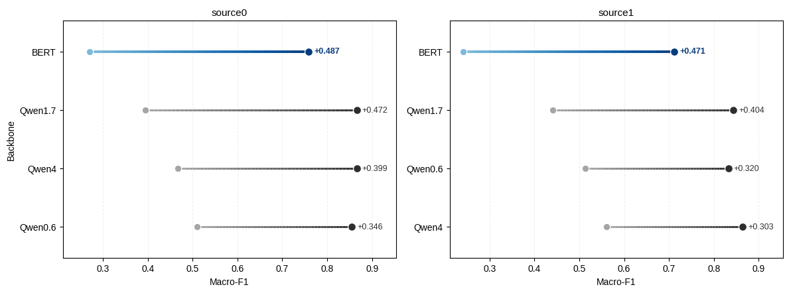
Experiments and Results
Key Findings
Fine-tuning leads to substantial performance improvements across all models, with weaker models showing significantly larger gains than stronger ones
BERT achieves the largest improvement, reflecting its strong dependence on task-specific adaptation and fine-tuning
Presenter: Weiye Li(z5597115)

Slide 28
Experiments and Results
Experiment D: Per-class Performance Analysis
Objective:
Analyze model performance at the class level to identify differences across positive, neutral, and negative sentiments
Focus on the neutral class, which is more challenging due to weaker and mixed emotional signals
Core Idea:
Evaluate how models perform on each class rather than relying on overall metrics
Identify whether performance differences are driven by class imbalance or semantic difficulty
Evaluation Metrics:
Per-class Precision, Recall, and F1-score
Compare class-wise performance across models and data sources
Evaluation Setup:
Decompose overall performance into per-class contributions to identify category-specific limitations
Analyze whether models can maintain a distinct neutral class under weak or ambiguous sentiment signals
Presenter: Weiye Li(z5597115)

Slide 29
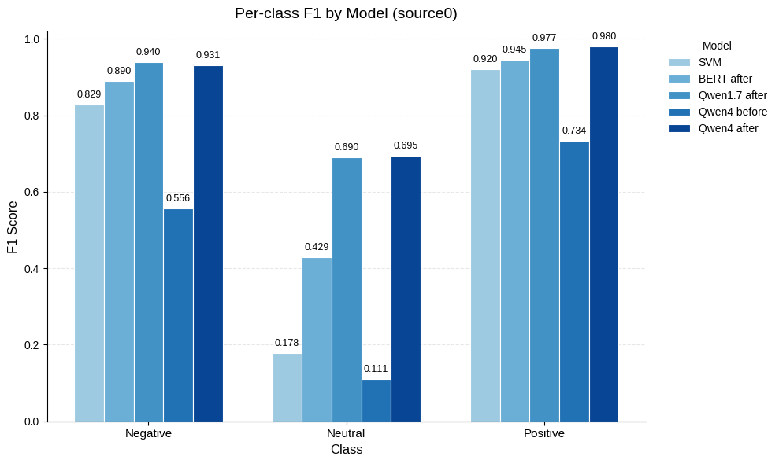
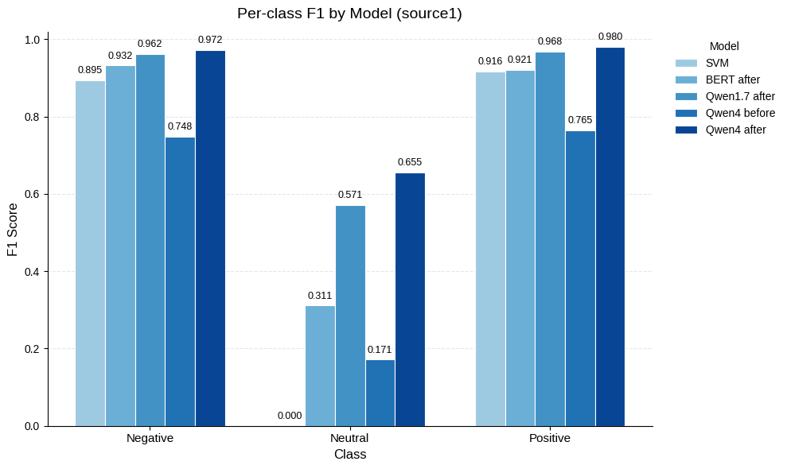
Experiments and Results
Key Findings
Performance is consistently high for positive and negative classes, but significantly lower for neutral across all models
Qwen3-4.0B (fine-tuned) achieves the best balance, substantially improving neutral classification while maintaining strong performance on other classes
Presenter: Weiye Li(z5597115)

Slide 30
Experiments and Results
Qualitative Error Analysis
Objective:
Analyze misclassified samples to understand model limitations beyond numerical metrics
Identify common patterns behind prediction errors
Core Idea:
Examine errors at the semantic level rather than treating them as isolated cases
Group errors into recurring patterns based on linguistic and sentiment characteristics
Analysis Method:
Collect all misclassified samples from Qwen3-4.0B (fine-tuned)
Categorize errors into predefined types (e.g., mixed sentiment, weak polarity, irony)
Analyze distribution and representative examples for each category
Presenter: Weiye Li(z5597115)

Slide 31
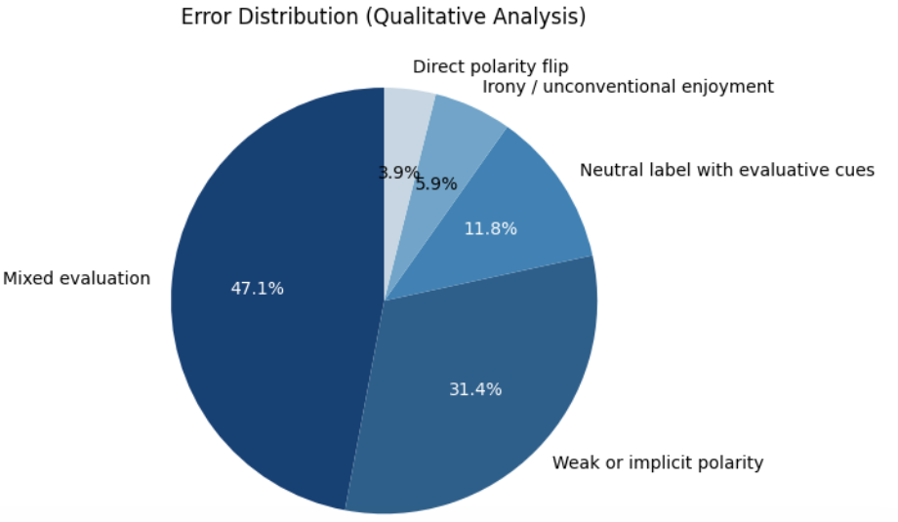
Experiments and Results
Key Findings
Errors are mainly concentrated in mixed and weak sentiment (~80%)
The model tends to predict neutral under ambiguity or conflicting signals
Performance remains strong for clear positive and negative cases
Key Insights
The main challenge lies in interpreting nuanced or conflicting sentiment, rather than identifying explicit polarity.
Presenter: Weiye Li(z5597115)

Slide 32
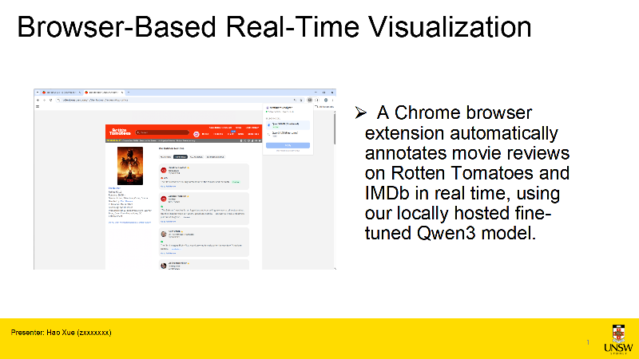

Slide 33

This Photo by Unknown Author is licensed under CC BY-SA

