Slide 1

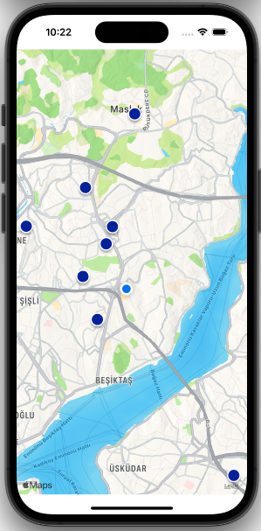
TRIP PLAN
Transportation is now easier!

Slide 2

How did I start this project?
First, I identified my needs.
I needed two screens. (UIViewController)
How should I design these two screens?
Which design pattern should I use? I chose that. (MVC)
I needed to create a model for the JSON data I fetched from the API.
I had to make a request to the service in order to use this model.
Which framework do I need?
What should I do when I click on the locations?

Slide 3
How did I design the storyboard?
I added two UIViewController instances to the storyboard. I placed an MKMapView component on my main UIViewController, covering the entire screen. Then, I added a UIButton to transition to the other UIViewController when clicked.
For the other UIViewController, I added a TableView. Additionally, I created a TableViewCell for the TableView.
I connected these two screens with a segue.

Slide 4
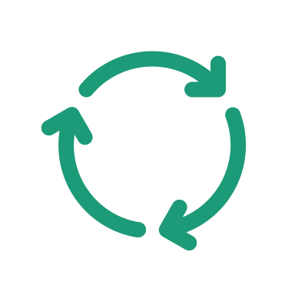
Why did I use the MVC design pattern?
MVC promotes a clear separation of concerns, allowing developers to focus on specific aspects of the application. This separation enhances code maintainability and reusability.
By dividing the application into three distinct components, MVC enables modular development. Each component can be developed, tested, and modified independently, promoting code organization and scalability.
The separation of concerns in MVC facilitates code reusability. Models can be reused across different views and controllers, promoting efficient development practices.

Slide 5
How did I design my model?
I created two structs: StationsModel and Trip. I designated these structs as Codable. I also used CodingKeys to change the variable names.
Codable is a combination of the Encodable and Decodable protocols.
Classes or structs that conform to the Encodable protocol can encode themselves into JSON format.
Classes or structs that conform to the Decodable protocol can create objects of their own types using JSON data.
CodingKeys allows you to use different variable names to represent your JSON keys.

Slide 6
Making a request to the service
I created the StationManager class to fetch data from the service. I added two functions to this class. I created the fetchStations method for the GET request and the fetchTripData method for the POST request. I defined the fetchStations method to retrieve the locations on the map, while I defined the fetchTripData method for the responses when the tripBook button is clicked.

Slide 7

Which framework do I need?
I used the MapKit framework to create the map. I created the user's location using CLLocationManager with the help of CLLocationManagerDelegate protocol. I determined the region and the range in which the user's location should be using the MKCoordinateRegion. I utilized the mapView() function from the CLLocationManagerDelegate protocol to create this.
I defined the appearance of the annotations using MKAnnotationView.

Slide 8

What should I do when I click on the locations?
After clicking on a location, I created a segue with the listTripsButton to pass the data. I sent the busName and time data to the TableViewCell based on the ID of the clicked location. When the bookButtonTapped button was clicked, if the response from the service was successful, I created a UIAlertController and ensured that when the popup was closed, it would return to the main UIViewController. If the response from the service was 400, I made sure that the UIAlertController I created would stay on the same list when the message was clicked.

Slide 9
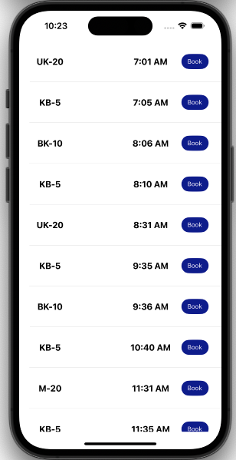
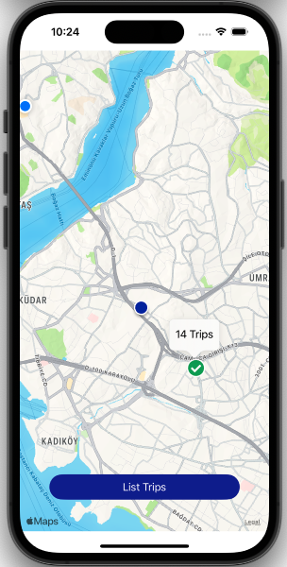
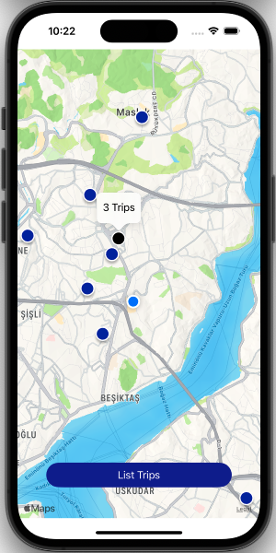
What did I achieve? What is the conclusion I reached?

Slide 10
Thank you for taking the time
Hope you enjoyed it
Created by Sena Küçükerdoğan

