Slide 1
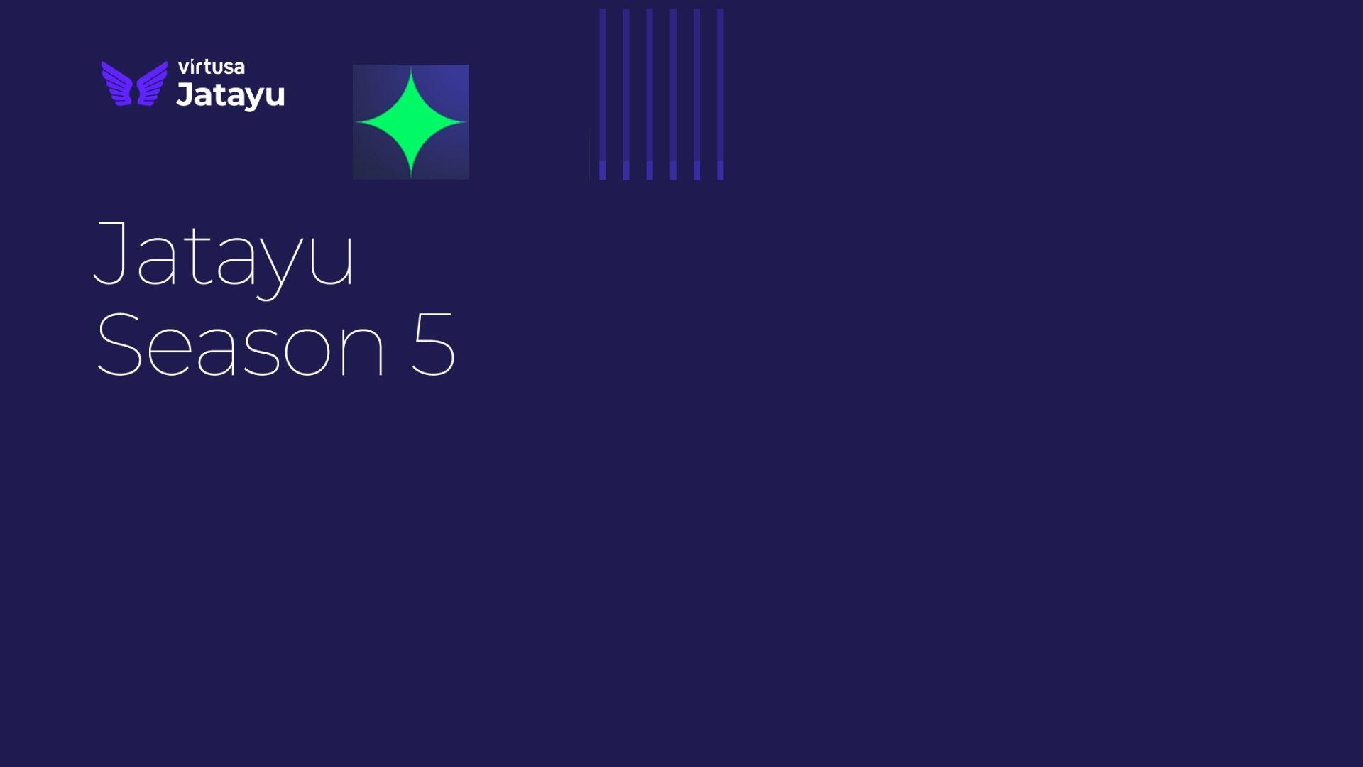
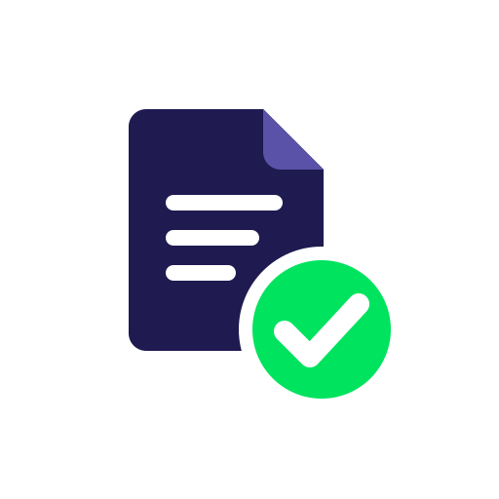
NIYAM
Agentic Regulatory Circular to
Live Rule Engine
Team Name: Dragorithm
Mentor Details
Prof. Suresh R
Team Members:
1.Senaaravichandran A
2.Abiyshek S
3.Jerrick Austin Manuel G
4.Venkat Narayanan S
5.Vishal R
College
Sri Manakula Vinayagar Engineering College,
Madagadipet, Puducherry, India.

Slide 2

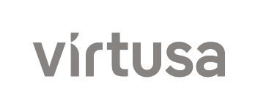
Problem Statement: FDS NA, Use Case 2
Title of the Use Case | Description | Details
Use Case 2: Regulatory Circular to Live Rule Engine | Problem Statement: Banks must manually interpret regulatory circulars, identify applicable obligations, map them to internal policies and existing system rules, and coordinate with IT to implement changes. This process can take weeks or months, risks missing critical obligations, and may introduce incorrect rule scope or unexpected transaction impacts. Description: A multi-agent AI system reads regulatory circulars, determines applicability, extracts obligations, maps them to internal rules, drafts changes, backtests their impact, and prepares them for human approval. Approved changes are deployed through shadow mode, controlled rollout, monitoring, and rollback. | Why Agentic AI: Specialized agents collaborate via A2A to interpret regulations, map policies, create rules, analyze impact, and iteratively resolve issues. Workflow: Circular Intake → Obligation Extraction → Policy Mapping → Rule Authoring → Backtesting → Impact Analysis → Validation → Human Approval → Shadow Deployment → Rollout & Monitoring. Data Sources: Regulatory circulars, internal policies, rule repositories, bank profiles, transaction data, backtest results, deployment metrics, and approval history. Tech Stack: Multi-agent orchestration, document retrieval, obligation registry, rule DSL, A2A messaging, sandbox engine, backtesting, version control, deployment APIs, monitoring, and LLMs. Guardrails: Draft-only rule changes, clause-level traceability, validation, mandatory human approval, controlled rollout, monitoring, rollback, and rate limits. Enterprise Impact: Faster regulatory implementation, fewer compliance gaps, reduced manual effort, better traceability, and safer rule deployment.
Our Answer:
NIYAM
7 A2A Agents
a Conductor and six workers, found via Agent Cards
MCP Tool Layer
per agent allowlists, no direct system access
Knowledge Graph
clause to rule traceability with a Bank Semantic Model
Safe Release
two person approval, shadow, canary, auto rollback

Slide 3





NIYAM: Agentic Regulatory Circular to Live Rule Engine
Business Need/Opportunity
Circular to Rule Automation: agents read circulars, extract obligations and draft rule changes in hours instead of months
Zero Missed Obligations: every MUST clause maps to a rule or a signed manual control, with clause level traceability
Safe Change Deployment: backtesting, impact analysis, shadow mode and canary rollout with auto rollback before customers are affected
Inspection Ready Compliance: every live alert traces back to the circular sentence and the humans who approved it
Target Segment
Problem Statement
Urban Cooperative & Small Finance Banks: full RBI regulatory load with lean compliance teams
NBFCs (Mid and Upper Layer): fast changing scale based rules and digital lending norms
Large Banks: a regulation to rule layer over existing AML, fraud and limit engines
BFSI System Integrators: an accelerator for compliance transformation programs
Banks interpret every RBI circular by hand, map it to policies and system rules, then wait on IT to change them. This takes weeks to months, risks missed obligations and wrong rule scope, and causes unexpected transaction impact with no clause level audit trail.
Market Size and Growth
Future Readiness
Global RegTech Market
Market size in USD Billion, analyst midpoint, CAGR ~19%
Market Overview
1
2
3
4
5
Study Period
2025 to 2030
Global Market (2025)
USD 15 to 19 Billion
Global CAGR
17% to 21%
India RegTech CAGR
18% to 27% (2025 to 2030)
Research &
Design
PoC
Development
Pilot Testing
& Refinement
Enterprise Scale
& Governance
Multi-Regulator
Launch
RBI Master Directions
244, from 9,000+ circulars
RBI Penalties (FY25)
353, worth ₹54.78 cr
Define the obligation schema, Bank Semantic Model, agent roles and Agent Cards
Build the 7 agent A2A mesh, MCP tools, rule DSL, backtest and rollback demo
Read only pilot with a UCB or NBFC; measure extraction accuracy and analyst time saved
Rule engine connectors, on premise LLMs and FREE-AI aligned model governance
SEBI, IRDAI and global regulator packs as a SaaS and SI accelerator
Target Entities
1,457 UCBs, 9,000+ NBFCs
India SAM (est.)
₹550 cr per year
Sources: IMARC, ResearchAndMarkets (2025); 2030 implied at ~19% CAGR
Key Players
CUBE, Corlytics, IBM
PoC now → pilot in 0 to 3 months → product in 3 to 6 months → scale in 6 to 24 months

Slide 4
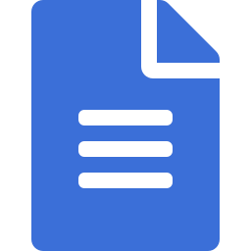









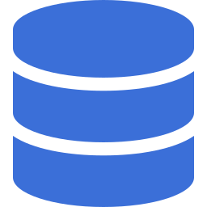
Solution Details
Circular to Rule Compilation Engine (CRCE)
Multi-Agent Regulatory Intelligence: seven agents (a Conductor and six workers) read, scope and extract obligations from each circular and collaborate over the A2A protocol, discovered through their Agent Cards.
Knowledge Graph & Semantic Model: a Regulatory Knowledge Graph, modelled for Neo4j, links circulars, clauses, obligations, policies and rules, while a Bank Semantic Model maps regulatory language to the bank’s own data.
Safe Rule Lifecycle: rules are drafted in a typed DSL, backtested on transaction history, validated, approved by two humans, then released through shadow, canary and live with auto rollback.
Governed by Design: tools are reached only through MCP with per agent allowlists; every action is logged with clause level provenance under token and iteration limits.
Circular
Intake
Applicability
Obligation
Extraction
Policy
Mapping
Rule
Authoring
Parses PDF, segments clauses, links the amended direction
Matches clause scope to the bank profile
MUST, MUST NOT, MAY with exact source span
Finds affected policies and rules in the graph
Typed DSL draft on a git branch
Shadow &
Rollout
Human
Approval
Validation
Impact
Analysis
Backtesting
Shadow, canary, live with auto rollback
Two person maker checker sign off
Spans, numbers, boundary tests, conflicts
Alert delta, segments and analyst hours
Replays 90 days of transactions, old vs new
Unique Selling Proposition
Working
Use Case Diagram
Circular to Live Rule: covers the full path from PDF to a deployed rule, not just an obligation register.
Tests From the Regulation: auto generated boundary tests catch threshold, comparator, unit and date errors.
Human in Control: two person approval; agents can never deploy on their own.
Golden Thread Audit: any alert traces to its clause, rule version, backtest and approvers.
Plug and Play Regulators: new regulators join as Agent Cards and MCP servers, with no rewrite.
NIYAM
Conductor + A2A mesh
NIYAM Platform
RBI Circular
Bank Profile
Policies & Rules
Upload Circular
Reader
Intake + Scope
Extractor
+ Mapper
Author
Rule drafts
Validator
Backtest + Impact
Validator: Tests
Compliance
Officer
Review Obligations
Risk / IT
Approver
View Impact Report
Human Approval: maker checker, signed approval token
Approve Rule Change
Release: Shadow → Canary → Live
Monitor & Rollback
RBI Inspector
/ Auditor
IT Ops
MCP Tools
Knowledge Graph
Sentinel (drift tool)
Audit Trail
Trace Alert to Clause

