Slide 1


Performance Evaluation System (PES)
University of Sri Jayewardenepura
Faculty of Engineering
An intelligent academic management platform for the Faculty of Engineering
A BRIEFING FOR THE DEAN
Data Management Project 2026
K.M.L.N. Senadheera · 22/ENG/079 · EN108953
Notes:
[about 0:30] Good morning, sir. I am Lahiru Senadheera, 22/ENG/079. I would like to show you the Performance Evaluation System, PES: a platform I built for our faculty that brings each student's academic record into one place and applies the Faculty Handbook's rules automatically. In about twelve minutes I will show what it does for students, lecturers and the faculty office, how it keeps data safe, where it stands today, and the support it needs to be used across the faculty.

Slide 2







The academic record was scattered, and problems were found too late
01
WHY PES
PES
Attendance found out too late
Information in many places
One platform for the faculty's whole academic record, built on the Faculty Handbook's own rules.
Students learned they were below 80% only when they lost exam eligibility.
Results, notices and requests lived in sheets, paper and many channels.
Warns early attendance and grades, before it is too late
Shows each person only their part students, lecturers, heads and the office
No way to plan
No early warning
Guides with AI a planner, forecasts and an assistant
No picture of what a class of honours or a minor actually requires.
Mentors heard about a struggling student after the results, not before.
Notes:
[about 1:00] Four problems started this project. Students found out they were below 80% attendance only when they lost exam eligibility. Results, notices and requests were spread across spreadsheets, paper and many channels. Nobody could see what a class of honours or a minor really required. And mentors usually heard about a struggling student after the results came out. [Point to the dark panel] PES answers all four with one platform, built on the Faculty Handbook's own rules: it warns early, it shows each person only what they are allowed to see, and it guides students with a planner, forecasts and an AI assistant.

Slide 3



Live today, with three portals for everyone in the faculty
02
PES AT A GLANCE
167
41
232
7,392
45
24/7
students
lecturers
courses from the Handbook
published results
screens
online, on any phone or laptop
Students
Lecturers and heads
Faculty office
Results, CGPA and class of honours
Attendance with early warnings
Enrolment, planner and AI assistant
Medical certificates, feedback, mentor chat
Live QR attendance registers
Results entry and submission
Mentees and early warnings
Department views for heads
Publish results
Open enrolment windows
Batches, accounts and notices
Faculty-wide dashboards
Notes:
[about 1:00] PES is live today. It holds 167 students, 41 lecturers, 232 courses taken from the Faculty Handbook, and 7,392 published results, across 45 screens that work on any phone or laptop. There are three portals. Students see their own results, attendance, enrolment, a graduation planner and an AI assistant. Lecturers and heads of department run live attendance registers, enter results and look after their mentees. And the faculty office publishes results, opens enrolment and manages batches, accounts and notices.

Slide 4

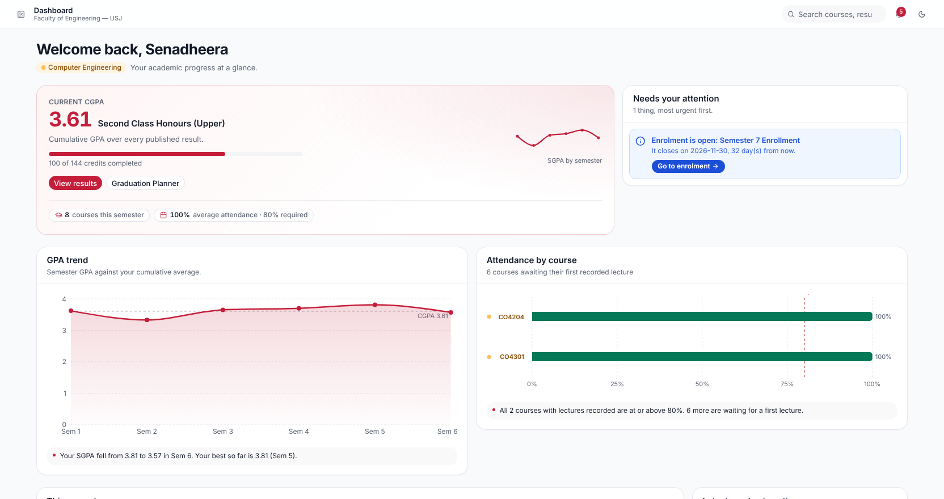



Every student sees where they stand, the moment they sign in
03
FOR STUDENTS
CGPA and class of honours
Worked out from published results with the Handbook's own grade points
Attendance against the 80% rule
Course by course, with a warning before a student falls below it
What needs attention
Open enrolment, a missing medical, a course to repeat
Requests online
Medical certificates and feedback, without paper
Notes:
[about 1:00] This is what a student sees after signing in. [Point to the CGPA] Their CGPA and class of honours, worked out from published results with the Handbook's grade points. [Point to the attendance chart] Their attendance course by course against the 80% rule, with a warning before they fall below it, not after. [Point to Needs your attention] And anything that needs action, such as an open enrolment window. Medical certificates and course feedback are submitted online too.

Slide 5
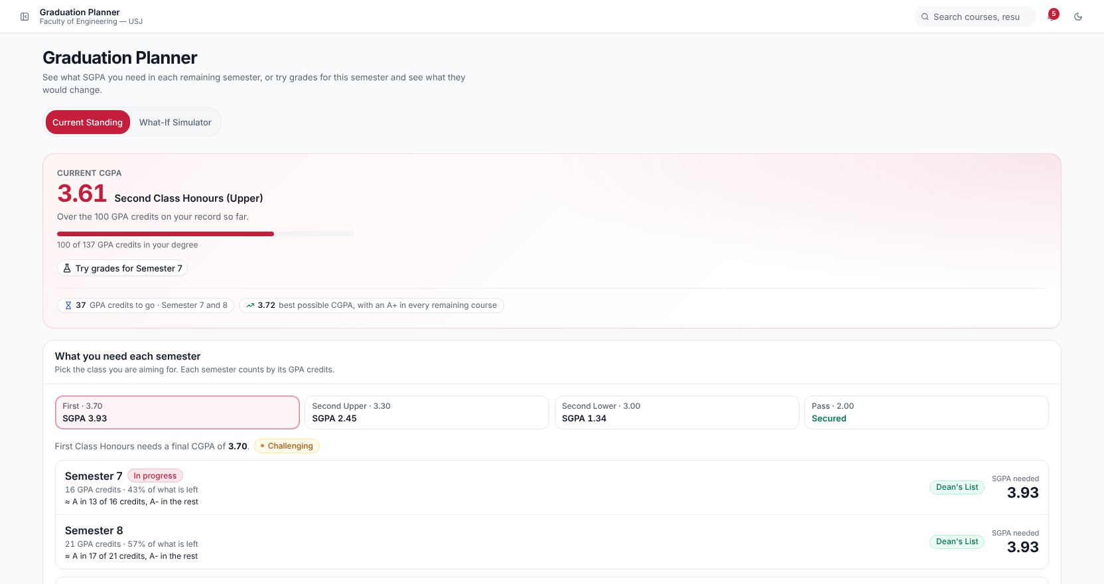



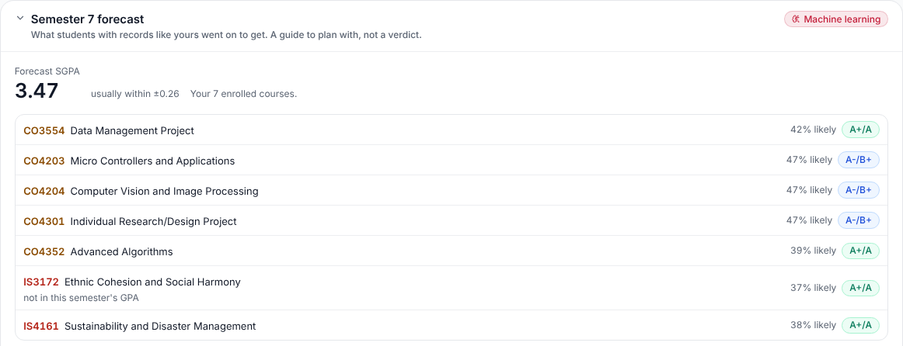
The Graduation Planner shows what each class of honours needs
04
PLANNING AHEAD
The SGPA each semester needs
For First, Second Upper, Second Lower or a Pass, from where the student is now
Try expected grades
A what-if view the student can save, or share with their mentor
A forecast for next semester
A model trained on 7,392 past results predicts each course's likely grade
Machine learning
Notes:
[about 1:00] The Graduation Planner answers the question every student has: what do I need from here? For each class of honours it shows the SGPA each remaining semester needs. A student can try expected grades and save the plan, or share it with their mentor. [Point to the forecast card] It also shows a forecast of next semester's grades from a machine-learning model trained on the faculty's 7,392 past results. On a semester it had never seen, its SGPA forecast was off by only 0.26 on average. Students see likely grades, never a failure prediction; that goes to their mentor.

Slide 6

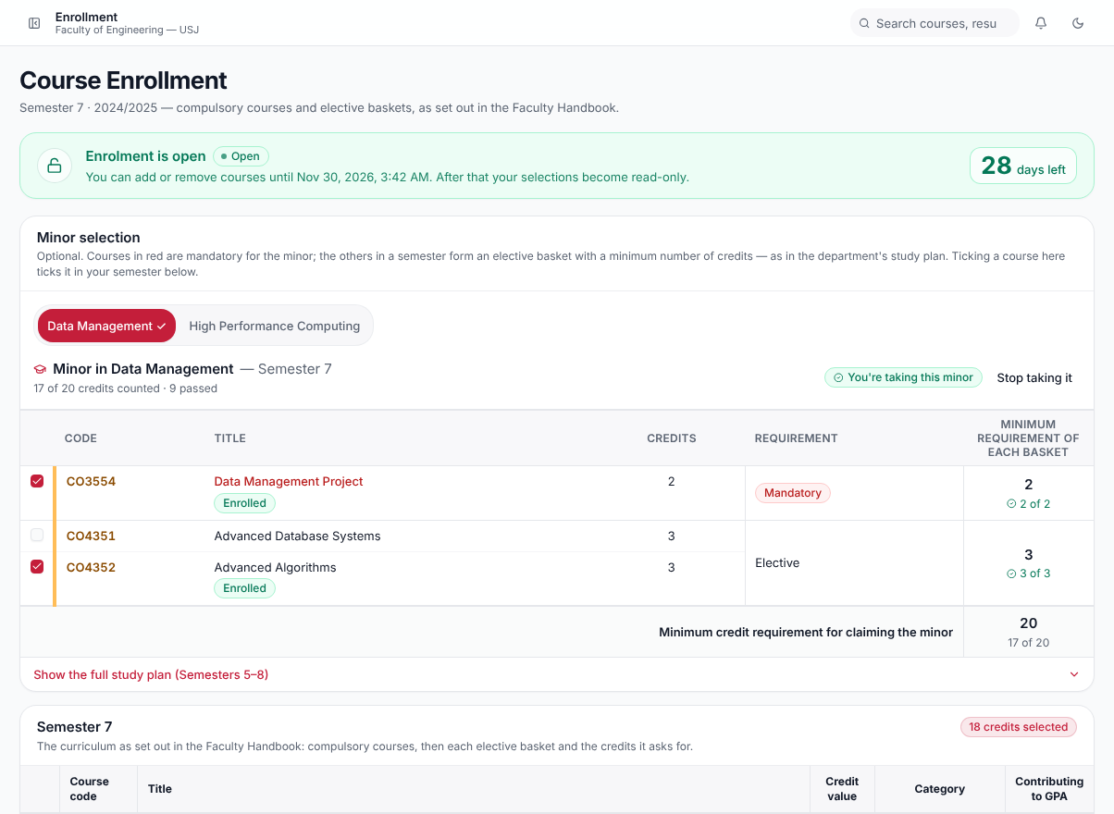



Enrolment follows the Faculty Handbook, basket by basket
05
ENROLMENT AND COURSES
The Handbook's own table
Compulsory courses and each elective basket, with the credits it asks for
Repeats handled by the rules
R and F repeats capped at C, a repeat counted once
Minors as published
Each department's minor study plan, and the student's progress in it
Windows set by the office
Opened, extended and closed by the faculty office
Notes:
[about 0:45] Enrolment follows the Faculty Handbook. A student sees the semester exactly as the Handbook prints it: the compulsory courses and each elective basket with the credits it asks for. Repeats follow the rules, so an R or F repeat is capped at C and counted once. Minors follow each department's published study plan. And the enrolment windows are opened, extended and closed by the faculty office.

Slide 7
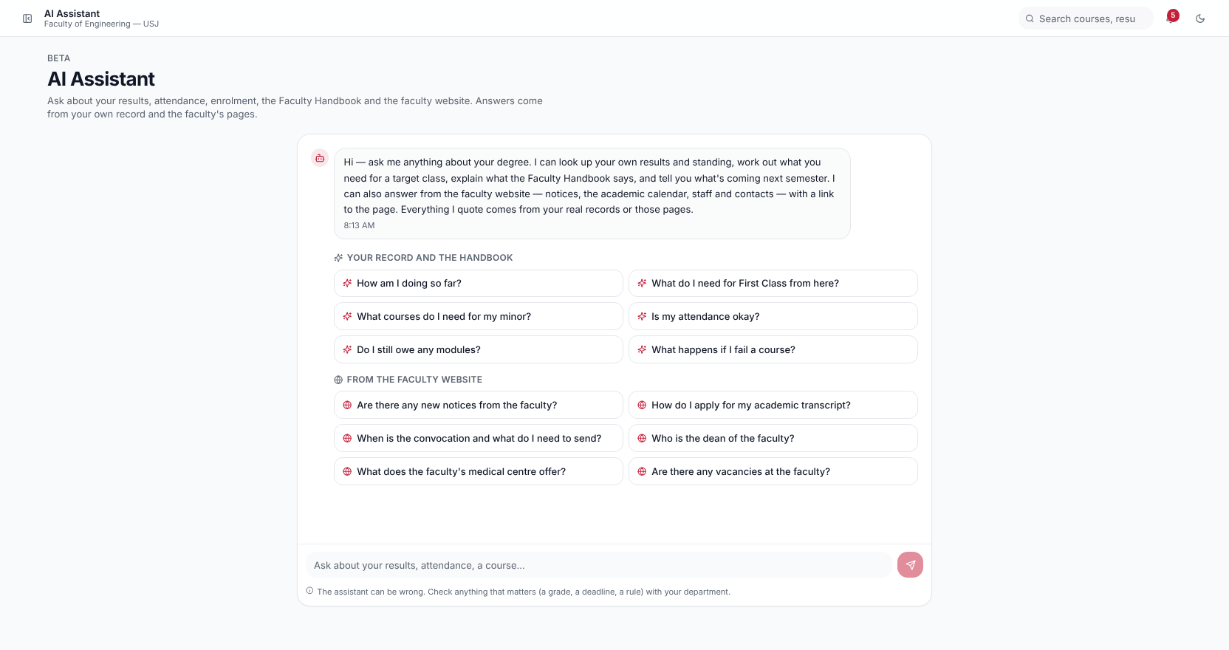




An AI assistant that answers from the student's real record
06
AI ASSISTANT
Plain questions, real answers
“What do I need for First Class?” “Is my attendance okay?”
Three trusted sources
The student's own record, the Faculty Handbook and the faculty website
Only their own data
It cannot see another student, and it never guesses a number
Runs on a faculty computer
With Google Gemini as a fallback
Notes:
[about 1:00] Students can also ask questions in plain English. The assistant answers from three trusted sources: the student's own record, the Faculty Handbook and the faculty website. Every number it gives comes from the database; it is not allowed to guess, and it cannot see any other student's record. It can run on an ordinary faculty computer, so student data stays in the faculty, with Google Gemini as a fallback.

Slide 8
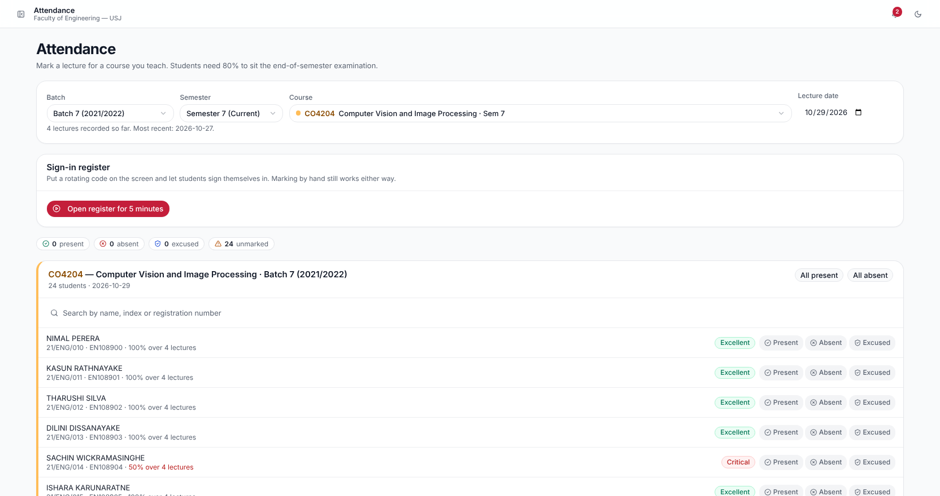


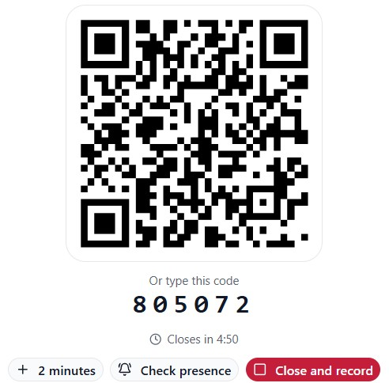


Attendance taken in minutes, with a rotating QR code
07
LIVE ATTENDANCE
Students scan a changing code
It changes every few seconds, so a photo sent to a friend is useless
The register fills itself
Live on the lecturer's screen; the office can still mark by hand
Proxy sign-ins flagged
A second model lists unusual sign-ins for the lecturer to check
Fair by design
It only lists; a person always decides
Notes:
[about 1:00] Lecturers take attendance with a QR code that changes every few seconds. Students scan it with their phones, and the register fills itself live on the lecturer's screen; the department office can still mark it by hand. Because the code keeps changing, a photo sent to an absent friend is useless. A second machine-learning model looks for proxy sign-ins, such as a friend signing in for someone who is not there, and lists them with reasons for the lecturer to check. It never marks anyone absent; a person always decides.

Slide 9
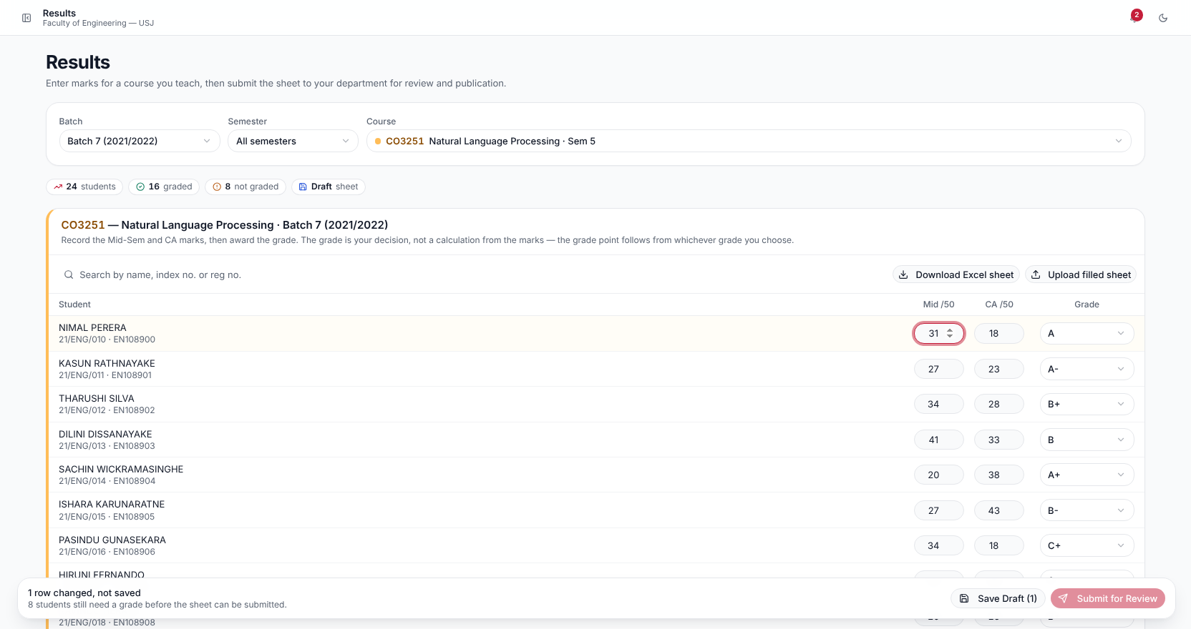
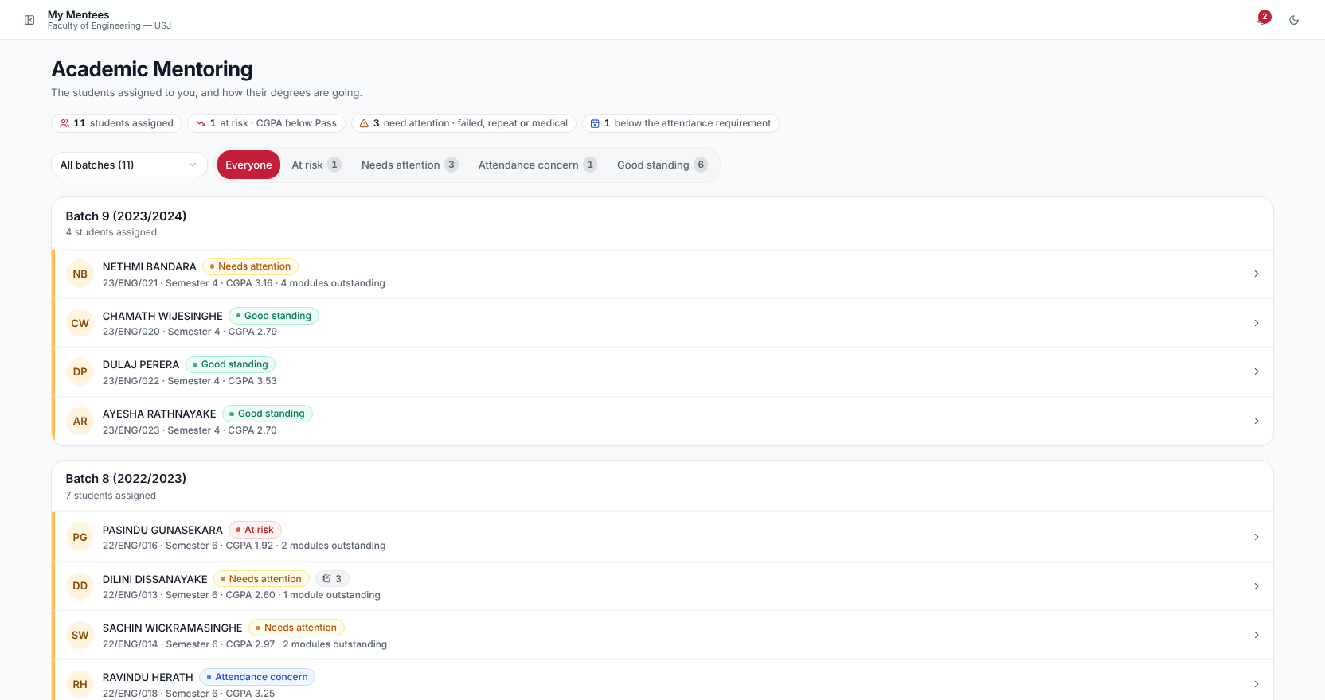
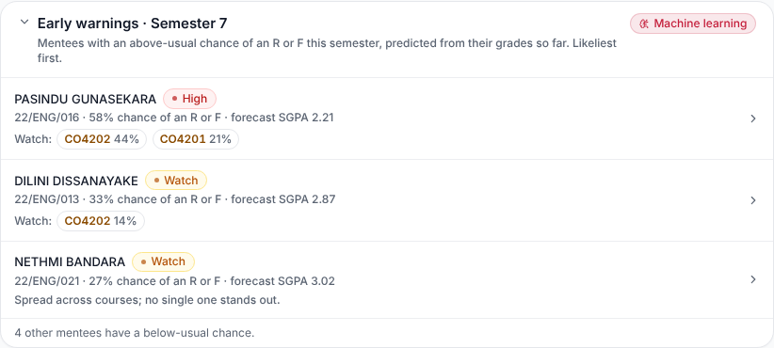
Results entered once, and struggling students noticed early
08
RESULTS AND MENTORING
Results Lecturers enter marks and grades; the database works out grade points, and students see results only after the department publishes them.
Mentoring Every student has a lecturer as mentor, with a private chat; early warnings list mentees likely to need help, likeliest first.
Notes:
[about 1:00] Results are entered once. Lecturers enter the marks and the grade the examiners awarded; the database works out the grade point; and students see a result only after the department publishes it. Every student also has a lecturer as a mentor, with a private chat. [Point to Early warnings] Using the grade forecast, the mentor gets an early-warning list of mentees likely to struggle, likeliest first, so they can talk to the student before the results, not after.

Slide 10

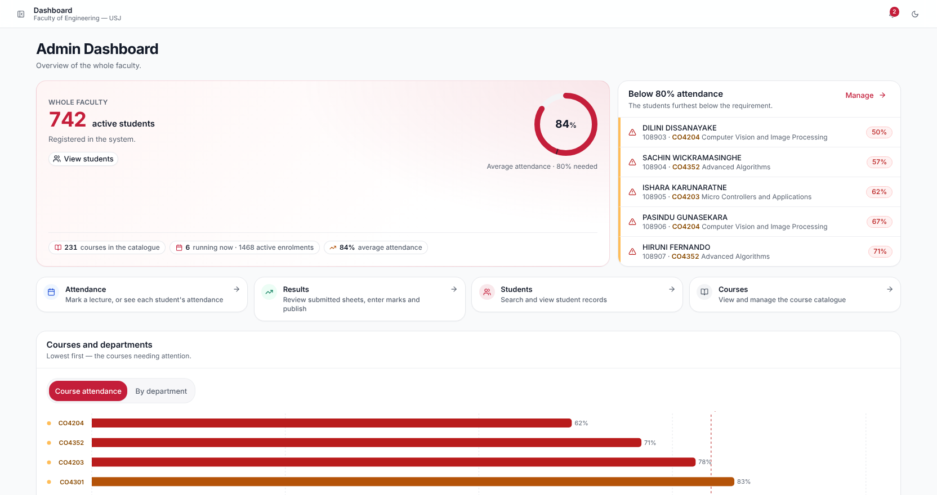



The whole faculty on one dashboard
09
FACULTY OFFICE AND HEADS
Faculty-wide picture
Attendance below 80%, courses and departments needing attention
Publish results
One step, and students are notified at once
Enrolment windows
Open, extend and close them for each batch
Batches and accounts
New intakes, staff invitations, heads of department
Notes:
[about 0:45] For the faculty office there is one dashboard for the whole faculty: who is below 80% attendance, and which courses and departments need attention. From here the office publishes results in one step, and students are notified at once; opens and extends enrolment windows; and brings in new batches, invites staff and sets heads of department. Heads of department get the same picture for their own department.

Slide 11






Each person sees only what they are allowed to see
10
SECURITY AND PRIVACY
Students see only themselves
Rules kept in the database
Results only when published
Not another student's results, attendance or messages.
Every one of the 54 tables is protected, whatever screen asks.
And course feedback stays anonymous.
Secure sign-in
Data can stay in the faculty
Built on the Handbook
Invitation links and password resets by email; accounts can be deactivated.
The AI assistant can run on a faculty computer.
The faculty's own rules, stored as data the faculty can change.
Notes:
[about 0:45] Because this is the faculty's academic record, it has to be safe. A student sees only their own record. The rules are kept inside the database itself, so every one of its 54 tables is protected whichever screen asks. Results stay hidden until the department publishes them, and course feedback is anonymous. Sign-in uses invitation links and password resets by email, and accounts can be deactivated. The assistant can run on a faculty computer, so data can stay in the faculty. And the faculty's own rules are stored as data, so they can be changed without new code.

Slide 12



Built and live; ready for a pilot with one batch
11
WHERE IT STANDS
DONE
NEXT
ASK
Built and live
Before the final evaluation
Support from the faculty
All three portals
User testing with a group of students
A pilot with one batch next semester
Live QR attendance
Examination registration
A faculty computer for the AI assistant
Results, enrolment, medicals, feedback
Release settings and the new design live
Agreement on data use and retention
Planner, AI assistant, two ML models
Final report
Staff accounts for the pilot
Notes:
[about 1:15] Where it stands: all three portals are built and live, with live QR attendance, results, enrolment, medical certificates, feedback, the planner, the assistant and two machine-learning models. Before my final evaluation I will test it with a group of students, add examination registration, restore the release settings, put the new design live and write the final report. [Point to the crimson column] To be used across the faculty, PES needs a little support: a pilot with one batch next semester, a faculty computer to run the AI assistant, an agreement on how the data may be used and kept, and staff accounts for the pilot.

Slide 13
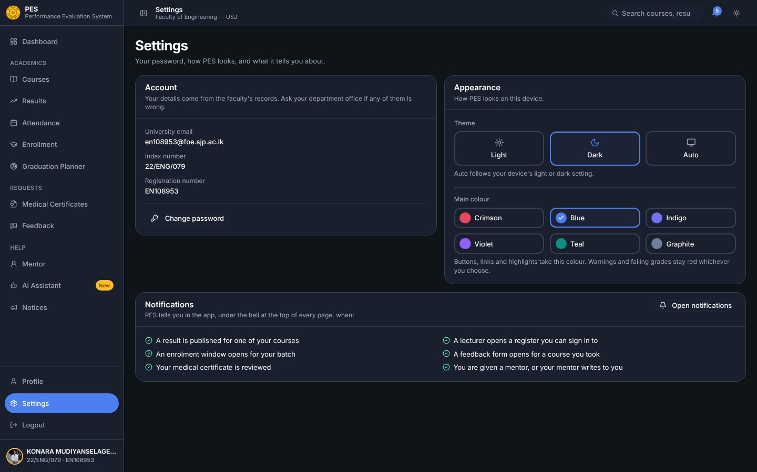
Thank you
I would be glad to show it live
K.M.L.N. Senadheera
22/ENG/079 · EN108953
Faculty of Engineering, University of Sri Jayewardenepura
PES in dark mode, with its six main colours to choose from
Notes:
[about 0:15] That is PES: built for our faculty, live today, and ready for a pilot. Thank you, sir. I would be glad to show it live or answer any questions.

