Slide 1


Family Treee
Team Member :
Nishanth S
Senadhian G
Senatmil C
Vijayasri S
Vishalni M

Slide 2
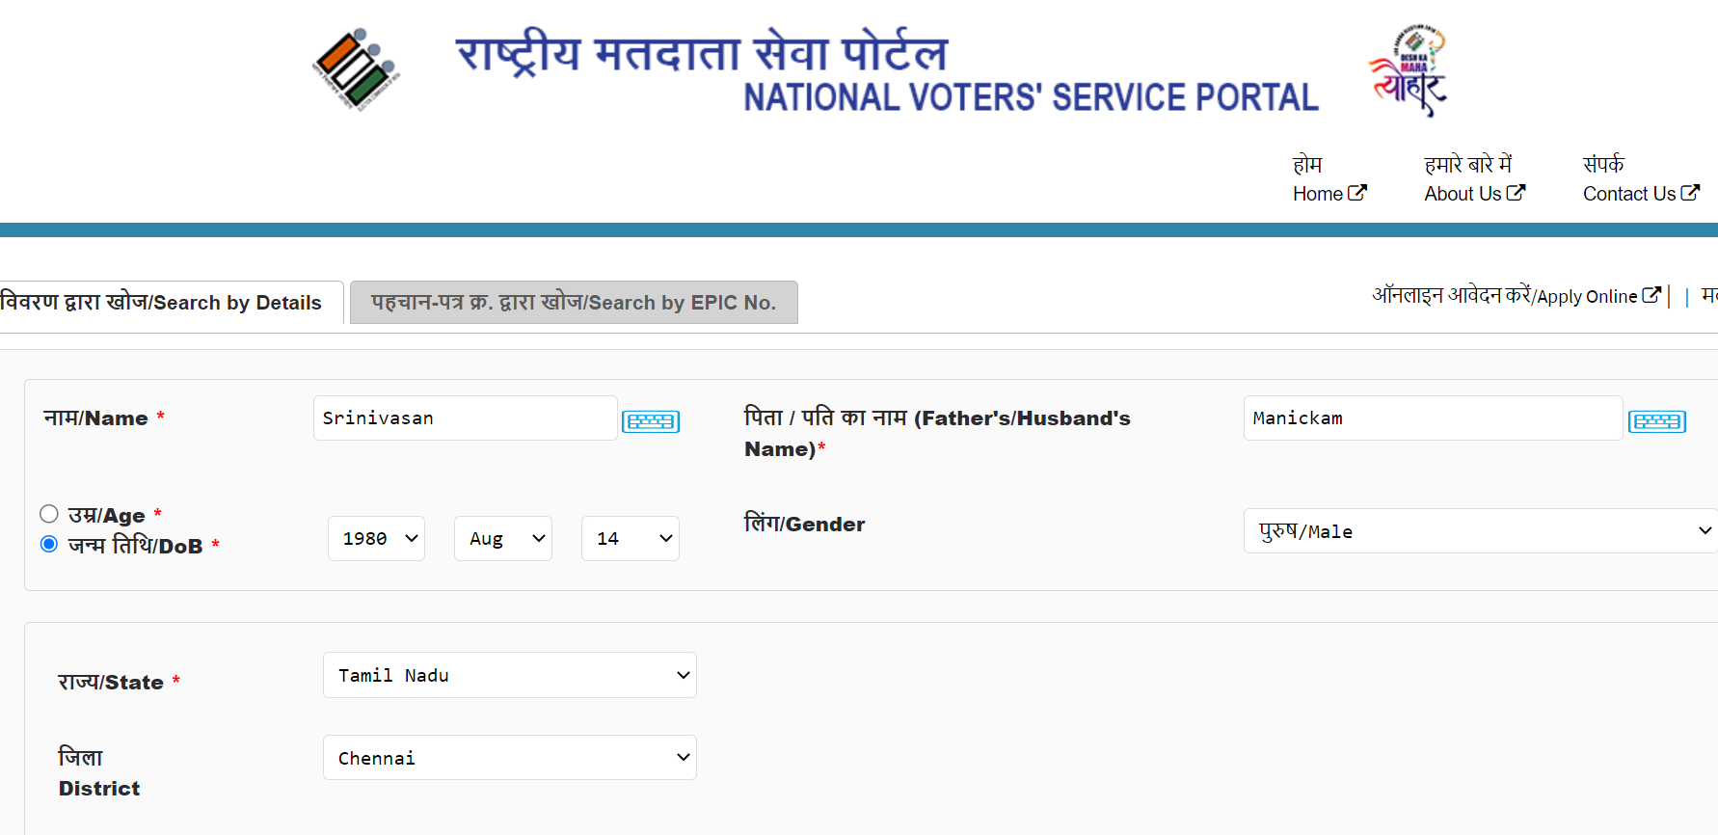
Input
{ “name”: “shyam Murugan”, “age”: 21 }
Output
{ “persons”: [ { “name”: “abcd efgh”, “relation”: “self” }, {“name”: “xyz ”, “relation”: “parent”}, {“name”: “blee “, “relation”: “parent”}]}

Slide 3
https://www.elections.tn.gov.in/DRAFTROLL_09112022/dt2/ac016/ac016001.pdf

Slide 4
