Slide 1
AI-Based VR Meditation System
Sri Lanka Institute of Information Technology
Group R26-DS-006

Slide 2




Group Members
Perera W.T.S.R
IT22231314
Preference-Aware Adaptive VR Relaxation Engine
Perera B.D.P.D.
IT22191038
Cosinor-Enhanced Multi-level Stress Inference from Wearable RR Intervals
Samarasekara K.S.M
IT22172396
Preference-Aware Adaptive VR Relaxation Engine
S. Prathikesh
IT22621788
Preference-Aware Adaptive VR Relaxation Engine
Perera W.T.S.R
IT22231314
Preference-Aware Adaptive VR Relaxation Engine

Slide 3
Comments | How we addressed them
VR Component How do you plan to evaluate your agent? | The key demonstration is how the VR environment responds to real-time stress predictions. Previously, a pre-recorded stress sequence could be replayed at accelerated speed to show different responses within a short demo. Now, the system is being demonstrated using real-time physiological data, with the agent responding directly to the user’s current stress state. The same processing and decision-making pipeline is used for both real-time and recorded inputs.
Stress classifier component Improve scope and analytical depth | Expanded from simple stress model development to a mechanism-focused analytical investigation. Analysed the contributions of time, baseline (MESOR), and physiological deviation/residuals. Investigated circadian validity, temporal coverage, and different baseline timescales. Added ordinal error analysis, cross-dataset validation, architecture experiments, and statistical validation. Investigated personalisation and self-calibration for practical deployment.
Audio controller component Explain design and rewards | Improved the explanation and formalisation of the system design. Clearly defined the State → Action → Reward → Learning Objective framework. Explained how system actions are selected based on the user's current condition. Defined rewards based on improvement, relaxation, stability, and appropriate adaptation. Prepared a clearer explanation of the overall decision-making process.
Voice-Based Stress Assessment component Proper comparison of studies | Developed a more structured comparison of existing studies. Compare studies based on datasets, sensors, methods, AI techniques, real-time capability, and adaptivity. Organised previous research to clearly identify limitations and research gaps. Added a comparison between existing approaches and the proposed system.

Slide 4
The problem
Every meditation app on the market is static. It plays the same scene, the same sounds, at the same pace — whether the user is calm or panicking, and it has no idea which.
Low long-term engagement
4.7%
Users
People who want guided relaxation that responds to them, specially University Students
median Day-30 retention for
mindfulness / meditation apps
Pain point
A system that cannot sense the user cannot adapt to them
≈ 95.3% not retained by Day 30

Slide 5
Research gap and objectives
1
Sensing
2
Adaptation
3
Validation
HRV stress models are evaluated offline, on complete recordings, using data a live system never has — and wrist sensors give no measure of how far a reading can be trusted.
Adaptive VR systems assume one optimal policy for every user and play fixed soundscapes. Preferences are pluralistic and divergent.
Session success is judged by questionnaire, or from the very signal that drove the adaptation — so it is assumed rather than shown.
OBJECTIVES
Continuous Sensing – Capture and reliably stream wearable heart-rate data with quality estimation.
Real-Time Stress Inference – Classify four stress levels from HRV with confidence scores.
Adaptive Visual Environment – Personalise VR visuals using reinforcement learning based on stress.
Adaptive Audio Environment – Personalise ambient and meditation audio throughout the session.
Independent Session Validation – Validate stress reduction using voice-based stress analysis.
System Integration – Integrate all components into a unified closed-loop system.
Main Objective
Develop and evaluate an AI-driven adaptive VR meditation system for real-time stress reduction.
≈ 95.3% not retained by Day 30

Slide 6
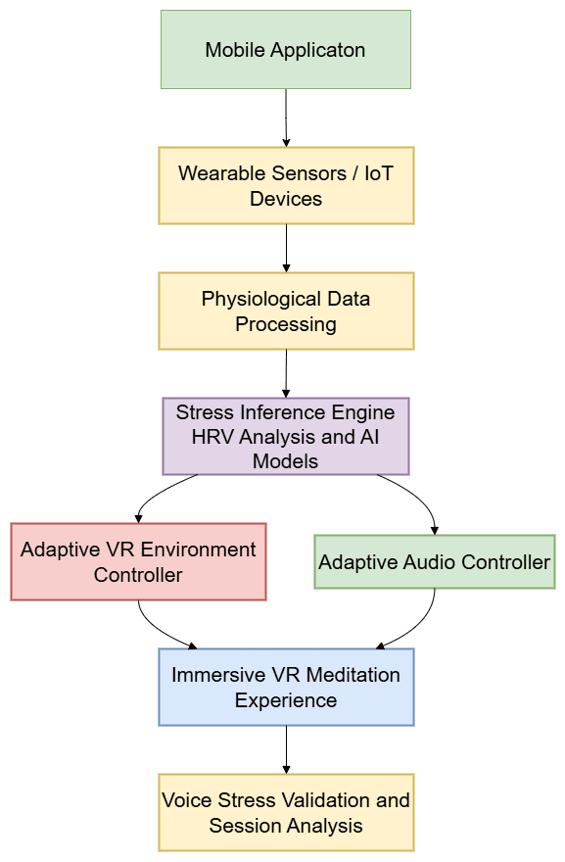
Proposed Solution
Physiological Data Acquisition – collects physiological signals from wearable sensors such as HRV and heart rate.
Stress Inference Engine – analyzes HRV features and temporal patterns to classify the user’s stress level.
Adaptive Environment Controller – dynamically adjusts meditation visuals and ambience based on detected stress.
Adaptive Audio Controller – modifies soundscape and meditation audio to enhance relaxation.
Session Validation Module – evaluates meditation effectiveness using voice-based stress analysis and system feedback.

Slide 7
Integration and completion
Component
Planned
Status today
Wearable + app (common)
HR streaming + signal quality
Complete
Stress inference
4-level live classification
Complete
Visual RL agent
2 scenes, RL over fog / light / colour
Complete
Audio RL agent
Ambient vs. generated music
Complete
Voice + validation
Pre/post speech, cross-modal, anomaly
Complete
End-to-end loop
Sensor → headset → report
Complete

Slide 8
Evaluation evidence
Cosinor-Enhanced Multi-level Stress Inference from Wearable RR Intervals
Model | Quadratic κ
Bidirectional two-way ensemble | 0.790
MS-CGCA three-way (+ personalisation) | 0.777
MS-CGCA two-way (deployed) | 0.776
XGBoost alone | 0.723
Deployed Model
MS-CGCA two-way
Why?
The three-way ensemble's extra personalisation member added only +0.0066 macro-F1 at Wilcoxon p = 0.625 which is indistinguishable from seed noise, while requiring per-subject calibration buffers, runtime fine-tuning and a third artifact, so the two-way ships.

Slide 9
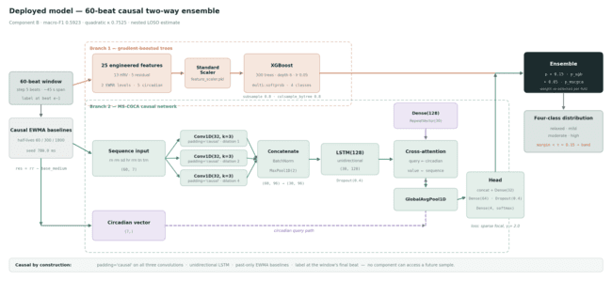

Slide 10
Evaluation evidence
Cosinor-Enhanced Multi-level Stress Inference from Wearable RR Intervals
Model / Approach | Evaluation Setting | Accuracy / F1 | Key Finding
wav2vec2 | PP1 | 60.9% | Weak stress detection
Hand-crafted Audio Features | PP1 | 70.8% | Moderate performance
emotion2vec | PP1 | 84.7% | Best encoder
PP2 Fusion Model | Internal Test | F1 = 0.92 | Learned emotion → stress mapping
Best Lab Model | Real Voices | 38% | Poor real-world generalisation
Final Valence-Based Model | Real Voices | 91.7% | Best real-voice performance
fusion_meld_baseline
Deployed Model
Encoder: emotion2vec
Input: Voice/audio recording (~30 seconds)
Approach: Valence-based stress estimation
Languages validated: English and Sinhala
Real-voice accuracy: 91.7%
Role: Compares pre-VR vs. post-VR voice stress to estimate whether the VR meditation session reduced stress.

Slide 11
Commercialization and demo
1
Who buys
Digital wellness platforms and corporate wellbeing programmes that need engagement past week one.
2
Why they adopt
A new user is productive in 45 seconds, not after days of baselining — and the system reports its own uncertainty, so it never adapts confidently to a guess.
3
How it ships
API and SDK. The backend already runs as a WebSocket service, so the delivery form matches the architecture.

Slide 12
Thank You

