Slide 1
CSIS 4495 · MIDTERM PROGRESS & IMPLEMENTATION
3D FORGE
AI-assisted 3D model generation and spatial editing, in the browser.
Mikhail Senatorov & Javid Aliyev June 27, 2026
Instructor: Michael Ma

Slide 2
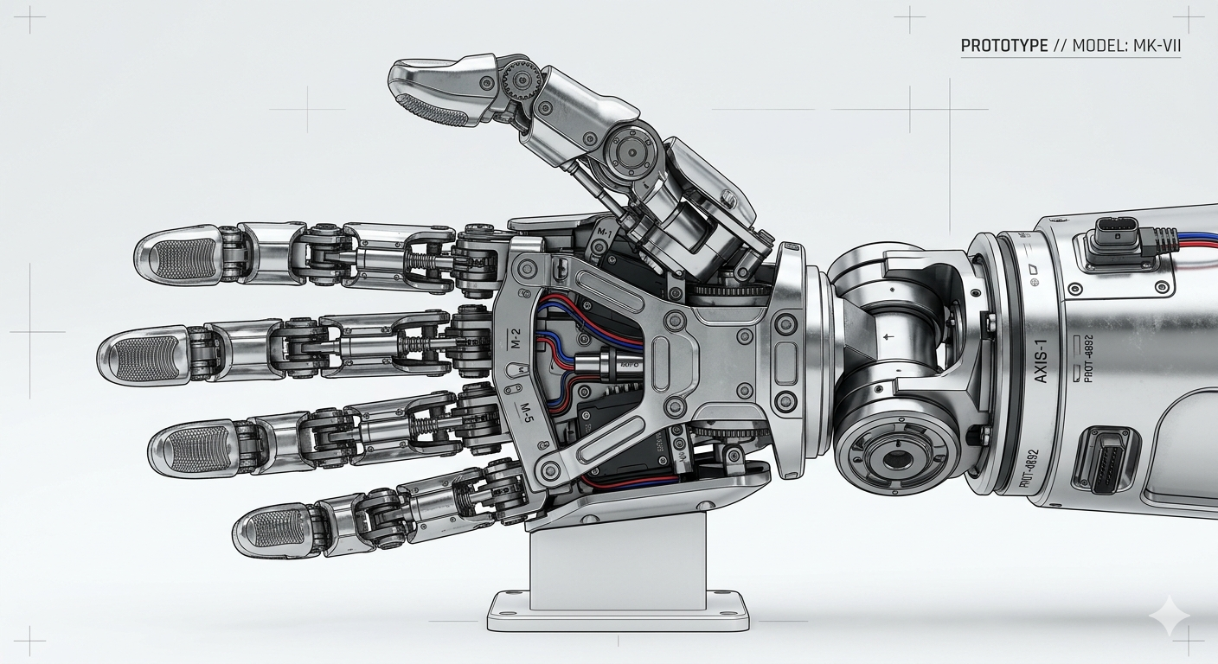
WHAT WE ARE BUILDING
Make 3D models by pointing and talking
Generate a 3D model from a text prompt, then click the exact part you want to change and describe the edit in plain language.
No 3D-modelling skills required. It grew into a small community platform where people publish, like, comment and follow.
Our base model — the same mesh users remix in the gallery.
Generate
Edit by region
Share & follow
3D FORGE · Midterm Progress
2

Slide 3
OVERALL PROJECT PROGRESS
Where we are now
DONE
NOW
NEXT
Foundation
In progress
Planned
Text-to-3D viewer + region select
Spatial Prompt Engine
Accounts & community platform
Real Meshy generation (M5 / M6)
Per-point spatial prompts
Voice-to-prompt in the browser
Edit / delete, follow, notifications
Model previews on cards
Image-first step (cheap iteration)
Real same-model 3D editing
Compare multiple gen APIs
Live deployment with keys
3D FORGE · Midterm Progress
3

Slide 4
SYSTEM ARCHITECTURE
How the pieces fit together
Meshy API
Browser — Client
Server — Express API
text-to-3D (M5 / M6)
React + Vite (SPA)
Three.js 3D viewer
Click-to-select points
Web Speech (voice)
Auth (JWT + bcrypt)
Posts / likes / comments
Follows / notifications
Spatial Prompt Engine
Claude API
prompt refinement
MongoDB / mock store
data (file-persisted)
Runs fully key-free in “mock mode” — no database or API keys needed to demo. Add keys to go live.
3D FORGE · Midterm Progress
4

Slide 5
TECH STACK
Technologies we use
Frontend
React · Vite · Three.js · React Router · Web Speech API
Backend
Node.js · Express · Mongoose · JWT · bcrypt
AI & external
Meshy (text-to-3D) · Anthropic Claude (prompt refinement)
Tooling & build
Plain JS (ESM) · node --test · GitHub Actions · Claude Code
3D FORGE · Midterm Progress
5

Slide 6
THE PRODUCT — THREE STEPS
Image → Model → Edit
1
Image
2
Model
3
Edit
→
→
Generate a reference image first
Text-to-3D via Meshy (M5 / M6)
Change it with spatial prompts
Sharper 3D, saves credits, cheap to iterate
Working on the site today
Points + prompts ready; editing is next
PLANNED
WORKING
IN PROGRESS

Slide 7
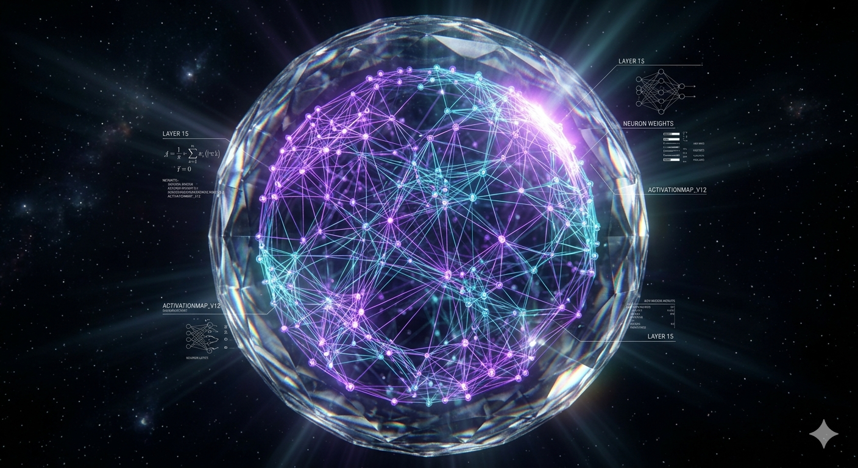
STEP 1 — IMAGE
Start from an image (planned)
Before paying for a full 3D generation, the user generates a reference image. It's cheap, fast, and easy to iterate on.
Sharper results
A clear image guides the 3D model and raises fidelity.
Saves tokens & credits
Iterate on a cheap image, not an expensive 3D mesh.
Edit before you commit
Today every model starts from text — the image step is the next upgrade.
Lock the look first, then build the heavy 3D once.
PLANNED
3D FORGE · Midterm Progress
7

Slide 8


STEP 2 — MODEL GENERATION
Text-to-3D with the Meshy API
Working today. A prompt becomes a real GLB model you can spin in the browser.
Two quality tiers — M5 — fast & cheap (~5 credits) · M6 — prettier (~20)
Daily cost guard — Caps real generations per day; mock mode is unlimited
Mock mode — Full demo with no API key — a stub generator stands in
Asset proxy — Server streams Meshy GLBs (browser CORS workaround)
WORKING
3D FORGE · Midterm Progress
8

Slide 9
STEP 3 — SPATIAL EDITING
Edit by pointing: the Spatial Prompt
Click a spot on the mesh, type what to change there. We turn click + region + your words into one grounded instruction.
point (x, y, z) + region “index finger” + “make it longer”
→ one structured prompt, refined by Claude, sent to the generator
✓ Click-to-select points on the model
The hand: click a finger, describe the change.
✓ A separate prompt per point (numbered)
✓ Spatial vs. plain comparison + rating
IN PROGRESS
3D FORGE · Midterm Progress
9

Slide 10
CURRENT IMPLEMENTATION
What works right now
Forge tool
Accounts
Community gallery
Generate, upload, click points, per-point prompts, history, compare
Register / login (JWT + bcrypt), profiles with avatars
Publish, Explore feed, search + tags, model thumbnails
Social
Post pages
Voice input
Likes, comments, follow / following, activity notifications
Rotating viewer, share link, present mode, edit / delete
Speak your prompt in the browser (Web Speech API)
3D FORGE · Midterm Progress
10

Slide 11
CHALLENGES & ISSUES
The hard parts
1
Spatial prompting
2
Meshy can't edit a mesh
Turning a 3D click + region + free text into one instruction a generator actually respects — the core research problem.
It's text-to-3D only: it re-generates the whole model and ignores our 3D points. Real same-model editing needs another path.
3
API integration
4
Voice in the browser
Async task polling, Meshy's CORS, credit costs — solved with a server proxy, a daily cost guard, and a key-free mock mode.
Web Speech API differs across browsers; wired it into both the generate box and the per-point editors.
3D FORGE · Midterm Progress
11

Slide 12
AI USAGE IN IMPLEMENTATION
AI in the product — and in how we built it
In the product
In how we built it
Meshy AI — text-to-3D generation (M5 / M6)
Anthropic Claude — refines the spatial prompt before generation
Web Speech API — voice-to-prompt input
Claude Code — AI pair-programming for features & tests
Code-review subagents check every branch before a PR
A GitHub @claude bot reviews each pull request
Branch → review → PR → merge, every change verified
3D FORGE · Midterm Progress
12

Slide 13
LIVE DEMO
Let's open the app
Home & the community gallery (real model thumbnails)
The Forge — generate, click points, write per-point prompts, voice input
A post page — likes, comments, follow, edit / delete
All running key-free in mock mode

Slide 14
NEXT STEPS
What's next
1
Image-first generation
Add Step 1 so users iterate on a cheap image before the 3D build.
2
Real same-model editing
Retexture for colour + local Three.js geometry edits, since Meshy can't.
3
Compare generators
Plug in other 3D APIs side-by-side to compare quality & cost.
4
Go live
Real Meshy + MongoDB Atlas keys, then deploy for the final demo.
3D FORGE · Midterm Progress
14

Slide 15
Thank you
Questions & live demo
Mikhail Senatorov & Javid Aliyev github.com/SenatorBLOG/3D-Forge

