Slide 1
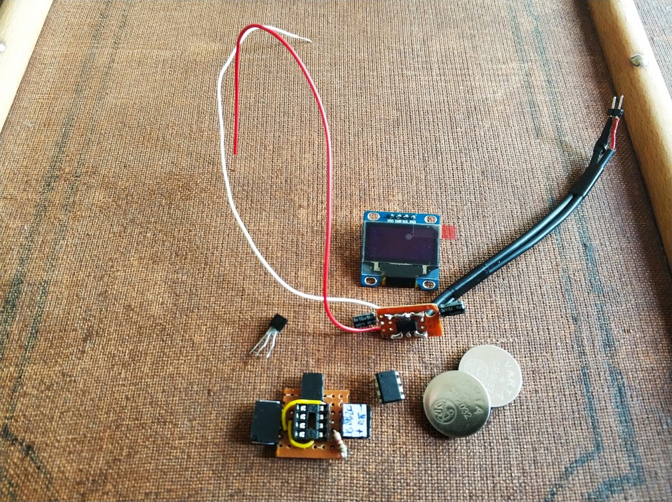
SSD1306
TS2940
DS18B20
ATTiny85
Circuit according to Wiring

