Slide 1
TankAlarm 112025 - Opta Setup Guide
Hardware Wiring & Software Installation

Slide 2
1. System Overview

Slide 3
What is TankAlarm 112025?
Cellular tank level monitoring system
Arduino Opta + Blues Wireless cellular connectivity
Client devices monitor tank levels
Server aggregates data and provides web dashboard
SMS and email alerts for alarms
No SD card required - uses internal flash storage
Remote configuration via web interface

Slide 4
System Components
Client Devices (Tank Monitors):
• Arduino Opta Lite
• Blues Wireless for Opta
• Arduino Opta Ext A0602 (analog expansion)
• Level sensors (analog/4-20mA)
Server Device (Data Aggregation):
• Arduino Opta Lite
• Blues Wireless for Opta
• Ethernet connection
• Web dashboard for monitoring & configuration

Slide 5
2. Hardware Requirements

Slide 6
Client Hardware
Required Components:
• Arduino Opta Lite ($95)
• Blues Wireless for Opta ($49)
• Arduino Pro Opta Ext A0602 ($56)
(Analog/4-20mA expansion module)
• USB-C cable for programming
• 24V DC power supply
• Tank level sensors (analog/digital/4-20mA)
Purchase Links:
• store-usa.arduino.cc/products/opta-lite
• shop.blues.com

Slide 7
Server Hardware
Required Components:
• Arduino Opta Lite ($95)
• Blues Wireless for Opta ($49)
• USB-C cable for programming
• Ethernet cable (RJ45)
• 12-24V DC power supply
Network Requirements:
• Access to local network (intranet)
• DHCP enabled (or configure static IP)
• Port 80 accessible for web dashboard

Slide 8
3. Arduino IDE Installation

Slide 9
Install Arduino IDE
Download Arduino IDE:
• Visit: arduino.cc/en/software
• Download Arduino IDE 2.0 or later
• Install for your OS (Windows/Mac/Linux)
• Launch Arduino IDE
First-time setup:
• Accept any firewall prompts
• IDE will download board indexes on first launch
• Wait for initialization to complete

Slide 10
Install Opta Board Support
Add Arduino Opta to IDE:
1. Open Tools → Board → Boards Manager
2. Search: 'Arduino Mbed OS Opta Boards'
3. Click Install (may take several minutes)
4. Wait for download and installation
Verify Installation:
• Tools → Board → Arduino Mbed OS Opta Boards
• You should see 'Arduino Opta' option
• If not visible, restart Arduino IDE

Slide 11
4. Required Libraries

Slide 12
Install Required Libraries
Open Library Manager:
• Tools → Manage Libraries
Install These Libraries:
1. ArduinoJson (v7.x or later)
Search: 'ArduinoJson'
Install: 'ArduinoJson by Benoit Blanchon'
2. Blues Wireless Notecard (latest)
Search: 'Notecard'
Install: 'Blues Wireless Notecard by Blues Inc.'
3. Built-in (no install needed):
• Ethernet, Wire, LittleFS

Slide 13
5. Blues Notehub Configuration

Slide 14
Create Blues Notehub Account
Sign up for Blues Notehub:
1. Visit: notehub.io
2. Click 'Sign Up' (free account available)
3. Verify email address
4. Log in to Notehub dashboard
Create a Product:
1. Click '+ New Product'
2. Name: 'TankAlarm System' (or your choice)
3. Note the Product UID
Format: com.company.product:project
4. You'll need this for device configuration

Slide 15
Create Device Fleets
Fleet-based communication setup:
Create Server Fleet:
1. Go to Fleets → Create Fleet
2. Name: 'tankalarm-server'
3. Description: 'Base station server'
Create Client Fleet:
1. Go to Fleets → Create Fleet
2. Name: 'tankalarm-clients'
3. Description: 'Field monitoring devices'
Benefits:
• No manual route configuration needed
• Automatic device-to-device messaging
• Easy to scale with more devices

Slide 16
Provision Notecards
Add Notecards to your Product:
For each device:
1. Power on the Arduino Opta with Notecard
2. In Notehub, go to Devices
3. The Notecard should appear automatically
4. Click 'Claim Device'
5. Assign to appropriate fleet:
• Server → 'tankalarm-server' fleet
• Clients → 'tankalarm-clients' fleet
Note the Device UID:
• Format: dev:xxxxxxxxxxxxxxxxxx
• You'll need this for configuration

Slide 17
6. Client Device Wiring

Slide 18
Client Wiring Overview
Connection Steps:
1. Install Blues Wireless for Opta on Opta Lite
2. Connect Opta Ext A0602 expansion module
3. Wire analog sensors to expansion inputs
4. Connect 24V DC power supply
Sensor Wiring Options:
• Analog voltage sensors (0-10V)
• 4-20mA current loop sensors
• Digital pulse sensors
Important:
• Do not exceed voltage ratings
• Verify sensor polarity
• Use shielded cable for long sensor runs

Slide 19
Analog Sensor Connections
Using Opta Ext A0602 Expansion:
For each tank sensor:
1. Connect sensor signal to input terminal
• Channel 0-7 (up to 8 sensors)
2. Connect sensor ground to GND
3. Provide sensor excitation voltage if needed
Configuration:
• Set sensor type in web interface
• Configure input pin mapping
• Set calibration values
Supported Sensor Types:
• Analog voltage (ratiometric)
• 4-20mA current loop
• Ultrasonic level sensors

Slide 20
7. Server Device Wiring

Slide 21
Server Wiring Overview
Connection Steps:
1. Install Blues Wireless for Opta on Opta Lite
2. Connect Ethernet cable to RJ45 port
3. Connect 12-24V DC power supply
4. No sensor expansion needed for server
Network Connection:
• Connect to local network switch/router
• DHCP will assign IP address
• Or configure static IP in code
Power Requirements:
• 12-24V DC, 1A minimum
• Use industrial-grade power supply
• Consider UPS for critical installations

Slide 22
8. Upload Client Firmware

Slide 23
Open Client Sketch
Load the client code:
1. Download/clone repository from GitHub
2. Navigate to folder:
TankAlarm-112025-Client-BluesOpta/
3. Open file:
TankAlarm-112025-Client-BluesOpta.ino
4. Arduino IDE will open the sketch
Configure Product UID:
1. Find this line near the top:
#define PRODUCT_UID
2. Replace with your Notehub Product UID
3. Format: "com.company.product:project"
4. Save the file (Ctrl+S)

Slide 24
Compile and Upload Client
Select Board:
1. Tools → Board → Arduino Mbed OS Opta Boards
2. Select 'Arduino Opta'
3. Tools → Port → Select Opta COM port
Compile:
1. Click Verify (✓) button
2. Wait for compilation
3. Check for errors in console
Upload:
1. Click Upload (→) button
2. Wait for upload to complete
3. Success: 'Upload complete' message
Typical memory usage: 60-80% flash, 40-60% RAM

Slide 25
Verify Client Operation
Open Serial Monitor:
1. Tools → Serial Monitor (Ctrl+Shift+M)
2. Set baud rate: 115200
3. Press Reset button on Opta
Expected Output:
• 'TankAlarm 112025 Client - Blues Opta'
• 'LittleFS initialized'
• 'Notecard UID: dev:xxxxx...'
• 'Configuration loaded from flash'
• Hardware requirements listed
• Initial sensor readings
If errors occur:
• Check library installation
• Verify board selection
• Check Notecard connection

Slide 26
9. Upload Server Firmware

Slide 27
Open Server Sketch
Load the server code:
1. Navigate to folder:
TankAlarm-112025-Server-BluesOpta/
2. Open file:
TankAlarm-112025-Server-BluesOpta.ino
3. Arduino IDE will open the sketch
Configure Product UID:
1. Find this line near the top:
#define SERVER_PRODUCT_UID
2. Replace with your Notehub Product UID
3. Must match client Product UID
4. Save the file (Ctrl+S)

Slide 28
Compile and Upload Server
Follow same steps as client:
1. Select Board: Arduino Opta
2. Select Port: Opta COM port
3. Click Verify (✓)
4. Click Upload (→)
Note:
• Server sketch is larger than client
• May use 70-85% flash memory
• This is normal and expected
After upload:
1. Disconnect USB (optional)
2. Connect Ethernet cable
3. Apply power (12-24V DC)

Slide 29
Verify Server Operation
Check Serial Monitor (if USB connected):
• 'TankAlarm 112025 Server - Blues Opta'
• 'LittleFS initialized'
• 'Notecard UID: dev:xxxxx...'
• 'Ethernet connected'
• 'IP address: xxx.xxx.xxx.xxx'
• 'Server listening on port 80'
Note the IP Address!
• You'll need this to access web dashboard
If no serial access:
• Check your router's DHCP client list
• Look for 'Arduino Opta' device
• Try common IP ranges: 192.168.1.x

Slide 30
10. Server Web Dashboard

Slide 31
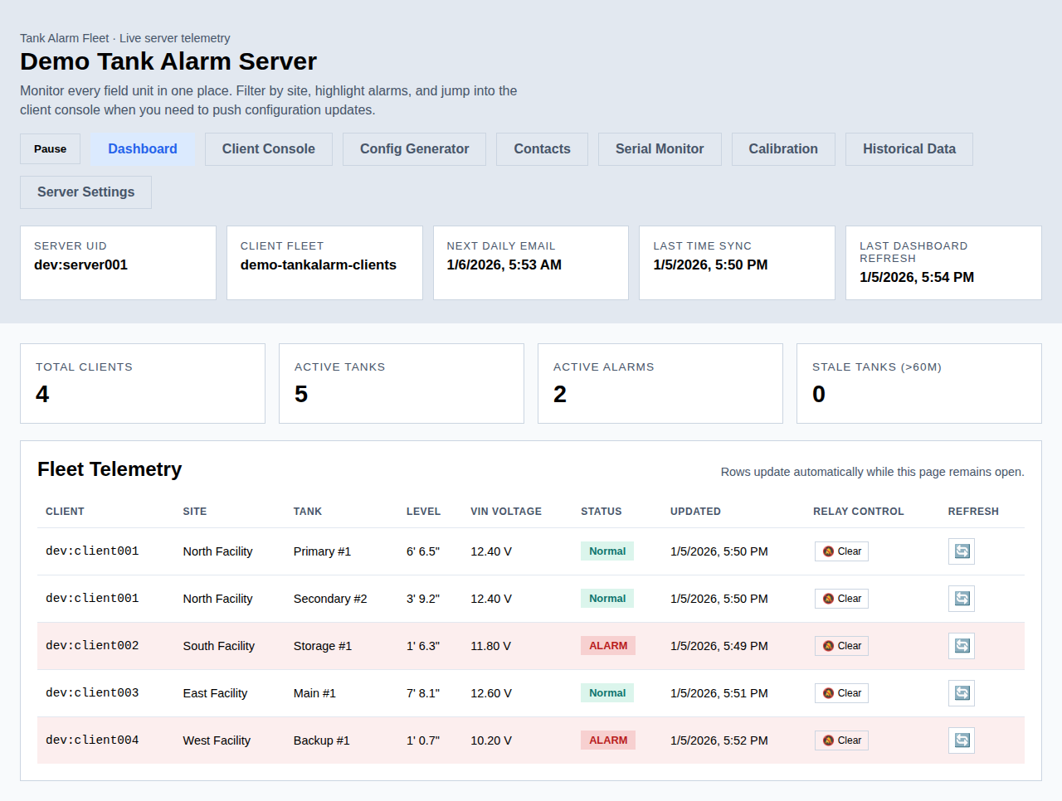
Server Dashboard - Overview
Real-time tank levels, alarm status, and last update times

Slide 32
Access the Web Dashboard
Open web browser on your network:
1. Enter server IP address:
http://192.168.1.xxx/
2. Dashboard should load immediately
Dashboard Features:
• Real-time tank level display
• Current alarm status
• Last update timestamp for each client
• Client configuration interface
• Server settings management
• Historical data view
Bookmark this page for easy access!

Slide 33
11. Adding Sensors & Alarms

Slide 34
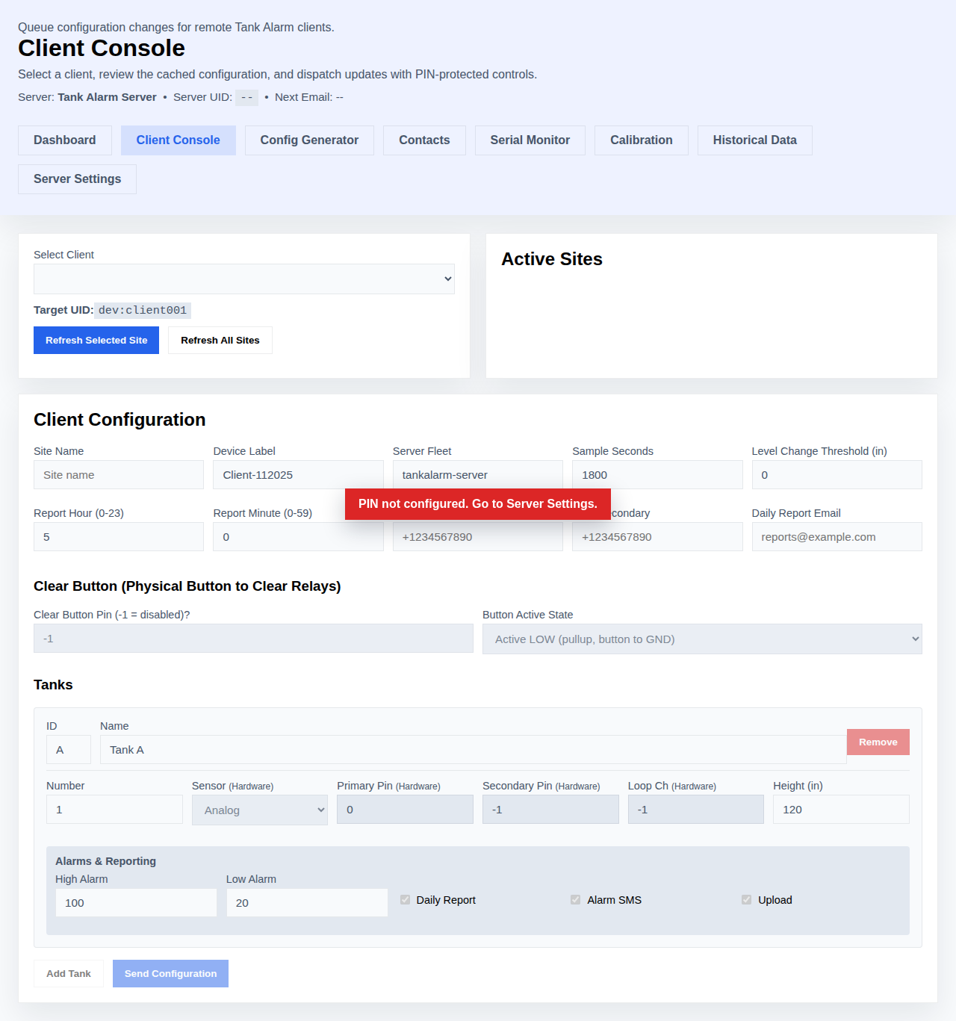
Client Configuration Console
Configure client devices through the web interface

Slide 35
Configure Client Devices
From the server dashboard:
1. Scroll to 'Update Client Config' section
2. Select client from dropdown menu
(auto-populated from received telemetry)
Client Information:
• Device UID shown
• Last contact time displayed
• Current configuration loaded
If client not in dropdown:
• Wait for first telemetry (30 min default)
• Verify fleet assignment in Notehub
• Check client serial console for errors

Slide 36
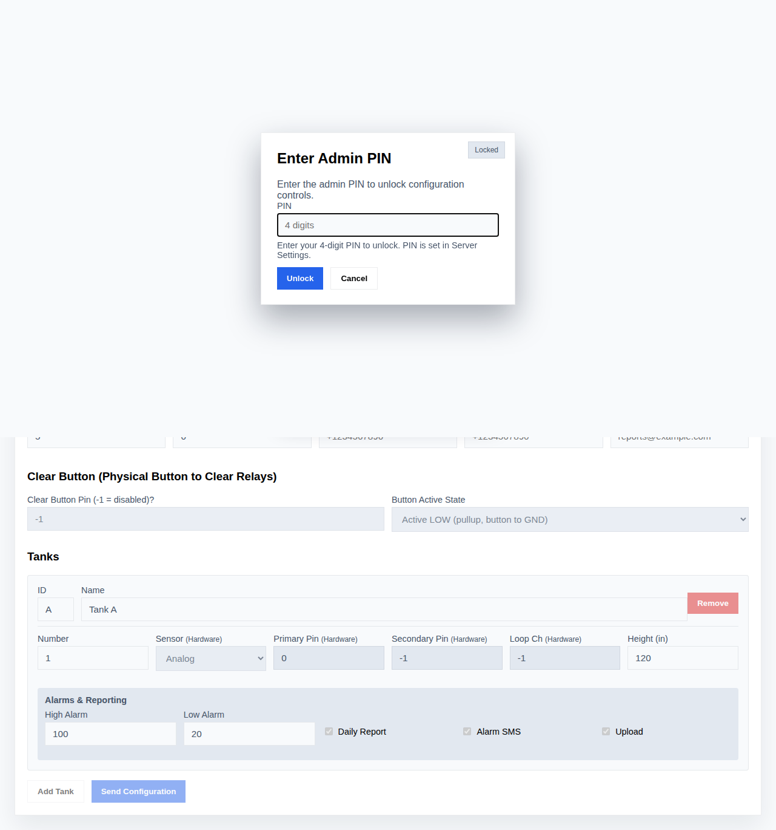
Sensor Pin Configuration
Set up sensor types and pin assignments for each tank

Slide 37
Add a New Tank Sensor
In client configuration form:
1. Basic Settings:
• Tank ID: A-H (single letter)
• Tank Name: Descriptive name
• Tank Number: 1-8
2. Sensor Configuration:
• Sensor Type: analog/digital/4-20mA
• Primary Pin: 0-7 (expansion channel)
• Secondary Pin: -1 (or redundant sensor)
• Loop Channel: -1 (or 4-20mA channel)
3. Tank Parameters:
• Height: Total tank height in inches
• High Alarm: Upper threshold in inches
• Low Alarm: Lower threshold in inches

Slide 38
Configure Alarm Settings
For each tank:
Enable Alarms:
☑ Daily Report - Include in daily summary
☑ Alarm SMS - Send SMS on alarm condition
☑ Upload - Include in telemetry
Alarm Behavior:
• High alarm triggers when level exceeds threshold
• Low alarm triggers when level drops below threshold
• SMS sent to server's contact list
• Alarm persists until condition clears
Testing:
• Set test thresholds initially
• Verify SMS delivery
• Adjust to actual operational thresholds

Slide 39
Send Configuration to Client
After configuring all settings:
1. Review configuration:
• Site name and device label
• Server fleet: 'tankalarm-server'
• Sample interval (seconds)
• All tank configurations
2. Click 'Send Config to Client' button
3. Server will:
• Create configuration note
• Send via Blues Notehub
• Target specific client device
4. Client will:
• Receive configuration
• Validate and apply settings
• Save to internal flash
• Report back via serial console

Slide 40
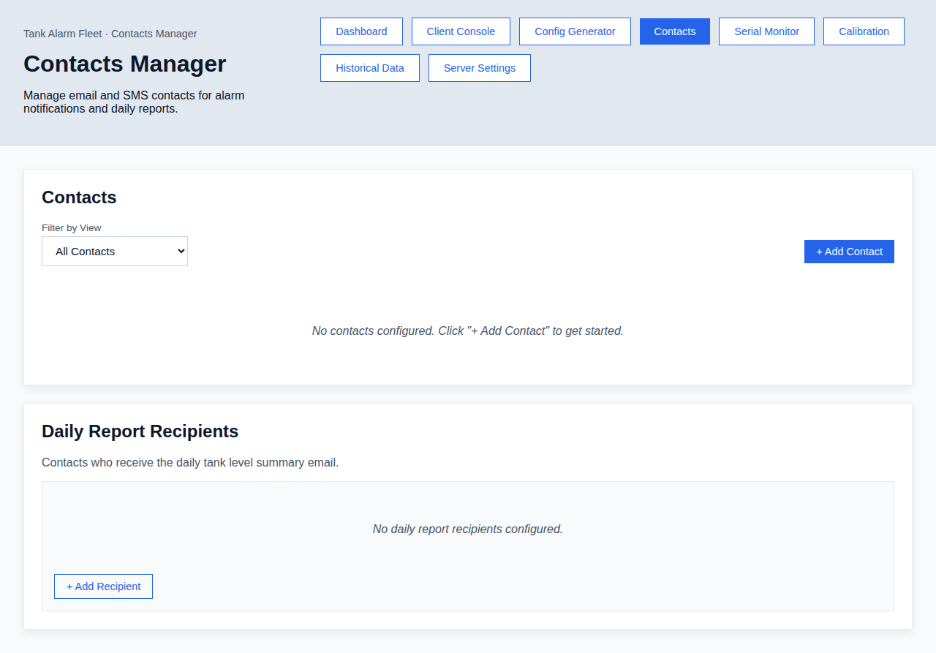
SMS Contact Management
Configure phone numbers for SMS alerts

Slide 41
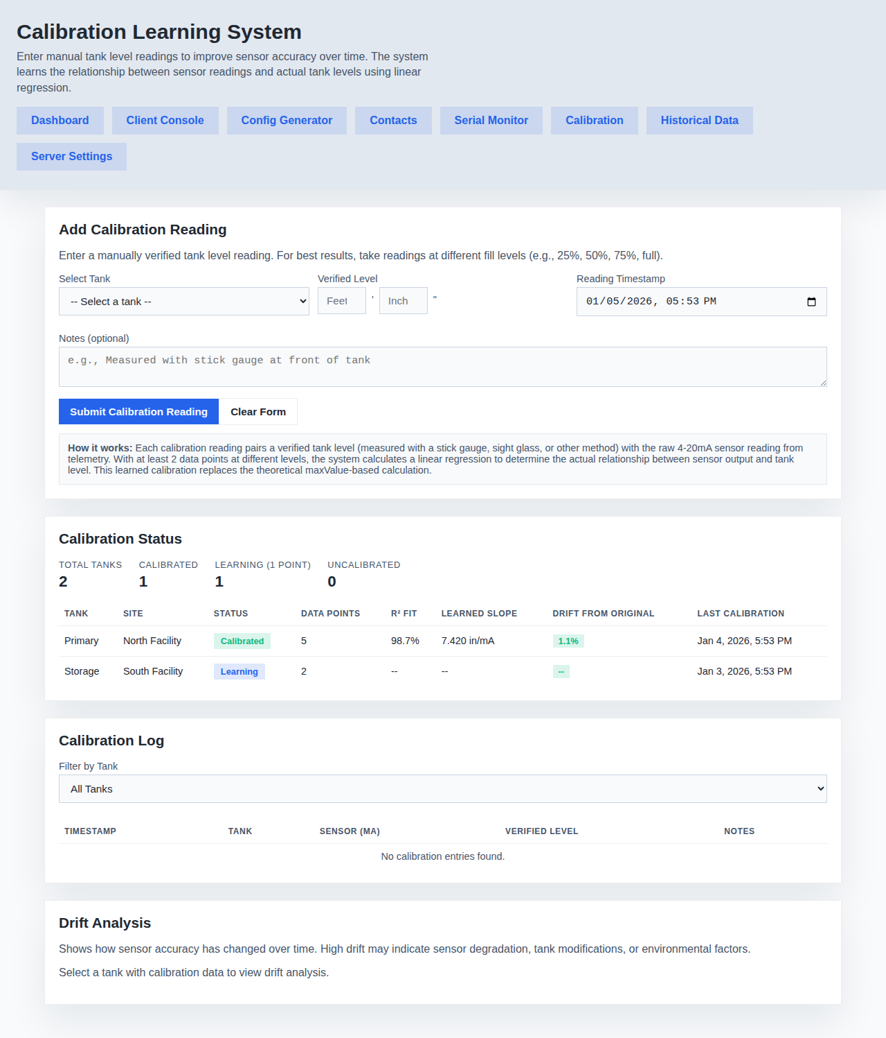
Sensor Calibration
Calibrate sensors for accurate level readings

Slide 42
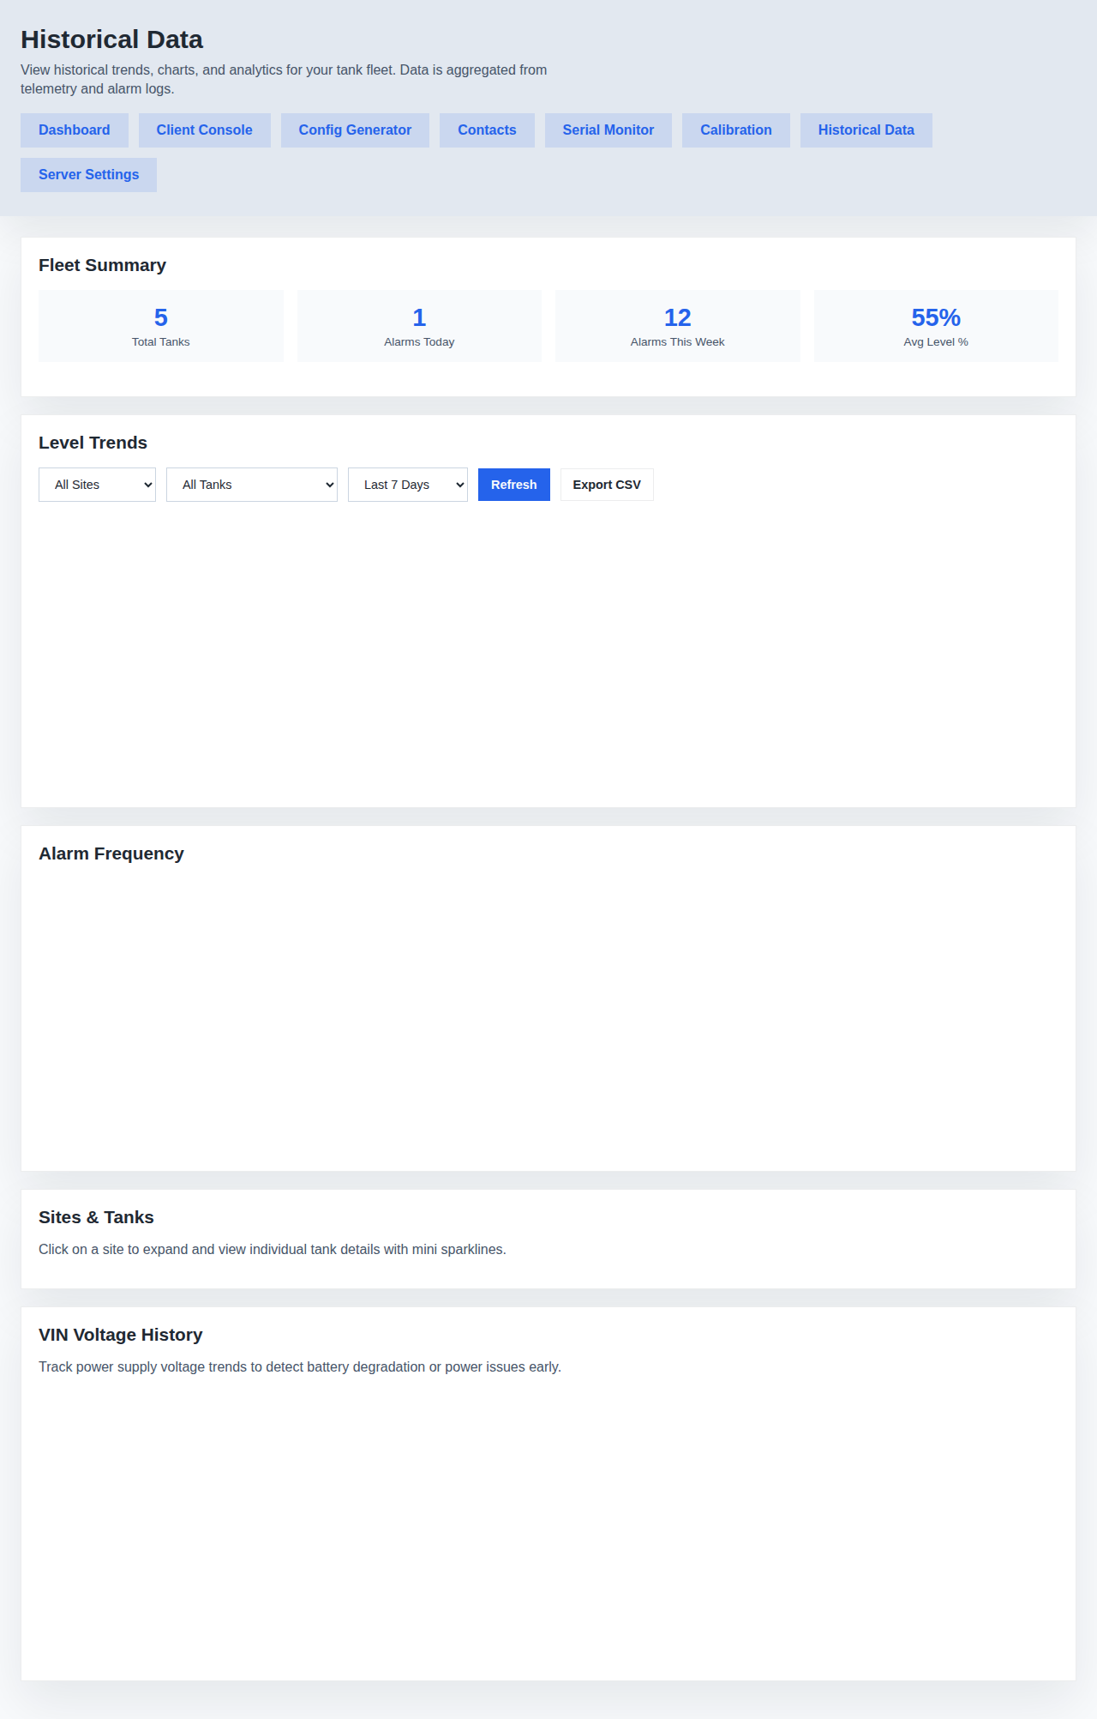
Historical Data View
View historical tank levels and trends

Slide 43
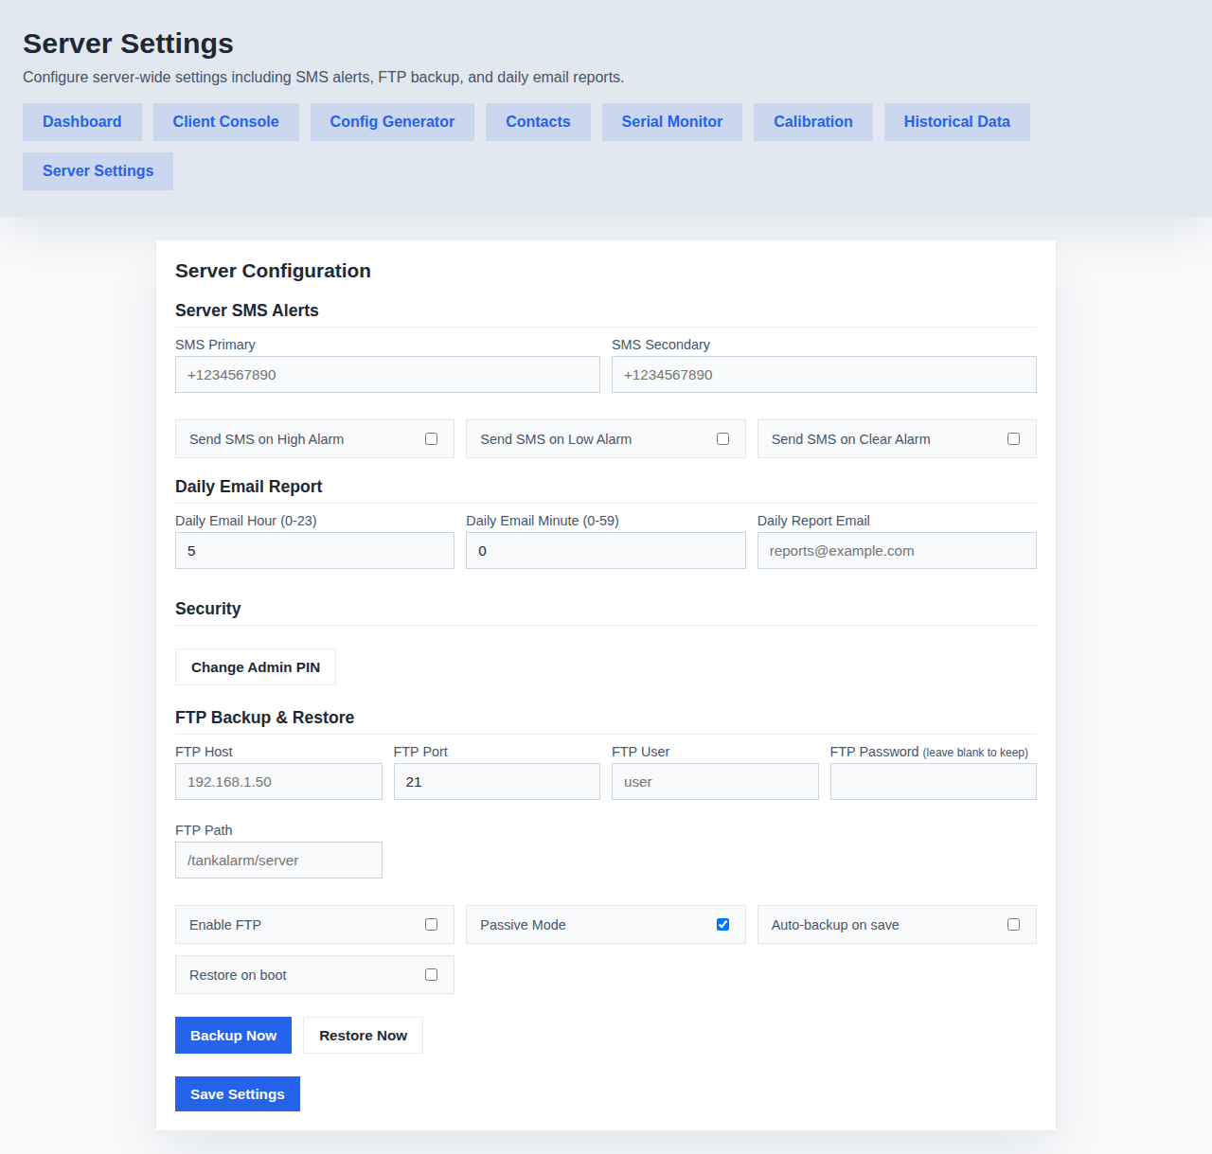
Server Settings
Configure server name, fleets, and daily report settings

Slide 44
12. Blues Notehub Device Management

Slide 45
Verify Devices in Notehub
Check device connectivity:
1. Log in to notehub.io
2. Select your Product
3. Go to Devices tab
You should see:
• All Notecards listed
• Status: Connected/Online
• Last activity timestamp
• Fleet assignments
For each device:
• Click device name to view details
• Check 'Fleets' section
• Verify correct fleet assignment
• Review recent activity in Events

Slide 46
Monitor Note Traffic
View communication between devices:
1. In Notehub, go to Events
2. Filter by device or note type
Client Notes (outbound to server):
• fleet.tankalarm-server:telemetry.qi
• fleet.tankalarm-server:alarm.qi
• fleet.tankalarm-server:daily.qi
Server Notes (outbound to clients):
• device:<uid>:config.qi
Healthy System Shows:
• Regular telemetry from clients
• Config updates when sent
• Recent timestamps (< 1 hour)

Slide 47
Troubleshooting Connectivity
If devices not communicating:
Check Fleet Assignments:
1. Devices → Select device
2. Verify fleet in 'Fleets' section
3. Reassign if incorrect
Verify Notecard Status:
1. Check for cellular signal
2. Review Events for errors
3. Check SIM card activation
Force Sync:
1. In Notehub, go to device
2. Click 'Sync Now'
3. Wait for sync to complete
Check Client Serial Console:
• Should show sync activity
• Look for Notecard errors

Slide 48
13. System Testing

Slide 49
Test Sensor Readings
Verify sensors are working:
1. Client Serial Console:
• Shows real-time sensor readings
• Values should be reasonable
• Check units (inches)
2. Server Dashboard:
• Wait for telemetry (sample interval)
• Tank levels should appear
• Timestamps should update
3. Calibration:
• Measure actual tank level
• Compare to displayed value
• Adjust calibration if needed
• Use calibration interface on server

Slide 50
Test Alarm Functionality
Verify alarms work correctly:
1. Set Test Threshold:
• Configure low alarm above current level
• Or high alarm below current level
• Send config to client
2. Wait for Alarm:
• Client detects alarm condition
• Sends alarm note to server
• Check server dashboard for alarm
3. Verify SMS (if configured):
• SMS should be sent
• Check received message content
• Verify phone numbers correct
4. Reset Thresholds:
• Set to actual operational values
• Send updated config

Slide 51
Test Daily Reports
Verify daily reporting:
1. Configure Report Time:
• Set time in server settings
• Usually early morning (5-7 AM)
2. For Testing:
• Set report time to near future
• Wait for scheduled time
3. Verify Report:
• Client sends daily note
• Server processes report
• Email sent (if configured)
4. Production:
• Set to desired daily time
• Monitor for first few days
• Adjust as needed

Slide 52
14. Ongoing Maintenance

Slide 53
Regular Monitoring
Daily tasks:
• Check dashboard for current levels
• Verify all clients reporting
• Review any active alarms
Weekly tasks:
• Review historical trends
• Check for missed reports
• Verify Blues Notehub connectivity
Monthly tasks:
• Review Blues data usage
• Check sensor calibration
• Test alarm SMS delivery
• Verify contact phone numbers current
Best Practices:
• Bookmark server dashboard
• Set up mobile access for alerts
• Document any configuration changes

Slide 54
Updating Configuration
To update client settings:
1. Access server web dashboard
2. Select client from dropdown
3. Modify desired settings:
• Tank parameters
• Alarm thresholds
• Sample interval
• Server fleet name
4. Click 'Send Config to Client'
5. Verify receipt in client console
Configuration is saved to:
• Client internal flash (persistent)
• Server internal flash (for reference)
Changes take effect:
• Immediately after client receives config
• No need to restart or recompile

Slide 55
Additional Resources
Documentation:
• GitHub Repository:
github.com/SenaxInc/ArduinoSMSTankAlarm
• Installation Guides:
- TankAlarm-112025-Client-BluesOpta/INSTALLATION.md
- TankAlarm-112025-Server-BluesOpta/INSTALLATION.md
• Fleet Setup Guide:
- TankAlarm-112025-Server-BluesOpta/FLEET_SETUP.md
External Resources:
• Arduino Opta: docs.arduino.cc/hardware/opta
• Blues Wireless: dev.blues.io
• Blues Notehub: notehub.io
Support:
• GitHub Issues
• Blues Wireless Forums

