Slide 1
Introduction in Computer Networks

Slide 2
Networking
Computer network A collection of computing devices that are connected in various ways in order to communicate and share resources
Usually, the connections between computers in a network are made using physical wires or cables
  However, some connections are wireless, using radio waves or infrared signals
15-<number>

Slide 3
Networking
The generic term node or host refers to any device on a network
Data transfer rate The speed with which data is moved from one place on a network to another
Data transfer rate is a key issue in computer networks
15-<number>

Slide 4
How many kinds of Networks?
Depending on one’s perspective, we can classify networks in different ways
  Based on transmission media: Wired (UTP, coaxial cables, fiber-optic cables) and Wireless
  Based on network size: LAN and WAN (and MAN)
  Based on management method: Peer-to-peer and Client/Server
  Based on topology (connectivity): Bus, Star, Ring …
15-<number>

Slide 5
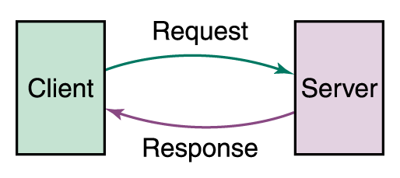
Networking
Computer networks have opened up an entire frontier in the world of computing called the client/server model
Figure 15.1 Client/Server interaction
15-<number>

Slide 6
Networking
File server A computer that stores and manages files for multiple users on a network
Web server A computer dedicated to responding to requests (from the browser client) for web pages
15-<number>

Slide 7
Types of Networks
Local-area network (LAN) A network that connects a relatively small number of machines in a relatively close geographical area
15-<number>

Slide 8
Types of Networks
Wide-area network (WAN) A network that connects two or more local-area networks over a potentially large geographic distance
  Often one particular node on a LAN is set up to serve as a gateway to handle all communication going between that LAN and other networks
Communication between networks is called internetworking
  The Internet, as we know it today, is essentially the ultimate wide-area network, spanning the entire globe
15-<number>

Slide 9
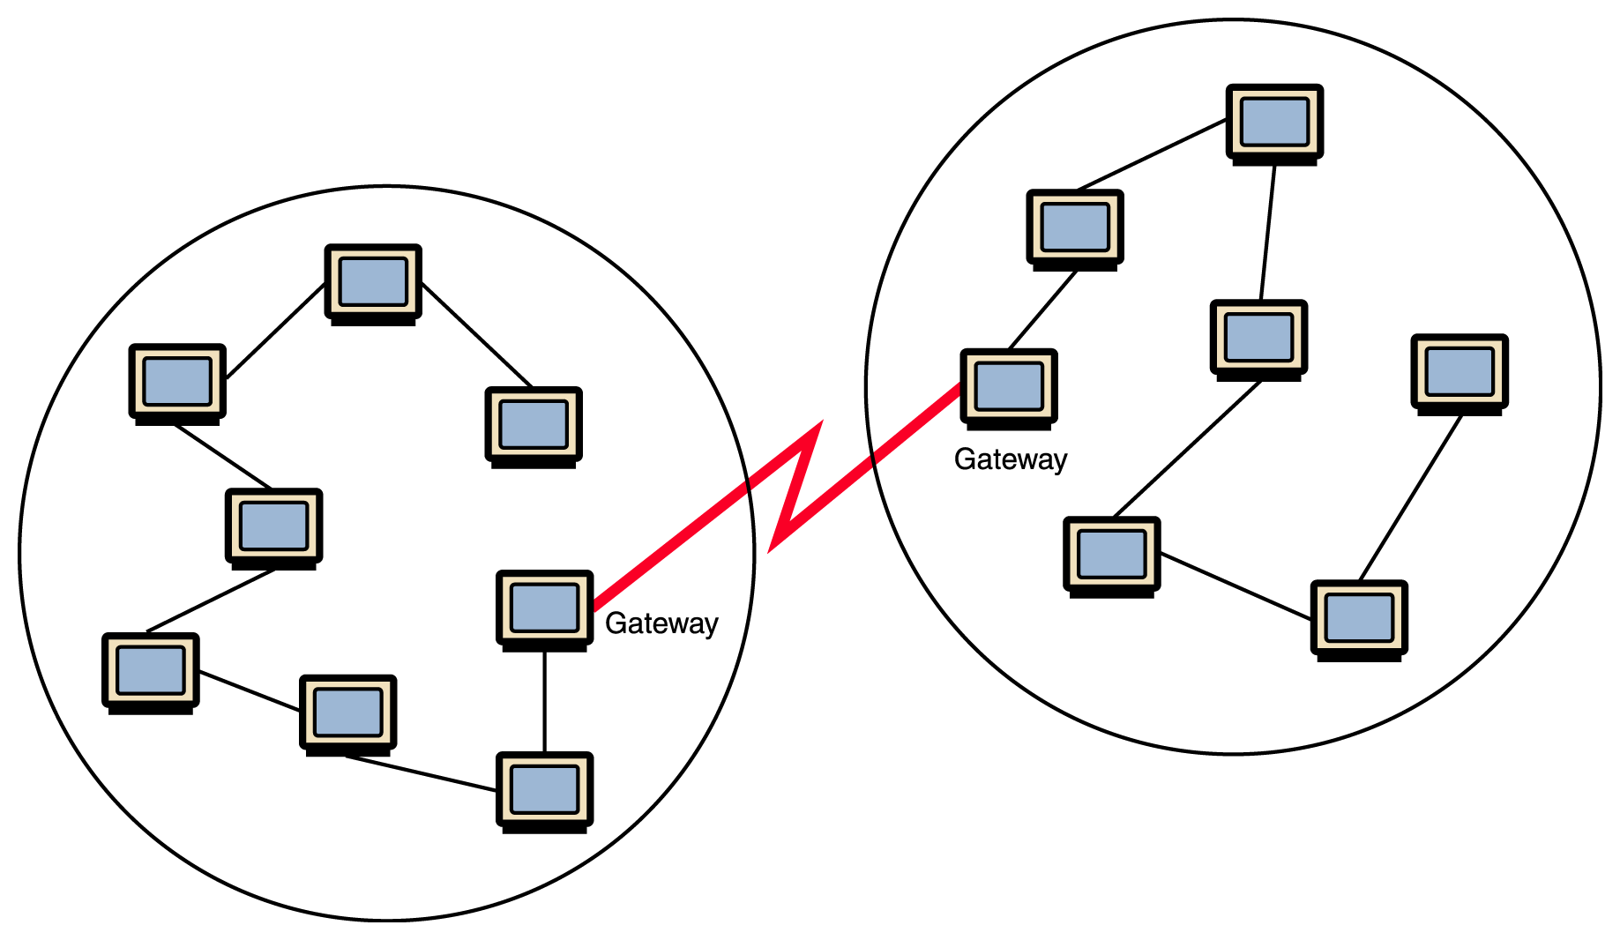
Types of Networks
Figure 15.1 Local-area networks connected across a distance to create a wide-area network
15-<number>

Slide 10
Types of Networks
Metropolitan-area network (MAN) The communication infrastructures that have been developed in and around large cities
15-<number>

Slide 11
Network structure
network edge: applications and hosts
network core: Routers, network of Networks, access networks.
physical media: communication links
15-<number>

Slide 12
Network edges
end systems (hosts)
client/server model
  client host requests, receives service from always-on server
  e.g. Web browser/server; email
peer-peer model
  minimal (or no) use of dedicated servers
  e.g. Gnutella, KaZaA,bit torrent
15-<number>

Slide 13
Network core
how is data transferred through net?
Two ways:
Circuit switching - dedicated circuit per call: telephone net
Packet switching – data sent thru net in discrete “chunks”
15-<number>

Slide 14
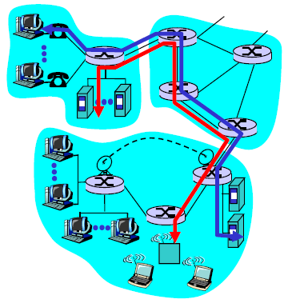
Network Core: Circuit Switching
End-end resources reserved for “call”
  link bandwidth, switch capacity
  dedicated resources: no sharing
  Circuit-like (guaranteed) performance
  call setup required
15-<number>

Slide 15
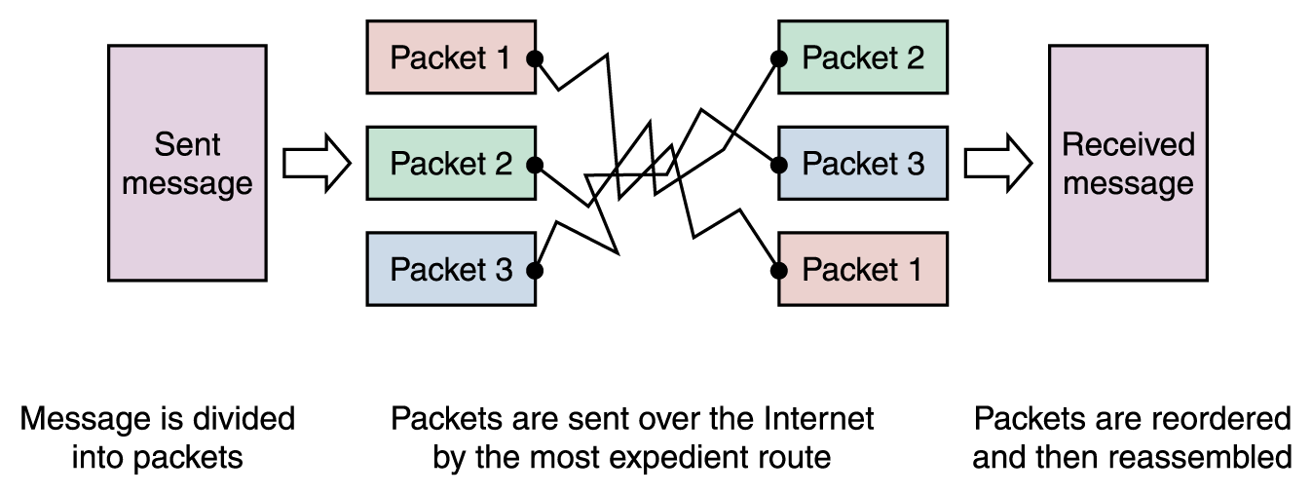
Network Core: Packet Switching
To improve the efficiency of transferring information over a shared communication line, messages are divided into fixed-sized, numbered packets
Network devices called routers are used to direct packets between networks
Figure 15.4
Messages sent by packet switching
15-18

Slide 16
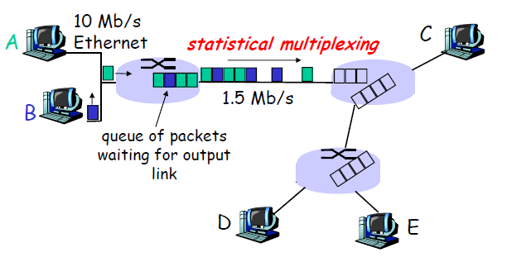
Network Core: Packet Switching
15-<number>

Slide 17
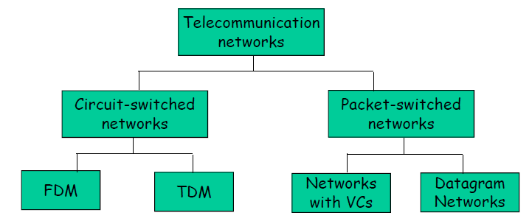
Network Taxonomy
15-<number>

Slide 18
Types of Networks
Various configurations, called topologies, have been used to administer LANs
  Ring topology A configuration that connects all nodes in a closed loop on which messages travel in one direction
  Star topology A configuration that centers around one node to which all others are connected and through which all messages are sent
  Bus topology All nodes are connected to a single communication line that carries messages in both directions
15-<number>

Slide 19
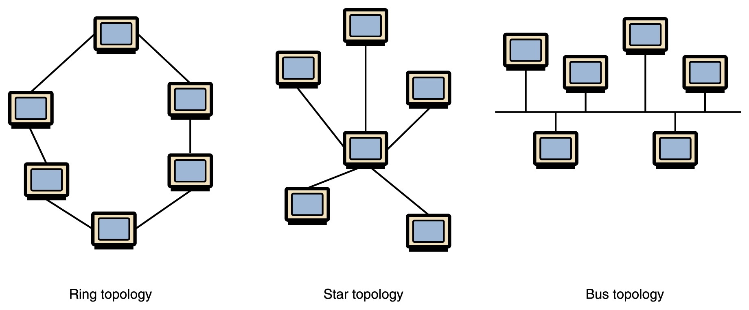
Types of Networks
Figure 15.2 Various network topologies
A bus technology called Ethernet has become the industry standard for local-area networks
15-10

Slide 20
Bus and Star Topology
  Bus Topology
    Simple and low-cost
    A single cable called a trunk (backbone, segment)
    Only one computer can send messages at a time
    Passive topology - computer only listen for, not regenerate data
  Star Topology
    Each computer has a cable connected to a single point
    More cabling, hence higher cost
    All signals transmission through the hub; if down, entire network down
    Depending on the intelligence of hub, two or more computers may send message at the same time
15-<number>

Slide 21
Ring Topology
  Every computer serves as a repeater to boost signals
  Typical way to send data:
    Token passing
      only the computer who gets the token can send data
  Disadvantages
    Difficult to add computers
    More expensive
    If one computer fails, whole network fails
15-<number>

Slide 22
Network Protocols
protocols define format, order of messages sent and received among network entities, and actions taken on messages transmission, receipt.
15-<number>

Slide 23
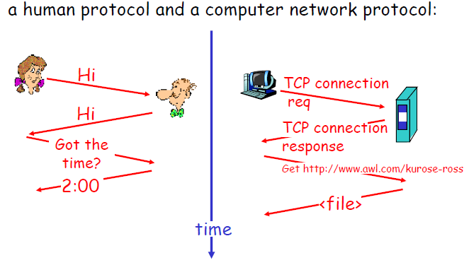
Network Protocols
15-<number>

Slide 24
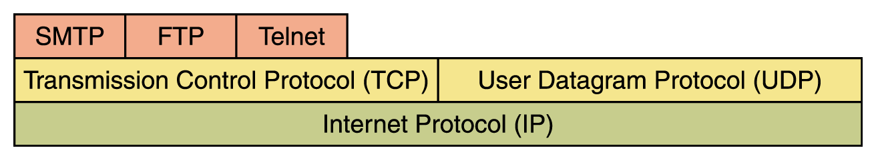
Network Protocols
Network protocols are layered such that each one relies on the protocols that underlie it
Sometimes referred to as a protocol stack
Figure 15.6 Layering of key network protocols
15-<number>

Slide 25
Open Systems
Proprietary system A system that uses technologies kept private by a particular commercial vendor
  One system couldn’t communicate with another, leading to the need for
Interoperability The ability of software and hardware on multiple machines and from multiple commercial vendors to communicate
  Leading to
Open systems Systems based on a common model of network architecture and a suite of protocols used in its implementation
15-<number>

Slide 26
Communication Architecture
OSI Model
Strategy for connecting host computers and other communicating equipment.
Defines necessary elements for data communication between devices.
A communication architecture, therefore, defines a standard for the communicating hosts.
A programmer formats data in a manner defined by the communication architecture and passes it on to the communication software.
Separating communication functions adds flexibility, for example, we do not need to modify the entire host software to include more communication devices.

Slide 27
Layer Architecture
OSI Model
Layer architecture simplifies the network design.
It is easy to debug network applications in a layered architecture network.
The network management is easier due to the layered architecture.
Network layers follow a set of rules, called protocol.
The protocol defines the format of the data being exchanged, and the control and timing for the handshake between layers.

Slide 28
Communication Architectures
ISO OSI (Open System Interconnection)
Internet Architecture

Slide 29
Open Systems Interconnection (OSI) Model
OSI Model
International standard organization (ISO) established a committee in 1977 to develop an architecture for computer communication.
Open Systems Interconnection (OSI) reference model is the result of this effort.
In 1984, the Open Systems Interconnection (OSI) reference model was approved as an international standard for communications architecture.
Term “open” denotes the ability to connect any two systems which conform to the reference model and associated standards.

Slide 30
OSI Reference Model
OSI Model
The OSI model is now considered the primary Architectural model for inter-computer communications.
The OSI model describes how information or data makes its way from application programmes (such as spreadsheets) through a network medium (such as wire) to another application programme located on another network.
The OSI reference model divides the problem of moving information between computers over a network medium into SEVEN smaller and more manageable problems .
This separation into smaller more manageable functions is known as layering.

Slide 31
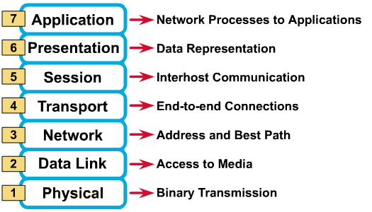
OSI Reference Model: 7 Layers
OSI Model

Slide 32
OSI: A Layered Network Model
OSI Model
The process of breaking up the functions or tasks of networking into layers reduces complexity.
Each layer provides a service to the layer above it in the protocol specification.
Each layer communicates with the same layer’s software or hardware on other computers.
The lower 4 layers (transport, network, data link and physical —Layers 4, 3, 2, and 1) are concerned with the flow of data from end to end through the network.
The upper four layers of the OSI model (application, presentation and session—Layers 7, 6 and 5) are orientated more toward services to the applications.
Data is encapsulated with the necessary protocol information as it moves down the layers before network transit.

Slide 33
Physical Layer
OSI Model
Provides physical interface for transmission of information.
Defines rules by which bits are passed from one system to another on a physical communication medium.
Covers all - mechanical, electrical, functional and procedural - aspects for physical communication.
Such characteristics as voltage levels, timing of voltage changes, physical data rates, maximum transmission distances, physical connectors, and other similar attributes are defined by physical layer specifications.

Slide 34
Data Link Layer
OSI Model
Data link layer attempts to provide reliable communication over the physical layer interface.
Breaks the outgoing data into frames and reassemble the received frames.
Create and detect frame boundaries.
Handle errors by implementing an acknowledgement and retransmission scheme.
Implement flow control.
Supports points-to-point as well as broadcast communication.
Supports simplex, half-duplex or full-duplex communication.

Slide 35
Network Layer
OSI Model
Implements routing of frames (packets) through the network.
Defines the most optimum path the packet should take from the source to the destination
Defines logical addressing so that any endpoint can be identified.
Handles congestion in the network.
Facilitates interconnection between heterogeneous networks (Internetworking).
The network layer also defines how to fragment a packet into smaller packets to accommodate different media.

Slide 36
Transport Layer
OSI Model
Purpose of this layer is to provide a reliable mechanism for the exchange of data between two processes in different computers.
Ensures that the data units are delivered error free.
Ensures that data units are delivered in sequence.
Ensures that there is no loss or duplication of data units.
Provides connectionless or connection oriented service.
Provides for the connection management.
Multiplex multiple connection over a single channel.

Slide 37
Session Layer
OSI Model
Session layer provides mechanism for controlling the dialogue between the two end systems. It defines how to start, control and end conversations (called sessions) between applications.
This layer requests for a logical connection to be established on an end-user’s request.
Any necessary log-on or password validation is also handled by this layer.
Session layer is also responsible for terminating the connection.
This layer provides services like dialogue discipline which can be full duplex or half duplex.
Session layer can also provide check-pointing mechanism such that if a failure of some sort occurs between checkpoints, all data can be retransmitted from the last checkpoint.

Slide 38
Presentation Layer
Presentation layer defines the format in which the data is to be exchanged between the two communicating entities.
Also handles data compression and data encryption (cryptography).

Slide 39
Application Layer
OSI Model
Application layer interacts with application programs and is the highest level of OSI model.
Application layer contains management functions to support distributed applications.
Examples of application layer are applications such as file transfer, electronic mail, remote login etc.

Slide 40
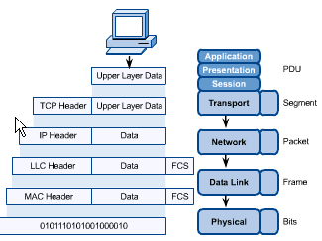
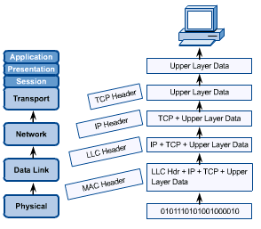
OSI in Action
OSI Model
A message begins at the top application layer and moves down the OSI layers to the bottom physical layer.
As the message descends, each successive OSI model layer adds a header to it.
A header is layer-specific information that basically explains what functions the layer carried out.
Conversely, at the receiving end, headers are striped from the message as it travels up the corresponding layers.

Slide 41
TCP/IP Model
TCP/IP MODEL

Slide 42
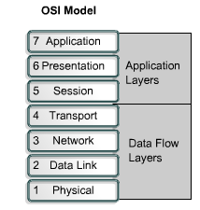
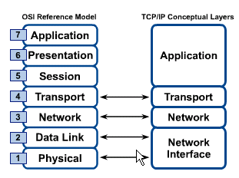
OSI & TCP/IP Models
TCP/IP Model

Slide 43
TCP/IP Model
Application Layer
Application programs using the network
Transport Layer (TCP/UDP)
Management of end-to-end message transmission,
error detection and error correction
Network Layer (IP)
Handling of datagrams : routing and congestion
Data Link Layer
Management of cost effective and reliable data delivery,
access to physical networks
Physical Layer
Physical Media

