Slide 1
Physical Media Layer
Valery Kasyanik

Slide 2
Objectives
Characteristics of wireline transmission
Properties and uses of coaxial cable
Properties and uses of different types of twisted-pair wire
Characteristics of lightwave transmission
Properties and uses of fiber optic cable
Factors to consider when selecting a telecommunications medium
Cabling standards
Installing wire and fiber optic cabling
Testing continuity and performance on physical transmission media

Slide 3
Characteristics of Wireline Transmission
Impedance: expressed in Ohms, is the combined effect of a circuit’s inductance and capacitance.
Propagation Delay and Latency: the difference in time between a data packet’s transmission and its reception over a specific route.
Distortion: the unintended and undesirable modification of at least one signal component, which makes the signal different from how it was originally transmitted.
Noise: any unwanted interference from external sources.

Slide 4
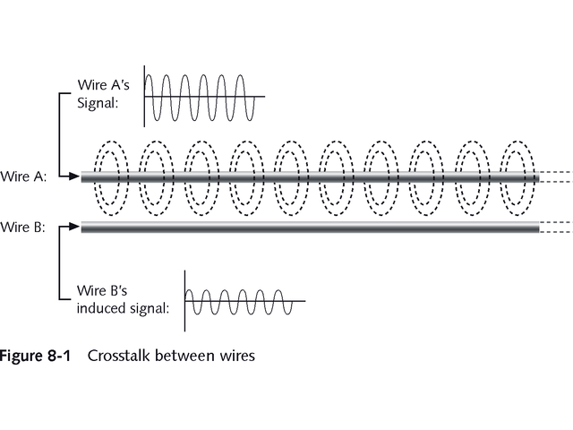

Crosstalk

Slide 5
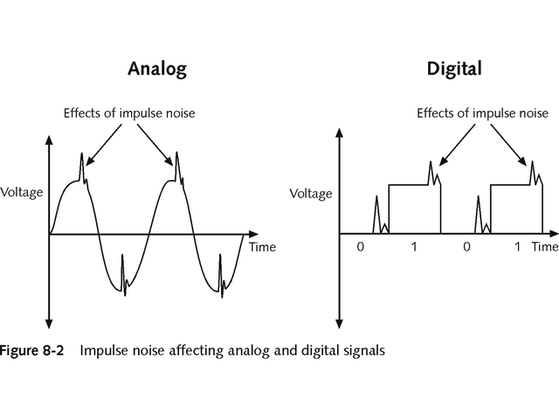
Impulse Noise

Slide 6
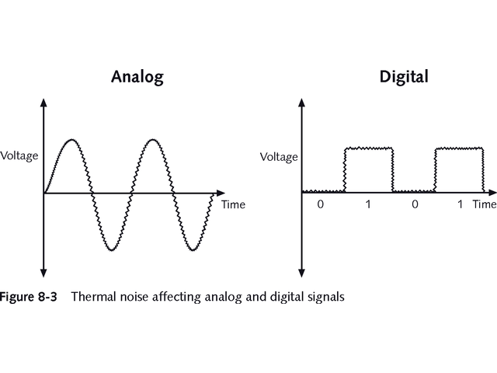
Thermal Noise

Slide 7
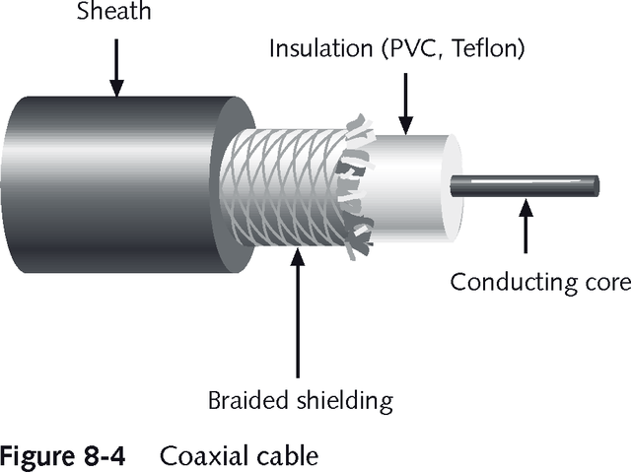
Coaxial Cable

Slide 8
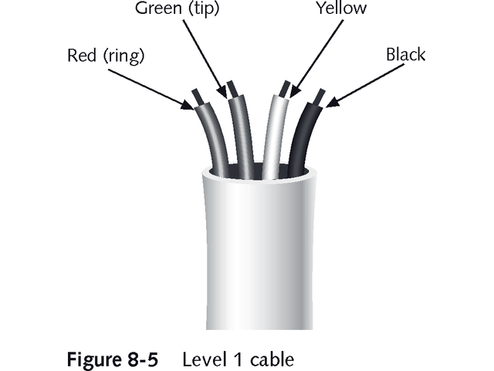
Non-twisted Wire

Slide 9
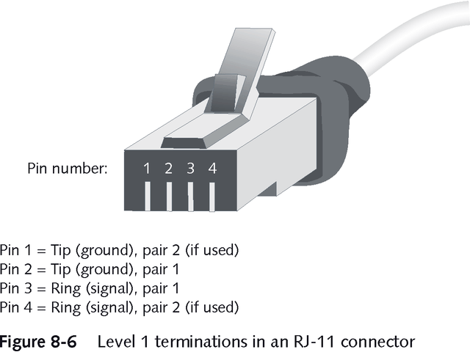
Level 1 Terminations

Slide 10
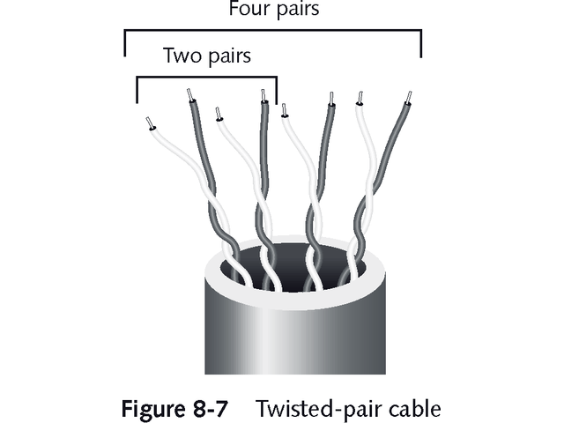
Twisted Pair (TP)

Slide 11
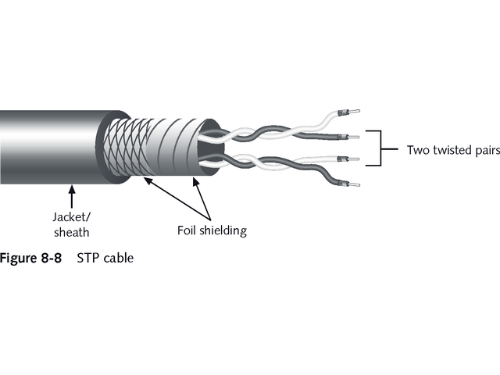
Shielded Twisted Pair (STP)

Slide 12
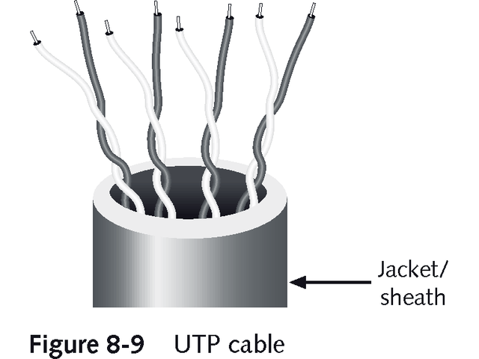
Unshielded Twisted Pair (UTP)

Slide 13
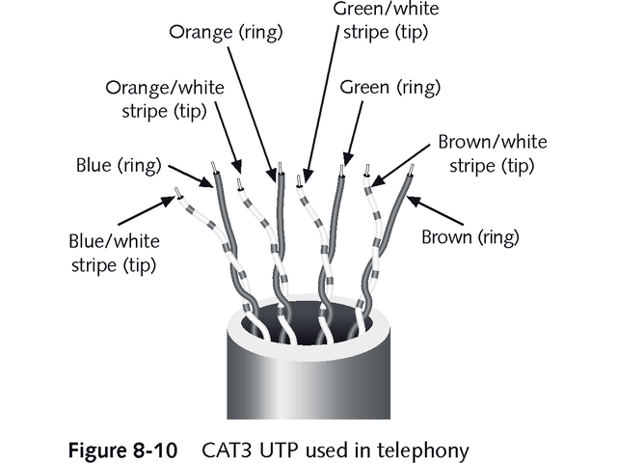
Category 5 (CAT5)

Slide 14
Category of twisted pair
CAT1
CAT2
CAT3
CAT4
CAT5
CAT6
CAT7

Slide 15
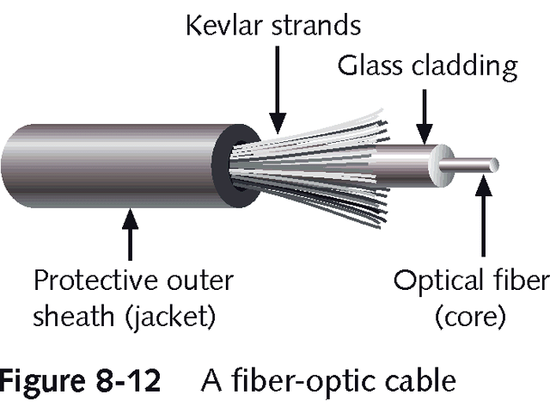
Fiber Optic Cable

Slide 16
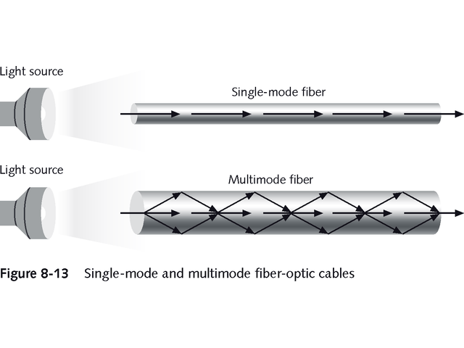
Fiber Optic Cable

Slide 17
Popular Uses for Fiber Optic Cable
Includes connecting:
  Regional and local cable TV facilities
  Internet NAPs with other large telecommunications exchange point
  Central offices with other central offices
  Main feeders with central offices
  A telecommunication’s network with private LANs
  A telecommunication’s network with private switching systems, such as PBX

Slide 18
Selecting Appropriate Media
When selecting telecommunications media consider:
  Existing infrastructure
  Throughput potential
  Cost of installation
  Noise immunity
  Security
  Size and scalability

Slide 19
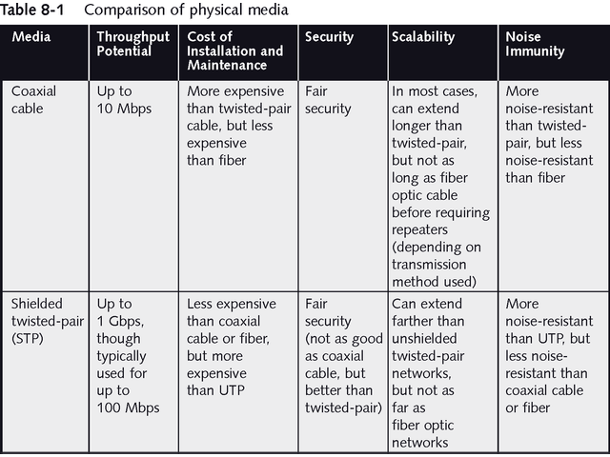
Comparison of Physical Media

Slide 20
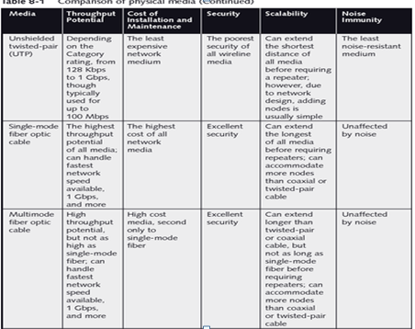
Comparison of Physical Media

Slide 21
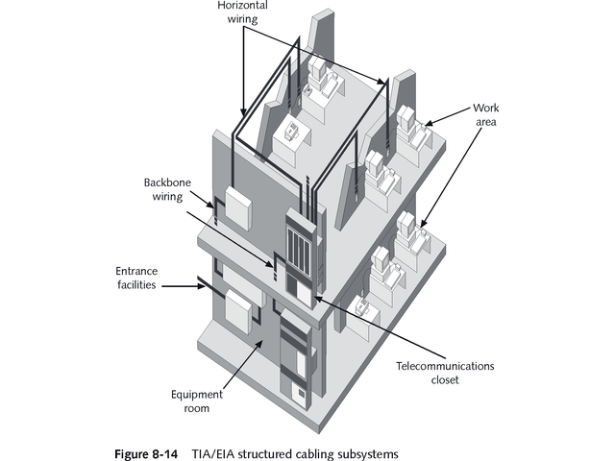
Structured Cabling

Slide 22
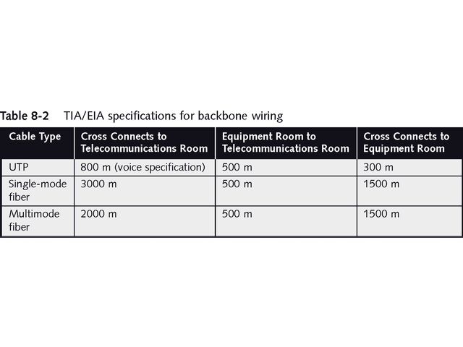
Backbone Wiring

